Slide 1
Intro to FreeSurfer Jargon
Notes:
This talk is an introduction to some common terms in FreeSurfer to give you a solid foundation for the rest of the course
1

Slide 2
Intro to FreeSurfer Jargon
recon
volume
voxel
surface
vertex
cortical, subcortical
parcellation/segmentation
registration, morph, deform, transforms (computing vs. resampling)
Notes:
2
They might look like gibberish now, but hopefully by the end these terms will hold some meaning for you

Slide 3
Recon
“recon your data”
…short for reconstruction
Notes:
3
One of the most common terms you will hear is the word “recon”
Short for reconstruction, but that term refers to different things and we use it in several different ways
There are different types of reconstruction in MRI
In FreeSurfer we are referring to a cortical surface reconstruction, a surface model, not a k-space reconstruction (that will already be done, normally by the MRI scanner, to create the T1-weighted image you use as input to FreeSurfer)
Recon-all is how you process data in FreeSurfer. means recon everything- do all of the steps of the processing pipeline
Recon data=run through the processing stream and create a reconstruction
Finally, “check your recons” refers to the output of recon-all

Slide 4
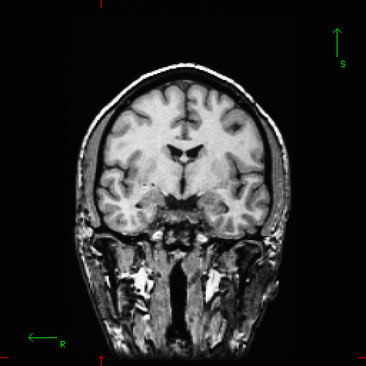
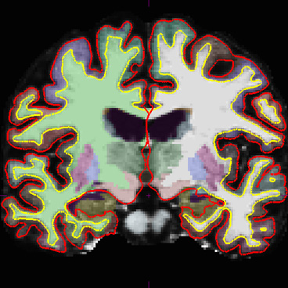
What FreeSurfer Does…
FreeSurfer creates computerized models of the brain from MRI data.
Input:
T1-weighted (MPRAGE)
1mm³ resolution
(.dcm)
Output:
Segmented & parcellated conformed volume
(.mgz)
Notes:
4
Automatically labels GM, WM, subcortical structures in your brain

Slide 5
Recon
“recon your data”
…short for reconstruction
“recon-all”: the command line to begin FreeSurfer’s reconstruction processing stream
Notes:
5
One of the most common terms you will hear is the word “recon”
Short for reconstruction, but that term refers to different things and we use it in several different ways
There are different types of reconstruction in MRI
In FreeSurfer we are referring to a cortical surface reconstruction, a surface model, not a k-space reconstruction (that will already be done, normally by the MRI scanner, to create the T1-weighted image you use as input to FreeSurfer)
Recon-all is how you process data in FreeSurfer. means recon everything- do all of the steps of the processing pipeline
Recon data=run through the processing stream and create a reconstruction
Finally, “check your recons” refers to the output of recon-all

Slide 6
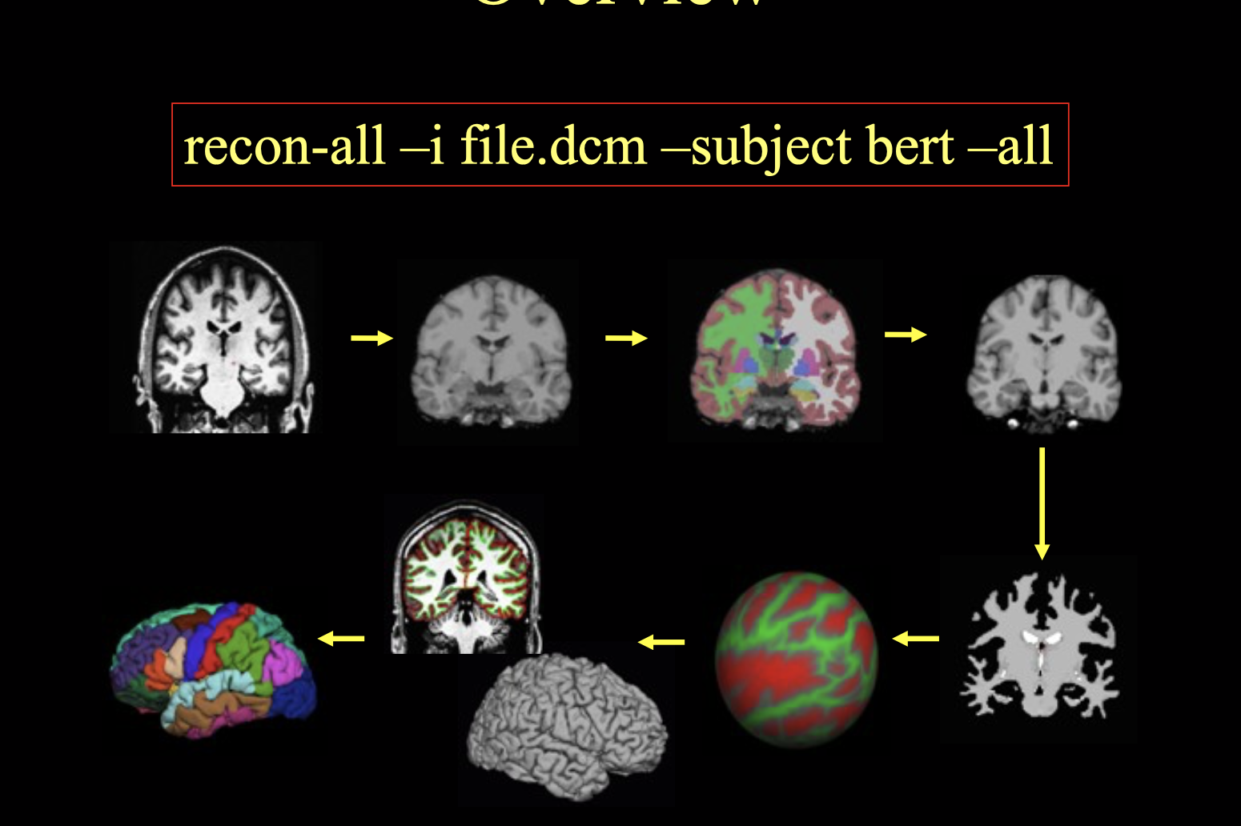

Slide 7
Recon
“recon your data”
…short for reconstruction
“recon-all”: the command line to begin FreeSurfer’s reconstruction processing stream
“check your recons”: referring to the output
Notes:
7
One of the most common terms you will hear is the word “recon”
Short for reconstruction, but that term refers to different things and we use it in several different ways
There are different types of reconstruction in MRI
In FreeSurfer we are referring to a cortical surface reconstruction, a surface model, not a k-space reconstruction (that will already be done, normally by the MRI scanner, to create the T1-weighted image you use as input to FreeSurfer)
Recon-all is how you process data in FreeSurfer. means recon everything- do all of the steps of the processing pipeline
Recon data=run through the processing stream and create a reconstruction
Finally, “check your recons” refers to the output of recon-all

Slide 8
Recon
Notes:
8
Typical recon output

Slide 9
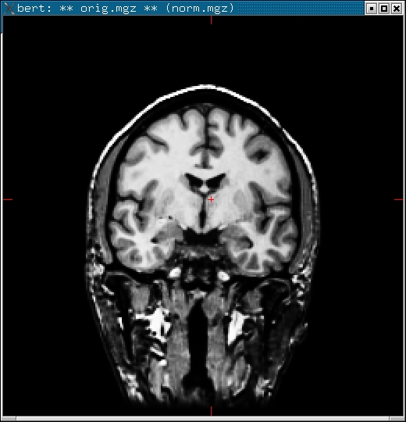
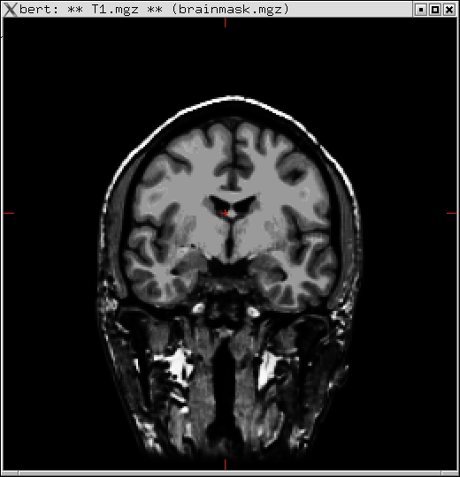
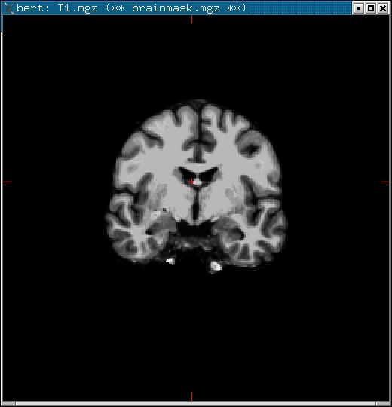
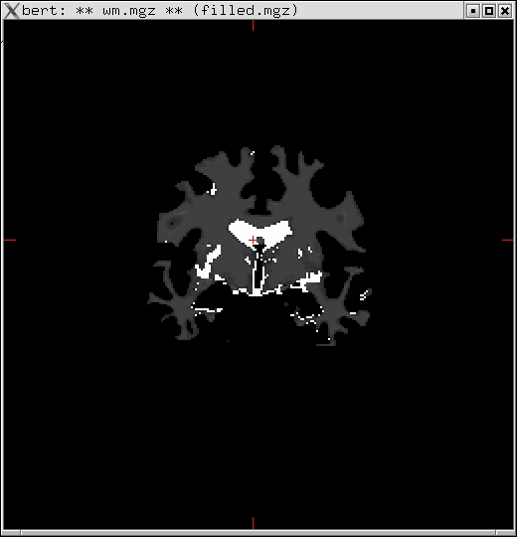
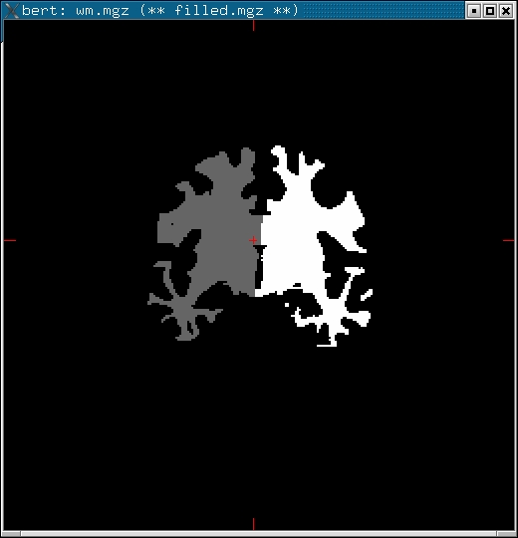
Volumes
orig.mgz
T1.mgz
brainmask.mgz
wm.mgz
filled.mgz
(Subcortical Mass)
Notes:
9
At many different points in the recon process, FS will generate files that look similar to MRI data -> called volumes
When we say “volumes”, we are usually referring to MRI data or mgz files created by FreeSurfer instead of actual volume measurements
Each one can tell you something a little different, which we will explain in a later talk
Several files that FreeSurfer outputs
Look like MRI data

Slide 10
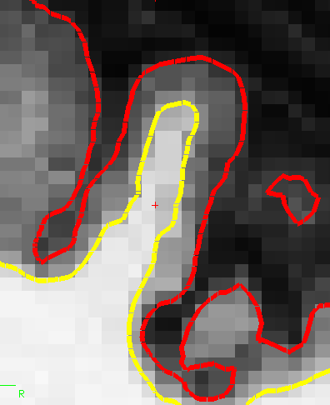
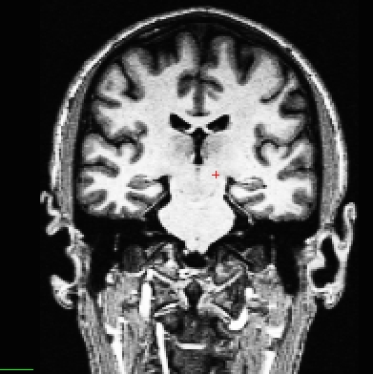
Intro to FreeSurfer Jargon
voxel
volume
Notes:
10
If you zoom in on the MRI image on the left, you would see many little grey boxes (right)
tons of 2-D pixels make up this image, but with scan data we call them voxels (because they have a volume)
They have an area (as you see here in this slice), but each MRI slice also has a thickness (which you can’t see here), so it has volume too
Pixel is 2D, voxel is 3D
Typically our voxels are 1mm^3 in FreeSurfer
Basically a pixel
MRI images made up of all of these voxels, that’s how we get our measurements
The square has volume, has a value
We can add up all of the voxels of the brain and know its volume

Slide 11
Intro to FreeSurfer Jargon
surface
Notes:
11
got all this data, want to divide it up to have some meaningful info about this subject
So another function of FS is to generate surfaces
Surface is a cortical boundary
White surface- between wm and gm (here the yellow line)
Pial surface- bewteen gm and pia/cerebral spinal fluid (here the red line)
colors not necessarily always red and yellow- can pick what colors you want them to be in Freeview
Surface = boundaries
Boundary between CSF and GM
Red line is boundary between CSF and GM—called pial surface
Yellow line is boundary between WM and GM—called the white surface

Slide 12
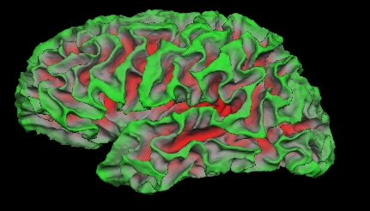
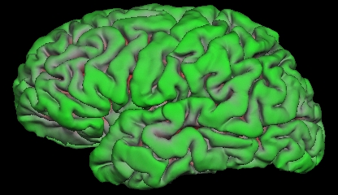
Intro to FreeSurfer Jargon
surface
Notes:
12
think of surfaces not only in terms of this 2D slice (picture on right) but also in terms of how they would look over the entire 3D structure of a brain
If you stack up every slice’s surfaces, you get these 3D versions on the left
Top left image: what boundary over all the wm in brain looks like – the white surface
can see into sulci
Bottom left image: what boundary over all the gm in brain looks like – the pial surface
probably more used to seeing this
Surfaces are 3D
But have to remember image on the right is a zoomed in 2D slice of a brain
You take every slice of the brain and stack them up, you’ll have these images here
So the top is the white surface, you can see down into the sulci
And the bottom is the pial surface

Slide 13
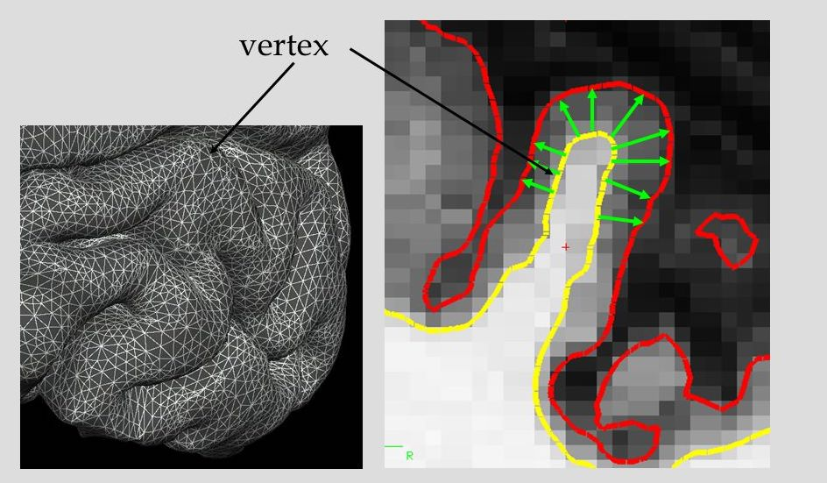
Intro to FreeSurfer Jargon
Notes:
13
Surface might look like just a solid line, but actually it is made up of many tiny points called vertices. (singular- vertex)
It is important to know that this is what makes up surfaces
b/c this is where we store all the information about the surface (and where we take measurements like thickness, curvature and others)
Each surface is made up of many tiny points
These vertices make up the surfaces and where we store the measurements/information

Slide 14
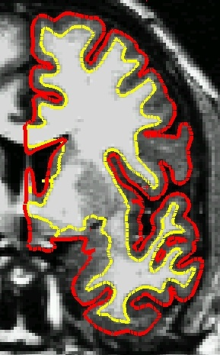
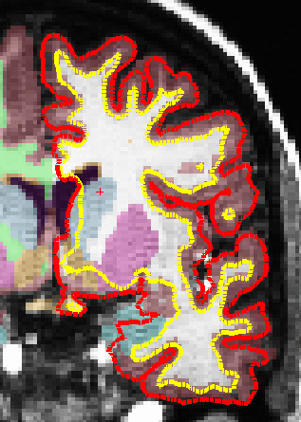
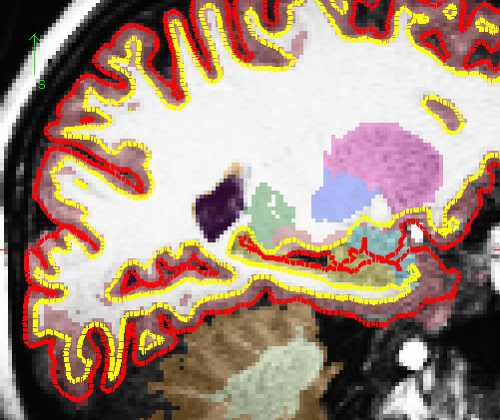
Cortical vs. Subcortical GM
cortical gm
subcortical gm
sagittal
coronal
Notes:
14
This is how we represent the two classes of gm- cortical and subcortical
Surfaces are used to get measurements on cortical gm
Surfaces NOT used to get measurements on subcortical gm (putamen, hippo etc.) – for those we use segmentation color maps in the volume
So it’s ok that the surfaces get a little funky around the subcort structures (shown in the green ovals)
you don’t have to worry or try to fix anything because they’re not being used for the subcortical measurements
A little anatomy
FS differentiates cortex/cortical ribbon (GM) and subcortical grey matter

Slide 15
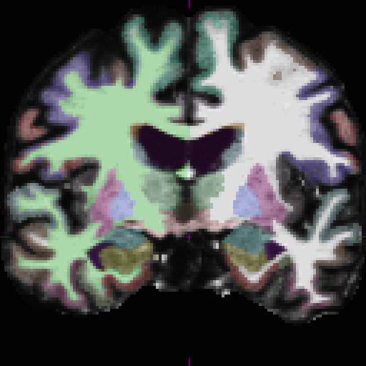
Parcellation vs. Segmentation
(cortical) parcellation
(subcortical) segmentation
Notes:
15
This is an example of two of the color maps FS produces
one for cortical ribbon
other for subcortical structures
parcellation refers to division of cortical areas
segmentation refers to division of subcortical areas, sometimes also segmentation of wm and gm

Slide 16

Intro to FreeSurfer Jargon
recon
volume
voxel
surface
vertex
cortical, subcortical
parcellation/segmentation
registration, morph, deform, transforms (computing vs. resampling)
Notes:
16
We have covered all of the most common terms
The last section of terms that we didn’t go over (registration, transforms, etc.) will be covered by Doug tomorrow.

Slide 17
Registration
Goal:
to find a common coordinate system for the input data sets
Examples:
comparing different MRI images of the same individual (longitudinal scans, diffusion vs functional scans)
comparing MRI images of different individuals
Notes:
Registration = spatial alignment is a tool/algorithm
Need anytime you’re doing analysis/comparison on
Same individual: subject may be positioned differently in scanner or has anatomical differences, maybe some pathology so you need to register those
Different individuals:

Slide 18
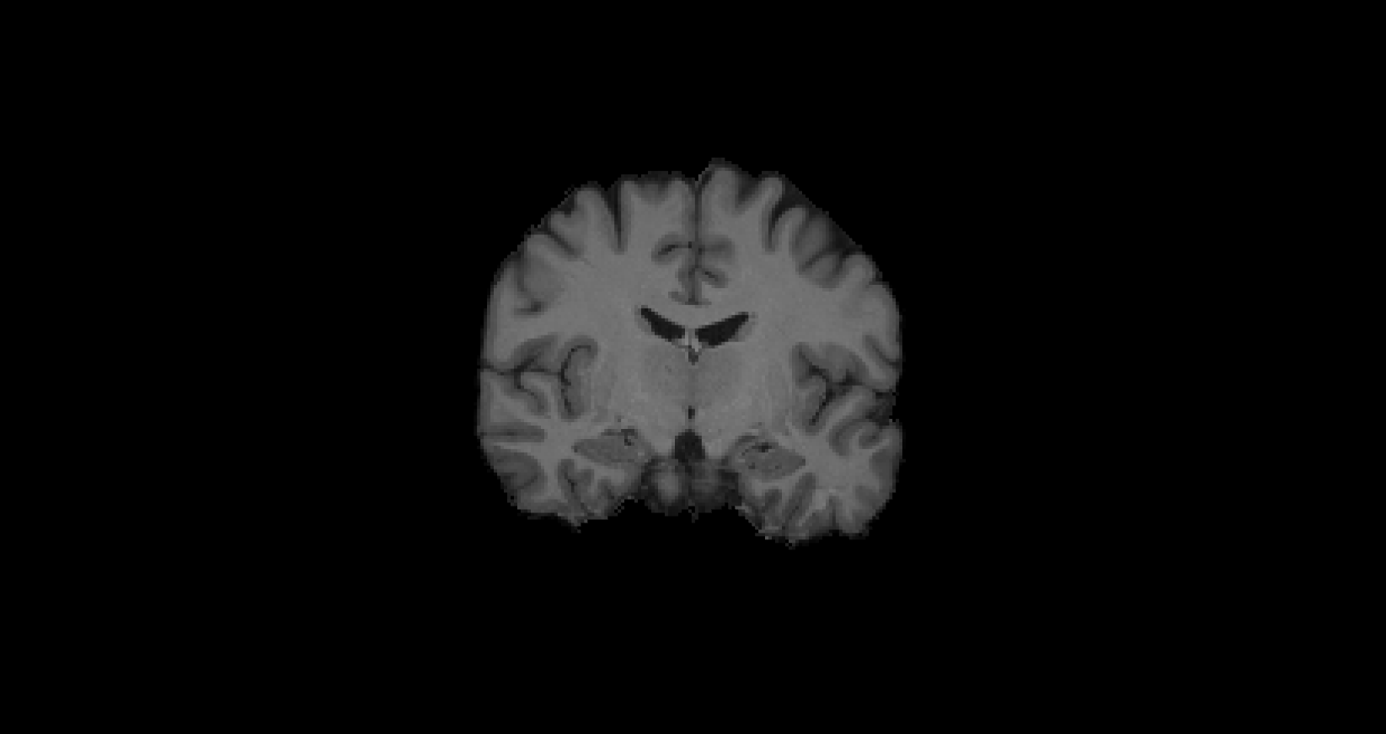
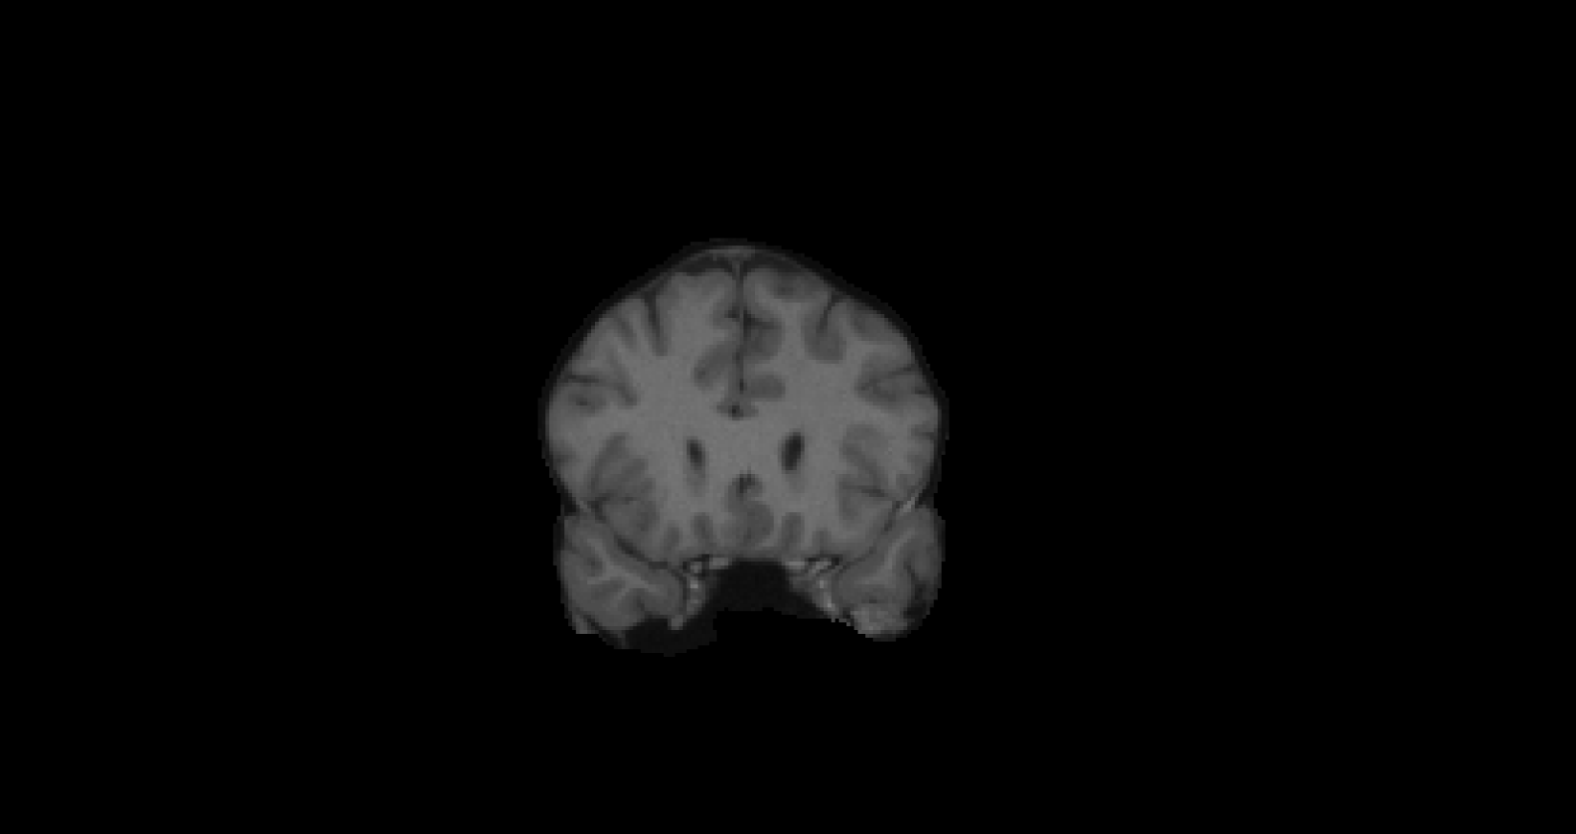
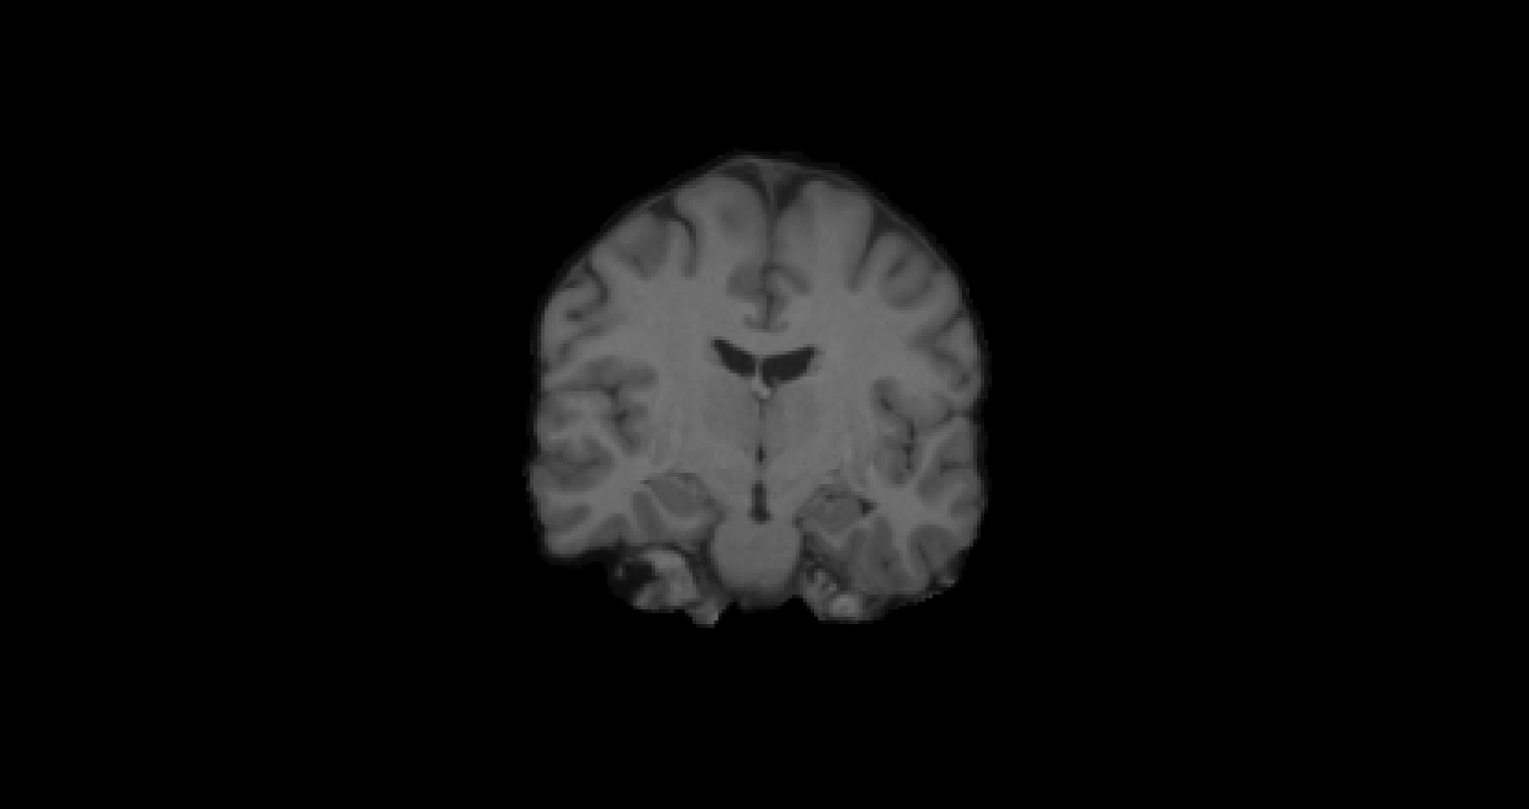

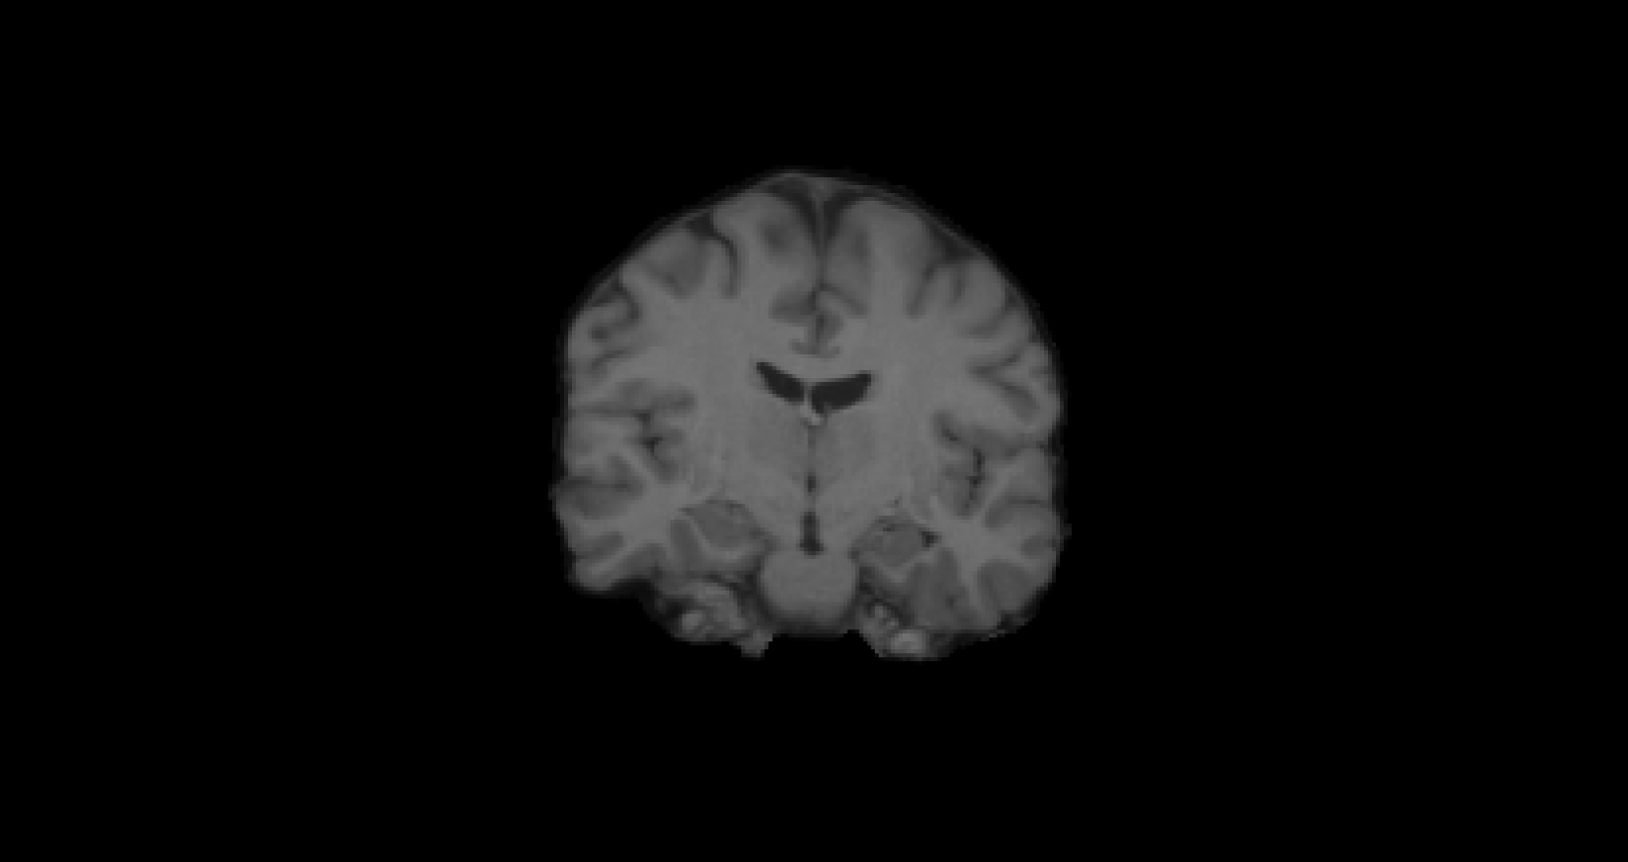
Inter-subject, uni-modal example
target
subject
flirt 6 DOF
flirt 9 DOF
flirt 12 DOF
Notes:
18
18
Inter subject: two different subjects
Flirt: tool to register
3 different solutions for registration
6 DOF: rotation is the 3 axes and displacement along 3 axes
9 DOF: scaling parameters
12 DOF: add shearing component to your transformation

Slide 19
Linear registration: 6, 9, 12 DOF
target
subject
Flirt 9 DOF
Flirt 12 DOF
Flirt 6 DOF
Notes:
19
19
Subject not living in the same coordinate space as target
6 DOF: global alignment with rotation and displacement
9 DOF: scaling applied to the brain
12 DOF: shearing movement
Final solution: Target and 12 DOF

Slide 20
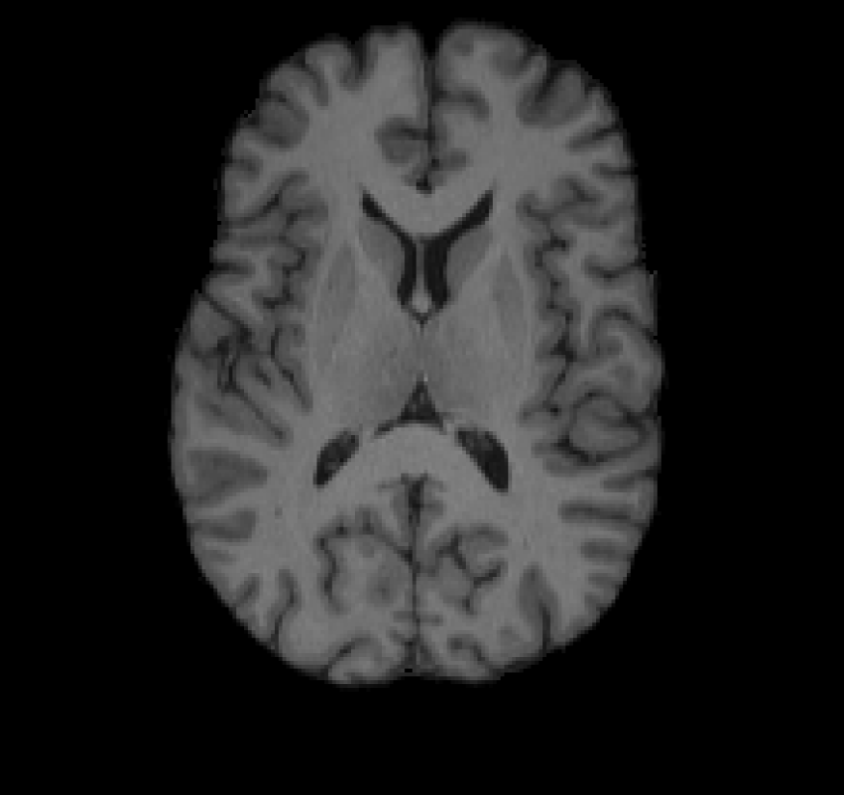
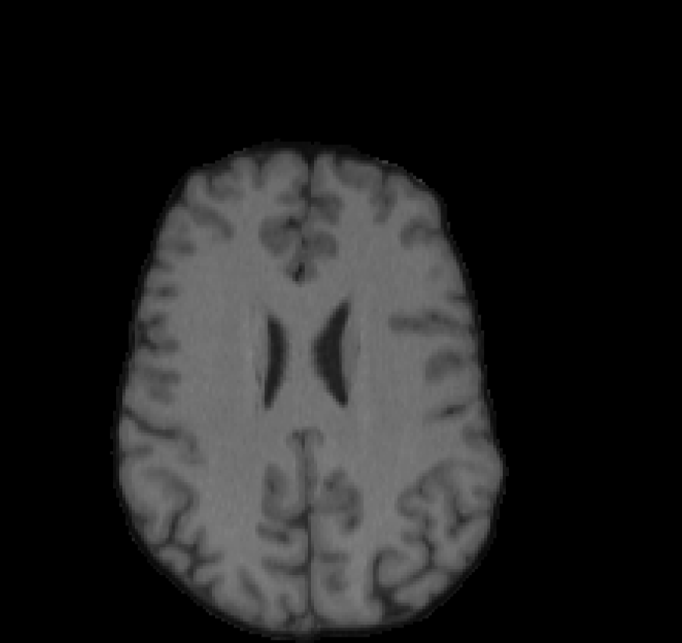
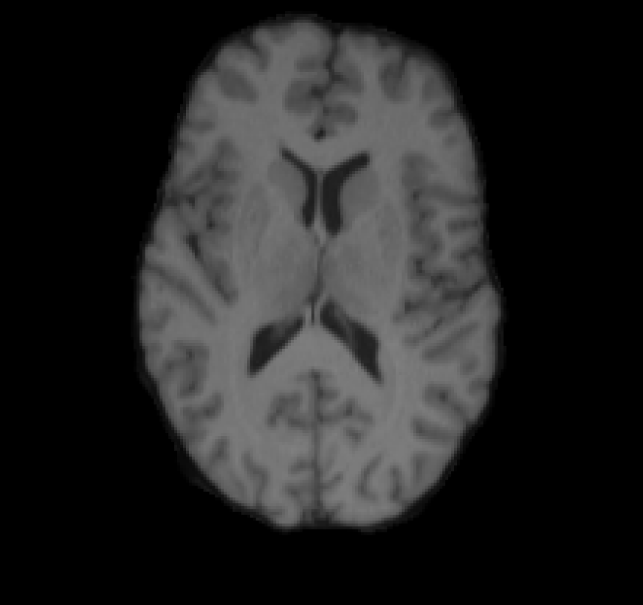
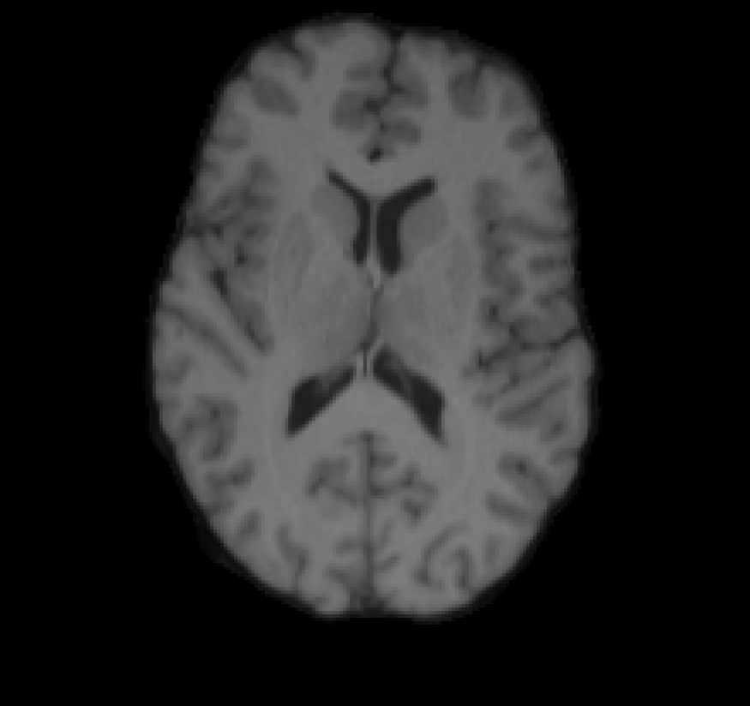
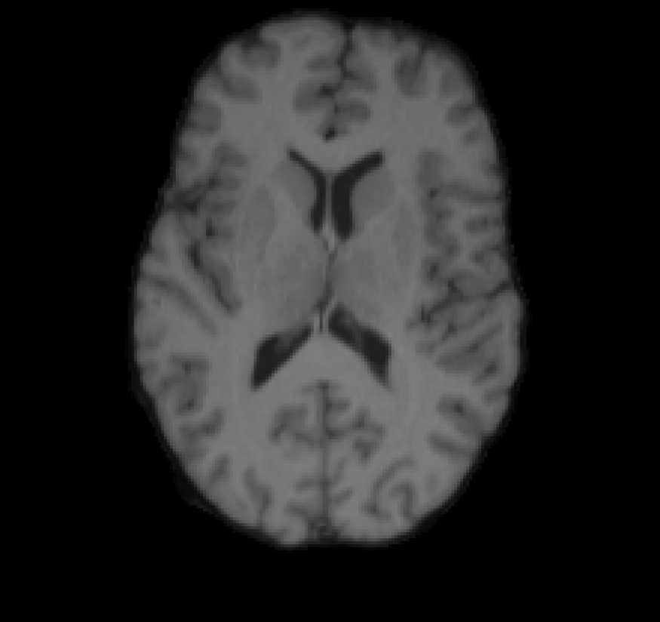
Linear registration: 6, 9, 12 DOF
Flirt 9 DOF
subject
Flirt 12 DOF
target
Flirt 6 DOF

Slide 21
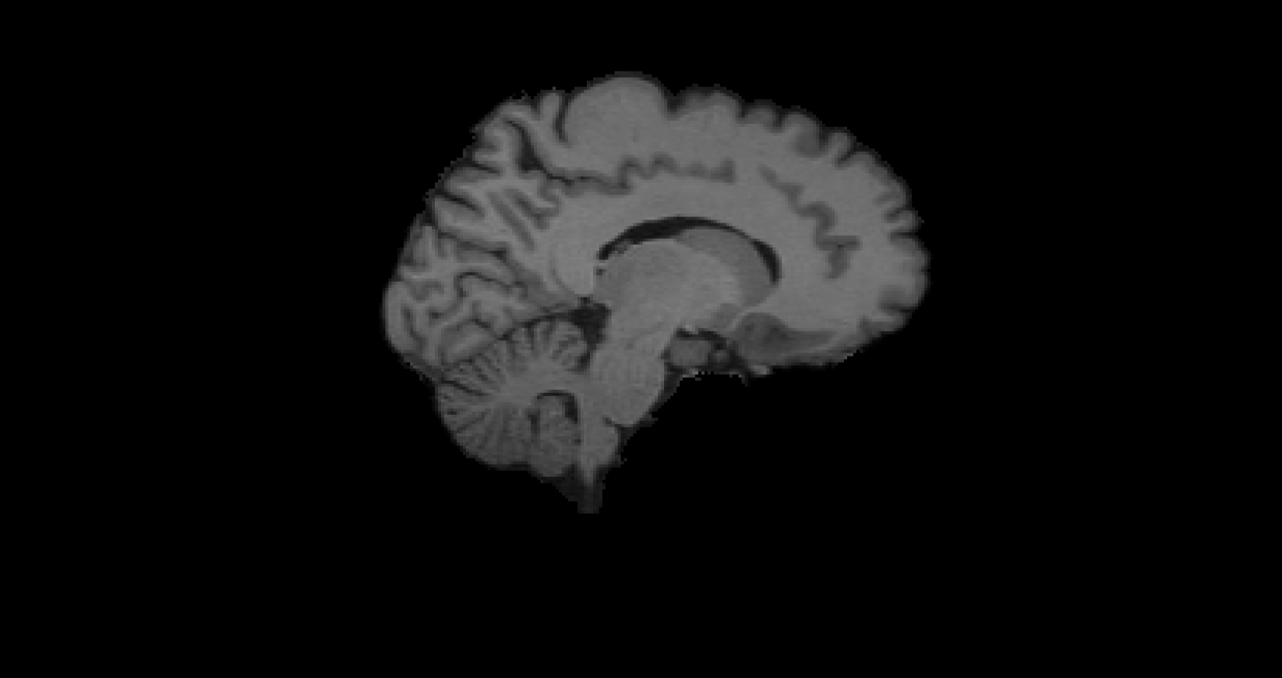
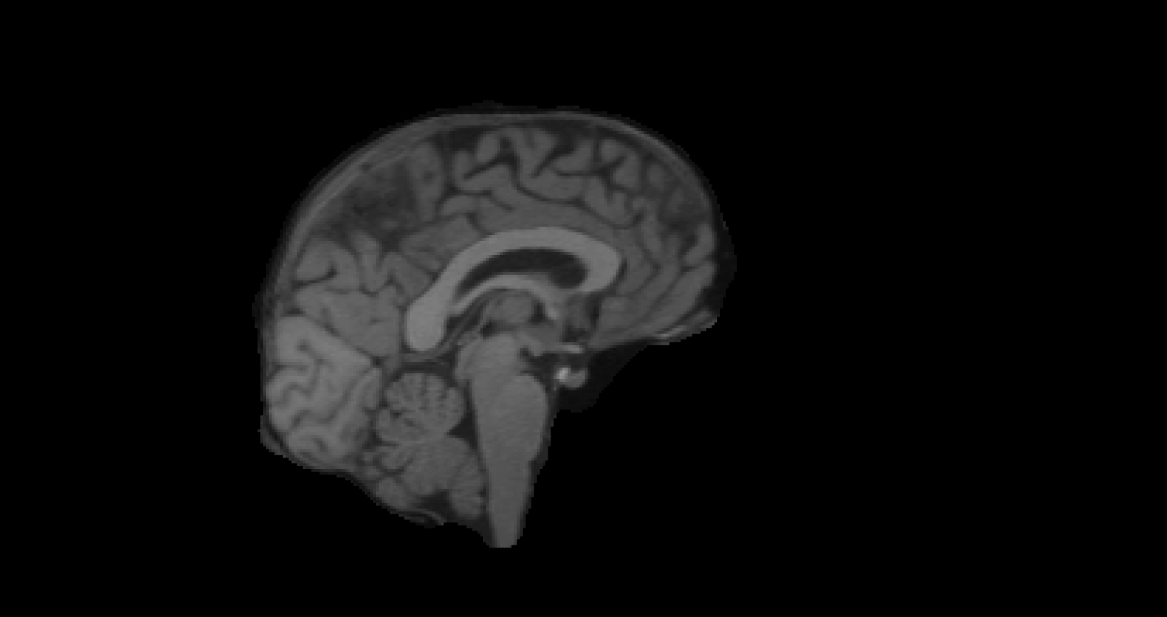
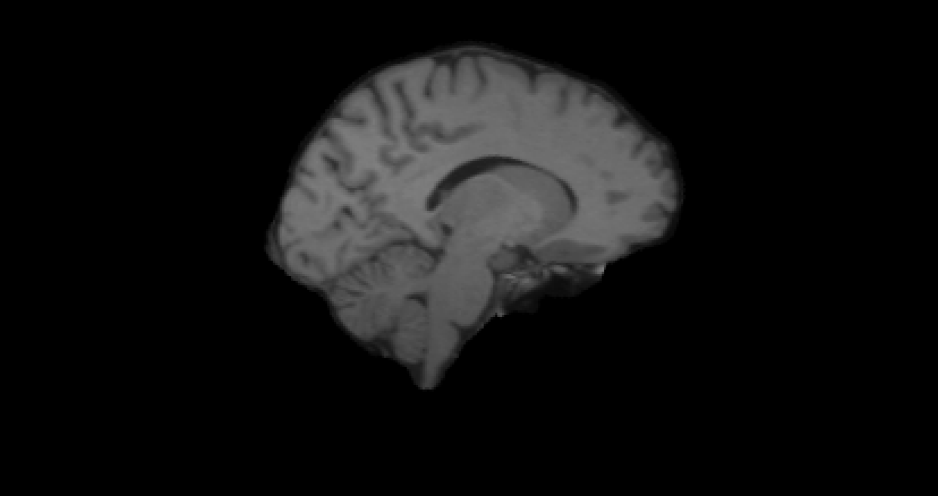

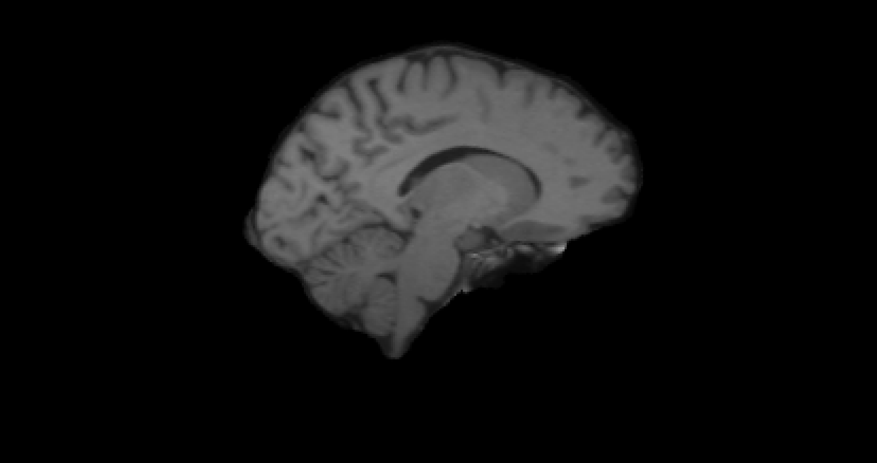
Linear registration: 6, 9, 12 DOF
Flirt 6 DOF
Flirt 9 DOF
target
Flirt 12 DOF
subject

Slide 22
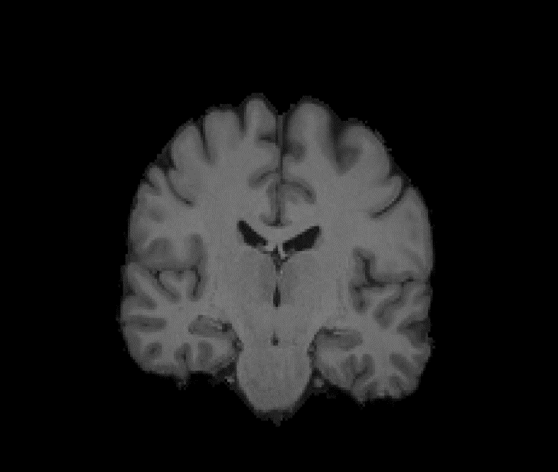
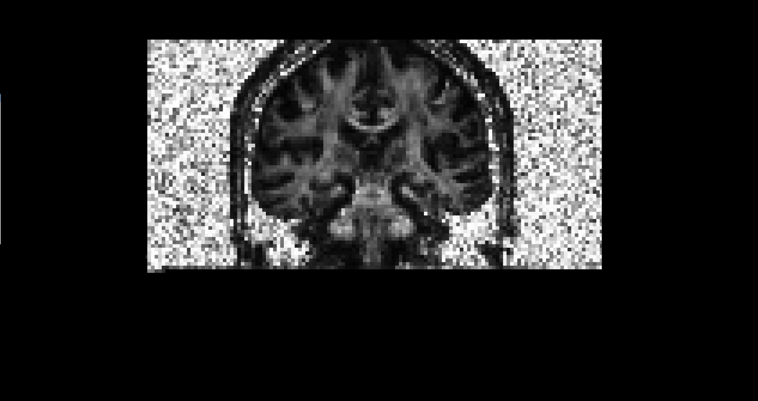
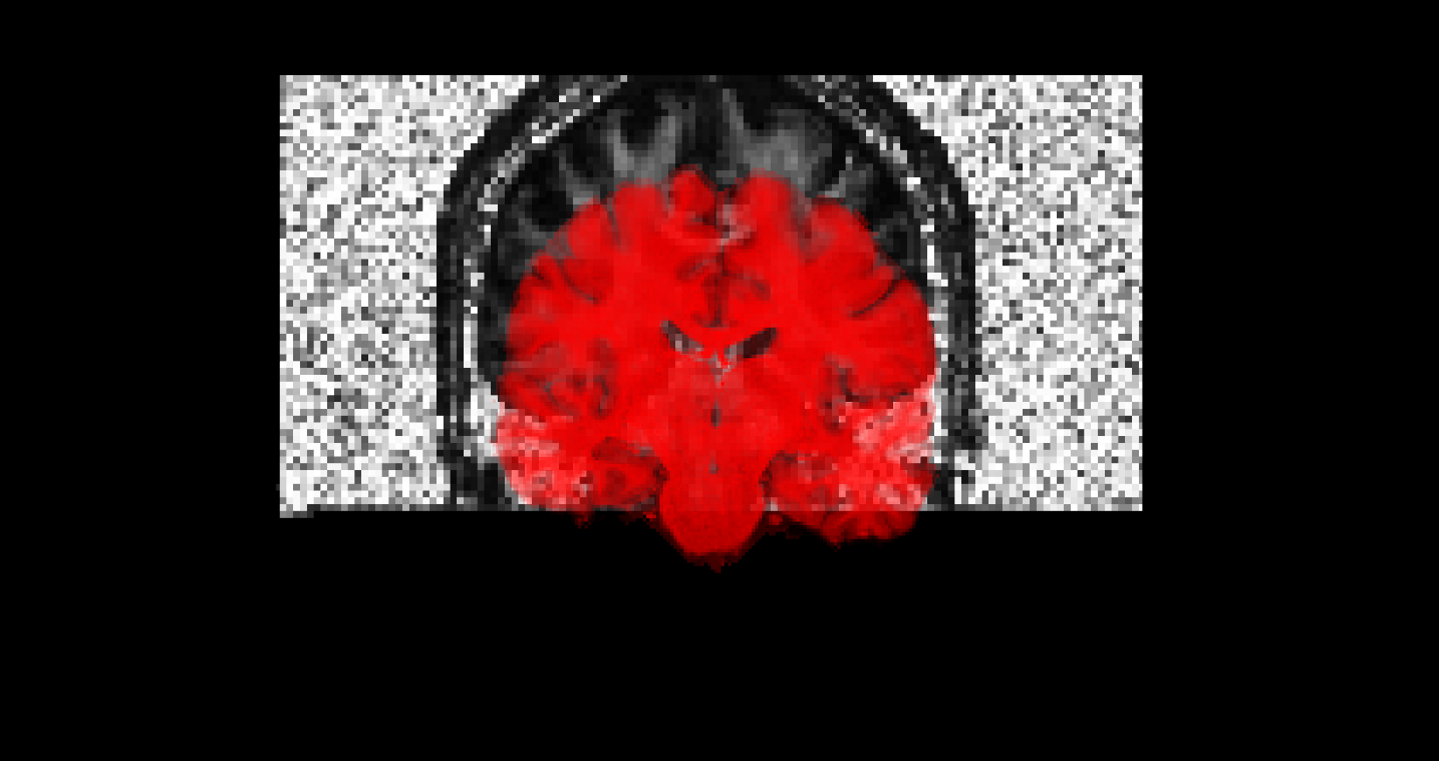
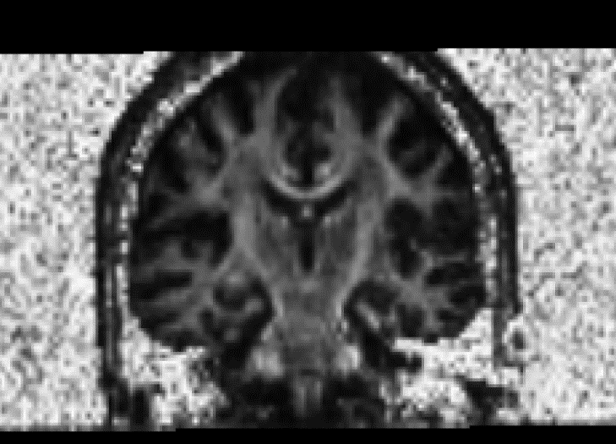
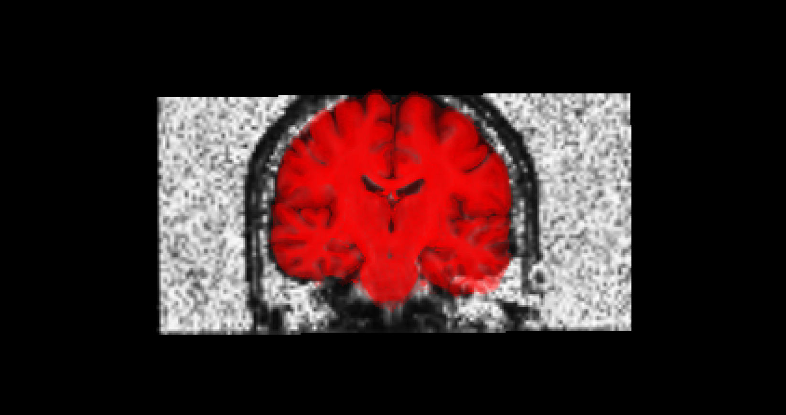
Intra-subject, multi-modal example
before spatial alignment
after spatial alignment
Notes:
Intra-subject: same subject
Multi-modal: different types of sequences/images as input images
This demo: diffusion weighted images (FA scalar map) and structural T1.
Or subject could have moved or got the scans at different times.

Slide 23
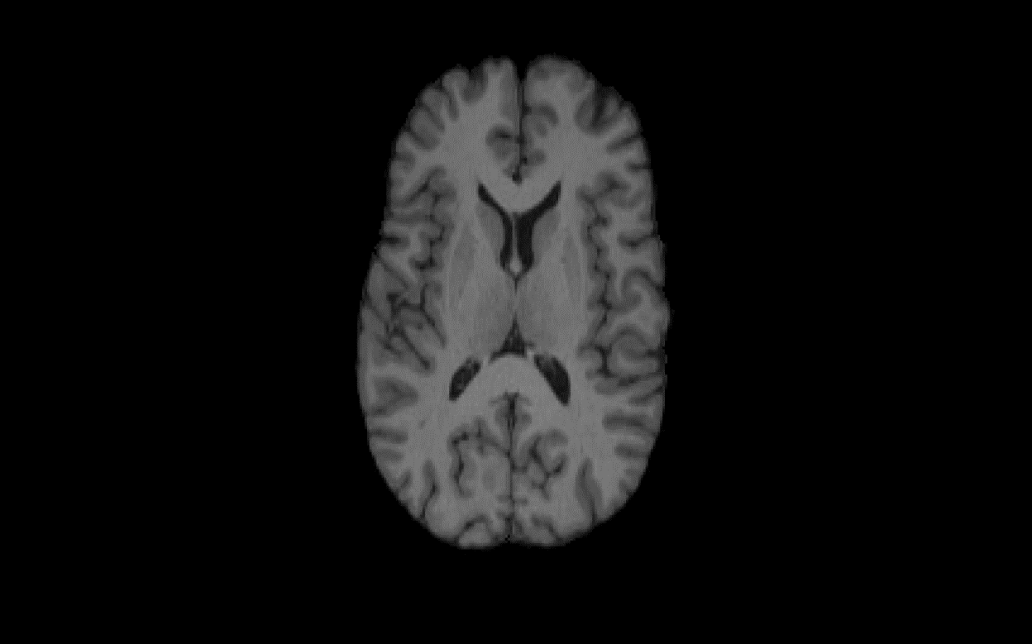
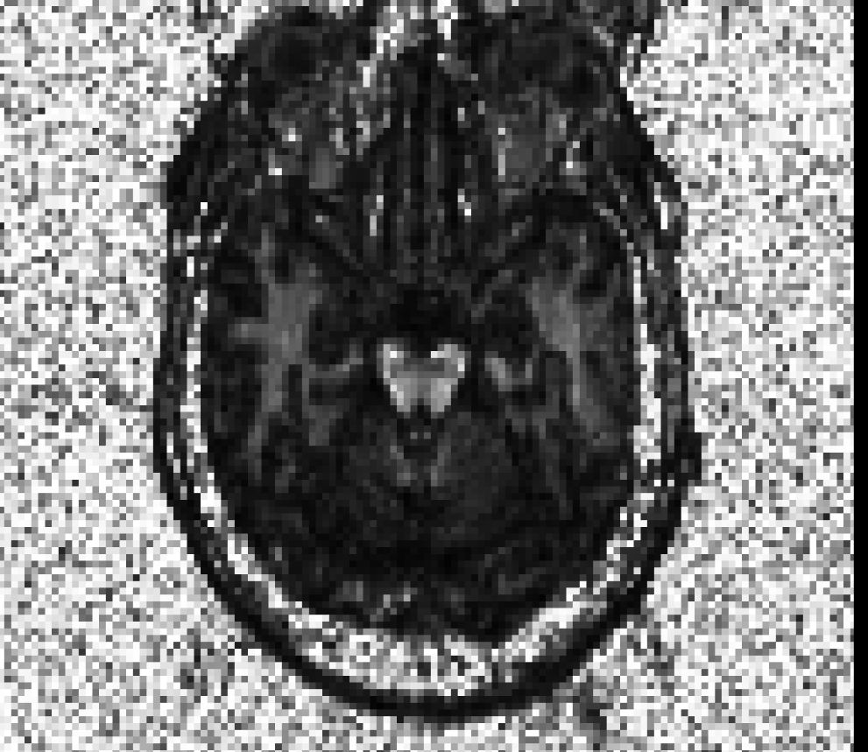
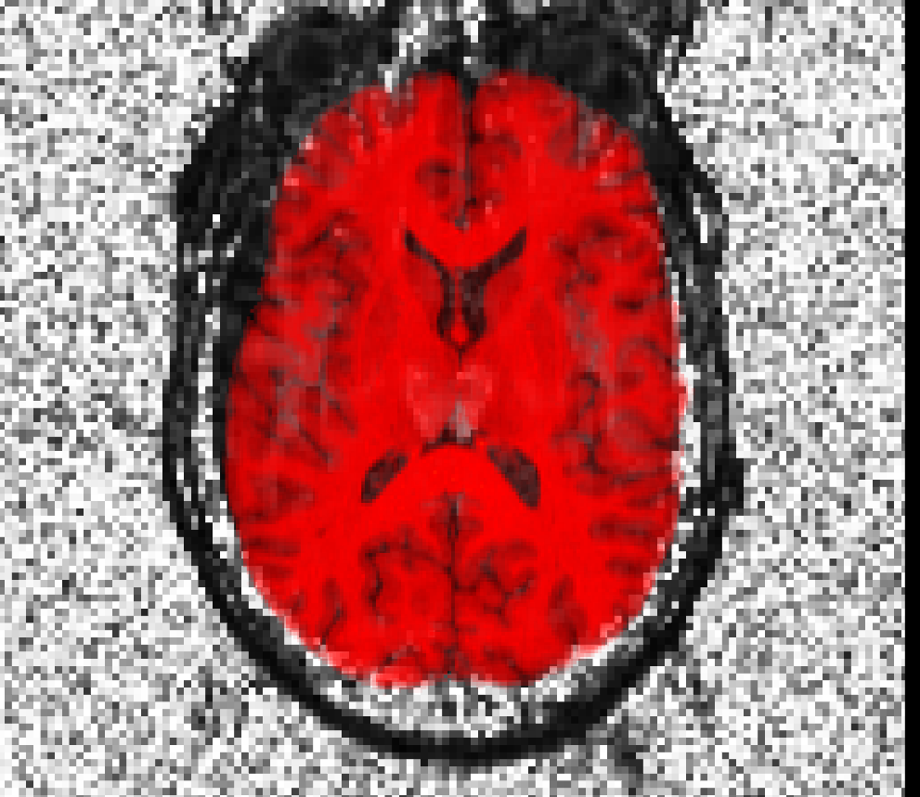
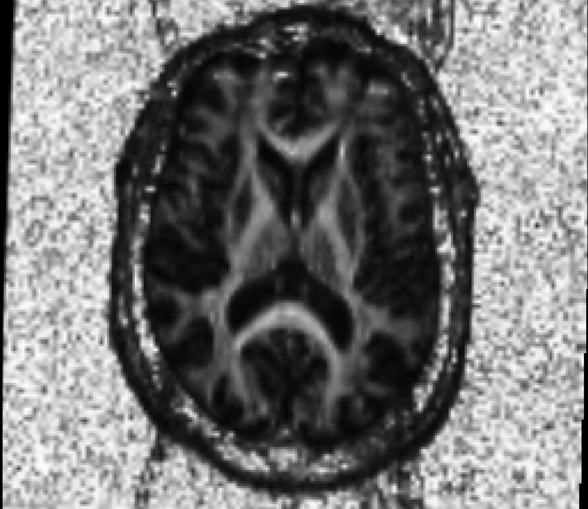
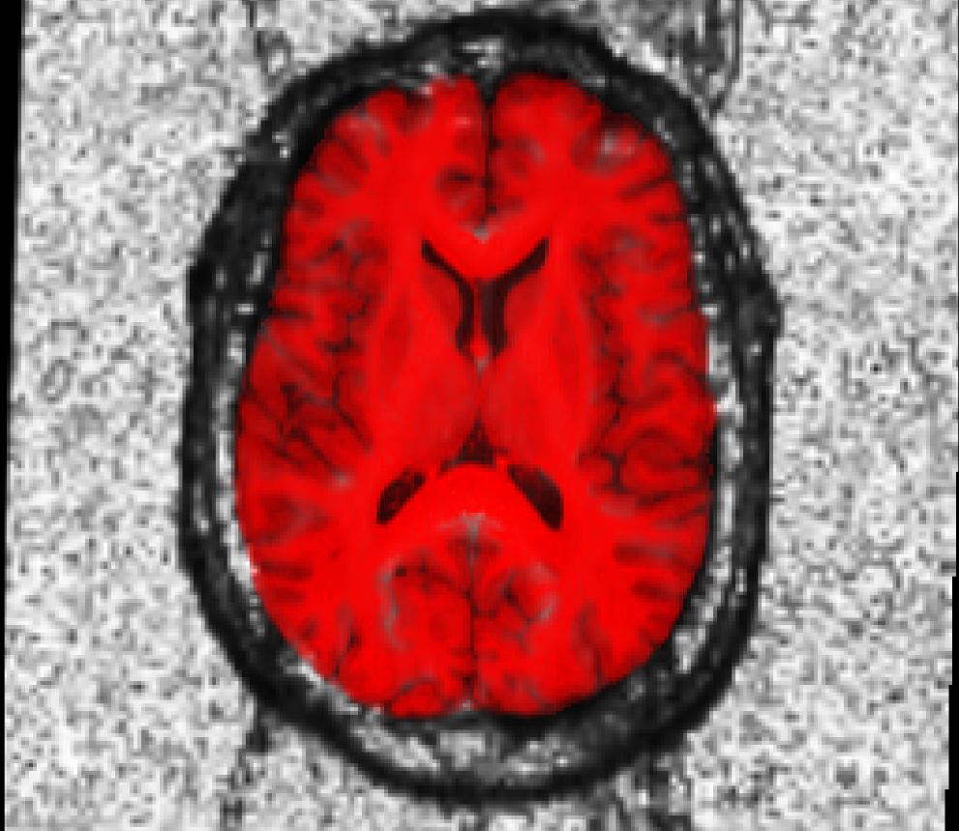
before spatial alignment
after spatial alignment

Slide 24
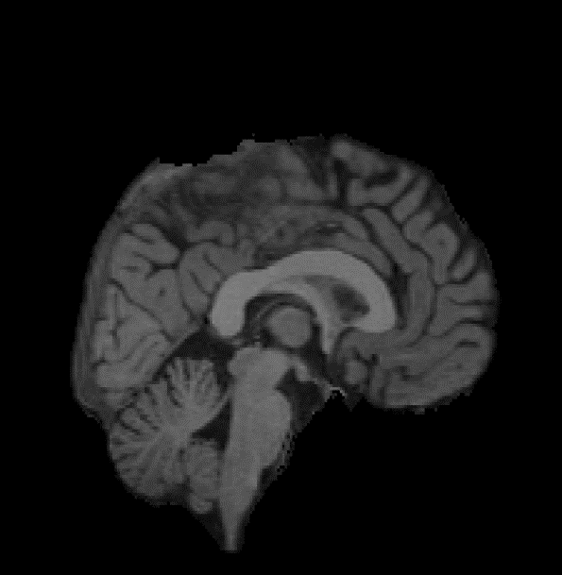
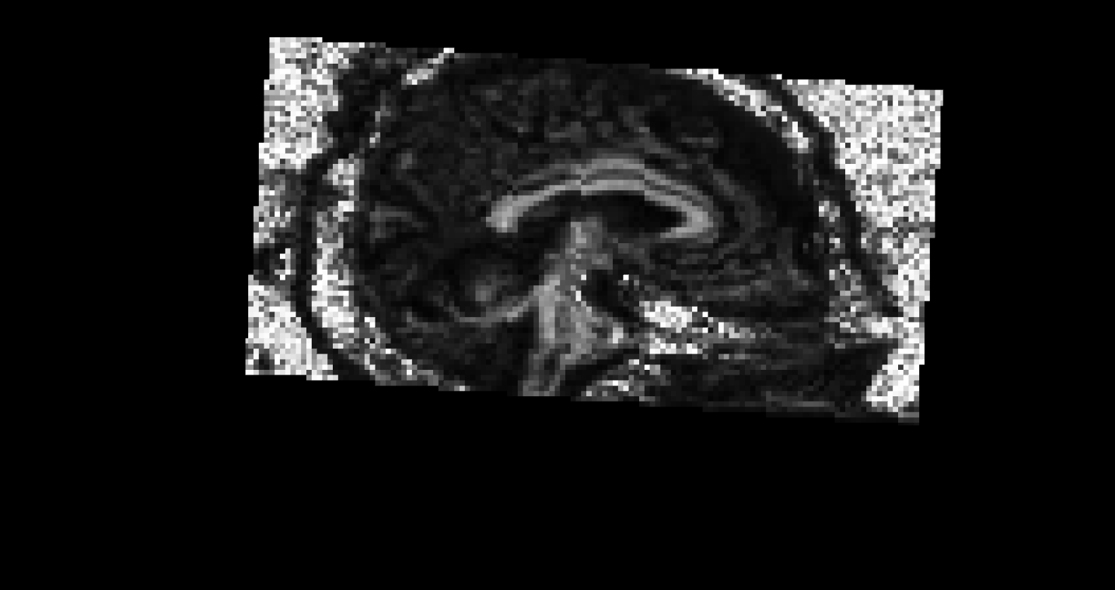
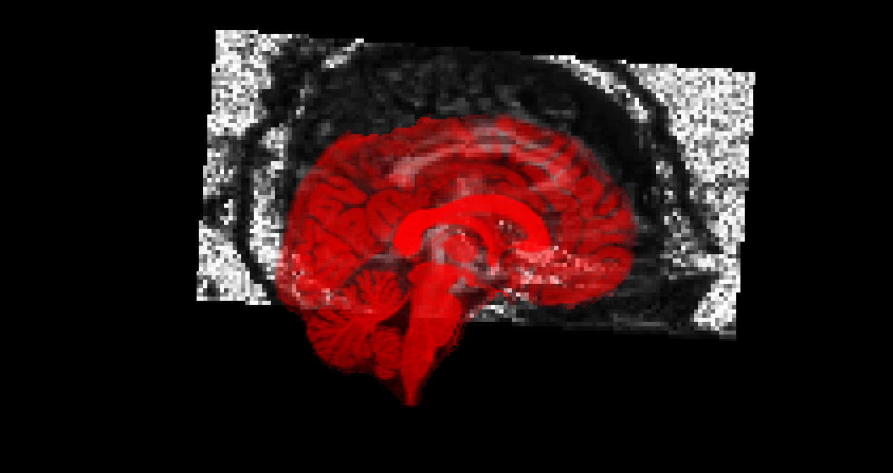
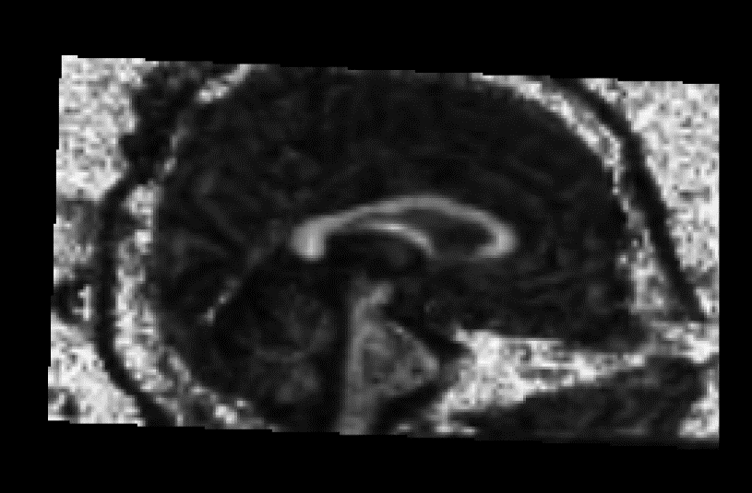
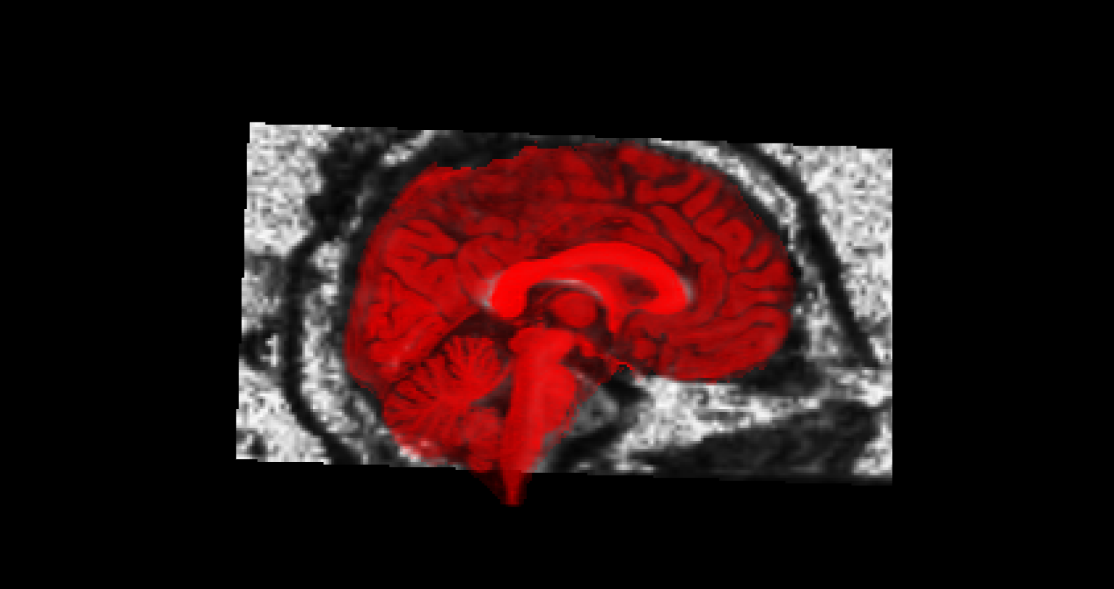
before spatial alignment
after spatial alignment

Slide 25
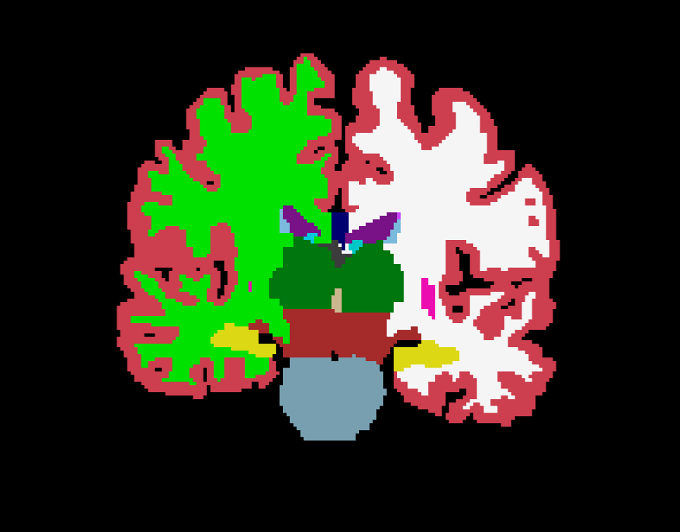
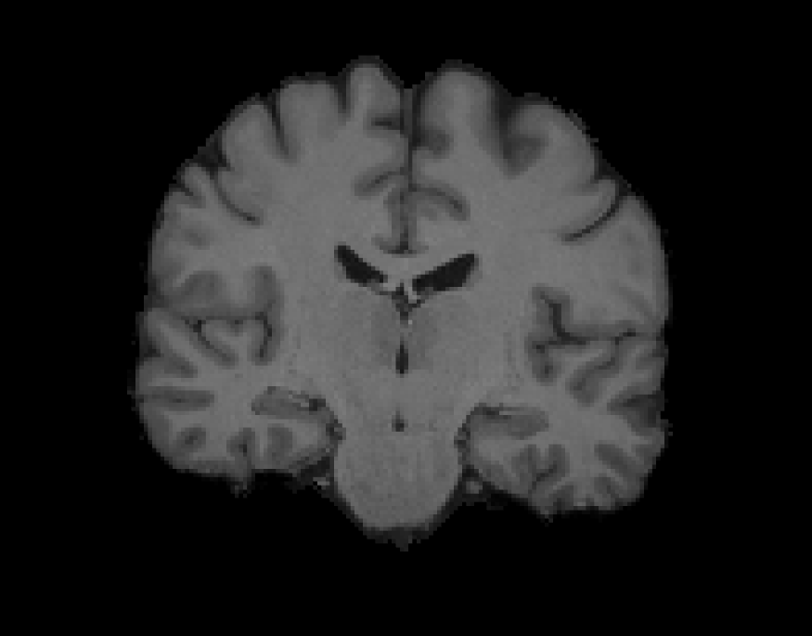
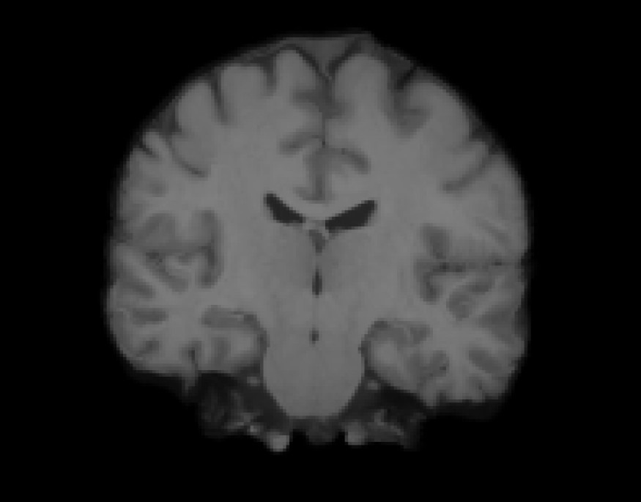
Inter-subject non-linear example
target
CVS reg
Notes:
Dr. Lilla Zollei developed CVS: a more complex non-linear registration mechanism, Combined Volumetric Surface-Based registration
Higher complexity registration
Morphs your image
Gets higher accuracy of correspondence within your images
Helpful when:
You need higher, much more local correspondence between your put data sets
Useful for mapping cortical/subcortical regions from one subject/atlas to the rest of the population your analyzing

Slide 26
Some registration vocabulary
Input datasets:
  Fixed / template / target
  Moving / subject
Transformation models
  rigid
  affine
  nonlinear
Objective / similarity functions
Applying the results
  deform, morph, resample, transform
Interpolation types
  (tri)linear
  nearest neighbor
Notes:
2 input datasets
Rigid: what you just saw (6 DOF)
Affine/non-linear: more complex transformations
Objective functions: good to keep in mind that when we do auto-segmentation – it’s an optimization problem
The objective function is the value you’re trying to optimize that you need to minimize or maximize
Similarity functions:
real-valued function that quantifies the similarity between two objects
Useful to know what similarity functions are in order to make sure that the images you are comparing are best suited by this objective function
Apply your registrations to other images (to ensure accuracy)
Also a choice between interpolation types:
difference: nearest neighbor (morph dataset – you wont introduce new labels into dataset) with tri-linear (more accurate model) transfers data into new space, introduces new intensity value (if voxel is ona. Boundary, wants to make a smoother transition)
Rule of thumb: when you have a segmentation, binary image, or mask – always use nearest neighbor
When grey-scaled images (FA, structural), use linear

Slide 27
FreeSurfer Questions
Search for terms and answers
to all your questions in the Glossary, FAQ, or
FreeSurfer Mailing List Archives
Notes:
27
Links on FS wiki main page to glossary and FAQ
firefox opens to the schedule page. from there links to lecture slides and tutorials. follow along
----- Meeting Notes (2/26/15 12:32) -----
demo

