Slide 1
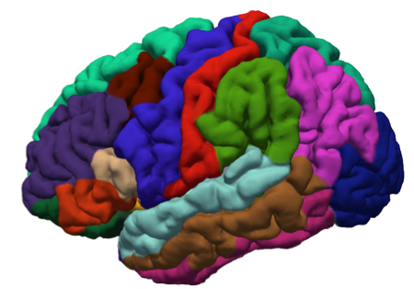
FreeSurfer Introduction

Slide 2
Course Overview
Day 1
Introduction
Individual Subject Analysis
Troubleshooting
Day 2
ROI Analysis
Surface-based Analysis
Group Analysis
Longitudinal Analysis

Slide 3
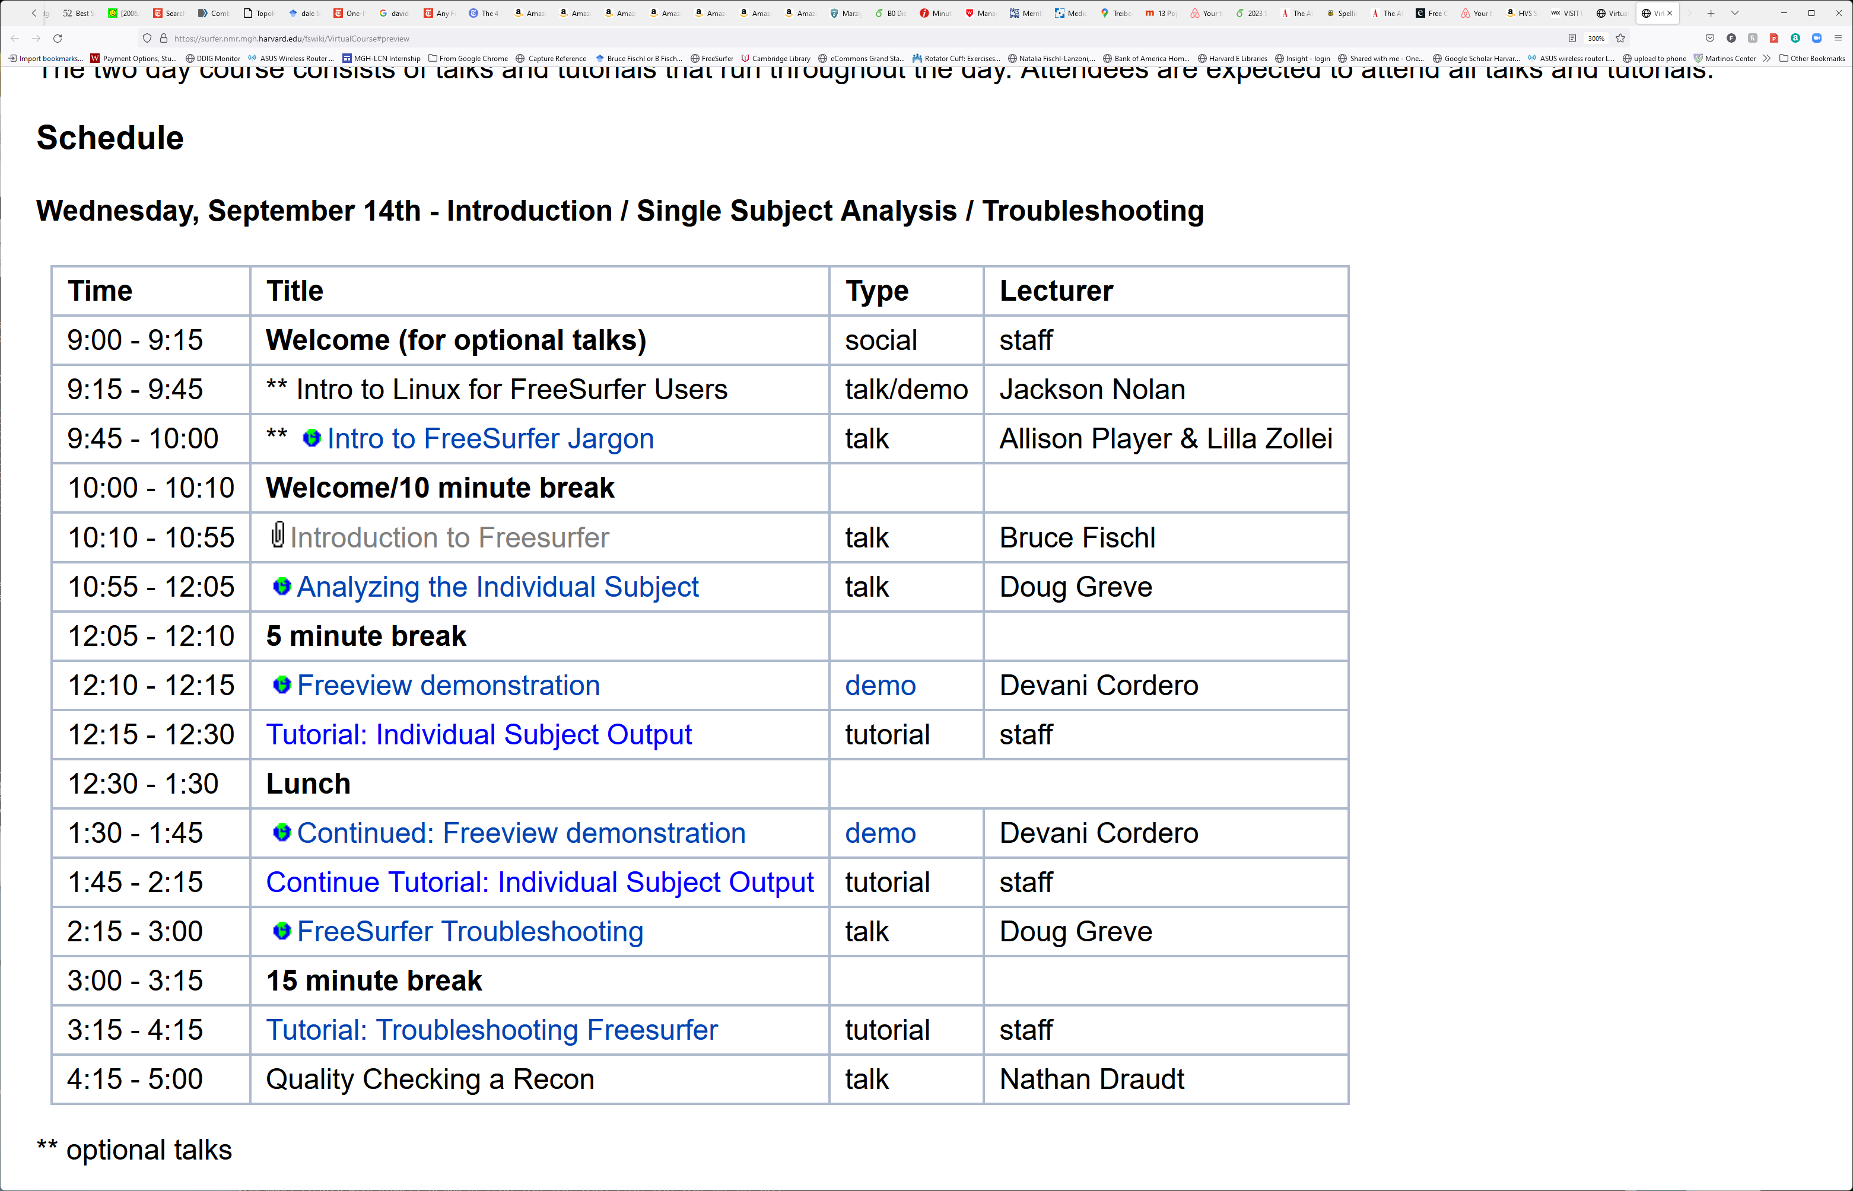
Course Schedule
https://surfer.nmr.mgh.harvard.edu/fswiki/VirtualCourse#preview
Notes:
-click on the links on the schedule page to access the slides to follow along & to access the tutorials when it’s time to do those

Slide 4
Lectures and Practicals
General format: talk followed by tutorial
Note about tutorials: we have many people with different background who will help. Whoever comes over first will either be able to answer your question(s), or will find someone who can
Search on YouTube for the FreeSurfer channel!
Notes:
-Our staff will be in the room during tutorials; raise your hand to get their attention
-We have many people with different background who will help. Whoever comes over first will either be able to answer your question(s), or will find someone who can.

Slide 5
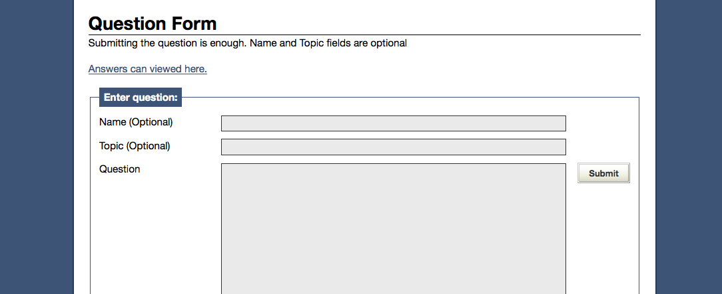
Post Your Questions!
http://surfer.nmr.mgh.harvard.edu/cgi-bin/fsurfer/questions.cgi

Slide 6
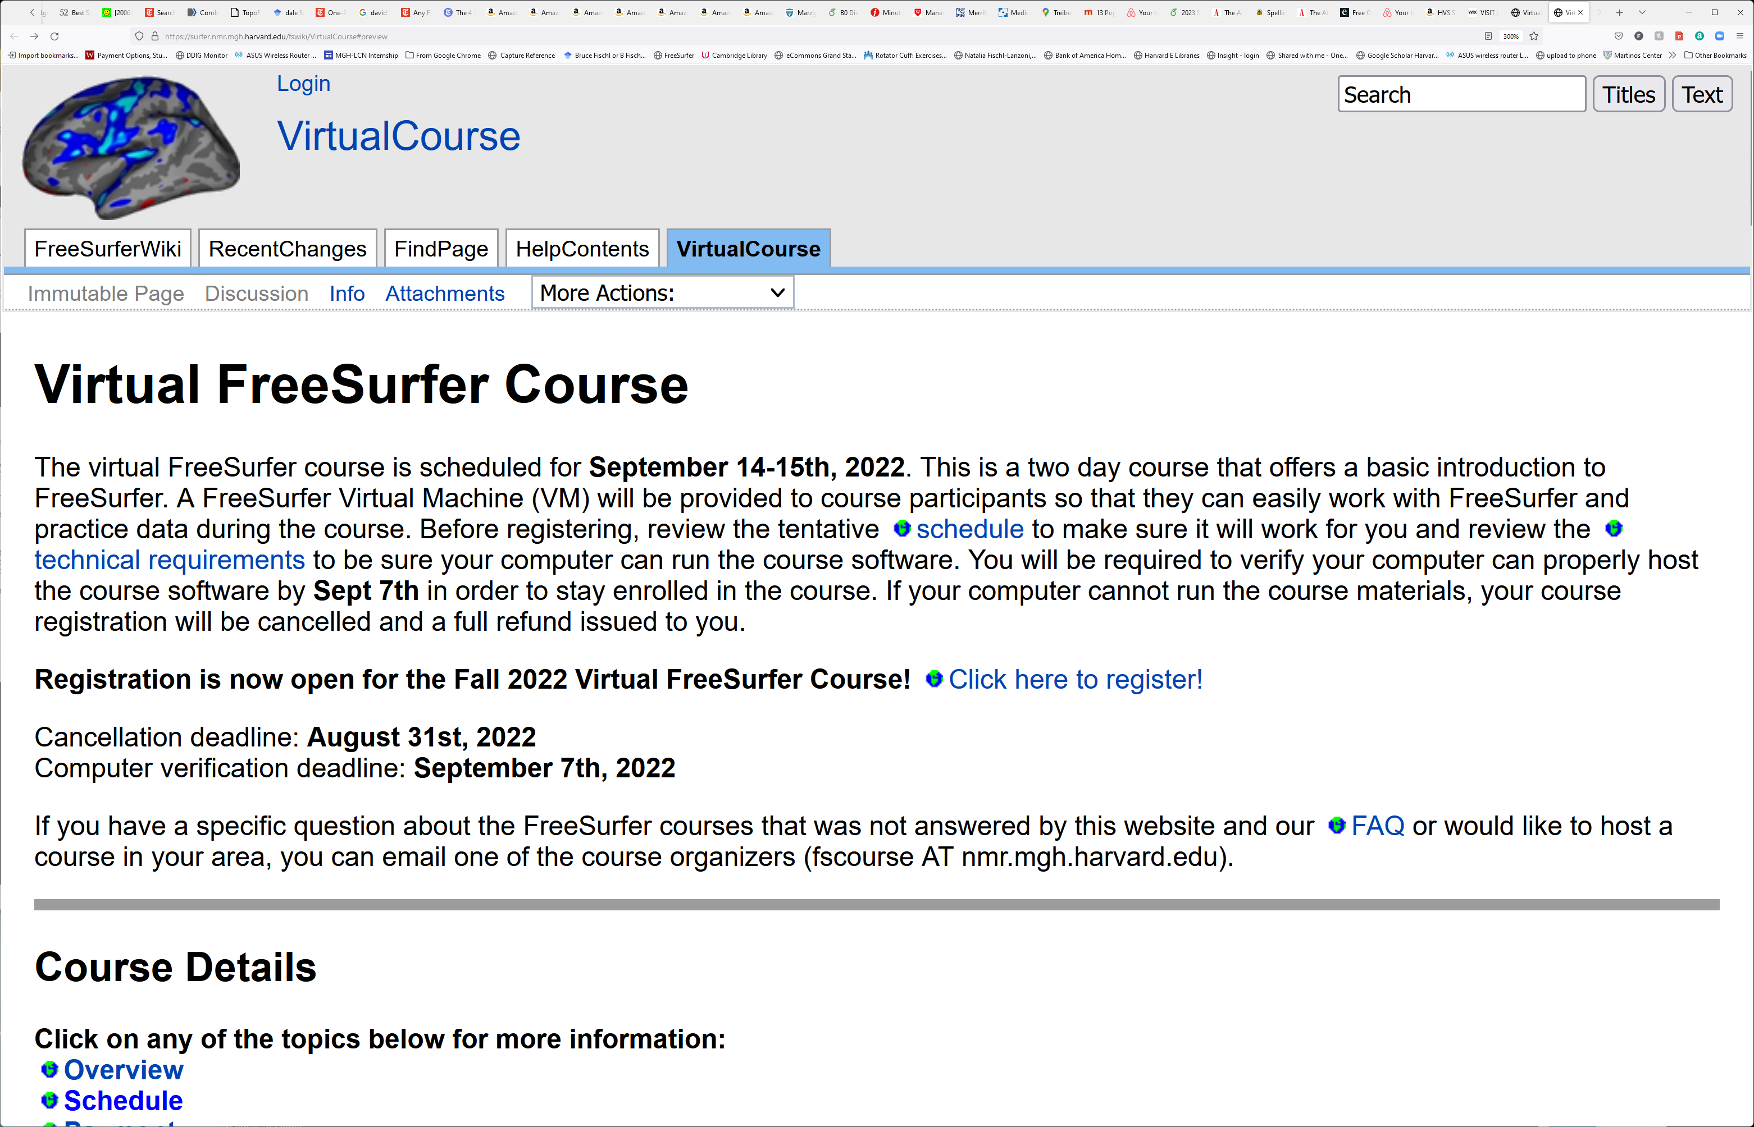
Search for Answers

Slide 7
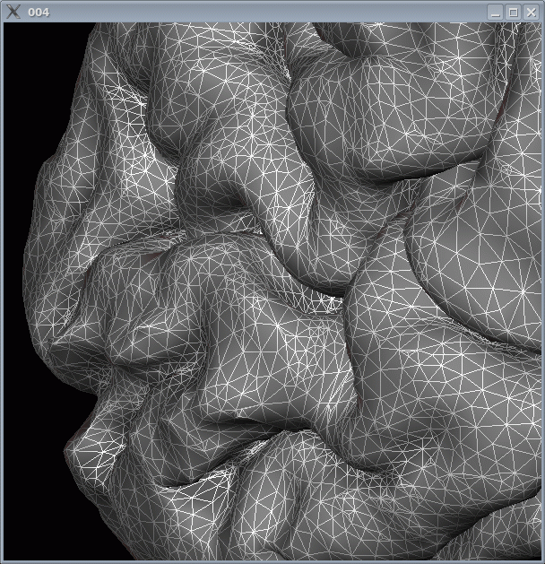
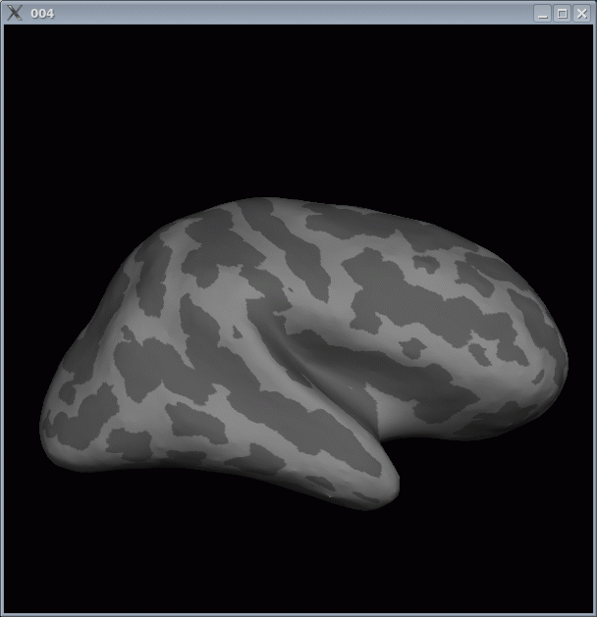
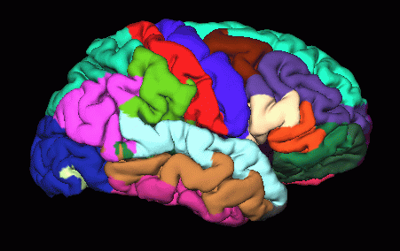
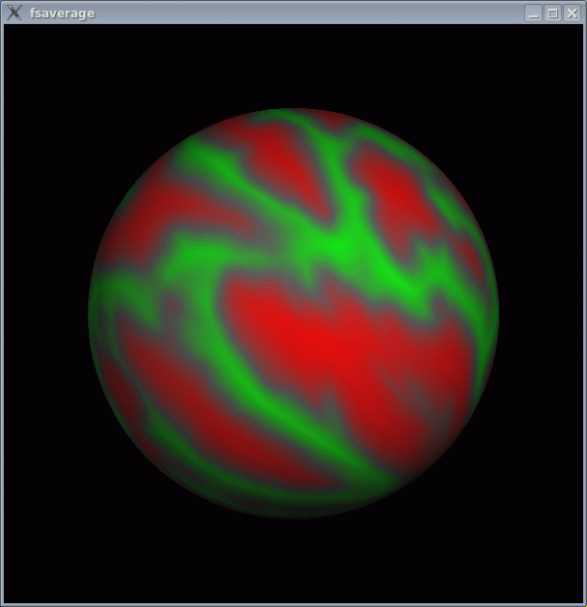
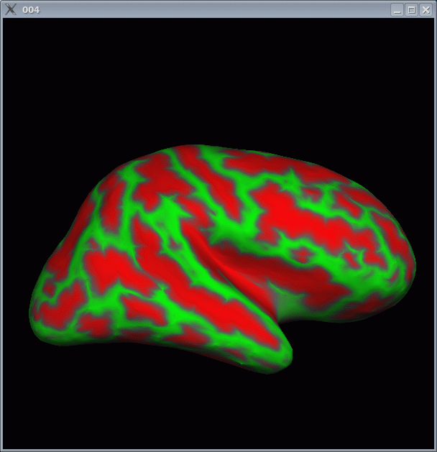
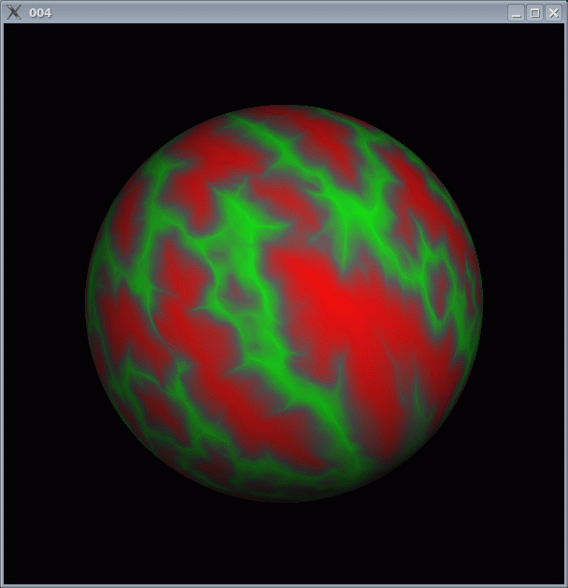
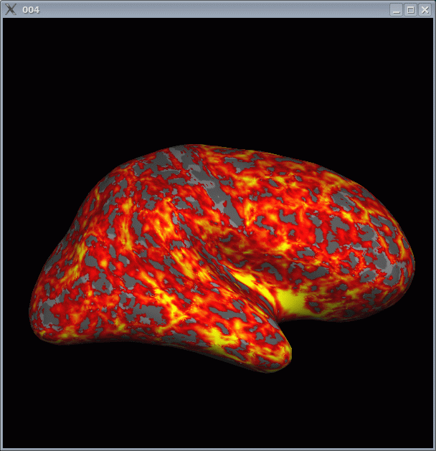
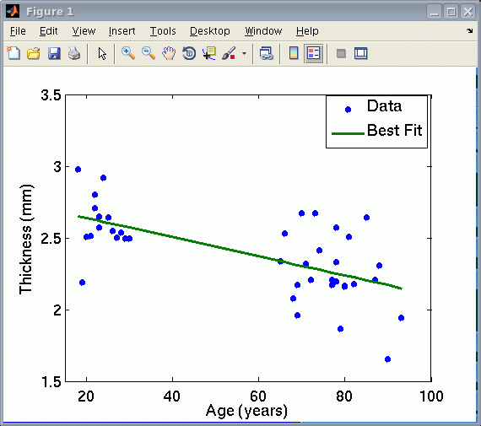
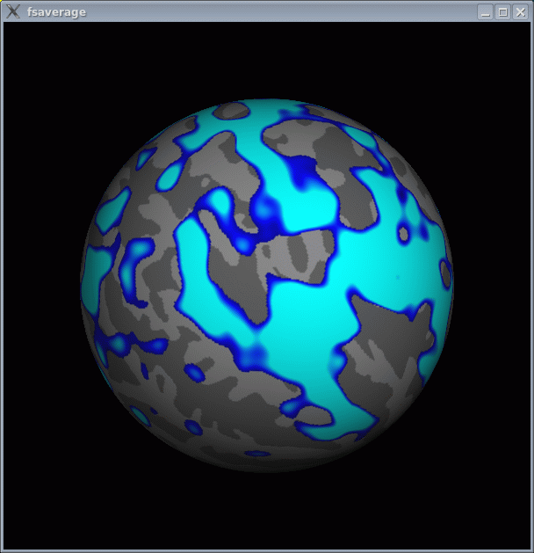
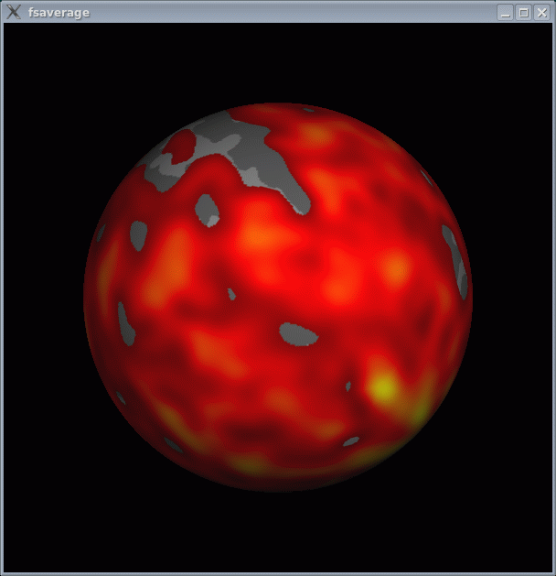
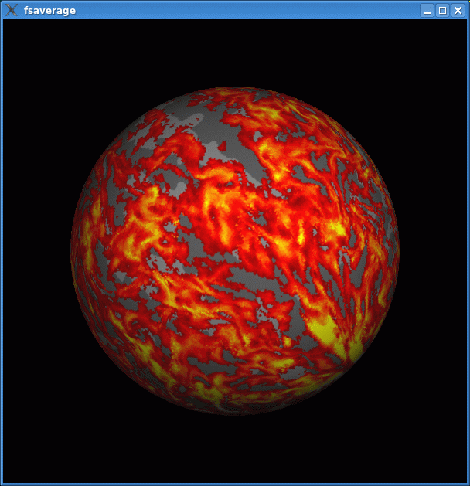
What Is FreeSurfer?
Surface Mesh
Inflation
Surface ROI
Group
Template
D
E
J
Curvature
Sphere
C
F
I
Individual T1
Spatial
Normalization
A
A
Surface
Extraction
B
Thickness
G
H
Deformation
Field
2mm
4mm
Apply
Deformation
Volume ROI
O
Statistical Map
Statistical Map
N
M
Group
Analysis
L
K
Smooth
p<.01
p<.01
Thickness
(Group Space)
Other Subjects

Slide 8
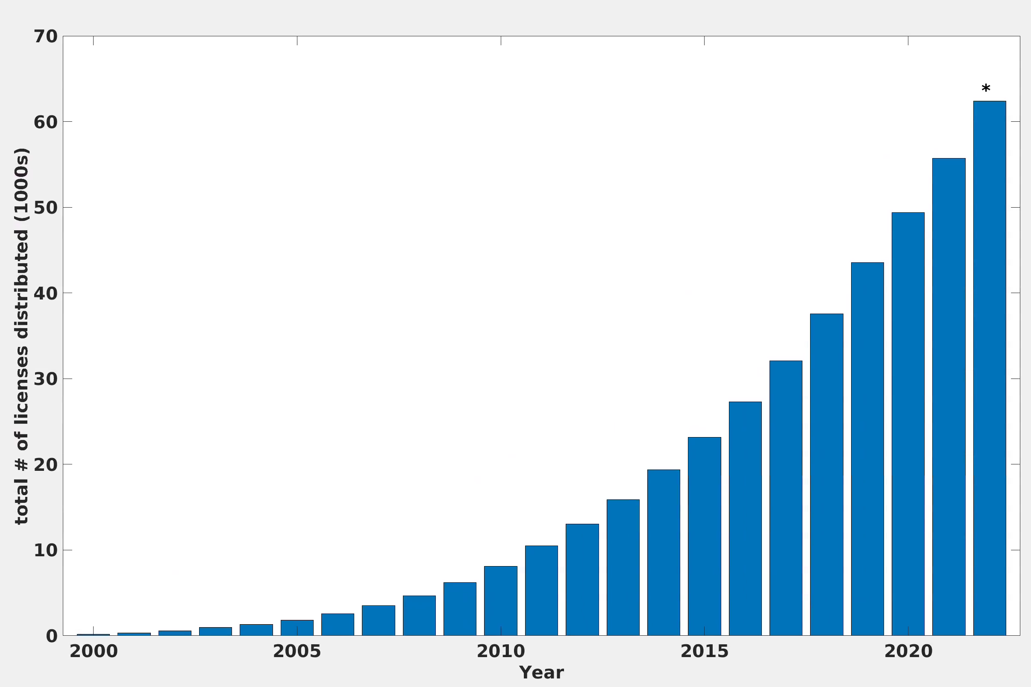
What is FreeSurfer?
Total # licenses distributed as of April 19, 2022
(over 57,000 total)

Slide 9
Outline
A Brief History of FreeSurfer
What are Surfaces Good For Anyway?
Inferring Microstructural Locations
Longitudinal Analysis
DWI/Tractography
fMRI

Slide 10
FreeSurfer began life as a means for EEG/MEG Analysis
Citations
2298
1749
Improved localization of cortical activity by combining EEG and MEG with MRI cortical surface reconstruction: a linear approach. AM Dale, MI Sereno. Journal of cognitive neuroscience 5 (2), 162-176, 1994.
Dynamic statistical parametric mapping: combining fMRI and MEG for high-resolution imaging of cortical activity. AM Dale, AK Liu, et al, Neuron 26 (1), 55-67, 2000.

Slide 11
How To Model The Pial Surface? (an unanswered question circa 1996)

Slide 12
Inferring the Location of the Pial Surface
Key Insight (Anders’ and Marty’s, not mine): Model the gray/white boundary and use it to infer pial surface locations
Citations
9641
6093
Cortical surface-based analysis: I. Segmentation and surface reconstruction. AM Dale, B Fischl, MI Sereno, Neuroimage 9 (2), 179-194. 1999.
Cortical surface-based analysis: II: inflation, flattening, and a surface-based coordinate system. B Fischl, MI Sereno, AM Dale Neuroimage 9 (2), 195-207. 1999.

Slide 13
Inferring the Location of the Pial Surface
Key Insight (Anders’ and Marty’s, not mine): Model the gray/white boundary and use it to infer pial surface locations
Citations
9641
6093
Cortical surface-based analysis: I. Segmentation and surface reconstruction. AM Dale, B Fischl, MI Sereno, Neuroimage 9 (2), 179-194. 1999.
Cortical surface-based analysis: II: inflation, flattening, and a surface-based coordinate system. B Fischl, MI Sereno, AM Dale Neuroimage 9 (2), 195-207. 1999.
My Favorite Review: “In the method section alone, scholarship is lacking, the notation is incorrect and misleading and even a basic understanding of elementary topology is lacking…

Slide 14
Inferring the Location of the Pial Surface
Key Insight (Anders’ and Marty’s, not mine): Model the gray/white boundary and use it to infer pial surface locations
Citations
9641
6093
Cortical surface-based analysis: I. Segmentation and surface reconstruction. AM Dale, B Fischl, MI Sereno, Neuroimage 9 (2), 179-194. 1999.
Cortical surface-based analysis: II: inflation, flattening, and a surface-based coordinate system. B Fischl, MI Sereno, AM Dale Neuroimage 9 (2), 195-207. 1999.
My Favorite Review: “In the method section alone, scholarship is lacking, the notation is incorrect and misleading and even a basic understanding of elementary topology is lacking…
That said, this is by far the strongest section of the paper”

Slide 15
FreeSurfer: Surface-based modeling challenges
One wants a topologically correct model (no handles or holes) so that (1) distances along the surface aren’t dramatically distorted, and (2) it is possible to establish point-to-point registration across subjects for every point in the cortex, but….
The only technique to guarantee topology at the time was “shrink wrapping” in which you start with a surface of the correct topology (a sphere) and try to deform it so it settles on the true pial surface.
The problem is that shrink wrapping a highly-folded surface like the human brain is HARD!*.
*We have made some Deep Learning progress on this. See (Hoopes et al., MIDL 2022 ):
https://openreview.net/forum?id=-JiHeZNDY3a

Slide 16
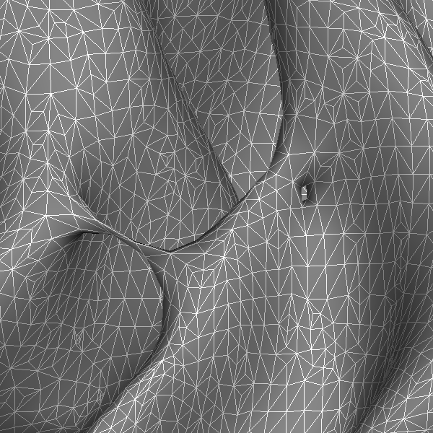
How To Get The Topology Right?

Slide 17
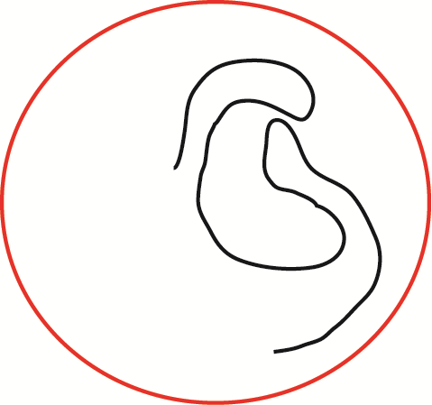
Why Shrink wrapping is Hard!

Slide 18
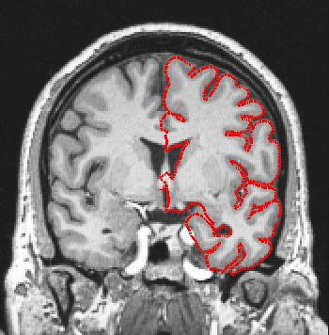
Shrink Wrapping

Slide 19
Topology Correction

Slide 20
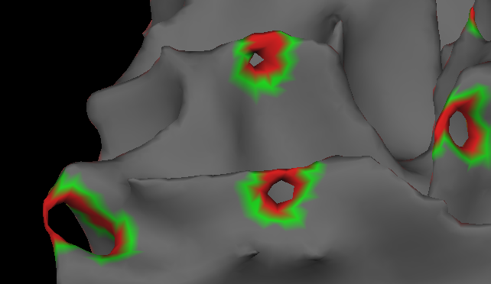
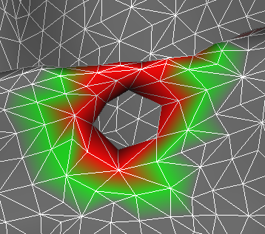
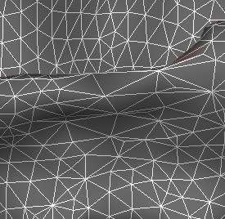
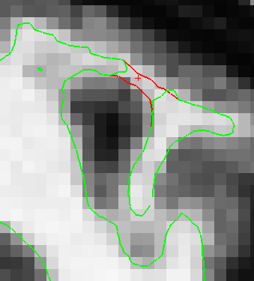
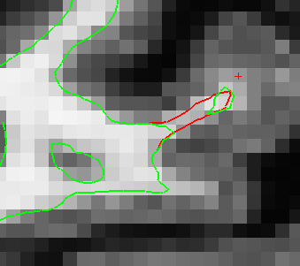
Automatic Defect Correction
Initial cortical surface
Topological defect
Corrected defect
Sagittal view
Coronal view

Slide 21
Topology Correction via Manifold Surgery
BEFORE
AFTER

Slide 22
Problems with Affine (12 DOF) Registration
Subject 2 aligned with Subject 1
(Subject 1’s Surface)
Subject 1

Slide 23
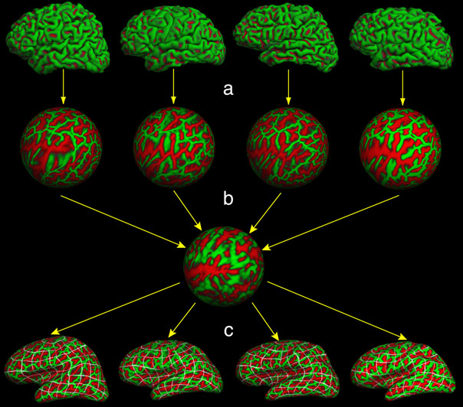
A Surface-Based Registration
Common space for group analysis (like Talairach) “fsaverage”

Slide 24
Topology Correction and Spherical Averaging
Citations
3068
1726
High-resolution intersubject averaging and a coordinate system for the cortical surface. B Fischl, MI Sereno, RBH Tootell, AM Dale. Human brain mapping 8 (4), 272-284, 1999.
Automated manifold surgery: constructing geometrically accurate and topologically correct models of the human cerebral cortex. B Fischl, A Liu, AM Dale, IEEE transactions on medical imaging 20 (1), 70-80, 2001.
My Second Favorite Review. We intended to submit equations like:

Slide 25
Topology Correction and Spherical Averaging
Citations
2260
1212
High-resolution intersubject averaging and a coordinate system for the cortical surface. B Fischl, MI Sereno, RBH Tootell, AM Dale. Human brain mapping 8 (4), 272-284, 1999.
Automated manifold surgery: constructing geometrically accurate and topologically correct models of the human cerebral cortex. B Fischl, A Liu, AM Dale, IEEE transactions on medical imaging 20 (1), 70-80, 2001.
My Second Favorite Review. Incorrect printer fonts turned them into:
⧫ = ♠♣♥♦

Slide 26
Topology Correction and Spherical Averaging
Citations
2260
1212
High-resolution intersubject averaging and a coordinate system for the cortical surface. B Fischl, MI Sereno, RBH Tootell, AM Dale. Human brain mapping 8 (4), 272-284, 1999.
Automated manifold surgery: constructing geometrically accurate and topologically correct models of the human cerebral cortex. B Fischl, A Liu, AM Dale, IEEE transactions on medical imaging 20 (1), 70-80, 2001.
My Second Favorite Review: “”
⧫ = ♠♣♥♦

Slide 27
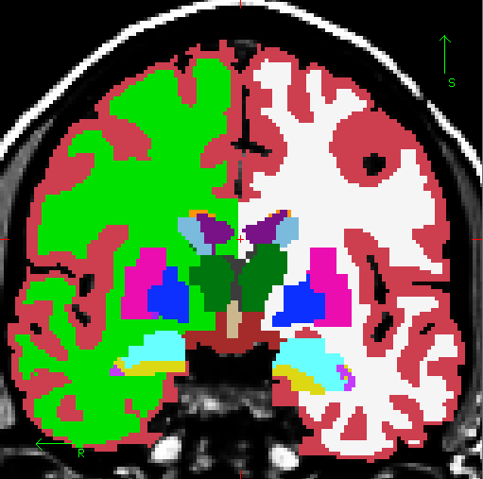
And Finally, the Aseg
Citations
7703
2055
Whole brain segmentation: automated labeling of neuroanatomical structures in the human brain. B Fischl, DH Salat, et al., Neuron 33 (3), 341-355. 2002
Sequence-independent segmentation of magnetic resonance images. B Fischl, DH Salat, et al., Neuroimage 23, S69-S84, 2004.
Cortex
White Matter
Lateral Ventricle
The aseg was the final piece that let us totally automate the processing.
Thalamus
Caudate
Putamen
Pallidum
Amygdala
Hippocampus

Slide 28
Outline
A Brief History of FreeSurfer
What are Surfaces Good For Anyway?
Inferring Microstructural Features
Longitudinal Analysis
DWI/Tractography
fMRI

Slide 29
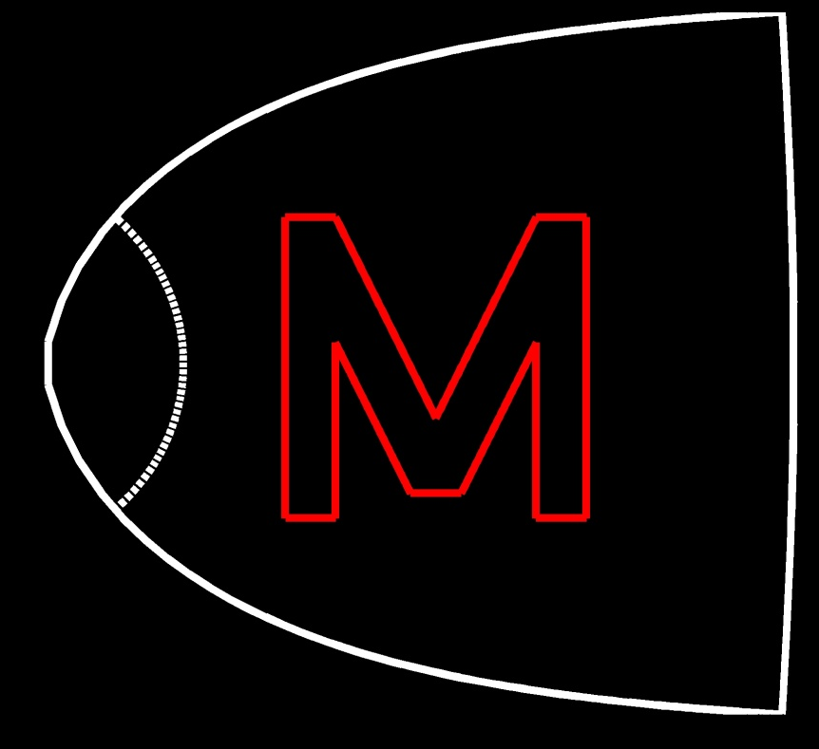
What Can One Do With A Surface Model?
goal: use model to imposed desired activity pattern on V1
desired shape of activity pattern
required shape of stimulus
w=k log(z+a)
left primary visual cortex
right visual
hemifield
Collaboration with Jon Polimeni and Larry Wald.

Slide 30
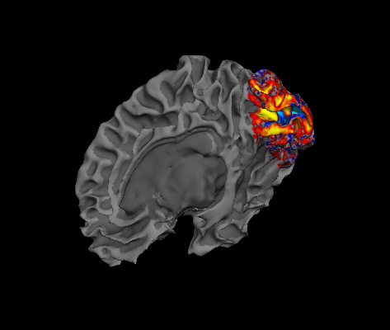
Tangential Resolution Measured with Surface-based Analysis
Collaboration with Jon Polimeni and Larry Wald. Polimeni, et al, 2010, NI.

Slide 31
Tangential Resolution Measured with Surface-based Analysis
Collaboration with Jon Polimeni and Larry Wald. Polimeni, et al, 2010, NI.

Slide 32
NeuroMarketing!
Aim 1 of our NCRR Center Grant, spelling:
“MGH Center for Functional Neuroimaging Technologies; and NCRR Center for Research Resources.”
(just kidding)
Thanks to Larry Wald for this slide.

Slide 33
Outline
A Brief History of FreeSurfer
What are Surfaces Good For Anyway?
Inferring Microstructural Locations
Longitudinal Analysis
DWI/Tractography
fMRI

Slide 34
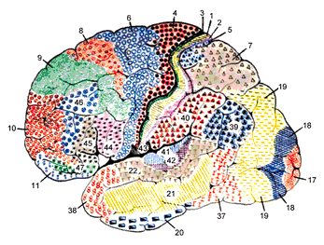
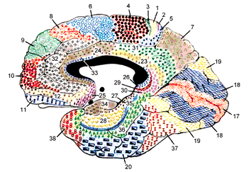
Surface-based Registration Performance
Brodmann, 1909

Slide 35
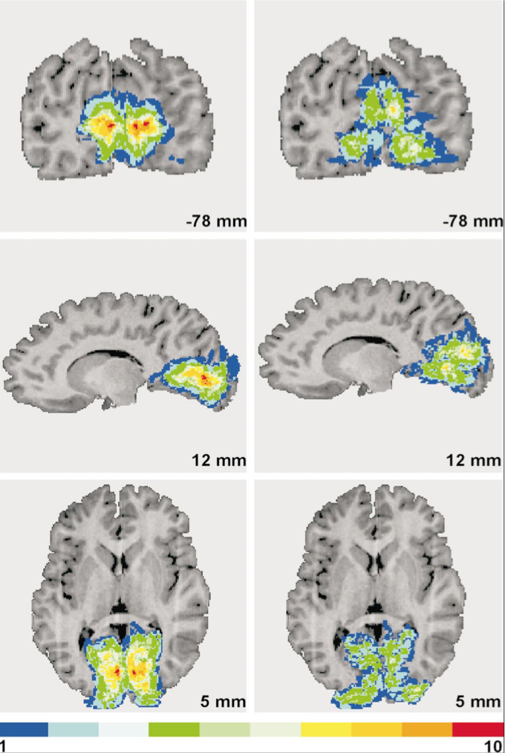
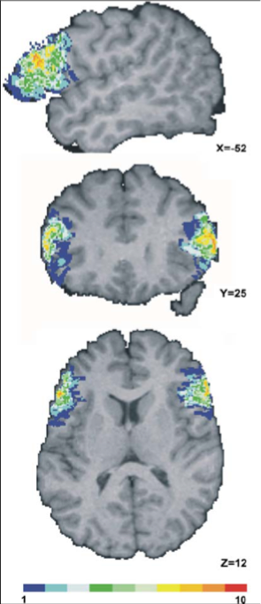
Predicting Brodmann Areas: Talairach Coordinates
10 subjects overlap
1 subject overlap
BA17 (V1) BA18 (V2) BA44 (Broca’s) BA45 (Broca’s)
(Amunts et al, 2000, 2004)

Slide 36
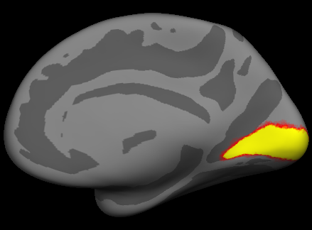
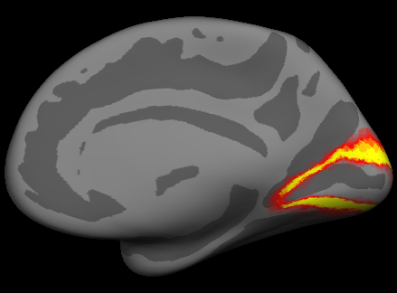
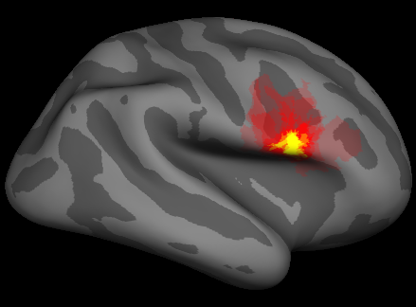
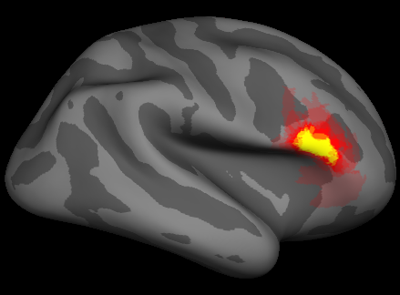
Predicting Brodmann Areas from Folding Patterns
BA 17 (V1)
BA 18 (V2)
0%
100% Overlap
BA 44
BA 45
Fischl, et al, 2007. Thanks to Katrin Amunts, Karl Zilles and Hartmut Mohlberg for the data, and to Niranjini Rajendran and Evelina Busa for the analysis.

Slide 37
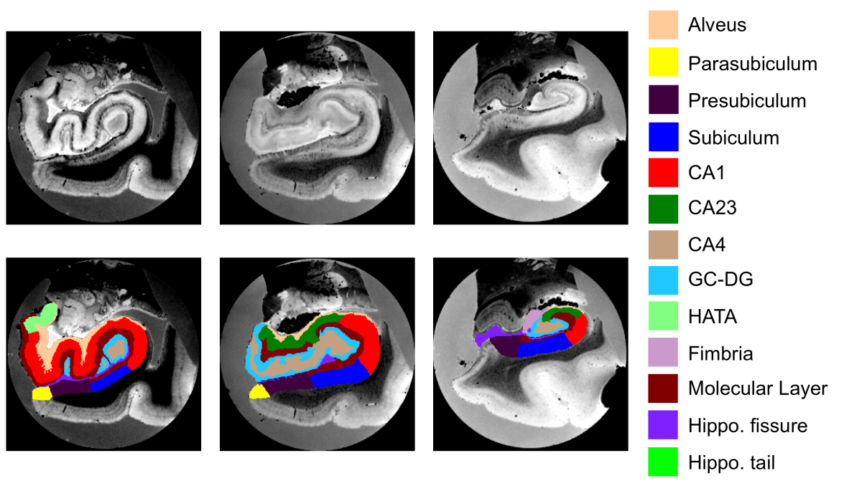
Ex vivo MRI of hippocampal subfields
Resolution as high as 0.1 mm isotropic
Allows precise manual tracing of hippocampal subfields.
The delineation only relies on geometry for subdividing the CA.
Joint work with J. Eugenio Iglesias, Koen van Leemput and Jean Augustinack
Notes:
37

Slide 38
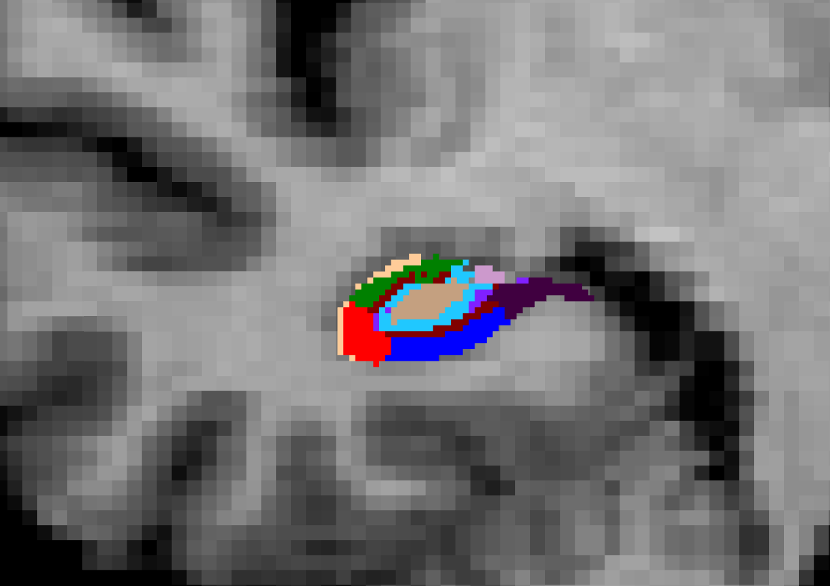
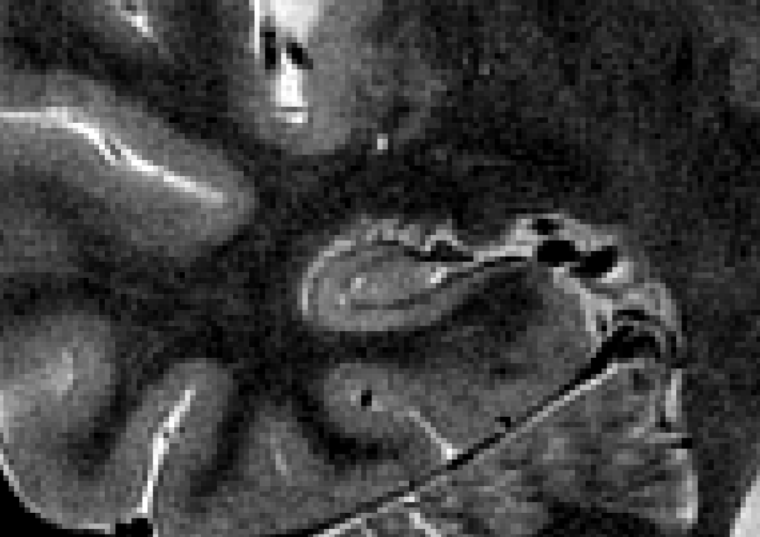
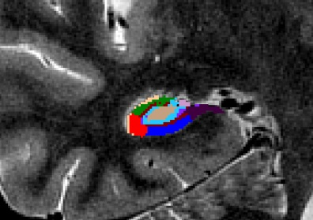
Automated Segmentation
We use the atlas as a prior, and connect it to the image through a Gaussian likelihood term for each label.
This makes the segmentation sequence-independent.
0.6 mm isotropic T1 (Winterburn et al.) 1 mm T1 + 0.4x0.4x2 mm T2 (ADNI)
Joint work with J. Eugenio Iglesias, Koen van Leemput and Jean Augustinack
Notes:
38

Slide 39
Outline
A Brief History of FreeSurfer
What are Surfaces Good For Anyway?
Inferring Microstructural Locations
Longitudinal Analysis
DWI/Tractography
fMRI

Slide 40
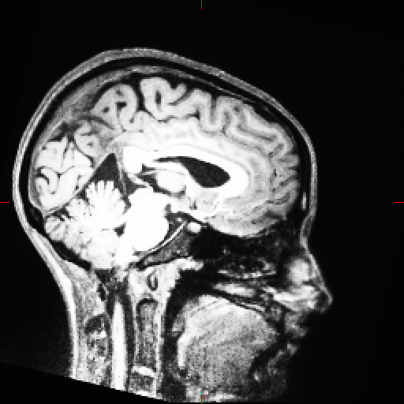
Robust Registration
Target
Target
Reuter et al, 2010 NeuroImage

Slide 41
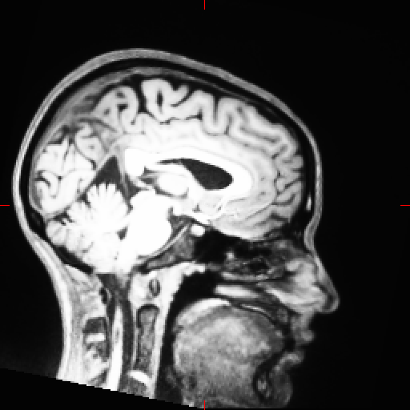
Robust Registration
Registered Src correlation ratio
Registered Src Robust
Reuter et al, 2010 NeuroImage

Slide 42
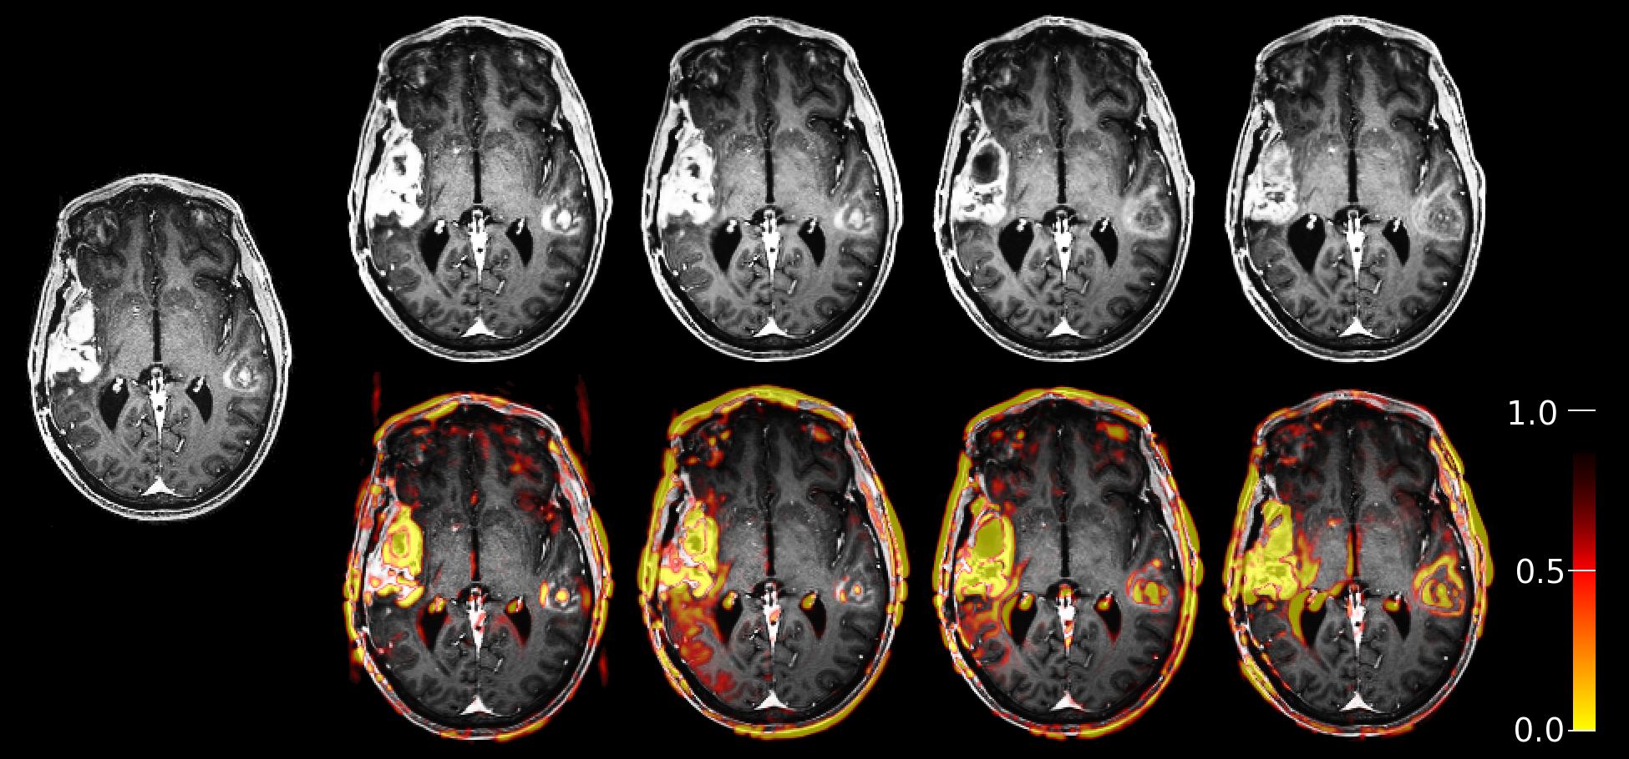
Robust Registration
Tumor data with significant intensity differences in the
brain, registered to first time point (left).
Reuter et al, 2010 NeuroImage

Slide 43
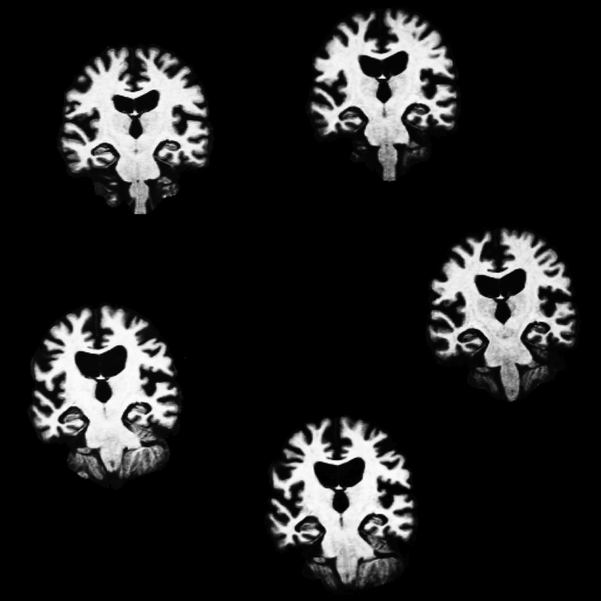
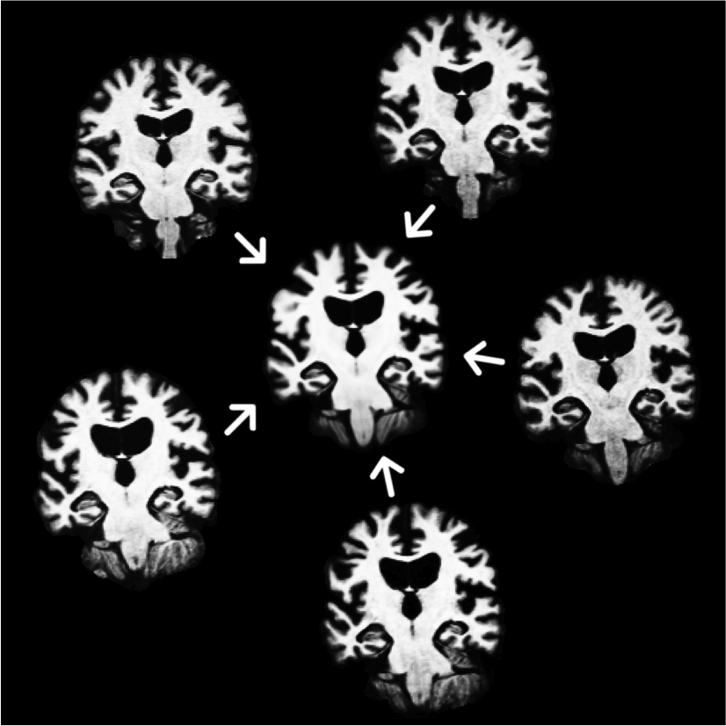
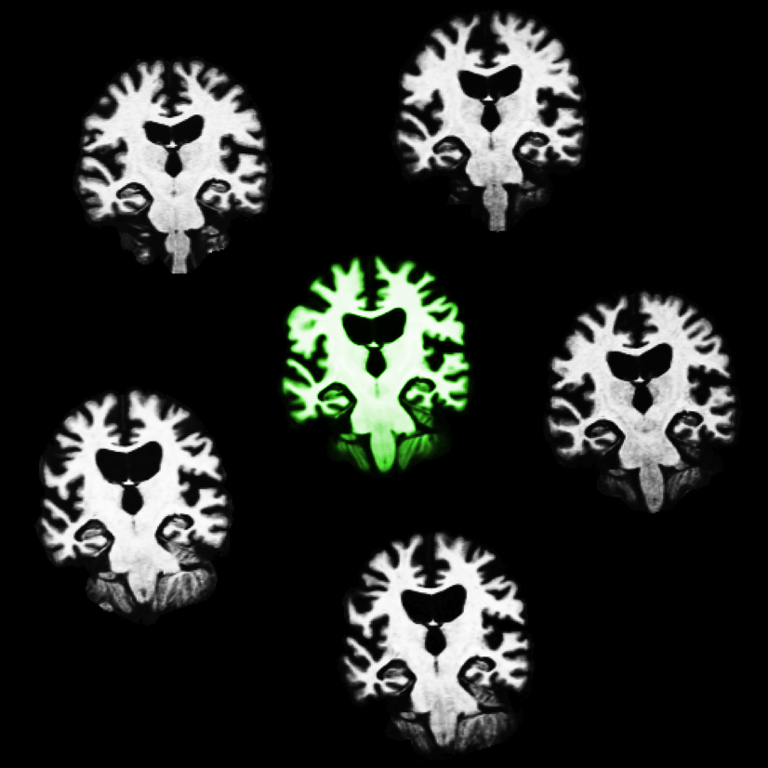
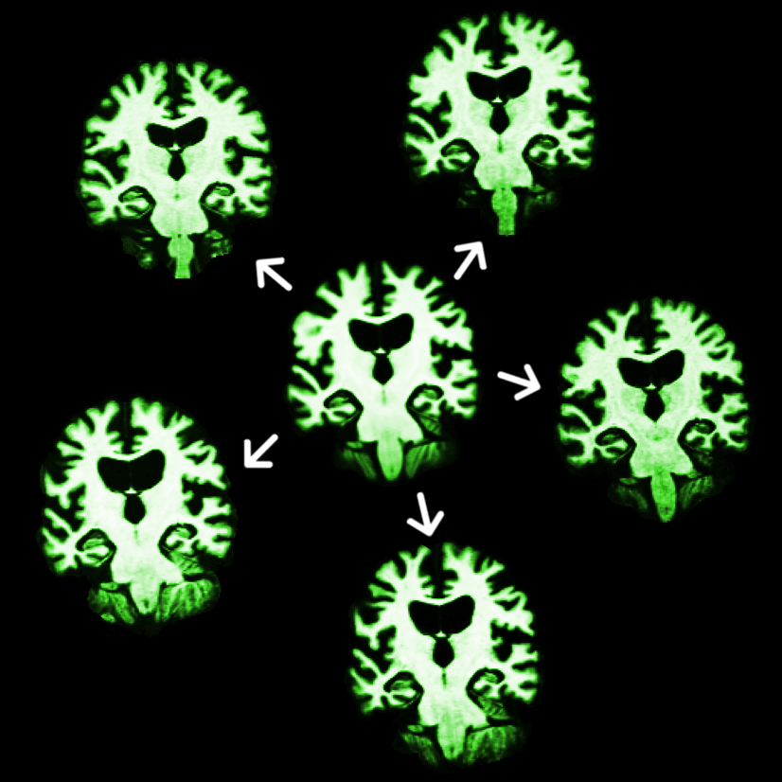
Longitudinal Processing
Create unbiased subject template (iterative registration to median)
Process template
Initialize time points
Let it evolve there
Avoid Bias: All time points are treated the same
Increases sensitivity and reliability!
Reuter et al. OHBM 2010, NeuroImage 2011 & 2012

Slide 44
Outline
A Brief History of FreeSurfer
What are Surfaces Good For Anyway?
Inferring Microstructural Locations
Longitudinal Analysis
DWI/Tractography
fMRI

Slide 45
Tractography with TRACULA (TRActs Constrained by the Underlying Anatomy)
Completely automated modeling of 18 major fascicles
Uses prior probabilistic information on the anatomical structures that each fascicle goes through or next to
Collaboration with Anastasia Yendiki, Lilla Zöllei, Saad Jbabdi, Tim Behrens and Jean Augustinack

Slide 46
Outline
A Brief History of FreeSurfer
What are Surfaces Good For Anyway?
Inferring Microstructural Locations
Longitudinal Analysis
DWI/Tractography
fMRI

Slide 47
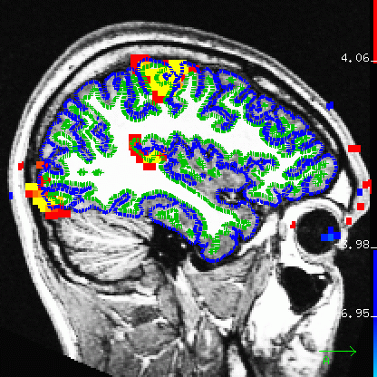
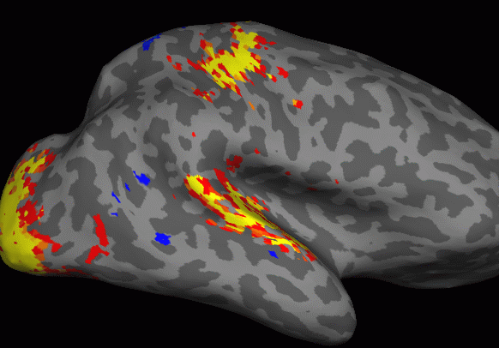
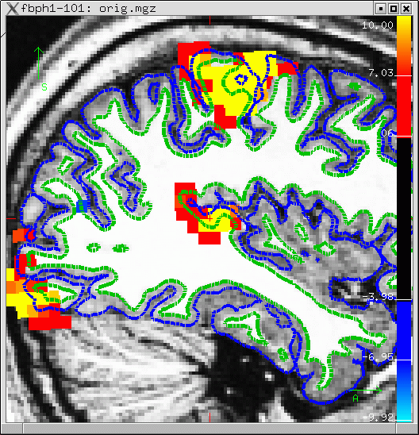
Sampling on the Surface
15 sec ‘ON’, 15 sec ‘OFF’
Flickering Checkerboard
Auditory Tone
Finger Tapping

Slide 48
fMRI Working Memory Paradigm Group Analysis
Probe-vs-Fixation. Data Functional Biomedical Informatics Research Network (fBIRN)

Slide 49
Spatial Smoothing
5 mm apart in 3D
25 mm apart on surface!
Kernel much larger
Averaging with other tissue types (WM, CSF)
Averaging with other functional areas

Slide 50
Group fMRI Analysis: Volume vs Surface
Affine registration to MNI305
5mm volume smoothing vs.
10mm surface smoothing

Slide 51
What is FreeSurfer?
Cortical extraction and labeling
Subcortical Segmentation
Surface-based Inter-subject Registration
Fully automated
Multi-modal integration
Use FreeSurfer
Be Happy

Slide 52
Why Should I Use FreeSurfer?
Please do not try this yourself without expert supervision – it can be extremely dangerous!

Slide 54
Food and such
Cafeteria in main building (Building 149)
Morning coffee and “breakfast” – muffins, bagels, fruit
Afternoon coffee and some snacks
Tuesday evening socializing at Boston Beer Works

Slide 55
To Caffeinate or not to Caffeinate?
Please don’t spill coffee (or anything else!) on the laptops. If you do, please be prepared to fund a replacement!

Slide 56
The FreeSurfer Team
Bruce
Martin
Longitudinal
Lilla
Registration/
Pediatric
Doug
fMRI/PET
Anastasia
Tractography
Software Engineers
Andre
MR Sequences
Zeke
Nick
Ruopeng
Allison
Recon Editing & Exvivo Data
56
Notes:
-Bruce: creator, implements most new code
-Doug: created & only person that works on fMRI stream; person that mostly works on group analysis code
-engineers: build & test the code; decide when to release new versions; most likely to help with installation problems
-me: expertise in manual interventions for failed datasets; oversee exvivo projects that ultimately add to atlases

Slide 57
Automated Subfield Segmentation
Leave-one-out cross-validation with 5 subjects
Dice Coefficient
Fimbria
CA2/3
CA1
CA4/DG
Presubiculum
Subiculum
Hippocampal fissure
Hippocampus
Inf. Lateral Ventricle
Choroid plexus
.8
.7
.6
.5
.4
.3
.2
.1
0
Relative Volume Difference (%)
80
70
60
50
40
30
20
10
0
high-resolution scan
of unseen subject
manual labeling
automated labeling
Collaboration with Koen van Leemput, J. Eugenio Iglesias and Jean Augustinack
27

Slide 58
Visual/Auditory/Motor Activation Paradigm
15 sec ‘ON’, 15 sec ‘OFF’
Flickering Checkerboard
Auditory Tone
Finger Tapping
33

Slide 59
On-vs-Off SPMs
+3%
0%
-3%
Contrast Amplitude
CON, COPE, CES
Contrast Amplitude
Variance
(Error Bars)
VARCOPE, CESVAR
Significance
t-Map (p,z,F)
(Thresholded p<.01)
34

Slide 60
Outline
Anatomical Analysis
Surface-based (Cortex)
Volume-based
Multi-modal integration
DWI/Tractography
fMRI – retinotopy
42

Slide 61
What does your brain do to Mona?
43

Slide 62
Left Cortical
Hemisphere
Right Cortical
Hemisphere
44

Slide 63
Map Function
VMU
Cartesian
Cortex
log(k(x+iy)+a)
HM
HM – Horizontal Meridian
VML
VMU – Vertical Meridian, Upper Field
VML – Vertical Meridian, Lower Field
45

Slide 64
V1 – Primary Visual Cortex
VML
HM
VMU
46

Slide 65
Retinotopic fMRI
Ring (Exp/Con)
(Eccentricity)
Wedge (Rot)
(Azimuth)
47

Slide 66
Retinotopic fMRI Analysis
R=Eccentricity Radius
β1=Asin(R)
β2=Acos(R)
-1
R = tan (β1/β2)
R
Eccentricity
48

Slide 67
Retinotopy Results
Eccentricity
Polimeni, NI 2010
Isoclines
Azimuth
Eccentricity
Azimuth
49

Slide 68
FreeSurfer Analysis Pipeline Overview
Surface Mesh
Inflation
Surface ROI
Group
Template
D
E
J
Curvature
Sphere
C
F
I
Individual T1
Spatial
Normalization
A
A
Surface
Extraction
B
Thickness
G
H
Deformation
Field
2mm
4mm
Apply
Deformation
Volume ROI
O
Statistical Map
Statistical Map
N
M
Group
Analysis
L
K
Smooth
p<.01
p<.01
Thickness
(Group Space)
Other Subjects
39

Slide 69
FreeSurfer Analysis Pipeline Overview
Surface Mesh
Inflation
Surface ROI
Group
Template
D
E
J
Curvature
Sphere
C
F
I
Individual T1
Spatial
Normalization
A
A
Surface
Extraction
B
Thickness
G
H
Deformation
Field
2mm
4mm
Apply
Deformation
Volume ROI
O
Statistical Map
Statistical Map
N
M
Group
Analysis
L
K
Smooth
p<.01
p<.01
Thickness
(Group Space)
Other Subjects
54

Slide 70
Quantifying Folding Patterns
Height or Depth Encodes Folding Pattern
Every vertex has a value
Central Sulcus
Gyri
Sulci
Central Sulcus
55

Slide 71
Motivation
To a large degree, function follows the folding patterns. So if you align the folding patterns between two subjects you will align the function.
56

Slide 72
Intersubject Registration
Subject 1
Subject 2
Central Sulcus
Central Sulcus
Central Sulcus
57

Slide 73
Surface Registration
Subject 1
Subject 2 (Before)
Subject 2 (After)
Shift, Rotate, Stretch
High dimensional (~500k)
58

Slide 74
What Can One Do With A Surface Model?
goal: use model to imposed desired activity pattern on V1
desired shape of activity pattern
required shape of stimulus
w=k log(z+a)
left primary visual cortex
right visual
hemifield
Collaboration with Jon Polimeni and Larry Wald.
59

Slide 75
Thanks!
Use FreeSurfer
Be Happy
75

Slide 76
Retinotopy Field Sign Maps
Changes in orientation between V1, V2, etc
From (Sereno et al, 1995, Science).

Slide 77
Surface Review
Cortex is a 2D sheet folded into 3D
Function is organized along the sheet
Visualization
Better to smooth in 2D instead of 3D
Register across subjects by aligning anatomy (folding patterns) in 2D
Common surface space (like Talairach) for group studies
62

Slide 78
Surface Registration
Subject 1
Subject 2 (Before)
Subject 2 (After)
63

Slide 79
Surfaces: White and Pial

Slide 80
Surface and Volume Analysis
Cortical Reconstruction
and Automatic Labeling
Inflation and Functional
Mapping
Automatic Subcortical
Gray Matter Labeling
Surface-based Intersubject
Alignment and Statistics
Automatic Gyral White
Matter Labeling
Surface Flattening

Slide 81
Inflation

Slide 82
Surface Flattening – Whole Hemisphere
central
anterior
posterior
sylvian
Inflated surface with cuts
superior temporal
calcarine
Metrically optimal flat map

Slide 83
Volume Differences Predictive of AD
Data courtesy of Drs Marilyn Albert and Ron Killiany

Slide 84
Why FreeSurfer?
Anatomical analysis is not like functional analysis – it is completely stereotyped.
Registration to a template (e.g. MNI/Talairach) doesn’t account for individual anatomy.
Even if you don’t care about the anatomy, anatomical models allow functional analysis not otherwise possible.

Slide 85
Why not just register to an ROI Atlas?
12 DOF
(Affine)
ICBM Atlas

Slide 86
Problems with Affine (12 DOF) Registration
Subject 2 aligned with Subject 1
(Subject 1’s Surface)
Subject 1

Slide 87
Talk Outline
Cortical (surface-based) Analysis.
Volume Analysis.
New Features in 5.1.

Slide 88
What Can One Do With A Surface Model?
goal: use model to imposed desired activity pattern on V1
desired shape of activity pattern
required shape of stimulus
w=k log(z+a)
left primary visual cortex
right visual hemifield
Collaboration with Jon Polimeni and Larry Wald.

Slide 89
Tangential Resolution Measured with Surface-based Analysis
Collaboration with Jon Polimeni and Larry Wald.

Slide 90
Tangential Resolution Measured with Surface-based Analysis
Collaboration with Jon Polimeni and Larry Wald.

Slide 91
Cortical Thickness
Distance between white and pial surfaces
One value per vertex
pial surface
white/gray surface
lh.thickness, rh.thickness

Slide 92
A Surface-Based Coordinate System

Slide 93
Inter-Subject Averaging
Spherical
Spherical
Native
GLM
Subject 1
Demographics
Surface-to-
Surface
Subject 2
Surface-to-
Surface
mri_glmfit
cf. Talairach

Slide 94
Visualization
Borrowed from (Halgren et al., 1999)

Slide 95
Rosas et al., 2002
Sailer et al., 2003
Kuperberg et al., 2003
Fischl et al., 2000
Gold et al., 2005
Salat et al., 2004
Rauch et al., 2004

Slide 96
Talk Outline
Cortical (surface-based) Analysis.
Volume Analysis.
New Features in 5.1.

Slide 97
Volume Analysis: Automatic Individualized Segmentation
Surface-based coordinate system/registration appropriate for cortex but not for thalamus, ventricular system, basal ganglia, etc…
Anatomy is extremely variable – measuring the variance and accounting for it is critical (more in the individual subject talk)!

Slide 98
FreeSurfer Version 5.1: New Features
Longitudinal Analysis (Martin Reuter).
Automated tractography with Tracula (Anastasia Yendiki).
Automated Hippocampal Subfield segmentation (Koen van Leemput).
New Architectonic Areas (entorhinal cortex, Jean Augustinack).
Open Source! (modified BSD/MIT license)

Slide 99
Unbiased Robust Registration*
The contribution of error is limited for outliers:
Squared Error
Tukey's Biweight
*Reuter, Rosas and Fischl, 2010, NeuroImage

Slide 100
New Areas: Entorhinal Cortex
Fischl et al., 2009, NeuroImage

Slide 101
Comparing Coordinate Systems and Brodmann Areas
Cumulative histogram (red=surface, blue=nonlinear Talairach)
Ratio of surface accuracy to volume accuracy
Notes:
Can use the ex vivo Brodmann delineations to assess the accuracy of a coordinate system. Of course being better than Talairach isn’t the strongest statement in the world….

Slide 102
Longitudinal Analysis: Increased Reliability
14 subjects scanned twice, two weeks apart.
Collaboration with Martin Reuter

