Slide 1
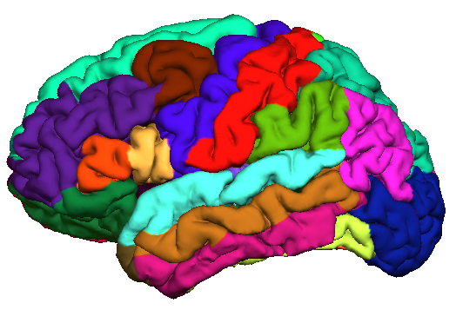
freesurfer.net
Working with FreeSurfer Regions-of-Interest (ROIs)

Slide 2
Outline
Subcortical Segmentation
Cortical Parcellation
WM Segmentation
Preparation/Analysis of Stats

Slide 3
FreeSurfer ROI Terminology
ROI = Region Of Interest
Volume/Image (Subcortical):
Segmentation
Surface (Cortical):
Parcellation/Annotation/Surface Segmentation
Label file:
Either space

Slide 4
SUBCORTICAL AUTOMATIC SEGMENTATION (aseg)

Slide 5
ROI Volume Study
Lateral Ventricular Volume (left)(Percent of Intracranial Volume)
Healthy
Did NOT convert
Did convert
Probable AD
Fischl, et al, 2002, Neuron

Slide 6
Segmentation
Volume-style format (mgz, nii, nii.gz)
Each voxel has one index (number ID)
All voxels in the brain are labeled
Index List found in color lookup table (LUT)
$FREESUFER_HOME/FreeSurferColorLUT.txt
17 Left-Hippocampus 220 216 20 0
Index = 17
Name = Left-Hippocampus
Red=220, Green=216, Blue=20 (out of 255)
alpha = 0 (not really used)
aseg.mgz, aparc+aseg.mgz, wmparc.mgz

Slide 7
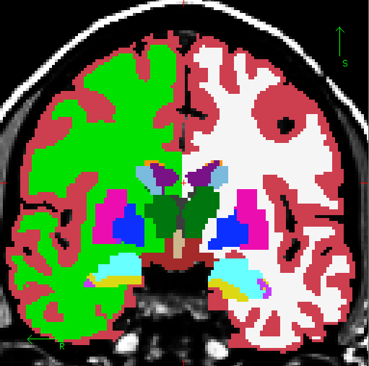
Subcortical Segmentation (aseg)
Cortex (not used)
White Matter
Lateral Ventricle
Not Shown:
Nucleus Accumbens
Cerebellum
Thalamus
Caudate
Putamen
subject
Pallidum
Amygdala
mri
Hippocampus
aseg.mgz
Whole Brain Segmentation: Automated Labeling of Neuroanatomical Structures in the Human Brain, Fischl et al. (2002). Neuron, 33:341-355.

Slide 8
Volumetric Segmentation Atlas Description
39 Subjects
14 Male, 25 Female
Ages 18-87
Young (18-22): 10
Mid (40-60): 10
Old Healthy (69+): 8
Old Alzheimer's (68+): 11
Siemens 1.5T Vision (Wash U)
Whole Brain Segmentation: Automated Labeling of Neuroanatomical Structures in the Human Brain, Fischl et al. (2002). Neuron, 33:341-355.

Slide 9
FreeSurfer Stats Outputs
SUBJECTS_DIR
subject1
subject2
subject3 …
mri
label
stats
aseg.stats – subcortical volumetric stats
created by mri_segstats

Slide 10
aseg.stats
Index SegId NVoxels Volume_mm3 StructName Mean StdDev Min Max Range
1 4 5855 5855.0 Left-Lateral-Ventricle 37.7920 10.9705 20.0000 88.0000 68.0000
2 5 245 245.0 Left-Inf-Lat-Vent 56.4091 9.5906 26.0000 79.0000 53.0000
3 7 16357 16357.0 Left-Cerebellum-White-Matter 91.2850 4.8989 49.0000 106.0000 57.0000
4 8 60367 60367.0 Left-Cerebellum-Cortex 76.3620 9.5724 26.0000 135.0000 109.0000
5 10 7460 7460.0 Left-Thalamus-Proper 91.3778 7.4668 43.0000 108.0000 65.0000
6 11 3133 3133.0 Left-Caudate 78.5801 8.2886 42.0000 107.0000 65.0000
7 12 5521 5521.0 Left-Putamen 86.9680 5.5752 66.0000 106.0000 40.0000
8 13 1816 1816.0 Left-Pallidum 97.7162 3.4302 79.0000 106.0000 27.0000
9 14 852 852.0 3rd-Ventricle 41.9007 11.8230 22.0000 69.0000 47.0000
10 15 1820 1820.0 4th-Ventricle 39.7053 10.6407 20.0000 76.0000 56.0000
11 16 25647 25647.0 Brain-Stem 85.2103 8.2819 38.0000 106.0000 68.0000
12 17 4467 4467.0 Left-Hippocampus 77.6346 7.5845 45.0000 107.0000 62.0000
13 18 1668 1668.0 Left-Amygdala 74.5104 5.8320 50.0000 94.0000 44.0000
14 24 1595 1595.0 CSF 52.1348 11.6113 29.0000 87.0000 58.0000
Index: nth Segmentation in stats file
SegId: index into lookup table
NVoxels: number of Voxels in segmentation
StructName: name of structure from LUT
Mean/StdDev/Min/Max/Range: intensity across ROI

Slide 11
Global Measures: Cortical, Gray, White, ESTIMATED Intracranial Volumes
Also in aseg.stats header:
# Measure BrainSeg, BrainSegVol, Brain Segmentation Volume, 978725.000000, mm^3
# Measure BrainSegNotVent, BrainSegVolNotVent, Brain Segmentation Volume Without Ventricles, 962148.000000, mm^3
# Measure lhCortex, lhCortexVol, Left hemisphere cortical gray matter volume, 195545.545231, mm^3
# Measure rhCortex, rhCortexVol, Right hemisphere cortical gray matter volume, 196859.412666, mm^3
# Measure Cortex, CortexVol, Total cortical gray matter volume, 392404.957896, mm^3
# Measure lhCerebralWhiteMatter, lhCerebralWhiteMatterVol, Left hemisphere cerebral white matter volume, 188889.518286, mm^3
# Measure rhCerebralWhiteMatter, rhCerebralWhiteMatterVol, Right hemisphere cerebral white matter volume, 191500.066881, mm^3
# Measure CerebralWhiteMatter, CerebralWhiteMatterVol, Total cerebral white matter volume, 380389.585168, mm^3
# Measure SubCortGray, SubCortGrayVol, Subcortical gray matter volume, 51448.000000, mm^3
# Measure TotalGray, TotalGrayVol, Total gray matter volume, 551598.957896, mm^3
# Measure SupraTentorial, SupraTentorialVol, Supratentorial volume, 839850.543064, mm^3
# Measure SupraTentorialNotVent, SupraTentorialVolNotVent, Supratentorial volume, 826297.543064, mm^3
# Measure EstimatedTotalIntraCranialVol, eTIV, Estimated Total Intracranial Volume, 1252184.753229, mm^3
These can be used
In their own right as interesting things to study
To scale ROI volumes to account for, eg, differences in head size
Details:
https://surfer.nmr.mgh.harvard.edu/fswiki/MorphometryStats
http://surfer.nmr.mgh.harvard.edu/fswiki/eTIV

Slide 12
ESTIMATED Intracranial Volume
eTIV – is “ESTIMATED” Total Intracranial Volume
Does NOT determine where the skull is and count voxels inside the skull
Exploits the relationship between the ICV and the linear transform to MNI305 space (the subject/mri/transforms/talairach.xfm)
Changes if the talairach.xfm changes
For more info see “A unified approach for morphometric and functional data analysis in young, old, and demented adults using automated atlas-based head size normalization: reliability and validation against manual measurement of total intracranial volume”. Buckner et al. (2004) NeuroImage 23:724-738.
http://surfer.nmr.mgh.harvard.edu/fswiki/eTIV

Slide 13
CORTICAL AUTOMATIC PARCELLATION (aparc)

Slide 14
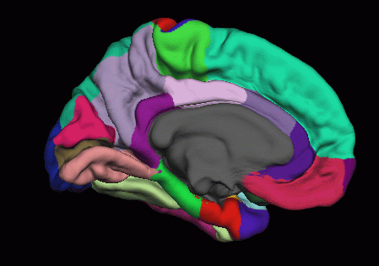
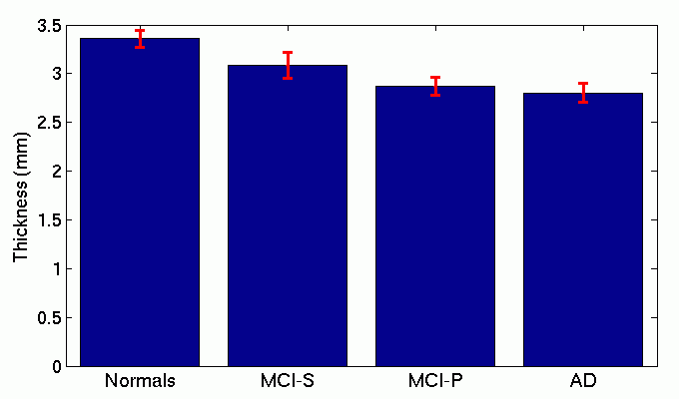
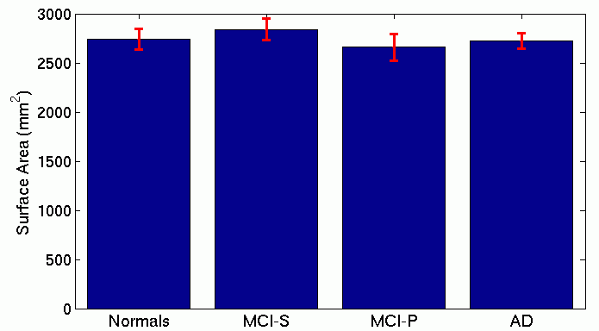
Thickness and Area ROI Studies
Thickness of Entorhinal Cortex
Entorhinal Cortex
Surface Area of MTG
Middle Temporal Gyrus
Gray matter volume also possible

Slide 15
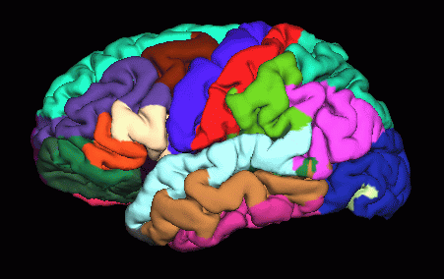
Parcellation/Annotation
Surface ONLY
Annotation format (something.annot)
Each vertex has only one label/index
Index List also found in color lookup table (LUT)
$FREESUFER_HOME/FreeSurferColorLUT.txt
?h.aparc.annot
?h.aparc.a2009.annot

Slide 16
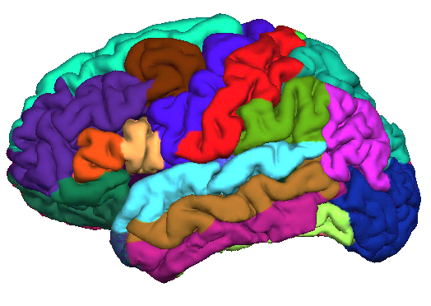
Automatic Surface Parcellation: Desikan/Killiany Atlas (35 ROI’s)
Precentral Gyrus
Postcentral Gyrus
subject
label
lh.aparc.annot
Superior Temporal Gyrus
An automated labeling system for subdividing the human cerebral cortex on MRI scans into gyral based regions of interest, Desikan, R.S., F. Segonne, B. Fischl, B.T. Quinn, B.C. Dickerson, D. Blacker, R.L. Buckner, A.M. Dale, R.P. Maguire, B.T. Hyman, M.S. Albert, and R.J. Killiany, (2006). NeuroImage 31(3):968-80.

Slide 17
Desikan/Killiany Atlas
40 Subjects
14 Male, 26 Female
Ages 18-87
30 Non-demented
10 Demented
Siemens 1.5T Vision (Wash U)
An automated labeling system for subdividing the human cerebral cortex on MRI scans into gyral based regions of interest, Desikan, R.S., F. Segonne, B. Fischl, B.T. Quinn, B.C. Dickerson, D. Blacker, R.L. Buckner, A.M. Dale, R.P. Maguire, B.T. Hyman, M.S. Albert, and R.J. Killiany, (2006). NeuroImage 31(3):968-80.

Slide 18
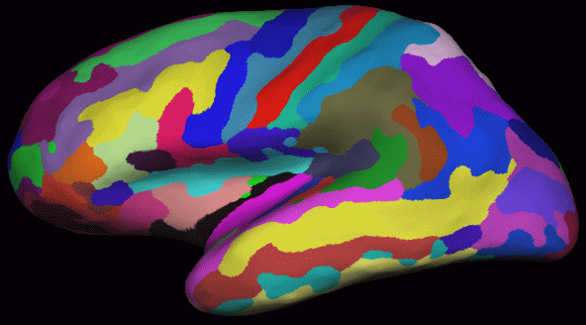
Automatic Surface Parcellation: Destrieux Atlas
58 Parcellation Units
12 Subjects
subject
label
lh.aparc.a2009s.annot
Automatically Parcellating the Human Cerebral Cortex, Fischl, B., A. van der Kouwe, C. Destrieux, E. Halgren, F. Segonne, D. Salat, E. Busa, L. Seidman, J. Goldstein, D. Kennedy, V. Caviness, N. Makris, B. Rosen, and A.M. Dale, (2004). Cerebral Cortex, 14:11-22.

Slide 19
FreeSurfer Stats Outputs
SUBJECTS_DIR
subject1
subject2
subject3 …
mri
label
stats
lh.aparc.stats – left hemi Desikan/Killiany surface stats
rh.aparc.stats – right hemi Desikan/Killiany surface stats
lh.aparc.a2009.stats – left hemi Destrieux
rh.aparc.a2009.stats – right hemi Destrieux
created by mris_anatomical_stats

Slide 20
Parcellation Stats File
StructName NumVert SurfArea GrayVol ThickAvg ThickStd MeanCurv GausCurv FoldInd CurvInd
bankssts 1157 811 1992 2.303 0.567 0.117 0.031 10 1.6
caudalanteriorcingulate 779 543 1908 3.472 0.676 0.185 0.064 26 1.8
caudalmiddlefrontal 3145 2137 5443 2.311 0.593 0.132 0.041 35 5.3
cuneus 1809 1195 2286 1.672 0.411 0.162 0.067 34 4.6
entorhinal 436 265 1269 2.871 0.881 0.119 0.037 5 0.6
fusiform 3307 2126 5161 2.109 0.689 0.144 0.064 71 8.7
inferiorparietal 5184 3514 8343 2.136 0.552 0.146 0.055 82 11.5
inferiortemporal 3746 2610 8752 2.683 0.748 0.178 0.132 140 18.0
StructName: Name of structure/ROI
NumVert: Number of vertices in ROI
SurfArea: Surface area in mm2
GrayVol: Volume of gray matter (surface-based)
ThickAvg/ThickStd: Average and stddev of thickness in ROI
MeanCurv: Mean curvature
GausCurv: Mean Gaussian curvature
FoldInd: Folding index
CurvInd: Curvature index

Slide 21
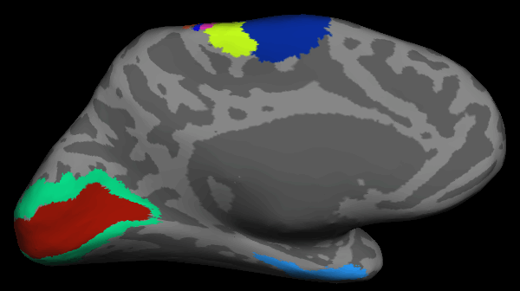
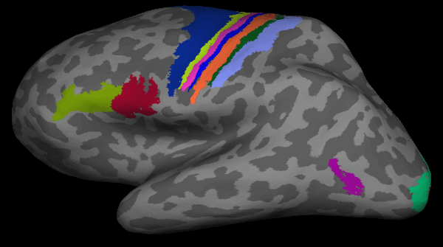
Other ROIs (ex vivo)
Brodmann Areas
6, 4a,4p,3a,3b,1,2
V1, V2
Entorhinal
Brodmann Areas
45,44
MT

Slide 22
Example Label Files
SUBJECTS_DIR
subject1
subject2
subject3 …
mri
label
stats
lh.cortex.label
lh.BA1.label
lh.BA2.label
lh.BA3.label
…

Slide 23
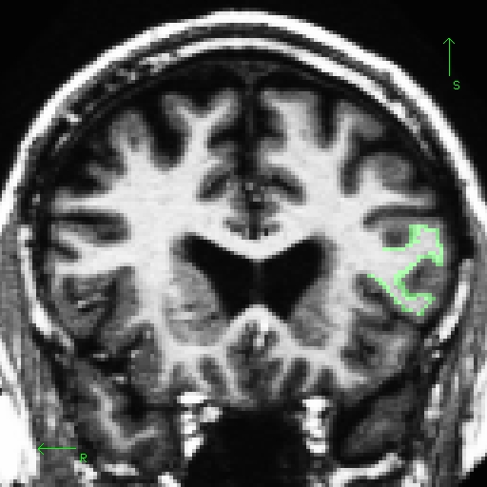
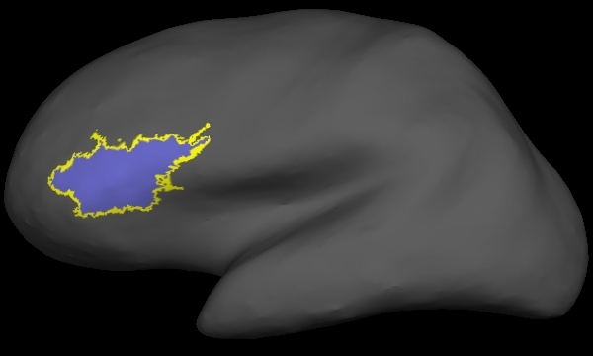
Label File
In Volume
On Surface
Volume: New Label File in Freeview
Surface: Use ‘Select Voxels’ Tool in tkmedit

Slide 24
Creating Label Files
Drawing tools:
tkmedit, freeview
tksurfer
QDEC
Deriving from other data
mri_annotation2label: cortical parcellation broken into units
mri_volcluster: a volume made into a cluster
mri_surfcluster: a surface made into a cluster
mri_vol2label: a volume/segmentation made into a label
mri_label2label: label from one space mapped to another

Slide 25
Merged Cortical + Subcortical
aparc
aparc+aseg.mgz
subject
No new information
For visualization only
mri
aparc+aseg.mgz
aseg.mgz

Slide 26
WHITE MATTER SEGMENTATION (wmparc)

Slide 27
Gyral White Matter Segmentation
+
+
wmparc.mgz
subject
Nearest Cortical Label
to point in White Matter
mri
wmparc.mgz
Salat, et al., Age-associated alterations in cortical gray and white matter signal intensity and gray to white matter contrast. Neuroimage 2009, 48, (1), 21-8.

Slide 28
ANALYSIS of STATS

Slide 29
FreeSurfer Stats Outputs
SUBJECTS_DIR
subject1
subject2
subject3 …
mri
label
stats
aseg.stats – subcortical volumetric stats
wmparc.stats – white matter segmentation volumetric stats
lh.aparc.stats – left hemi Desikan/Killiany surface stats
rh.aparc.stats – right hemi Desikan/Killiany surface stats
lh.aparc.a2009.stats – left hemi Destrieux
rh.aparc.a2009.stats – right Destrieux

Slide 30
Extract table of subcortical volumes of all structures for all subjects
asegstats2table
--subjects 001 002 003 004 005
--meas volume
--stats aseg.stats
--tablefile aseg.table.txt
Applies to wmparc.stats too:
(--stats wmparc.stats)
Output is a simple ASCII text file

Slide 31
Extract table of average thickness of all cortical structures for all subjects
aparcstats2table
--subjects 001 002 003
--hemi lh
--meas thickness
--parc aparc
--tablefile aparc_lh_thickness_table.txt
Desikan/Killiany Atlas: --parc aparc
Destrieux Atlas: --parc aparc.a2009s

Slide 32
Extract table of surface area of all cortical structures for all subjects
aparcstats2table
--subjects 001 002 003
--hemi lh
--meas area
--parc=aparc
--tablefile aparc_lh_area_table.txt

Slide 33
Extract table of GM volume of cortical structures for all subjects
aparcstats2table
--subjects 001 002 003
--hemi lh
--meas volume
--parc=aparc
--tablefile aparc_lh_volume_table.txt
Note that the volume of cortical ROIs is extracted with aparcstats2table whereas the volume of subcortical structures is extracted with asegstats2table.

Slide 34
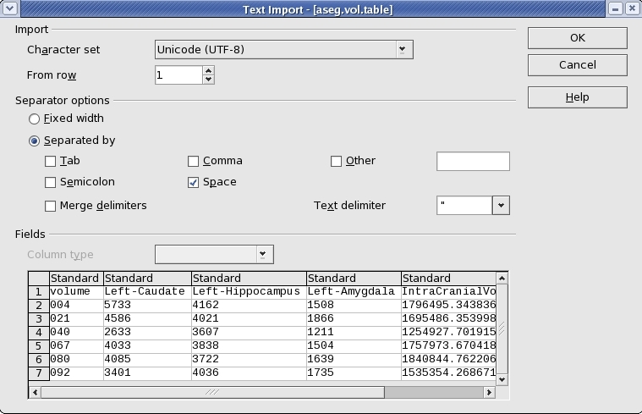
Importing Table Files
SPSS, oocalc, matlab, R
Choose: Delimited by spaces

Slide 35
GLM Analysis on Stats Files
mri_glmfit (used for image-based group analysis)
Use “--table table.txt” instead of “--y” to specify the input
Eg, “mri_glmfit --table aparc_lh_vol_stats.txt …”
The rest of the command-line is the same as you would use for a group study (e.g., FSGD file and contrasts).
Output is text file sig.table.dat that lists the significances (-log10(p)) for each ROI and contrast.

Slide 36
Summary
ROIs are individualized
Subcortical and WM ROIs (Volume)
Surface ROIs (Volume, Area, Thickness)
http://freesurfer.net/fswiki/MorphometryStats
Segmentation vs. Annotation vs. Label File
Extract to table (asegstats2table, aparcstats2table)
Now we can do Multimodal Applications

Slide 37
Tutorial
Load and Inspect:
aparc+aseg.mgz
aparc.annot
FreeSurferColorLUT.txt
Map label files
View Individual Stats Files
Group Table
Create
Load into spreadsheet

Slide 38
End of Presentation

