Slide 1

WELCOME FREESURFER
COURSE ATTENDEES!
Notes:
Good morning everyone and welcome to the FreeSurfer course
Thank you for attending this optional talk so early in the morning,

Slide 2
Introduction to Unix for FreeSurfer Users
Navigating directories
Listing directory contents
Creating new directories and text files
Copying and moving files
Setting up environment variables specific to FreeSurfer
Notes:
*This talk is intended to be a very basic introduction to the Unix Operating System, for those of you who haven’t used it before or are new to using it.
*A basic understanding on unix is necessary for using freesurfer
*We’ll cover some basic commands that will enable you to interact more confidently with FreeSurfer through the rest of the course
*At some point during the talk, I will encourage you to open up your own terminals on the laptops in front of you to try the commands along with me
*If you have any issues doing this, there will be someone walking around the room who can come over, or if it’s a general question you can ask me.

Slide 3
What is Unix/Linux?
An operating system (like Windows and OS X)
Linux is the free, modifiable, and redistributable version of Unix
Why use it?
  Power to write many scripts with many commands to work with lots of data
  To use computer resources on the network efficiently, such as clusters
Notes:
Use the term Linux interchangeably with Unix sometimes.
Why use it?
power to write many scripts with many commands to work with lots of data
The data that comes off the scanner is lots of data – hundreds of slices per subject and within each slice hundreds to thousands of voxels.
- It speeds up data processing,
- and enables processing large batches of data simultaneously either by implementing a script that you’ve written or by passing your command to computational resources available to you such as network clusters

Slide 4
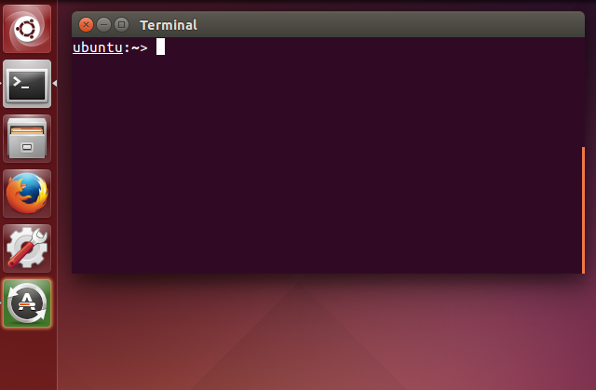
Getting Started
Communicate with operating system through a “shell” or terminal window.
For course-provided Linux computers:
Double click Terminal icon
on Desktop
For Macs:
Applications > Utilities > XQuartz (double click)
Applications > Utilities > Terminal
Notes:
*Instead of using a graphical user interface such as the one you would find on a windows operating system or the way most people probably use their macs, Communicate with operating system through a “shell” or terminal window.

Slide 5
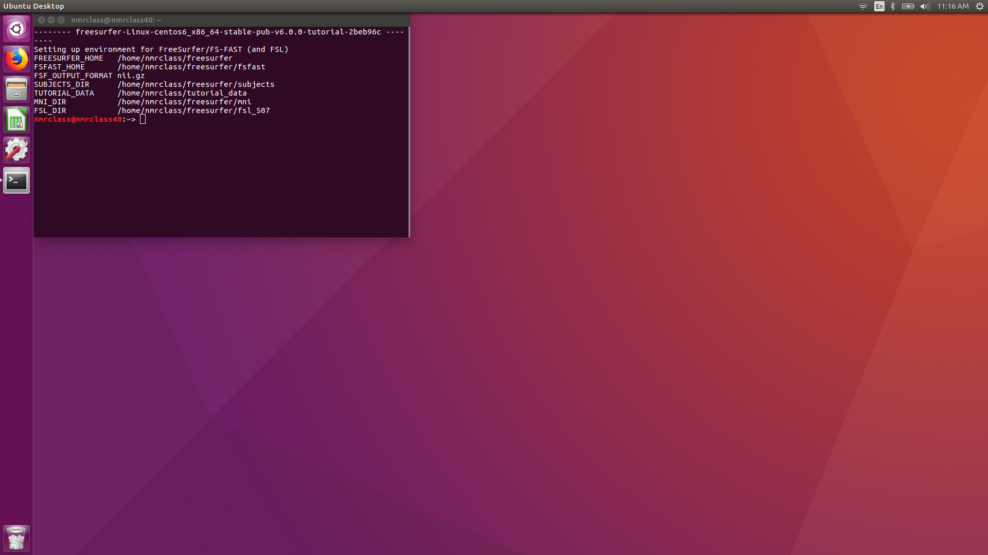
Linux Desktop
Notes:
so this is what your screen should look like, your terminals are probably empty for now but we’ll start working with them in a minute

Slide 6
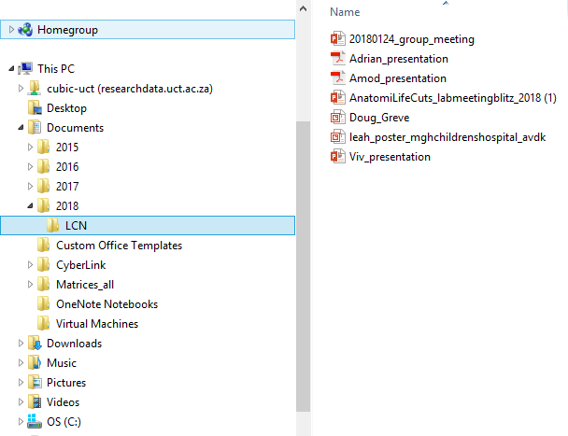
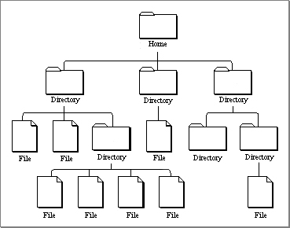
Directories
Unix uses a hierarchical file system (think folders in Windows)
Notes:
So again if you think of a windows user interface, you need to double click on each folder level before you can get to a file that you’re trying to open.
However with your terminal you have access to all directory locations and levels at once on the command line.
- Easier for accessing data and performing actions on the data

Slide 7
Directories
Home is like “My Computer”
Ex. “My Documents”
Ex. “My Photos”
picture.jpg
Notes:
Home is like My Computer

Slide 8
Anatomy of a Command
command -option1 –option2 file
command --help
Notes:
Whenever you want to perform an action or open an application, there will be a relevant command that you need to type. You'll grow familiar with these commands as you practice more.
So in your command line, you would type a command and any additional options using a flag (-) before your selection
-this format is true for Unix and FreeSurfer commands
If you know a command but can't remember the available options, you can always run the command followed by - - help. This will output information on the command such as what the command does and any available flags.

Slide 9
Try it yourself
Type the following command and hit enter!
pwd
You can also run this command for more information on “pwd”
pwd --help
Notes:
Now let's try an example. In your terminal type the command "pwd", you can also run "pwd --help" for more information on this command.

Slide 10
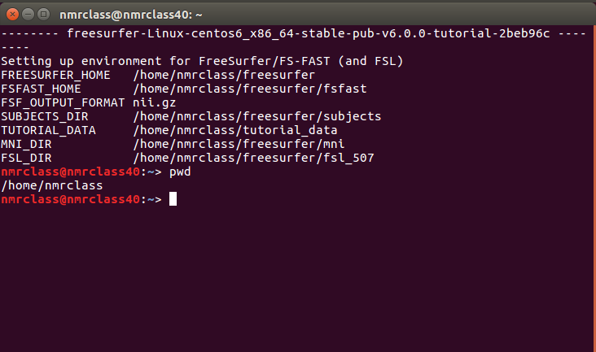
Determining Your Location
The ”pwd” command stands for present working directory
The output is your current location as a path
Your output should be either:
/home/nmrclass
/Users/YourName
Notes:
The command pwd prints the path of your current working directory. It’s basically like a trail of breadcrumbs from the root or home directory to where you are now. Same as the address bar that you would get in windows
-notice there are no spaces in between the names. Unix does not like spaces so please avoid them
-the path shows, at the end, the current directory you are in and all the directories you need to go through to get to it.

Slide 11
Navigating Directories
Now you can practice changing directories, type:
ls
Which stands for “list”
To move into another folder, use the command:
cd <directory name>
Which stands for “change directory”
Notes:
For navigating directories, it's important to know what files and directories are in your current working directory. To determine this, you can list the files using the command "ls"
To move into one of these listed directories, you can type "cd" and the directory name which just means to change the directory.

Slide 12
Navigating Directories
To list the files within your current working directory, type:
cd /home/nmrclass
Then type this:
ls
If your present working directory is this
Typing ls will print these names to your terminal
Notes:
Lets try this by first changing into the /home/nmrclass directory, and then running “ls” to the files. The arrows point to an example of where you are in the directory structure.

Slide 13
Directory Contents
The “ls” command has several flag options to display different information about the contents of the directory.
ls
Lists names of files and directories
ls -a
ls -l
ls -lrt
Notes:
The ls command has different options for flags which you can see by typing “ls --help”
ls just by itself lists the names of the files within the current directory

Slide 14
Directory Contents
The “ls” command has several flag options to display different information about the contents of the directory.
ls
Lists names of files and directories
Also lists any hidden files (ex. .alias, .bashrc, .cshrc)
ls -a
ls -l
ls -lrt
Notes:
-a “list –all”
Hidden files have a dot in front of them, environment set up files
user preferences, specify custom shortcut commands that you want or set it up to source FreeSurfer automatically for you , this is a little more advanced than I’ll go into now but someone can explain how you can do this later on in the course if you’re using your won laptop

Slide 15
Directory Contents
The “ls” command has several flag options to display different information about the contents of the directory.
ls
Lists names of files and directories
Also lists any hidden files (ex. .alias, .bashrc, .cshrc)
ls -a
ls -l
Lists file/directory details
ls -lrt
d{rwx}{rwx}{---} # owner group
User
Group
Others
Notes:
“list the long version” so it tells you information on the date created, who created the file, the size and the file permissions
File permission are contained in the first few letters so
d stands for directory
and then the next three letters apply to the user/owner of the file so in this example the user has read, write and execute permissions on the file which is like all access,
the next three spaces apply to group permissions and then the last three spaces are for all others.
if a permission does not apply to the user, a dash would be in the space in place of the letters

Slide 16
Directory Contents
The “ls” command has several flag options to display different information about the contents of the directory.
ls
Lists names of files and directories
Also lists any hidden files (ex. .alias, .bashrc, .cshrc)
ls -a
ls -l
Lists file/directory details
ls -lrt
Lists the most recent files last
Notes:
r could mean recursive or reverse, most recent files last

Slide 17
Save Some Time
Filename Completion:
Type:
And then hit tab. You should see the rest of the word “Desktop” appear, now hit enter.
History:
You can use the ⬆ key to scroll through previously submitted commands
ls Des
Notes:
Unix has some helpful time saving features such as file name completion by using the tab button. You can start by typing out a command and the first part of a file name or directory name and then press tab to complete the rest of the name.
In addition, pressing the up arrow key allows you to scroll through previously used commands which can also help save time.

Slide 18
Changing Directories
You can create a new directory using the command:
mkdir <new directory name>
Try this by making a new directory named “Practice”
mkdir Practice
Now when you run ls you should see Practice listed.
You can now change directories to get to practice by running:
cd Practice
Try running pwd,this should return /home/nmrclass/Practice
Now run ls, nothing should output since the directory “Practice” is empty
Notes:
The mkdir command creates new directories. Try this by making a directory called practice. After creating the directory, run the ls command and you should see your new directory. Now try to “cd’ into the directory and run “pwd’, you’ll see the new path for your present working directory. Finally run “ls” and you should notice that nothing is returned since the practice directory is empty.

Slide 19
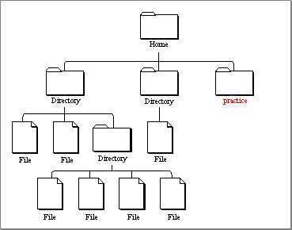
Changing Directories
Notes:
So if we were in the home directory, the practice directory in the circle is what we just created.

Slide 20
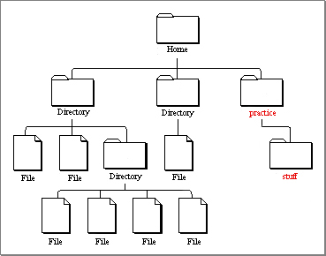
Try it Yourself!
mkdir stuff
Makes the folder “stuff” inside Practice
ls
You should now see the folder “stuff”
Notes:
Now within the Practice directory, create another directory named stuff. The directory hierarchy shows where this new directory is being created.

Slide 21
Using Dots
You can also use dots to quickly list files and move to different directories.
ls ..
Lists the files/directories one level up
ls ../..
Lists the files/directories two levels up
Two levels up
One level up
You are here
You can also use this trick when changing directories using the command cd
Notes:
Another time saver is using full stops to indicate directory level so a single dot ‘.’ represents the current directory level therefore ”ls .” is equivalent to ls in that it specifies the command to list contents of the current directory level.
“ls ..” lists the contents of one directory up
Ls ../.. Lists the contents of two directories up

Slide 22
Using an Editor
To open a text editor, start with the following command:
gedit mynotes.txt
If using Linux
emacs mynotes.txt
If using Mac
Now, you may type whatever you’d like, for example type “I could write a script”
File -> Save
Close gedit or ctrl + q
If using Linux
Ctrl + x and Ctrl + s (to save)
Ctrl + z (to exit)
If using Mac
When you type ls you should now see your file.
Notes:
You can write a text file or open up a simple text editor
In linux type gedit mynotes.txt and this will open gedit and name a blank text file mynotes.txt.
Now type something like “I could write a script” in the text editor.
Save that, - file save in gedit or on a mac ctrl-x and ctrl + s
close gedit or ctrl+x and ctrl-c on a max to close and return to terminal
Then type ls and you should see a new file there called mynotes.txt

Slide 23
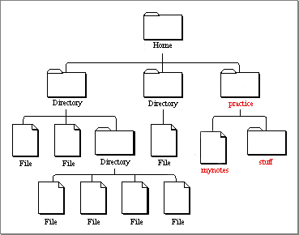
Using an Editor

Slide 24
Viewing file contents
You can quickly view the contents of a file using one of the following commands:
less mynotes.txt
more mynotes.txt
To exit viewing the file using less, type:
q
Notes:
View the contents of your new file by running either the more or less command and you should see whatever your typed into gedit.

Slide 25
Copying files
You can copy a file to a new location using the command:
cp
cp --help
Now, try it with the ”mynotes.txt” file you created!
cp mynotes.txt stuff
File to move
New location
Notes:
Copy command - type help and read through the different options
Copy mynotes.txt that we just created into stuff subdirectory

Slide 26
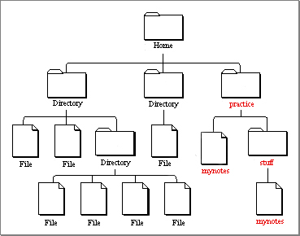
Copying files
You can check that the file moved by running:
cd stuff
ls
more mynotes.txt
Notes:
To just that the copy of mynotes is in the stuff subdirectory, cd into stuff and list the files.
To read the contents of a file without opening it in a text editor, you can use the more or less commands to print it to the terminal window.

Slide 27
Copying / Moving files
To move a file to a new location, use the command:
mv
mv --help
Try using this command by first creating a copy of mynotes.txt
cp mynotes.txt myothernotes.txt
mv myothernotes.txt notes.txt
Rename the file
mv notes.txt ..
Move the file one level up
Notes:
mv is like cut and paste, you can use it to move a file completely between directories or you’ll also use it to rename a file

Slide 28
Removing Files
To delete a file, use the command:
rm
Use the command with caution!
Now, let’s remove the mynotes.txt file in the Stuff directory:
pwd
You should be in the Stuff directory
ls
You should see the mynotes.txt file
rm mynotes.txt
Remove the mynotes.txt file
ls
You should no longer see the mynotes.txt file
Notes:
if you type ls, you should see mynotes.txt
so now to delete it, type rm mynotes.txt
type ls again and it should be gone now.
A note of caution, the same feature that makes the unix command line so powerful is also dangerous when it comes to deleting items.
When you delete something it’s gone forever; no trash.
Also, there are no features to double check that you want to remove a file before it's removed.

Slide 29
Removing Files

Slide 30
Things to know
Case sensitive – Ls vs ls
Does not use spaces in file names (e.g. filename.txt vs. file name.txt)
Ctrl+c kills a process & brings back command prompt
Highlight & middle click to copy & paste
Use ‘&’ to open a program in the background
When typing commands on a Mac, Ctrl+a goes to the start of the command line, Ctrl+e goes to end, and Ctrl + u clears the command line.
Notes:
Ls or Cd will return an error
Does NOT like spaces in file names. you’ll remember that the path is a string of words with forwards slashes to indicate directories and spaces tend to mess the path names up
Ctrl+a on mac goes to home; ctrl+e goes to end
Option + left right arrows jumps to spaces

Slide 31
Using FreeSurfer
When using FreeSurfer, certain variable must be set in order to use it.
FREESURFER_HOME
Tells the operating system where FreeSurfer is located
SUBJECTS_DIR
Tells FreeSurfer where the data is located
Notes:
-for the tutorials today, FREESURFER_HOME will already be set for you. But when you go home and use FreeSurfer on your own machine, you will need to make sure you have these variables set before you can begin working with FreeSurfer.
-during the course SUBJECTS_DIR will change often, so pay attention to instructions at top of tutorial and change it accordingly

Slide 32
Required Variables
To set these variables, the following commands are required:
export FREESUFER_HOME=/home/apps/freesurfer
This command tells the operating system where FreeSurfer is located
source $FREESURFER_HOME/SetUpFreeSurfer.csh
Sourcing this script gets your computer ready to use FreeSurfer
export SUBJECTS_DIR=/path/to/data
This command tells FreeSurfer where your data is located
Notes:
-use ‘export’ for bash shells – standard terminal language for linux and macs
Can set up .profile or .cshrc (if you’re using a c shell) to always run these commands for you for every terminal window opened
For this course, these three commands are run every time you open a new terminal window.

Slide 33
Required Variables
You may also see these commands written with setenv instead of export
setenv FREESUFER_HOME=/home/apps/freesurfer
source $FREESURFER_HOME/SetUpFreeSurfer.csh
setenv SUBJECTS_DIR=/path/to/data
Notes:
-Set up environment or initialize freesurfer (see setenv a lot)

Slide 34
Required Variables
You can go to the location of your data with the command:
cd $SUBJECTS_DIR
The $ means take the value of the variable
You can see what the path of SUBJECTS_DIR is with the command:
echo $SUBJECTS_DIR
echo can work with any variable using the structure:
echo $<Variable name>
Try this with $FREESURFER_HOME
Notes:
once youve set up your subject directory, you can then use this command to navigate into this directory without having to type out the full path.
-cd SUJBECTS_DIR is shortcut to cd /path/to/data
-in tutorial will often have to cd $SUBJECTS_DIR

Slide 35
More Help
Homework packet
CoursePrep on wiki has helpful links
http://surfer.nmr.mgh.harvard.edu/fswiki/FsTutorial/CommandLineNavigation

