Slide 1
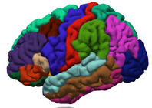
WELCOME FREESURFER
COURSE ATTENDEES!
Notes:
Good morning everyone and welcome to the FreeSurfer course
Thank you for attending this optional talk so early in the morning,

Slide 2
Introduction to Unix for FreeSurfer Users
changing directories
copying files
listing file contents
Setting up environment variables specific to FreeSurfer
Notes:
*This talk is intended to be a very basic introduction to the Unix Operating System, for those of you who haven’t used it before or are new to using it.
*We’ll cover some basic commands that will enable you to interact more confidently with FreeSurfer through the rest of the course
-covers only basics: cd, copying files; no scripting
-basic understanding of unix necessary to use FreeSurfer
-not comprehensive, just to get you through course
*At some point during the talk, I will encourage you to open up your own terminals on the laptops in front of you to try the commands along with me
*If you have any issues doing this, there will be someone walking around the room who can come over, or if it’s a general question you can ask me.

Slide 3
What is Unix/Linux?
An operating system (like Windows and OS X)
Linux is the free, modifiable, and redistributable version of Unix
Why use it?
  power to write many scripts with many commands to work with lots of data
  to use computer resources on the network efficiently, such as clusters
Notes:
Use the term Linux interchangeably with Unix sometimes.
Why use it?
power to write many scripts with many commands to work with lots of data
The data that comes off the scanner is lots of data – hundreds of slices per subject and within each slice hundreds to thousands of voxels.
- It speeds up data processing,
- and enables processing large batches of data simultaneously either by implementing a script that you’ve written or by passing your command to computational resources available to you such as network clusters

Slide 4
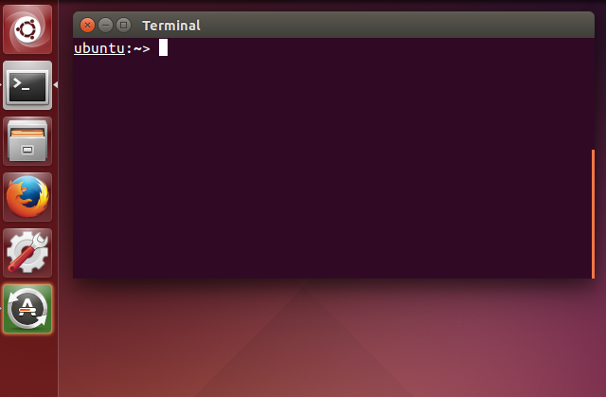
Getting Started
Communicate with operating system through a “shell” or terminal window.
For course-provided Linux computers:
Double click Terminal icon
on Desktop
For Macs:
Applications > Utilities > XQuartz (double click)
Applications > Utilities > Terminal
Notes:
*Instead of using a graphical user interface such as the one you would find on a windows operating system or the way most people probably use their macs, Communicate with operating system through a “shell” or terminal window.
*so for example in windowas to run an application you would click on the relevant icon and the app launches. Or if you wanted to copy or delete a file, you would click on a folder icon and select your action from a drop down menu.
On a unix platform, we launch apps and copy files through commands we type into the command line.
So you could find the terminal icon on your desktop of the course laptops or your mac and click here to launch the terminal.
And where your cursor is, is the start of the command line.
OLD
compare to Windows GUI → hit Start and see icons of programs to choose from. Similar to DOS.
-to run programs, must type a command for what you want to do on the command line.

Slide 5
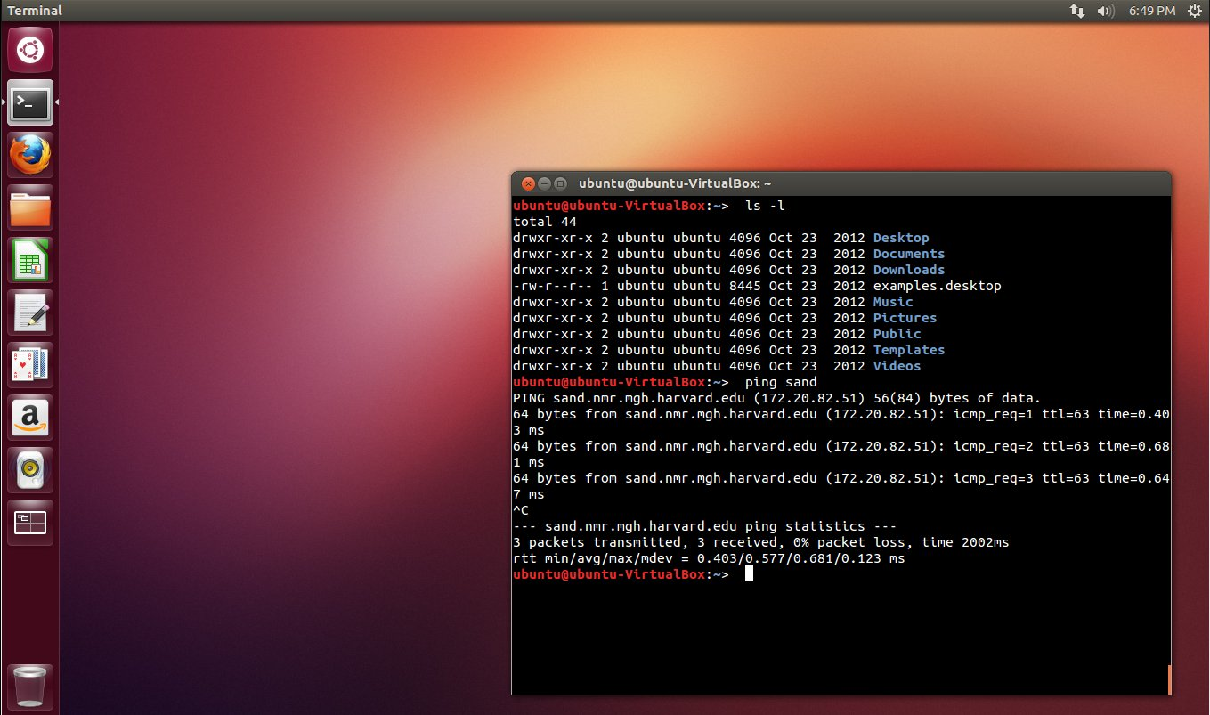
Linux Desktop
Most course laptops are set up with the Ubuntu Linux distribution
Notes:
so this is what your screen should look like, your terminals are probably empty for now but we’ll start working with them in a minute

Slide 6
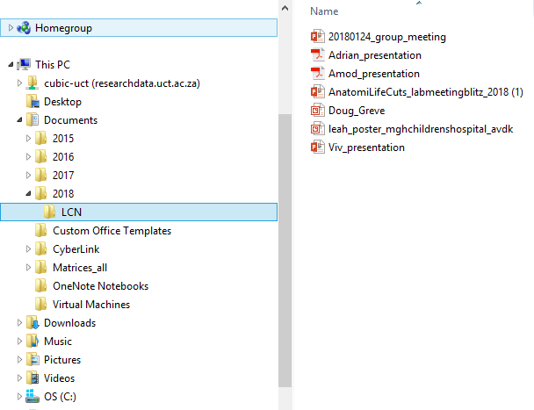
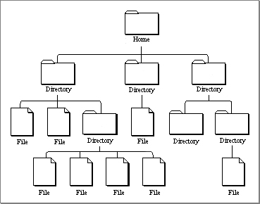
Directories
Unix uses a hierarchical file system
(think folders in Windows)
Notes:
So again if you think of a windows user interface, you need to double click on each folder level before you can get to a file that you’re trying to open, like passing through multiple doors to get to the fridge.
With your terminal though, you have access to all directory locations and levels at once on the command line so this makes accessing and performing actions on data comparatively much more efficient.

Slide 7
Directories
Unix uses a hierarchical file system
(think folders in Windows)
Home is like “My Computer”
Notes:
Home is like My Computer

Slide 8
Directories
Unix uses a hierarchical file system
(think folders in Windows)
Home is like “My Computer”
Like “My Documents”

Slide 9
Directories
Unix uses a hierarchical file system
(think folders in Windows)
Home is like “My Computer”
Like “ Documents”
Like “My Photos”
Notes:
*add a screen shot here for the windows terminal

Slide 10
Directories
Unix uses a hierarchical file system
(think folders in Windows)
Home is like “My Computer”
Like “My Documents”
Like “My Photos”
picture.jpg

Slide 11
Anatomy of a Command
command -option1 –option2 file
command - -help
Notes:
So for whichever action you want to perform or application you want to open, there will be a relevant command that you need to type. You’ll grow familiar with those commands as you practice more.
So in your command line, you would type a command and then that command may offer you options which you can select using a flag (-) before your selection
-option often called flag
-this format is true for Unix and FreeSurfer commands
-two dashes before the word “help”
If you know a command but can’t remember which order to make your selections in, you can always type the command name followed by –help in the command window for a sort of menu telling you about the command, what it does, what input it requires and the different flag options that you can type in

Slide 12
Anatomy of a Command
command -option1 –option2 file
command - -help
Try:
pwd - - help
Notes:
So we’ll try one now, in your terminal window type pwd -- help on the command line and then hit enter
So it tells you a little about the command, ls is used to list the contents of whichever directory you specify or the current directory that you’re in if nothing has been specified
-two dashes before help
-argument could be a file or volume

Slide 13
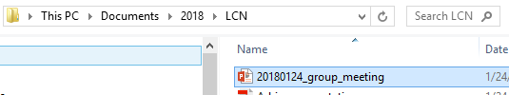
Location
/home/nmrclass
Type:
and hit enter. Should see
shows “present working directory” or current location as a path
OR
pwd
/Users/YourName
Notes:
Next try the command pwd which prints the path of your current working directory. It’s basically like a trail of breadcrumbs from the root or home directory to where you are now. Same as the address bar that you would get in windows
-notice there are no spaces in between the names. Unix does not like spaces so please avoid them
-the path shows, at the end, the current directory you are in and all the directories you need to go through to get to it.

Slide 14
Navigating Directories
“list”: see contents of directory
“change directory”: move into a folder
Type: pwd
Type: cd /home/nmrclass/
ls
cd <directory_name>
If your present working directory is this
Typing ls will print these names to your terminal
Notes:
Type ls to show directories in current folder
Type cd and then let’s type documents
Type pwd to see new path, ls again and then enter to show the contents of your current directory.
Type cd /home/nmrclass/ (home/leah for you), pwd

Slide 15
Directory Contents
List contents of directory you are in
  lists names of directories/files
ls
ls -a
ls -l
ls -lrt
Notes:
The ls command has different options for flags which you’ll remember from when we typed ls –help.
ls just by itself lists the names of the files within the current directory

Slide 16
Directory Contents
List contents of directory you are in
  lists names of directories/files
  lists hidden files too
ls
ls -a
ls -l
ls -lrt
.cshrc
.bashrc
.alias
Notes:
-a “list –all”
Hidden files have a dot in front of them, environment set up files
user preferences, specify custom shortcut commands that you want or set it up to source FreeSurfer automatically for you , this is a little more advanced than I’ll go into now but someone can explain how you can do this later on in the course if you’re using your won laptop

Slide 17
Directory Contents
List contents of directory you are in
  lists names of directories/files
  lists hidden files too
  lists file details
d{rwx}{rwx}{---} # owner group
ls
ls -a
ls -l
ls -lrt
user group others
Notes:
“list the long version” so it tells you information on the date created, who created the file, the size and the file permissions
File permissiong are contained in the first few letters so
d stands for directory
and then the next three letters apply to the user/owner of the file so in this example the user has read, write and execute permissions on the file which is like all access,
the next three spaces apply to group permissions and then the last three spaces are for all others.
if a permission does not apply to the user, a dash would be in the space in place of the letters,
OLD
-ownership of file as well as date it was created and size

Slide 18
Directory Contents
List contents of directory you are in
  lists names of directories/files
  lists hidden files too
  lists file details
  lists recent files last
ls
ls -a
ls -l
ls -lrt
Notes:
r could mean recursive or reverse, most recent files last

Slide 19
Save Some Time
Filename Completion
Type
hit Tab key and you should see hit enter
**Without changing directories, you can list what is under the directory Desktop
History
hit key and you should see
ls Des
ls Desktop
ls Desktop
history
Notes:
SLIDE
this is a good example actually of when I said you have access to many levels at once because here you can list the contents of the desktop without having to move into that folder, without having to go through that door, its like having x-ray vision into the fridge without having to go through the kitchen.

Slide 20
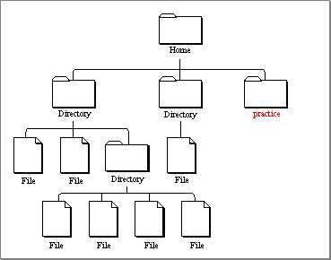
Changing Directories
mkdir practice
makes a new directory “practice”
changes to directory “practice”
ls -lrt
pwd
/home/nmrclass
should see
cd practice
pwd
should see
/home/nmrclass/practice
ls
should see
Nothing – Folder is empty
Notes:
Always do ls and pwd afterwards to see what changed.

Slide 21
Changing Directories

Slide 22
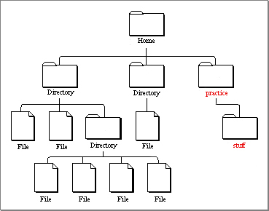
Changing Directories
mkdir stuff
makes folder “stuff” inside practice
ls
should see “stuff”

Slide 23
Using Dots …
shows one directory up
ls ..
can also do (but don’t right now):
cd ..
cd ../..
ls ../..
goes up two!
pwd
should see
/home/nmrclass/practice/
Notes:
Another time saver is using full stops to indicate directory level so a single dot ‘.’ represents the current directory level therefore ”ls .” is equivalent to ls in that it specifies the command to list contents of the current directory level.
“ls ..” lists the contents of one directory up
Ls ../.. Lists the contents of two directories up

Slide 24
Using an Editor
If using Linux type: | If using a Mac type:
Type: “I could write a script”
File > Save Close gedit Or Ctrl+q to quit Type | Ctrl+x (save) and Ctrl+c (exit) should see “mynotes.txt”
gedit mynotes.txt
emacs mynotes.txt
ls
Notes:
You can write a text file or open up a simple text editor
In linux type gedit mynotes.txt and this will open gedit and name a blank text file mynotes.txt.
type i could write a script
Save that, - file save in gedit or on a mac ctrl-x
close gedit or ctrl-c on a max to close and return to terminal
Then type ls and you should see a new file there called mynotes.txt

Slide 25
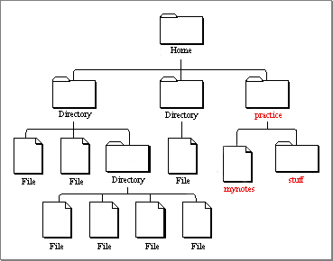
Using an Editor

Slide 26
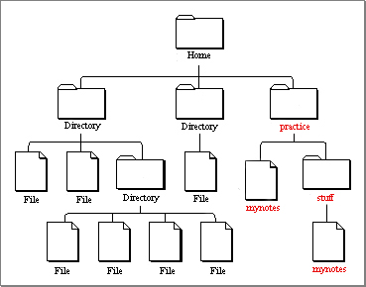
Copying files
cp
is the copy command
cp --help
cp mynotes.txt stuff
cd stuff
ls
more mynotes.txt
Notes:
Copy command - type help and read through the different options
Copy mynotes.txt that we just created into stuff subdirectory
Cd stuff and you should see it there now too
To read the contents of a file without opening it in a text editor, you can use the more or less commands to print it to the terminal window.

Slide 27
Copying files
cp
is the copy command
cp --help
cp mynotes.txt stuff
cd stuff
ls
less mynotes.txt
Notes:
“less” is similar to more, however it lets you scroll up and down pages. Must enter ‘q’ to get out of less command.

Slide 28
Copying / Moving files
cp mynotes.txt myothernotes.txt
mv myothernotes.txt hernotes.txt
Could also use dots:
mv hernotes.txt ..
Notes:
mv is like cut and paste, you can use it to move a file completely between directories or you’ll also use it to rename a file

Slide 29
Removing Files
pwd
should be in “stuff”
ls
rm mynotes.txt
ls
Notes:
should be in pwd directory and if you type ls, you should see mynotes.txt
so now to delete it, type rm mynotes.txt
type ls again and it should be done now.
A note of caution, the same feature that makes the unix command line so powerful is also dangerous when it comes to deleting items.
When you delete something it’s gone forever; no trash can and often here is no are you sure step before deleting something so it’s good practice to get used to making copies of your original data before moving it around and working with it.

Slide 30
Things to know
Case sensitive – Ls vs ls
Does not like spaces in file names
  (e.g. filename.txt vs. file name.txt – use file_name.txt
Ctrl+c kills a process & brings back command prompt
Type ‘q’ to quit the program ‘less’
Highlight & middle click to copy & paste
Use ‘&’ to open a program in the background
Ctrl+a on mac goes to home; ctrl+e goes to end
Ctrl+u clears the command line
Notes:
Ls or Cd will return an error
Does NOT like spaces in file names. you’ll remember that the path is a string of words with forwards slashes to indicate directories and spaces tend to mess the path names up
-keep hitting up arrow key to see other commands you typed in the past
Ctrl+a on mac goes to home; ctrl+e goes to end
Option + left right arrows jumps to spaces

Slide 31
Using FreeSurfer
With FreeSurfer, certain variables must be set in order to use it correctly:
FREESURFER_HOME
SUBJECTS_DIR
tell Operating System where FreeSurfer is
tell FreeSurfer where data is
Notes:
-for the tutorials today, FREESURFER_HOME will already be set for you. But when you go home and use FreeSurfer on your own machine, you will need to make sure you have these variables set before you can begin working with FreeSurfer.
-during the course SUBJECTS_DIR will change often, so pay attention to instructions at top of tutorial and change it accordingly

Slide 32
Required Variables
To use FreeSurfer you’ll have to do:
export FREESURFER_HOME=/home/apps/freesurfer
tell Operating System where FreeSurfer is
source $FREESURFER_HOME/SetUpFreeSurfer.csh
source this script to get your computer ready to use FreeSurfer (sources other scripts & sets other variables)
export SUBJECTS_DIR=/path/to/data
Notes:
-use ‘export’ for bash shells – standard terminal language for linux and macs
Can set up .profile or .cshrc (if you’re using a c shell) to always run these commands for you for every terminal window opened

Slide 33
Required Variables
To use FreeSurfer you’ll have to do:
setenv FREESURFER_HOME /home/apps/freesurfer
tell Operating System where FreeSurfer is
source $FREESURFER_HOME/SetUpFreeSurfer.csh
source this script to get your computer ready to use FreeSurfer (sources other scripts & sets other variables)
setenv SUBJECTS_DIR /path/to/data
Notes:
-Set up environment or initialize freesurfer (see setenv a lot)

Slide 34
Required Variables
To go to location of your data:
$ means take the value of the variable
cd $SUBJECTS_DIR
Notes:
once youve set up your subject directory, you can then use this command to navigate into this directory without having to type out the full path.
-cd SUJBECTS_DIR is shortcut to cd /path/to/data
-in tutorial will often have to cd $SUBJECTS_DIR

Slide 35
Required Variables
To go to location of your data:
$ means take the value of the variable
cd $SUBJECTS_DIR
aka
cd /path/to/data
How ‘echo’ works
echo $<any_variable>

Slide 36
Required Variables
With FreeSurfer, certain variables must be set in order to use it correctly:
FREESURFER_HOME
SUBJECTS_DIR
tell Operating System where FreeSurfer is
tell FreeSurfer where data is
To check variables
echo $FREESURFER_HOME
echo $SUBJECTS_DIR
Notes:
after doing that, since the freesurfer required variables are already set up for you, you could try echo ...

Slide 37
More Help
http://surfer.nmr.mgh.harvard.edu/fswiki/FsTutorial/CommandLineNavigation
Homework packet
CoursePrep on wiki has helpful links

Slide 38
The End
Good Luck!

