Slide 1
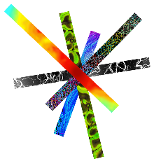
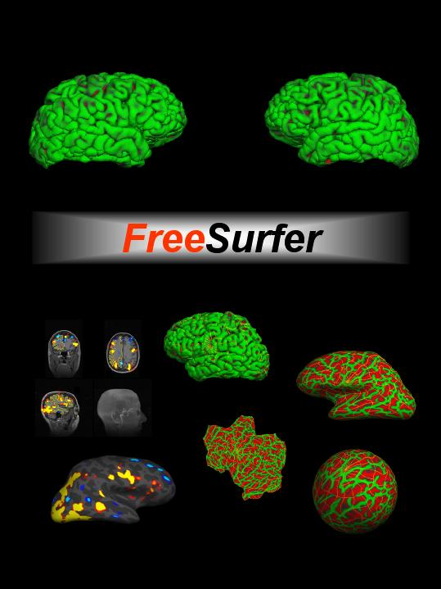





FreeSurfer: Troubleshooting surfer.nmr.mgh.harvard.edu
1
Notes:
Thank you for your attendance throughout the week, this was our first attempt at giving a big online course and we've had limited staff availability so we really appreciate your patience with our team and your support.
My name is Leah Morgan, I organize the FreeSurfer courses here in Boston which we hold twice a year in the spring and fall so if you have any questions about attending the courses, you can send those my way.
This talk is an intro troubleshooting the FS output. Recommed watching youtube video after this to reinforce what you've learned here.

Slide 2
Hard and Soft Failures
Categories of errors: Hard & Soft Failures
Hard = recon-all quits before it finishes
Soft = recon-all finishes but results need modification
(i.e. surface or segmentation inaccuracy)
  -recon-all takes a long time ( 3-20 hours) to run & some part of the process may need modification
  (e.g. cerebellum removed in skull stripping)
2

Slide 3
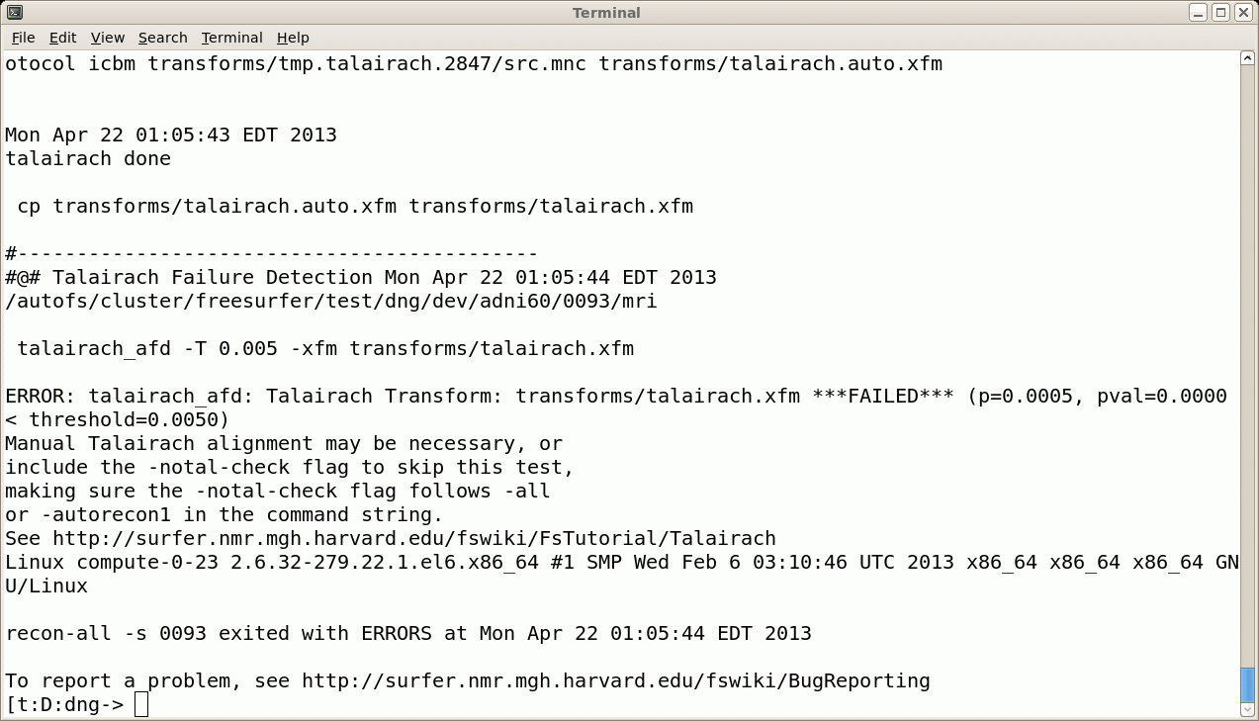
Troubleshooting: Hard Failures
bert
scripts mri surf label stats
recon-all.log
recon-all.error
  Ran out of disk space?
  Ran out of RAM?
  Unix file permissions?
  Pathological conditions (brain, artifact)
Send us recon-all.log freesurfer@nmr.mgh.harvard.edu
3

Slide 4
Hard Failure: What to do
Check recon-all.log for error message
Examine data quality
Rerun step that failed
Verify output from last successful step
Search FreeSurfer mailing list for this problem
Email the mailing list
4

Slide 5
Hard Failure: Help Us Help You!
Report version currently using
  see top of recon-all.log
  cat $FREESURFER_HOME/build-stamp.txt
Operating System/hardware
Exact command-line tried to run
Send recon-all.log
Output from terminal window if appropriate
(Nick even has a command to help – bugr)
5

Slide 6
Troubleshooting: Soft Failures
Some Examples of soft failures:
  Skull Strip Errors
  WM/ASEG Segmentation Errors
  Intensity Normalization Errors
  Pial Surface misplacement
  Topological Defect incorrectly fixed
6

Slide 7
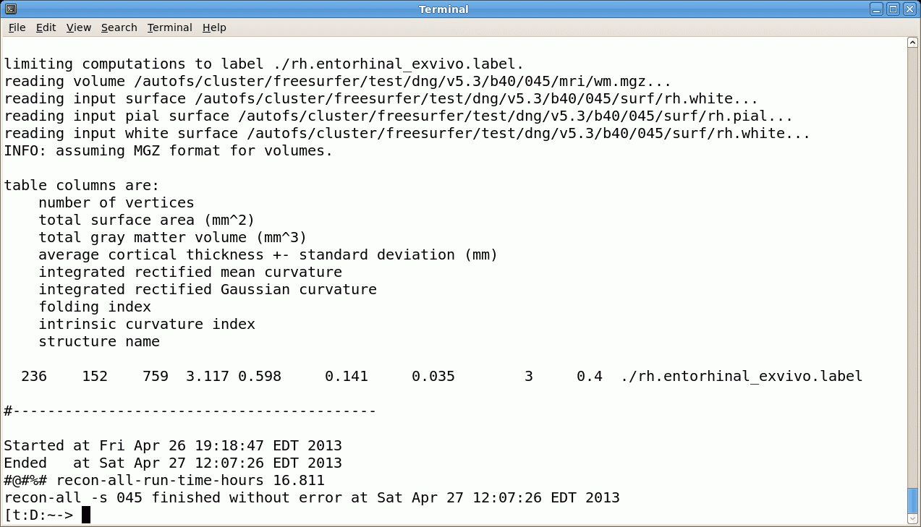
Upon Completion of recon-all…
bert
scripts mri surf label stats
recon-all.log
recon-all.done
Just because it finishes “without error” does not mean that everything is ok!
Could be a “soft” failure.
7
Notes:
All you know is no hard failure

Slide 8
Soft Failures
recon-all finishes but surfaces or aseg not accurate
It is not possible to directly edit the location of a surface.
When the surfaces are inaccurate, you have to (manually) change the information in a volume and regenerate the surface.
8

Slide 9
Check Your Recon for Accuracy
Do your surfaces follow gm/wm borders?
Does the subcortical segmentation follow intensity boundaries?
(editorial note: All morphometry packages make errors. FS allows you to correct these errors. This feature is not available in other packages.)
9
Notes:
To see if a soft failure has occured

Slide 10
Manual Interventions
Erase voxels
Fill voxels
Clone voxels (ie, copy from one volume to another)
Add “Control Points”
Manual interventions should take less than 30min
After manual intervention, re-run parts of recon-all
It is also possible to re-run recon-all with different parameters which is good for systematic or large errors
10
Notes:
scare talk - people feel very uncomfortable when they start. Not always obvious when something is accurate or not. Can be overwhelming, but in reality 30 mins is an over-estimate. 15 mins or so.
Most of the time if you can’t quite decide if it’s accurate or not, leave it alone. Most of the time FS will do the right thing.
Systematic/large errors

Slide 11
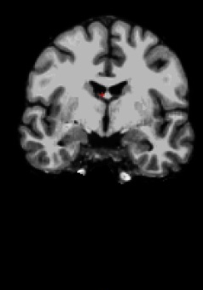
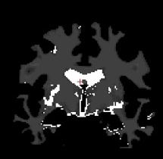
Manual Edits Applied to Volumes not Surfaces
bert
scripts mri surf label stats
 | Erase | Fill | Clone to | Control Points
brainmask | X |  | X | X
wm | X | X
brainmask.mgz
wm.mgz
*Other volumes involved in QA: brain.finalsurfs, norm.mgz, T1.mgz
11

Slide 12
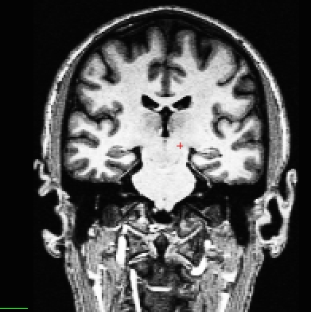
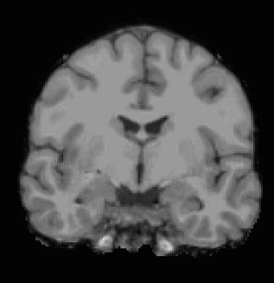
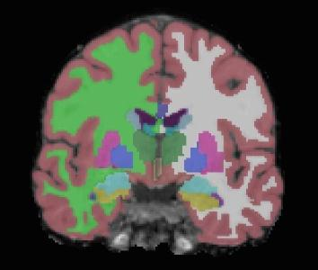
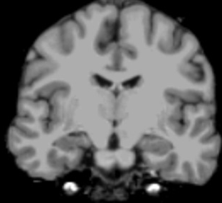
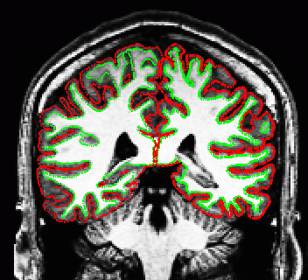
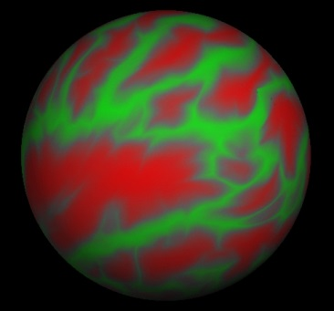
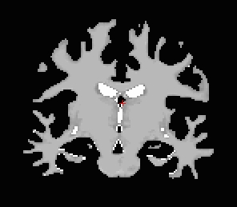
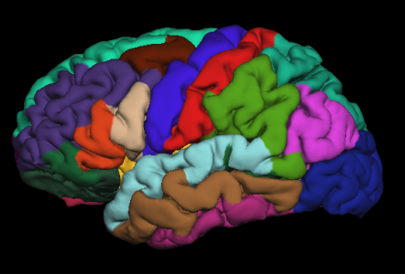
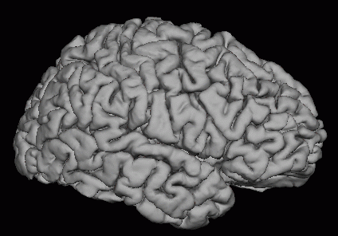
Processing Stream Overview
T1 Weighted
Input
Skull Stripping
Volumetric Labeling
Intensity Normalization
Gyral Labeling
Surface Atlas
Registration
White Matter
Segmentation
Surface Extraction
Stats!
12
Notes:
A reminder about the workflow and when/how the different volumes are generated. Need to think about this timeline when you’re editing volumes and where in the pipeline you choose to run recon-all from after that.

Slide 13
Reconstruction Stages
recon-all is broken into three stages
  autorecon1
  autorecon2
  autorecon3
  these 3 stages are equivalent to -all
13

Slide 14
Processing Stream Overview
T1 Weighted
Input
Skull Stripping
Volumetric Labeling
Intensity Normalization
Adjust skull strip algorithm:
recon-all –autorecon2
Add control points:
recon-all –autorecon2-cp
Gyral Labeling
Surface Atlas
Registration
White Matter
Segmentation
Surface Extraction
Fix pial surf:
recon-all –autorecon3-pial
Fix white surf:
recon-all –autorecon2-wm
Stats!
14

Slide 15
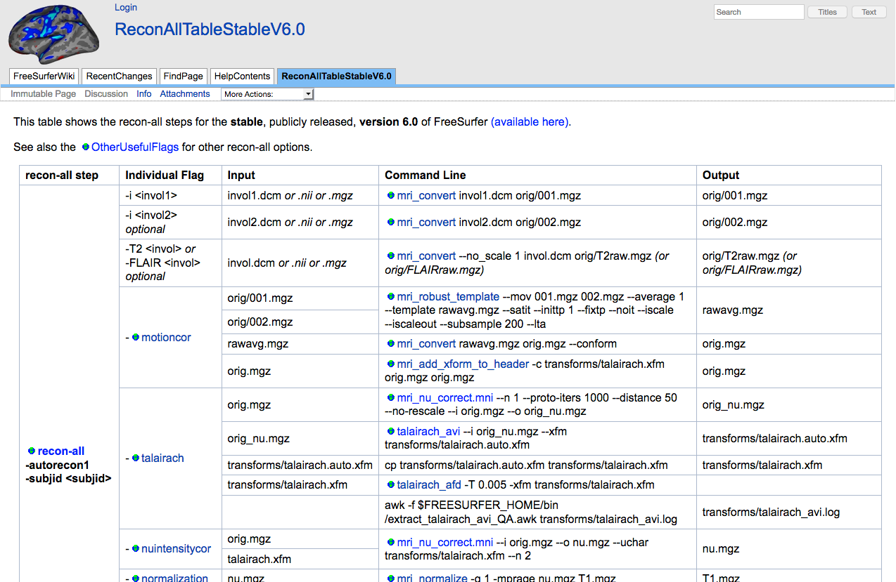
Processing Stream Order
http://surfer.nmr.mgh.harvard.edu/fswiki/ReconAllTableStableV6.0
15

Slide 16
Or Make Life Easier
recon-all -make all -s subjid
16
Notes:
tells reconall to check the timestamps of files created and picks up the processing stream from wherever there’s an out-of-date dependency file.

Slide 17
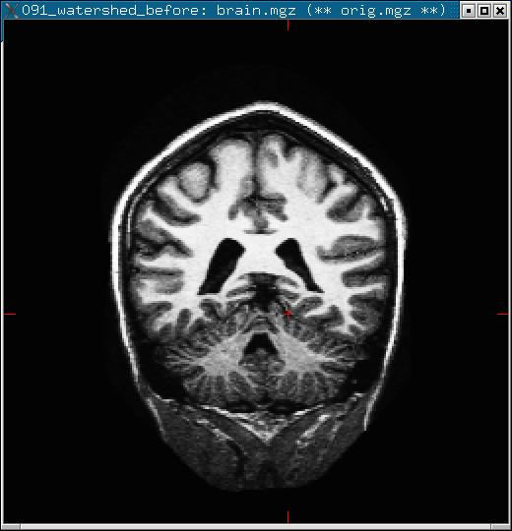
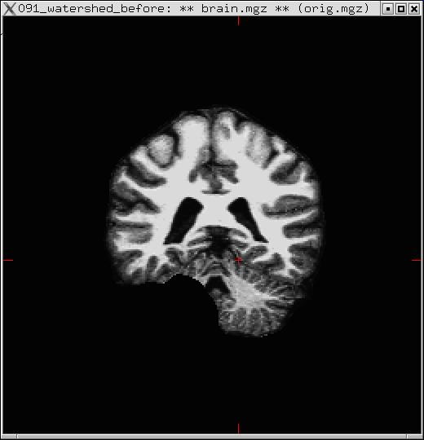
Skull Strip Failure: Too Much Removed
T1.mgz
brainmask.mgz
Use “clone” tool to manually correct, or adjust watershed parameters and run (default wsthresh is 25, higher means strip less):
recon-all -skullstrip -wsthresh 35 -clean-bm -no-wsgcaatlas -s <subj>
recon-all -s <subject> -autorecon2 -autorecon3
17

Slide 18
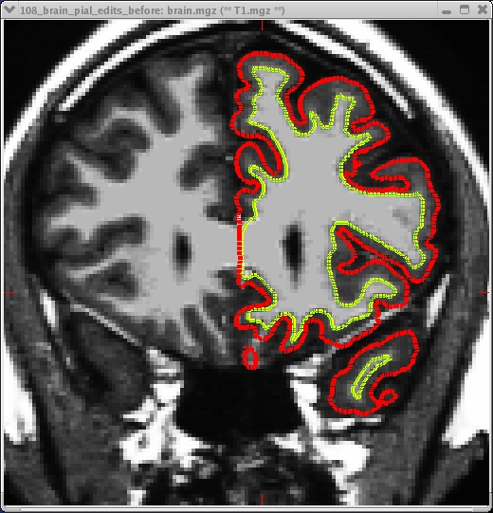
Skull Strip Failure: Not enough Removed
Dura or blood vessel.
the white surface is OK, but
the pial surface is inaccurate
Dura and GM have extremely similar intensity characteristics on most T1-weighted sequences (but different T2*!). Typical fix: edit the brainmask.mgz to erase dura/blood vessels, and run:
recon-all -s <subject> -autorecon3-pial
18

Slide 19
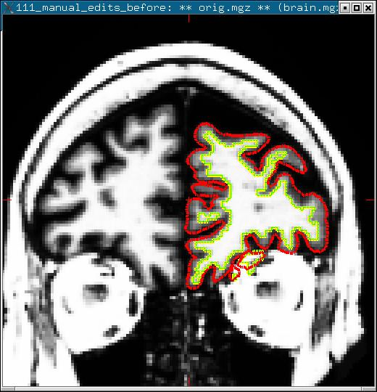
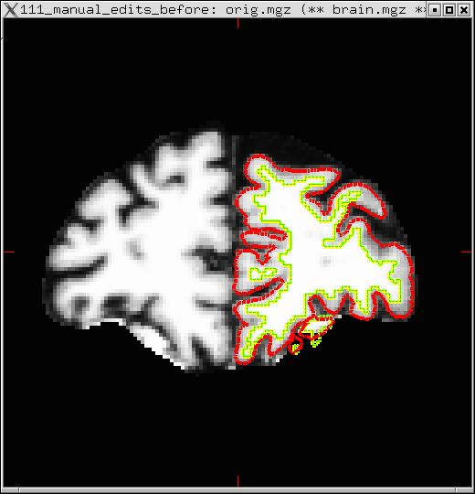
Skull Strip Failure: Not Enough Removed
Eye Socket classified as WM due to Skull Strip Failure.
Erase in wm.mgz then run:
recon-all -s <subject> -autorecon2-wm -autorecon3
19

Slide 20
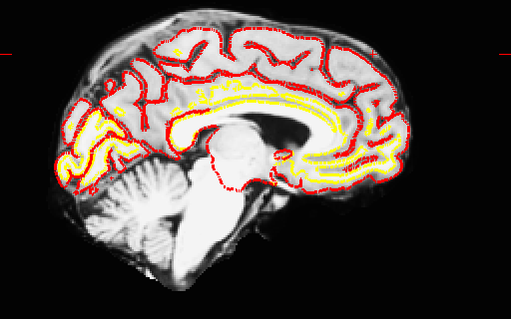
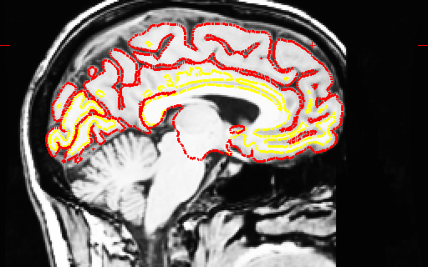
This is NOT a Skull Strip Error
It appears that the skull strip left a lot of dura. It did, but it does not affect the surface, so leave it!
20

Slide 21
Segmentation Errors
White Matter classified as non-White Matter
Gray Matter classified as White Matter
Causes:
  Intensity Normalization Failures
  Partial voluming
21

Slide 22

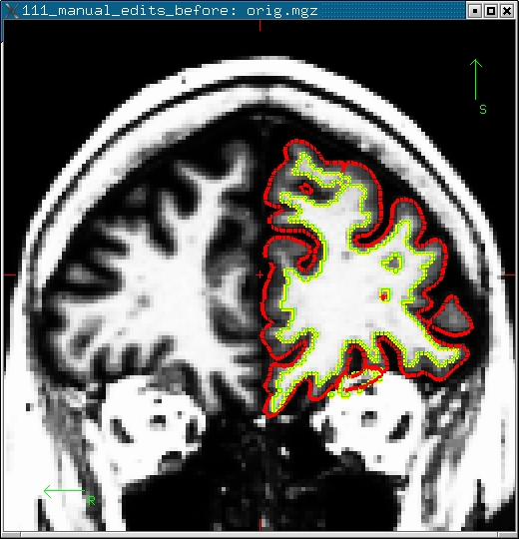
Segmentation Error
wm.mgz
“Hypo-Intensities”
White Matter Lesions
Misclassified as gray matter
Fill in wm.mgz then run:
recon-all -s <subject> -autorecon2-wm -autorecon3
22
Notes:
‘wm’ is really everything inside the cortical surface. not reclassifying wm, suggesting that this should be inside the cortical surface.

Slide 23
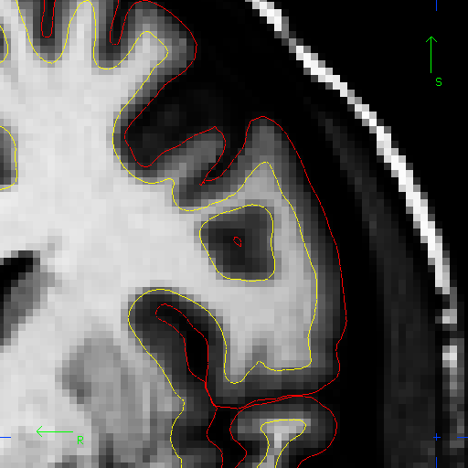
Is this a segmentation error?
Coronal View
23

Slide 24
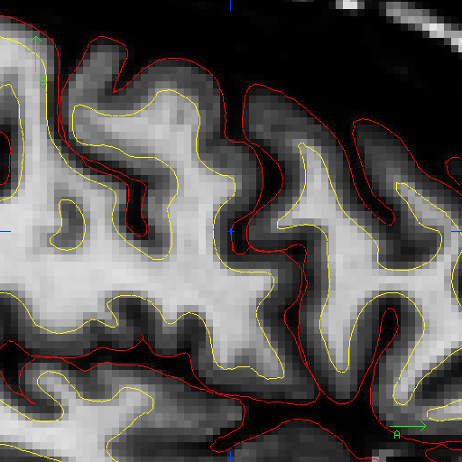
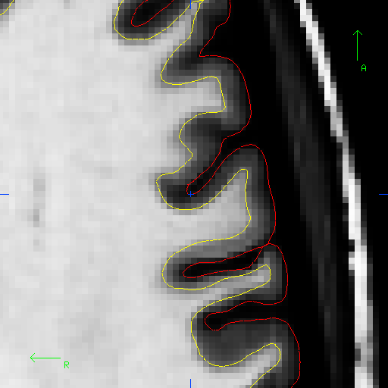
This is NOT an an error.
Sagittal View
Coronal View
Axial View
Make sure to look at all 3 views before deciding!
24
Notes:
two classes so far:
skullstripping errors: too much or not enough removed
wm segmentation errors - wm has been classified as gm or non-wm has been classified as wm.

Slide 25
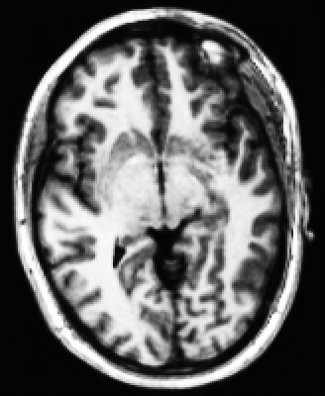
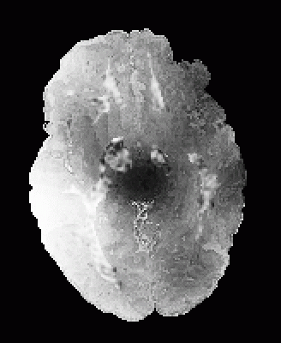
Intensity Bias
One side of the image much brighter than the other side
Worse with many coils
Makes gray/white segmentation difficult
25
Notes:
Talk about this a little bit before we go into the final edit that I'll touch on today - control points

Slide 26
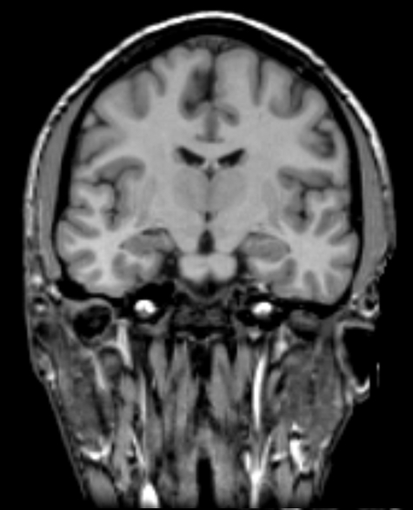
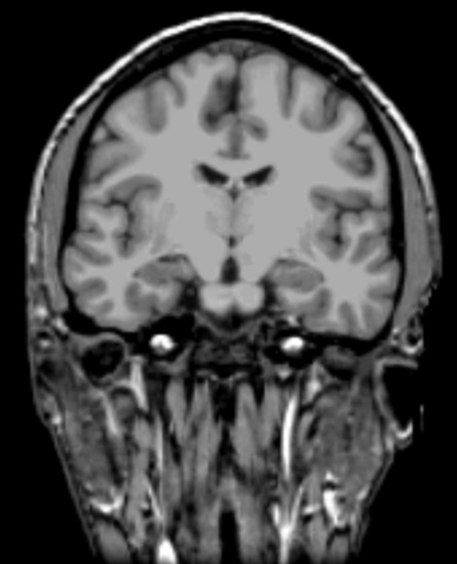
Intensity Normalization
Removes B0 and B1- bias
Most WM = 110 intensity
  Pre- and Post-Skull Strip
bert
mri
orig_nu.mgz
T1.mgz
nu.mgz
norm.mgz
brain.mgz
110.9
93.9
110.0
Before Normalization
After Normalization
26
Notes:
wm in T1, most of it will be around 110 for voxel intensity. If it’s not, could indicate a problem.

Slide 27
Intensity Normalization
Removes B1 bias field
NU (MNI) nu.mgz
Presegmentation (T1.mgz)
  Most WM = 110 intensity
  Pre- and Post-Skull Strip
bert
mri
nu.mgz
T1.mgz
110.9 ±1.8
108.9 ±1.5
110.0 ±0.0
nu.mgz
T1.mgz
27

Slide 28
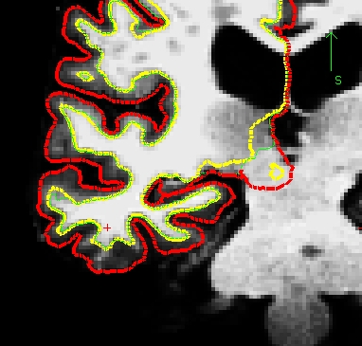
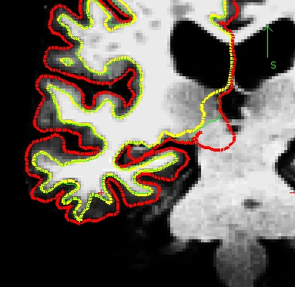
Troubleshooting: Intensity Normalization
+
+
+
Intensity Normalization Failure. Most WM in T1 volume (T1.mgz) should be close to 110. Can fix by editing wm.mgz or adding “Control Points” (+). Beware partial voluming!
recon-all -s <subject> -autorecon2-cp -autorecon3
28
Notes:
Has to find points that it’s absolutely confident are wm to make this estimate so in that sense, this step is a little bit consevative. So some places, especially in temp lobes and thin areas of wm, gyri being cut off.
Fix for this is control points. tells fs intensity normalization that these are definitely wm and you can confidently use these points to help re-evaluate that intensity normalization step.
Two things:
If it’s already 110, make no difference.
Have to put cp in areas you know are definitely wm. No partial-volume voxels, definitely no gm. Can go hugely wrong, can see why this would affect your whole volume. A single cp will affect definately the whole area around the point.

Slide 29
Control Points: Summary
+
+
+
Used to rescale intensity near the control point
Must go in voxels that are fully WM but not 110 !!!
Use sparingly
Can be created viewing any volume
Saved in a separate text file (e.g., bert/tmp/control.dat)
29
Notes:
skullstrip - brainmask
segmentation - wm.mgz
control points are just points in space, not associated with any particular volume and saved as a .dat file. can make over any helpful volume - T1.mgz

Slide 30
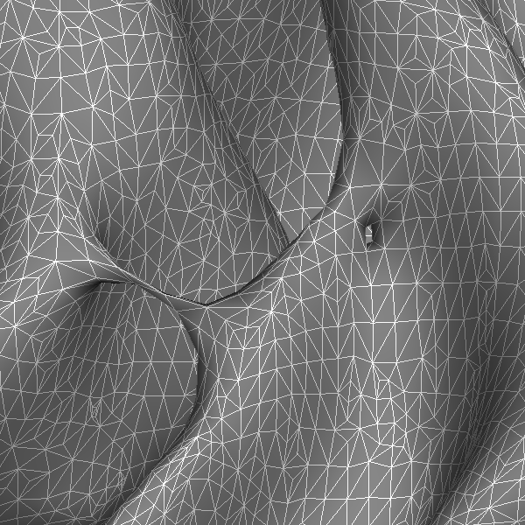
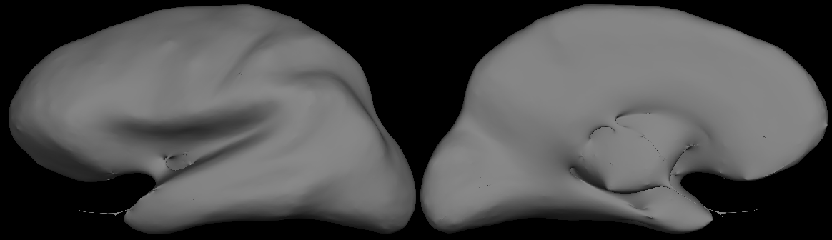
Segmentation Errors: Topological Defects
Fornix
hippocampus
Cortical Defects
Ventricles and Caudate
Pallidum and Putamen
Holes, Handles
Automatically Fixed
Not always fixed correctly
Edit wm.mgz
30
Notes:
complicated
problem is that if you take this and inflate it - not spherical topology

Slide 31
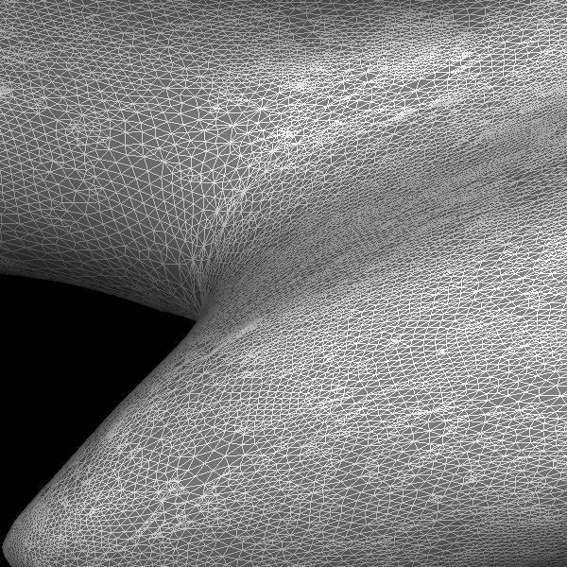
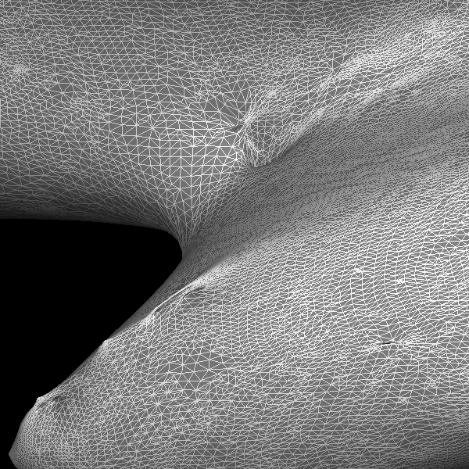
Topology Correction
BEFORE
AFTER
31
Notes:
topological corrections - goes in looks for bridges and holes and re-segments. Usually does a good job, but can occasionally fail.

Slide 32
Segmentation Errors: Topological Defects
Hole: Partial Voluming: WM + GM looks like non-WM, it is segmented as non-WM and creates a hole
Handle: Something bright in a sulcus that gets classified as WM.
Holes: fill voxels in the wm.mgz
Handles: erase voxels in the wm.mgz
wm.mgz
32
Notes:
bridge/handle across a gyrus - gm labelled as wm
hole - wm labelled as gm
Just another type of segmentation error to look out for in your slices.

Slide 33
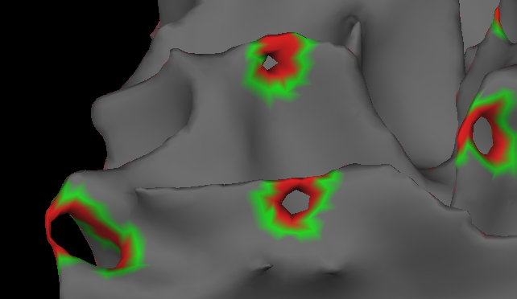
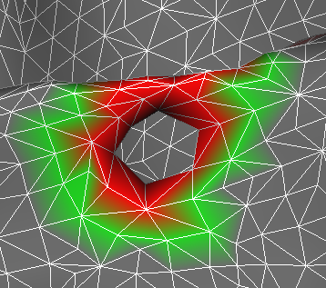
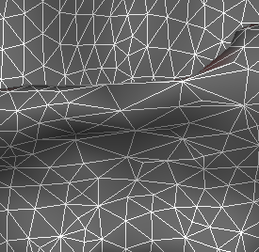
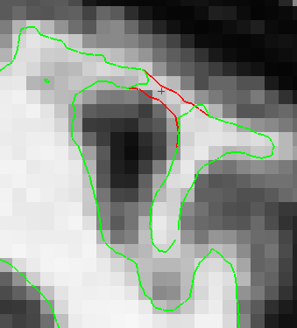
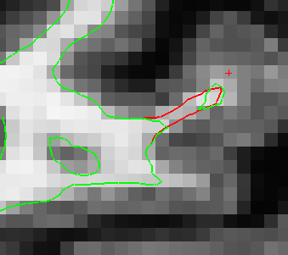
Automatic Defect Correction
Initial cortical surface
Topological defect
Corrected defect
Sagittal view
Coronal view
33

Slide 34
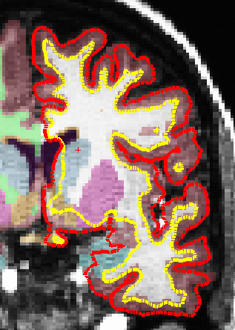
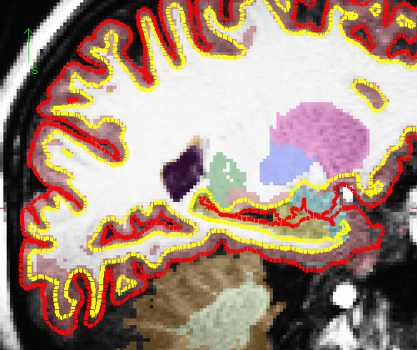
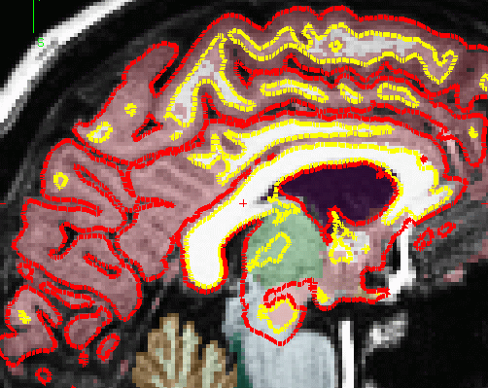
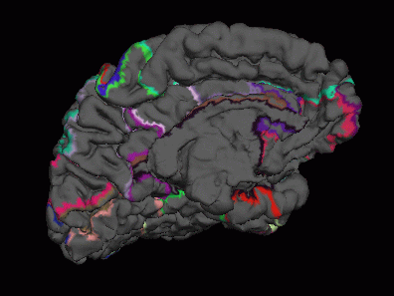
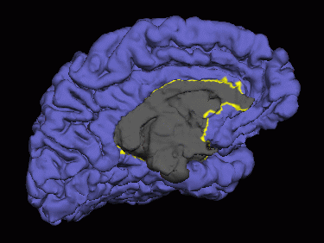
Noncortical Regions: These are not errors
Amygdala, Putamen, Hippocampus, Caudate, Ventricles, CC
?h.cortex.label
34
Notes:
each hemi is it’s own closed surface, analyzed separately. GM structures that cross the hemi midline, are not cortical GM structures and so FS does not try to create accurate surfaces here.

Slide 35
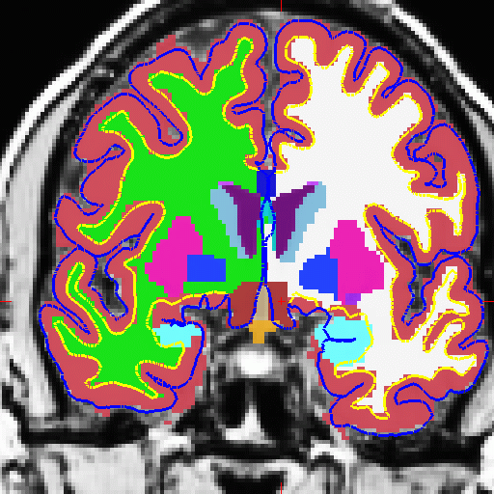
These are NOT errors
It appears that the aseg cortical ribbon is inaccurate. It is, but the aseg cortical ribbon is not used for anything!
Surfaces are not valid in subcortical regions along the medial wall.
It is possible to edit the segmentation.
35
Notes:
cortical gm in the aseg does not match the pial surface. technically an error in automatic volume segmentation but we don’t use the cortical information from the aseg so don’t necessarily need to go in and fix it. Most important is to check that the surfaces are following the boundaries.

Slide 36
How Do You Know What to Edit?
If pial surface includes too much:
  edit brainmask.mgz
If it affects the white surface (too much/little) or If pial surface includes too little:
  edit the wm.mgz (if segmentation error)
  add control points (if normalization error)
36

Slide 37
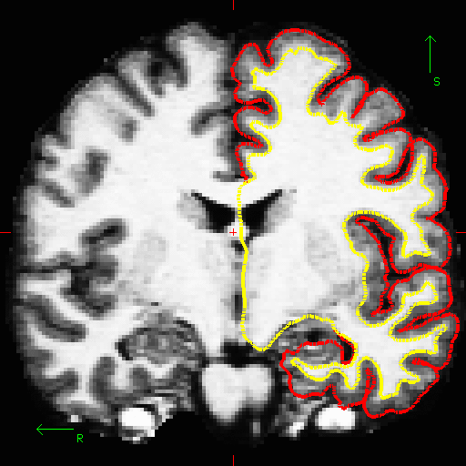
Pial surf grows from white surf
Errors in pial surface placement are typically caused by underlying errors in the white surface placement, and can be corrected by interventions that fix the white surface.
37
Notes:
pial surface grows out from the wm surface so we want to look for ways we can edit the wm volume first.

Slide 38
Which Volumes to Edit & When…
 | Non-gm in pial surf | Non-wm in white surf | wm excluded from surf & intensity = 110 | wm excluded from surf & intensity < 110 | Cerebellum in pial surf
brainmask.mgz | X
brain.finalsurfs.mgz | X |  |  |  | X
wm.mgz |  | X | X
add control points |  |  |  | X
38

Slide 39
Troubleshooting – Common Cases
(≈98% of surface accurate in about 98% of cases for good data [1])
Symptom: white matter not accurate in wm.mgz
Interventions
  add control points (if wm << 110).
  Expert opts to set intensity thresholds in segmentation (almost never).
  Manually erase/draw wm in wm.mgz
Symptom: skull strip not accurate
Interventions
  Adjust mri_watershed parameters or try –gcut
  Manually erase skull/clone T1.mgz to recover brain
Symptom: surfaces are not accurate.
Interventions:
  Add control points (if white matter << 110).
  Erase dura/blood vessels
  Check topology on ?h.inflated.nofix (if ?h.orig surface doesn’t follow wm.mgz)
[1] Salat, D, 2009. Personal Communication.
39

Slide 40
FreeSurfer Remembers!
When edits are made, the changes are saved in a way that indicates manual changes were made (e.g. voxels that are erased are set to 1, not 0, so we can detect them)
Re-running with a new version preserves these changes.
To rerun without edits, use –clean flags or start from scratch
40

Slide 41
Summary
Hard Errors (recon-all.log file)
Soft Errors – surfaces not accurate
Change volumes, regenerate surfaces
  Manual touch ups (erase, fill, clone, control points)
  Volumes: brainmask.mgz, brain.finalsurfs.mgz, wm.mgz
Skull strip: too much, not enough
Segmentation: WM classified as non-WM, or reverse
FreeSurfer keeps track of edits
Look at all 3 views and scroll back and forth a few slices
If you don’t know, leave it alone
Should take less than 30 min (or even 15 min)
41

Slide 42
Troubleshooting – Advice (Bruce)
Always look at the data in multiple views and scroll back and forth a few slices – 3D structure is difficult to discern!
If large regions of white matter are significantly darker than 110 (the target white matter intensity for normalization) then try adding control points, but make sure they are in the interior of the white matter.
If the ?h.orig surface misses white matter that is accurately labeled in the wm.mgz or extends into regions where there is no wm in the wm.mgz, then there is an incorrectly fixed topological defect.
Even one or two missing voxels can cause large-scale defects, so very minor editing (e.g. filling in white matter voxels that are holes, or erasing handles) may fix the problem.
Don’t edit too much! This will reduce reliability and is almost never needed. Usually this means you need to start over as you’ve done something wrong (e.g. put control points in the wrong place).
42

Slide 43
End of Presentation
43

Slide 44
Troubleshooting – Advice (Continued)
FLOW
AMBIGUITY
CONSISTENCY
Edit consistently within and across subjects.
SPEED
You will get faster with time; certain sections go faster.
44

Slide 45
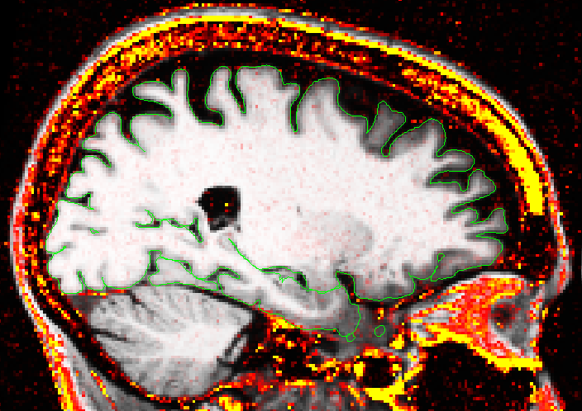
New Morphometry Protocol: Identifying Dura with Multi-echo MP-RAGE
*joint work with Andre van der Kouwe
45

Slide 46

Automatic Defect Correction
Difference between uncorrected (green) and corrected (red)
46

Slide 47

Troubleshooting: Topology Fixer Error
White Matter
“disconnects”
orig.nofix will be
accurate
47

Slide 48
What are the Common Interventions?
Manually edit the wm.mgz to change incorrectly labeled voxels (only for small errors).
Manually edit the brainmask.mgz to erase dura/vasculature.
Adjust watershed parameters or use –gcut to fix large-scale skull-strip errors.
Manually erase/clone regions of skull strip failure.
Control Points – add locations that are in the interior of the white matter and <110 to bring regional wm intensity up.
Use tkregister2 to fix incorrect talairach.xfm
48

