Slide 1
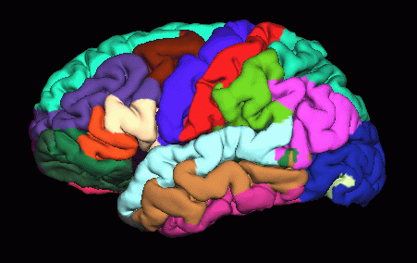
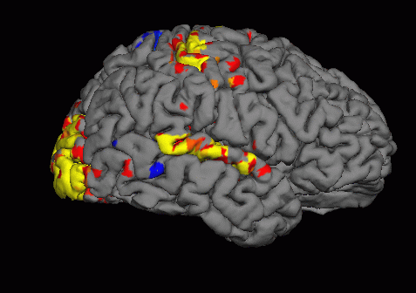
freesurfer.net
Multimodal Integration:
fMRI Surface and ROI Analysis

Slide 2
Outline
Visualize individual fMRI results on
  anatomical volume
  surface sampling and viewing
Surface-based fMRI group analysis
ROI, Intensity Study:
Average HRF inside of an ROI
ROI, Volume Study:
  Count number of voxels above threshold in an anatomical ROI
Notes:
Also important to integrate Afni FSL SPM with freesurfer, and gives foundation to go back and forth between different modalities.

Slide 3
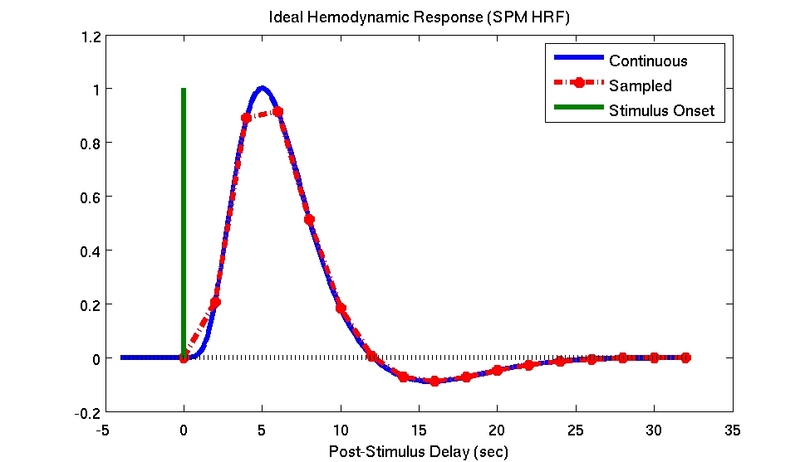
Hemodynamic Response
(BOLD)
Time-to-Peak (~6sec)
Dispersion
TR (~2sec)
Equilibrium
(~16-32sec)
Undershoot
Delay (~1-2sec)
Notes:
We cannot teach fMRI analysis, but this is 3 slides crash course.
Stimulus is represented by the green line, response can be measured after 1-2 seconds. Peak after 6 seconds and returns to baseline (undershoot) and equilibrium 16-32 s.
Amplitude is what we interested in, it is related to the amount of neuron firing.

Slide 4
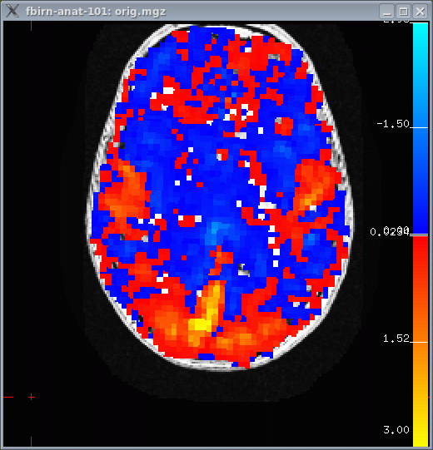
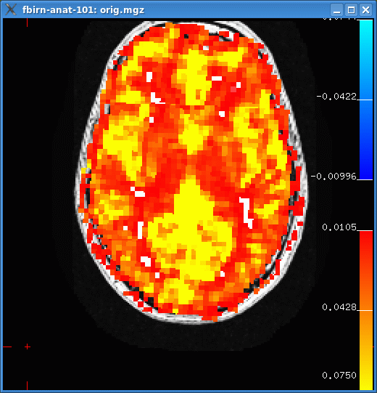
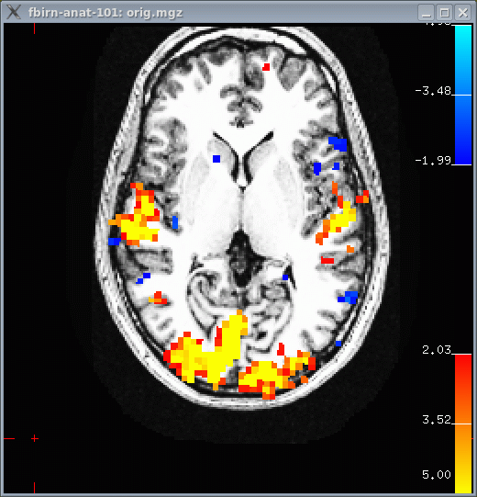
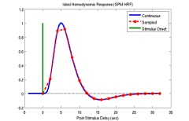
Statistical Parametric Map (SPM)
+3%
0%
-3%
Contrast Amplitude
CON, COPE, CES
Contrast Amplitude
Variance
(Error Bars)
VARCOPE, CESVAR
Significance
t-Map (p,z,F)
(Thresholded p<.01)
sig=-log10(p)
“Massive Univariate Analysis”
-- Analyze each voxel separately
Notes:
So you get Stats. Param map .
First you see signal change 0-3% (multi sensory, tone, flashing board, finger tipping): occipital, auditorial, motor cortex
Some pos, some negative. Variance map in the middle, ratio is the T-Map (threshold at some level).
We can visualize on volume or on surface, compute average response inside ROI, or inside ROI, but only in functional active part.
We can map it onto the surface, then group surface fs-average and do group analysis (same as thickness).

Slide 5
fMRI Preprocessing Overview
Motion Correction (MC Template)
  Use reference/template for registration
  bbregister --mov template.nii --bold --s subject --init-fsl --lta register.lta
  freeview -v template.nii:reg=register.lta -f $SUBJECTS_DIR/subject/surf/?h.white
Do not use nonlinear resampling to Talairach/MNI space. Best work in native space!
Do not spatially smooth (3D) (set fwhm=0 in SPM…) we do not smooth in volume, rather on surface later!
Notes:
If you do SPM or FSL, do not use non-linear template, best to work in native space.
Also do not smooth, so if using SPM or FSL set fwhm to 0. We don’t want to smooth in volume, rather later on the surface.

Slide 6
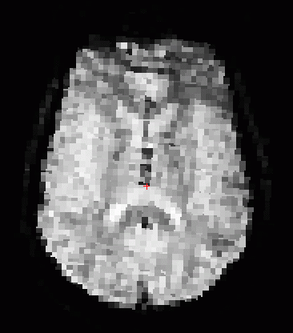
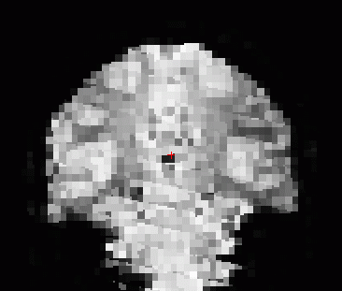
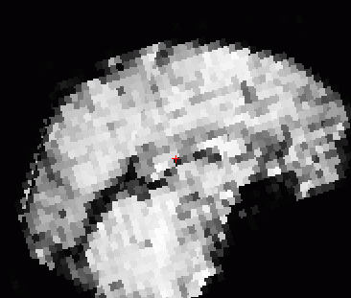
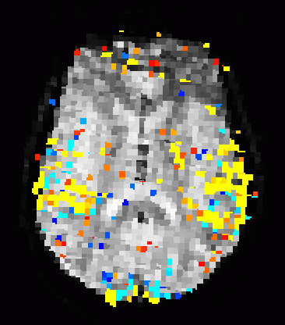
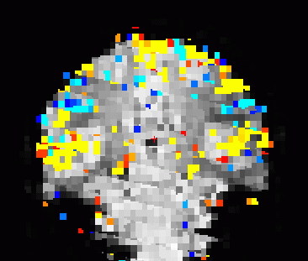
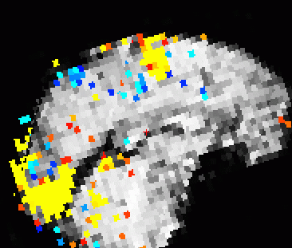
Reference and Parametric Map
Functional
Reference
(bbregister
and MC)
Reference &
Parametric Map
Notes:
Visual, motor and auditory activation

Slide 7
fMRI Parametric Maps
First-Level (Individual) Parametric Maps
  HRF Amplitude (or Contrast of Amplitudes)
    cope (FSL),
    CON (SPM),
    ces (FSFAST)
  Variance of Amplitude
    varcope (FSL), ??? (SPM), cesvar (FSFAST)
  Activation/Significance Maps:
    z, t, F
    sig (-log10(p))
All in alignment with MC Template!!!!
Notes:
SPM, maybe CONVAR for variance.

Slide 8
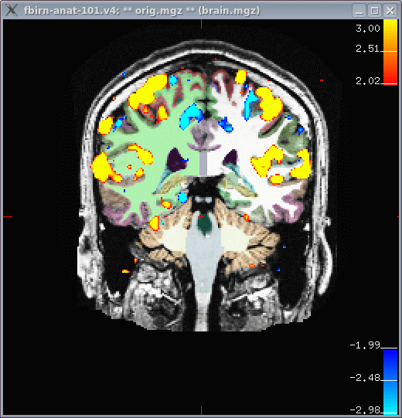
Volume Viewing
freeview -v $SUBJECTS_DIR/fbirn-anat-101.v4/mri/orig.mgz \
$SUBJECTS_DIR/fbirn-anat-101.v4/mri/aparc+aseg.mgz:colormap=lut:opacity=.3 \
sig.nii:colormap=heat:heatscale=2,3.0,4:reg=register.lta
sig.nii – significance map in native functional space.
Could have been z, t, or F map as well.
heatscale=2,3.0,4 – min threshold at 2, max at 4
register.lta – FreeSurfer registration file
aparc+aseg – display aparc+aseg.mgz.
You can load this from the interface, too.

Slide 9
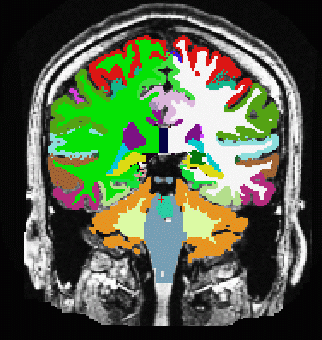
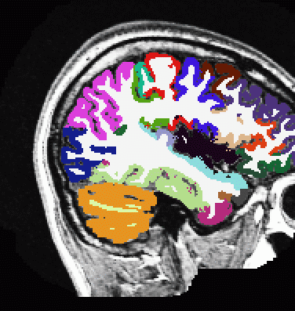
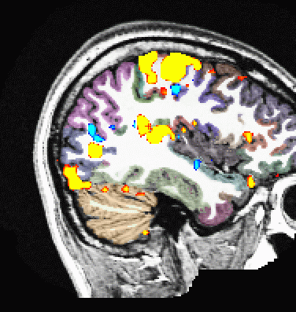
Volume Viewing with Overlay and ROIs
Red/Yellow +
Blue/Cyan -
Seg Opacity
ROI Average
ROI Count
Notes:
You can click on the ROI and it will show you information on where you are (e.g. what cortical region).

Slide 10
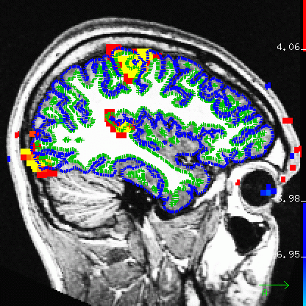
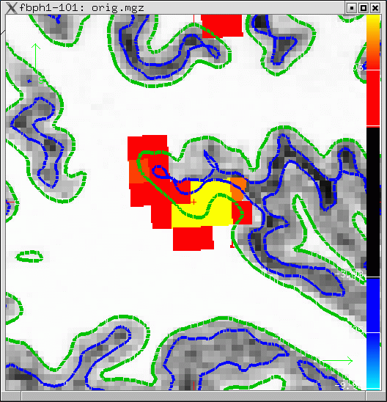
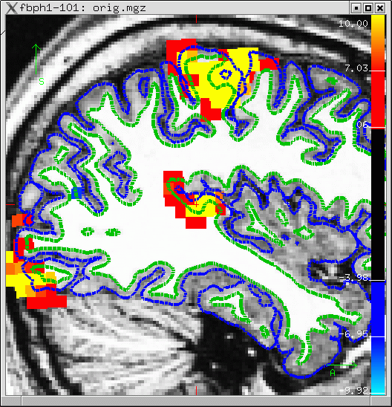
Sampling onto the Surface
Pial
White/Gray
Notes:
When you look at surface on anatomical : green is WM surface, blue is Pial.
Surface cuts a curve through the activation.
We assign each vertex on the surface the value of the activation map to create a surface overlay.

Slide 11
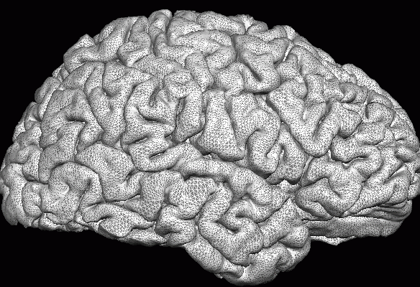
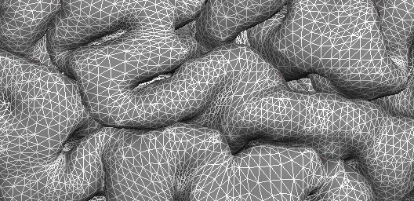
Sampling onto the Surface
Pial
White/Gray
White/Gray
Pial
Half Way
Average
Projection Fraction
--projfrac 0.5

Slide 12
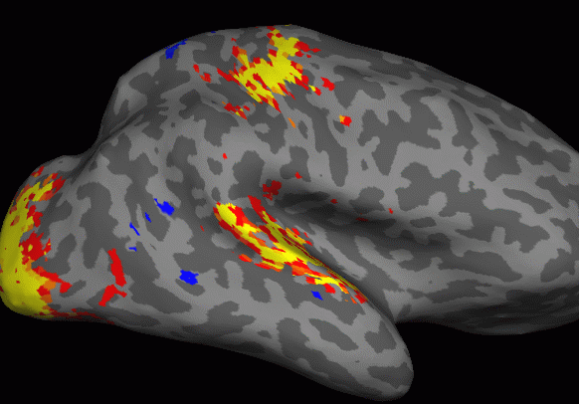
Sampling onto the Surface

Slide 13
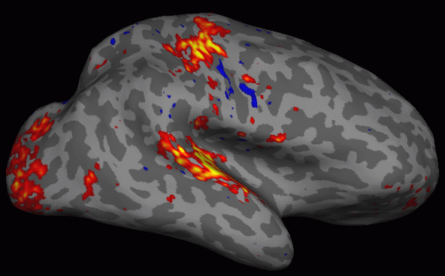
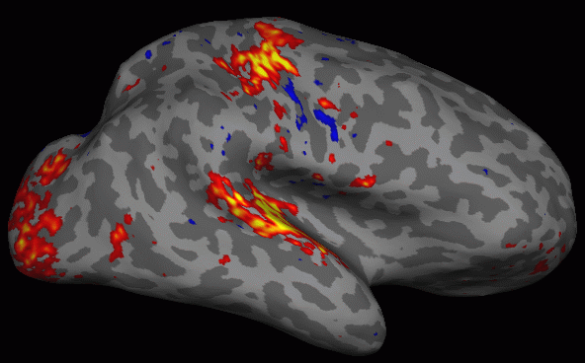
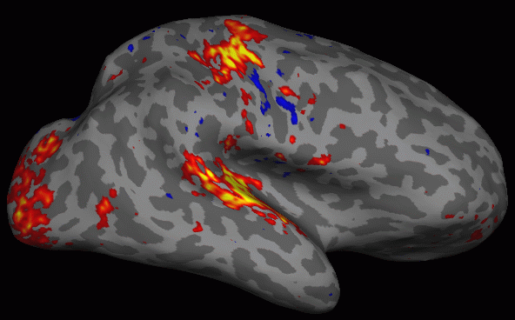
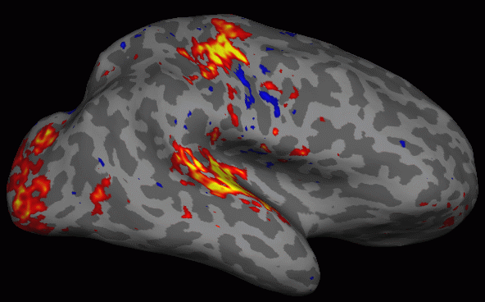
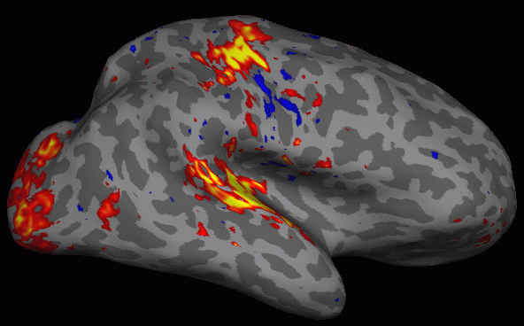

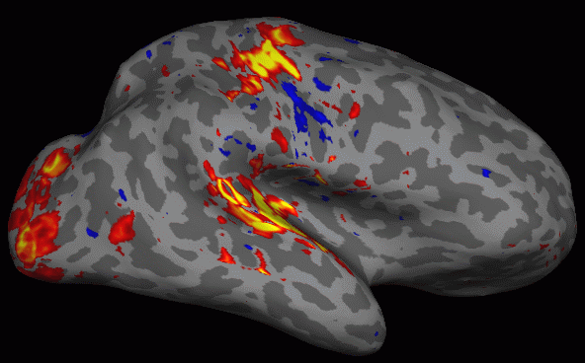
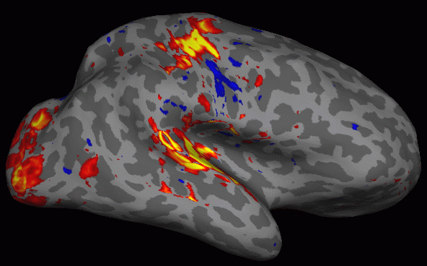

Sampling on the Surface: Projection Fraction
-0.1
0.0 (white)
+0.1
+0.3
+0.5
+0.7
+0.9
+1.0 (pial)
+1.1
Notes:
Which surface are you actually going to sample on? You get different results, but differences are small.
Cortex has 6 layers and may show different functions in different layers, but fMRI with 2mm voxel size, you cannot really sample at different layers.
White is 0 and pial is 1, there is not much of a difference.
Sampling at pial: risk increasing noise due to blood vessels.
WM could miss some activation, so we sample in between at 0.5 usually.

Slide 14
Surface Viewing
Resample HRF Contrast Significance to left hemisphere
mri_vol2surf \
--mov sig.nii \
--reg register.lta \
--hemi lh \
--projfrac 0.5 \
--o lh.sig.mgh
→ map in native functional space
→ FreeSurfer registration file
→ hemisphere
→ projection fraction (half)
→ output (Nvertices-x-1 mgh format)
Note similarity to bbregister command!
Load HRF Contrast Significance as overlay
freeview -f $SUBJECTS_DIRsubject/surf/lh.inflated:annot=aparc.annot:overlay=lh.sig.mgh:overlay_threshold=2,5 \
-viewport 3d
Easier command line to run freeview:
tksurferfv subject lh inflated -aparc –overlay lh.sig.mgh
Notes:
This command maps the functional map onto the surface (here we map the significance file).

Slide 15
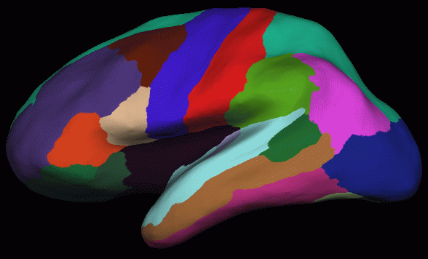
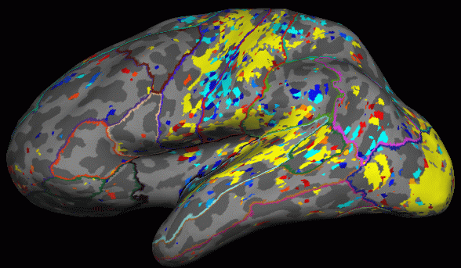
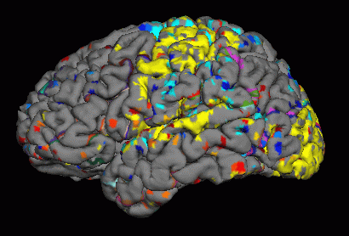
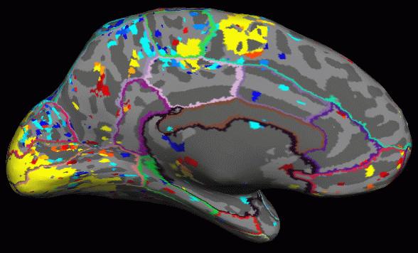
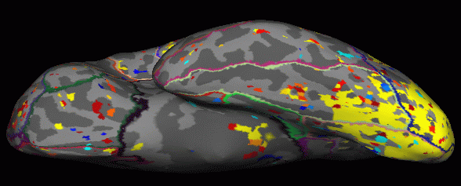
Surface Viewing, Overlay and ROIS
Red/Yellow +, Blue/Cyan -
Parcellation Outline
ROI Average
ROI Count
Notes:
When you load it you see the activations (motor, occipital auditory).

Slide 16
Surface-based Group Analysis
mris_preproc
--hemi lh
--o lh.fsaverage.ces.mgh
--iv subject1/ces.nii subject1func/register.lta
--iv subject2/ces.nii subject2func/register.lta
--iv subject3/ces.nii subject3func/register.lta
...
After that, everything else is the same as a thickness study …
mris_fwhm --i lh.fsaverage.ces.mgh --fwhm 10 \
--o lh.fsaverage.ces.sm10.mgh --cortex
mri_glmfit --surf fsaverage lh --cortex \
--y lh.fsaverage.ces.sm10.mgh ...
Notes:
For a group analysis remember you use mris_preproc (e.g. for thickness we mapped then from subject to fsaverage space). Here basically the same. Instead of --thickness we give it --iv with the volume and the registration file. So it will first sample on the surface of the subject then onto fsaverage. Then the same as thickness (smoothing and glmfit).

Slide 17
fMRI ROI Analysis
HRF Amplitude
  Full Anatomical ROI
  Functionally Constrained ROI
Volume

Slide 18
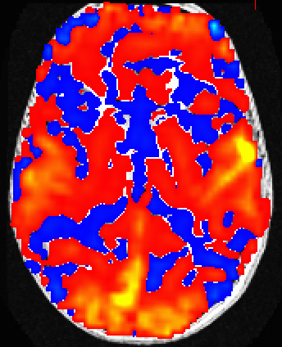
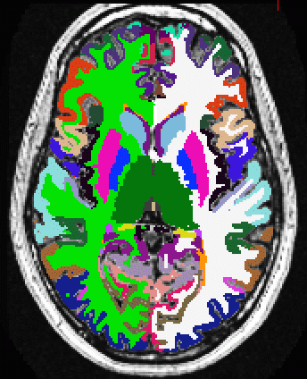
fMRI ROI Analysis
+3%
0%
-3%
Contrast
Amplitude
E.g., average functional HRF amplitudes from voxels inside of superior temporal gyrus (light blue) regardless of significance.
Notes:
Here we look at the entire gyrus regardless how much of it is active.

Slide 19
Step 1. Resample HRF Contrast to anatomical space
mri_vol2vol \
--mov ces.nii \
--reg register.lta \
--interp nearest \
--fstarg \
--o ces.anat.mgh
→ Command name
→ HRF map in functional space
→ FreeSurfer Registration File
→ Nearest neighbor interpolation
→ Specify anatomical output space
→ Output file in anatomical space
Note similarity to bbregister and mri_vol2surf commands!
Notes:
Resampling puts ces into voxel-for-voxel registration with aseg.mgz

Slide 20
Step 2: Average HRF Contrast within ROIs
mri_segstats
--seg $SUBJECTS_DIR/subject/mri/aseg.mgz
--ctab $FREESURFER_HOME/FreeSurferColorLUT.txt
--i ces.anat.mgh
--sum ces.aseg.stats
Notes:
--seg is the segmentation (e.g., aseg.mgz, aparc+aseg.mgz, etc.)
--ctab is matching color lookup table
Output File: ces.aseg.stats
simple text file with same format aseg.stats
multiple subjects can be combined with asegstats2table
can be used to extract a waveform from an fMRI volume, eg,
--i fmri.anat.mgh --avgwf output.dat
output.dat will have a row for each time point and a column for each ROI
Notes:
Segstats is also the same command that generates the aseg.stats file. It compute stats on each anatomical region from the label file (here aseg.mgz). It get’s the names of the regions from the color look up table.

Slide 21
Functionally Constraining ROIs
ROI1
(eg, precentral gyrus)
fMRI Blob
ROI2
(eg, superior parietal)

Slide 22
Functionally Constraining ROIs
ROI1
(eg, precentral gyrus)
ROI1-fMRI
Intersection
ROI2-fMRI
Intersection
fMRI Blob
ROI2
(eg, superior parietal)

Slide 23
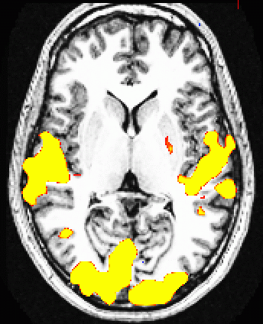
Average HRF within a Functionally Active area inside of an Anatomical ROI
+3%
0%
-3%
Contrast
Amplitude
Significance
(p<.01)
E.g., average functional HRF amplitudes from voxels inside of superior temporal gyrus (light blue) for voxels that have
p<.01 (sig>2) regardless of sign (yellow or blue), or
p<.01 (sig>2) for positive activation (yellow only), or
p<.01 (sig>2) for negative activation (blue only)
Notes:
You see that not all of that gyrus is activate, so you may want to exclude the inactive parts. (Regardless of sign, or directed).

Slide 24
Masked Average HRF within a Functionally Active Area inside of an Anatomical ROI
Resample HRF Contrast Significance to anatomical space (Step 1b)
mri_vol2vol \
--mov sig.nii \
--reg register.lta \
--interp nearest \
--fstarg \
--o sig.anat.mgh
Masked average HRF contrast within functionally constrained ROIs (Step 2)
mri_segstats \
--seg $SUBJECTS_DIR/subject/mri/aseg.mgz \
--ctab $FREESURFER_HOME/FreeSurferColorLUT.txt \
--i ces.anat.mgh --sum ces.aseg.mask.stats \
--mask sig.anat.mgh --mask-thresh 2 --mask-sign abs
(abs = absolute, ignore sign of sig map (alt: pos, neg)):
Notes:
We look only at voxels above threshold (abs).
So we first map the significance map into anatomical space, then use it as a mask, regardless of sign (abs). Thresh is p < .01 (2)

Slide 25
Summary
Multi/Cross-modal map (HRF Amplitude, FA)
Multimodal Integration requires a Reference
A Reference/Template is:
  Same size as multimodal map
  In Voxel-to-voxel alignment with map
  Has better anatomical contrast
    Baseline functional
    Low-B DTI
  Usually a motion corrected template
Volume and Intensity ROI Analyses
  Functionally-constrained ROI
Notes:
Multimodal acqusition, multiple time points, select one, motion correction, use bbregister to register that to anatomical. Then we can bring anything into anatomical space or vice-versa. Can map onto surface (middle layer), then to fsaverage for group analysis, or anayze rgegions of interest.

Slide 26
Tutorial
Registration – manual and automatic registration
fMRI Integration (Sensorimotor Paradigm)
  Individual
    Volume view sig
    Surface view sig
    ROI analysis with & without functional constraint
  Group
    mris_preproc
    ROI analysis (asegstats2table)
DTI Analysis there too

Slide 27
End of Presentation

Slide 28
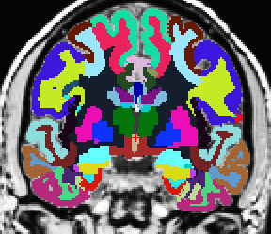
Quick Review: DTI Integration
View FA, etc., on subject’s anatomical volume
Intensity ROI Study: Average FA, etc., inside of White Matter Parcellation ROIs (wmparc.mgz)
wmparc.mgz
Notes:
Goal for example to integrate DTI into FS space to do a ROI study (average fractional anisotropy FA per structure)

Slide 29
Quick Review: DTI Integration
Motion/Eddy Current Correction (MC Template)
  Usually a low-b volume
  Use for registration template
  bbregister --mov mctemplate.nii --s subject --init-fsl --lta register.lta
  freeview -v mctemplate.nii:reg=register.lta -f $SUBJECTS_DIR/subject/surf/?h.white
First-Level (Individual) Analysis
  Fit Tensor Model
  Maps: FA (0-1), ADC, Eigenvectors, etc
  All in alignment with MC Template!!!!
Notes:
DTI analysis is similar to fMRI, collect several volumes, apply motion correction to B0 or low b volume as target (template). After computing the FA map, it can be registered to anatomical space and then you’d study ROI stats.

Slide 30
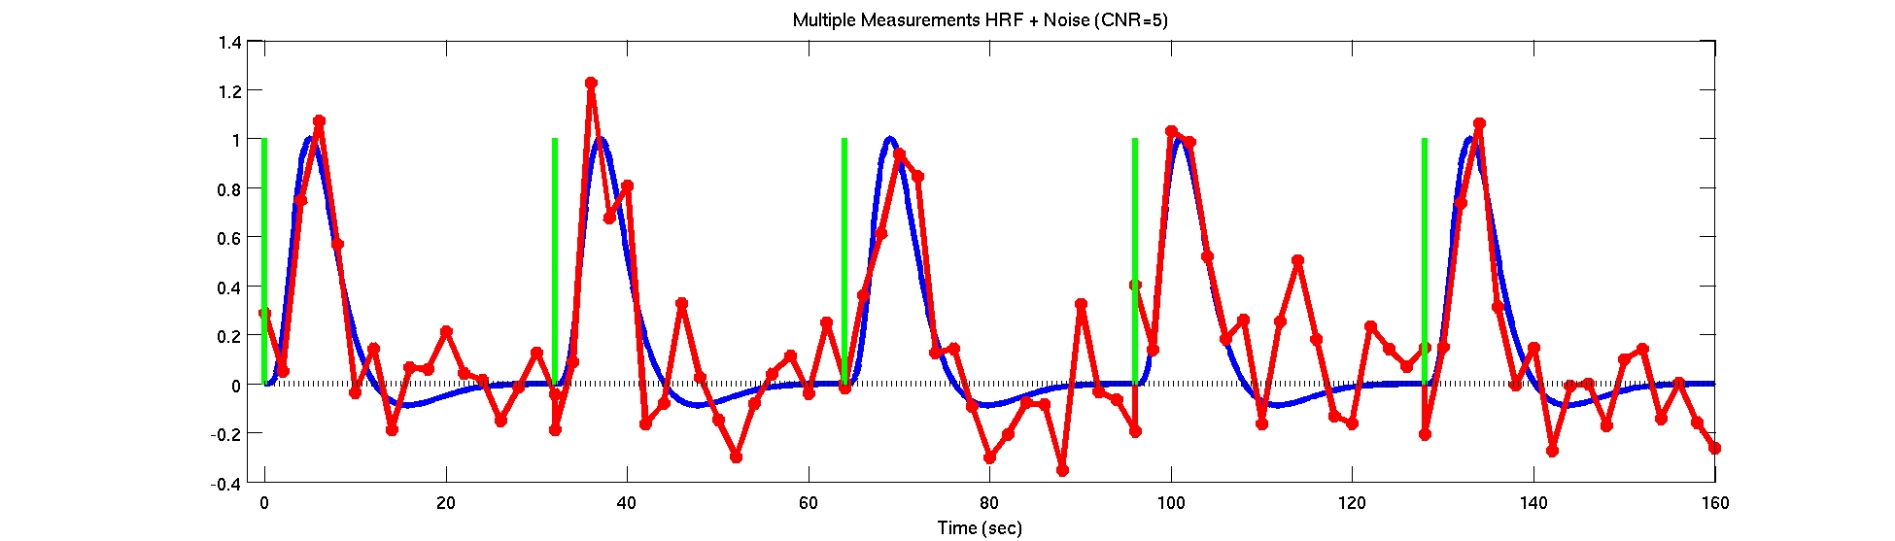
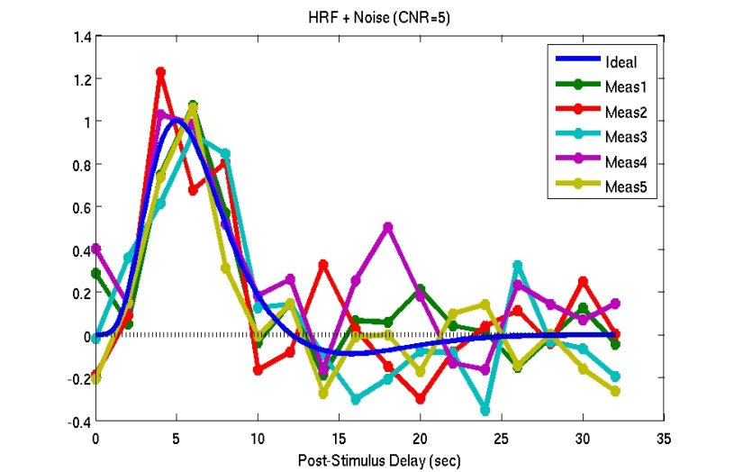
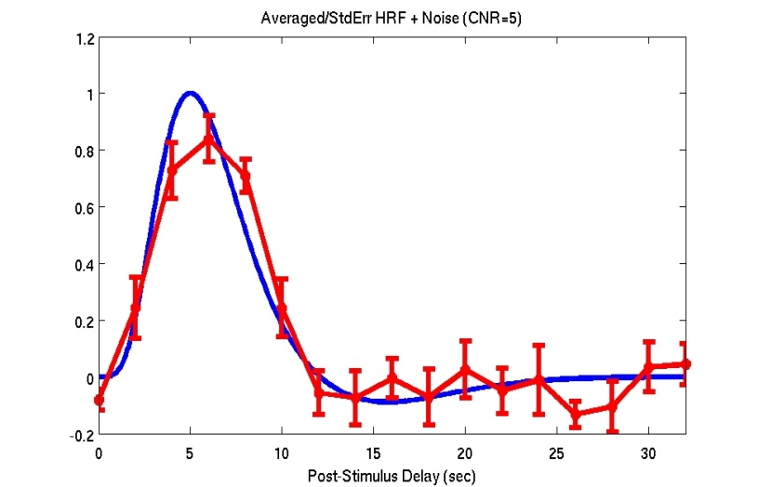
Multiple Presentations/Averaging
Individual Output: HRF Amp, HRF Var, p/z/t/F
Notes:
If you do analysis (time course), the blue line is the hemodynamic response, but the noisy measurements are different.
If you average them you get something that looks very similar to hemodynamic response.
You can compute the HRF amplitude and a standard deviation (error bar) and ratio for a t-test (for every voxel)

Slide 31
Volume Viewing , Alternative Command
freeview -tkmedit subject orig.mgz
-aparc+aseg
-overlay sig.nii -reg register.lta
-fthresh 2 -fmax 4
sig.nii – significance map in native functional space.
Could have been z, t, or F map as well.
register.lta – FreeSurfer registration file
fthresh – lower threshold (value depends on map).
You can change this in the interface.
fmax – saturation threshold. (value depends on map).
You can change this in the interface.
aparc+aseg – display aparc+aseg.mgz.
You can load this from the interface, too.
Notes:
After you have the maps and the registration you can load up the anatomical, aparc+aseg (segmentation) shows the activation as overlay

