Slide 1
Intro to Linux/Unix
FreeSurfer Course - Sept. 2022
Notes:
- Welcome
- Why start with this?
- familiarize you with terminal/cli

Slide 2

Objectives
Basic operations you’ll need for the course
  Navigate the file system
  Moving, copying, deleting files
  Executing commands
Notes:
Windows is not case sensitive with naming, UNIX IS!!! Give example

Slide 3
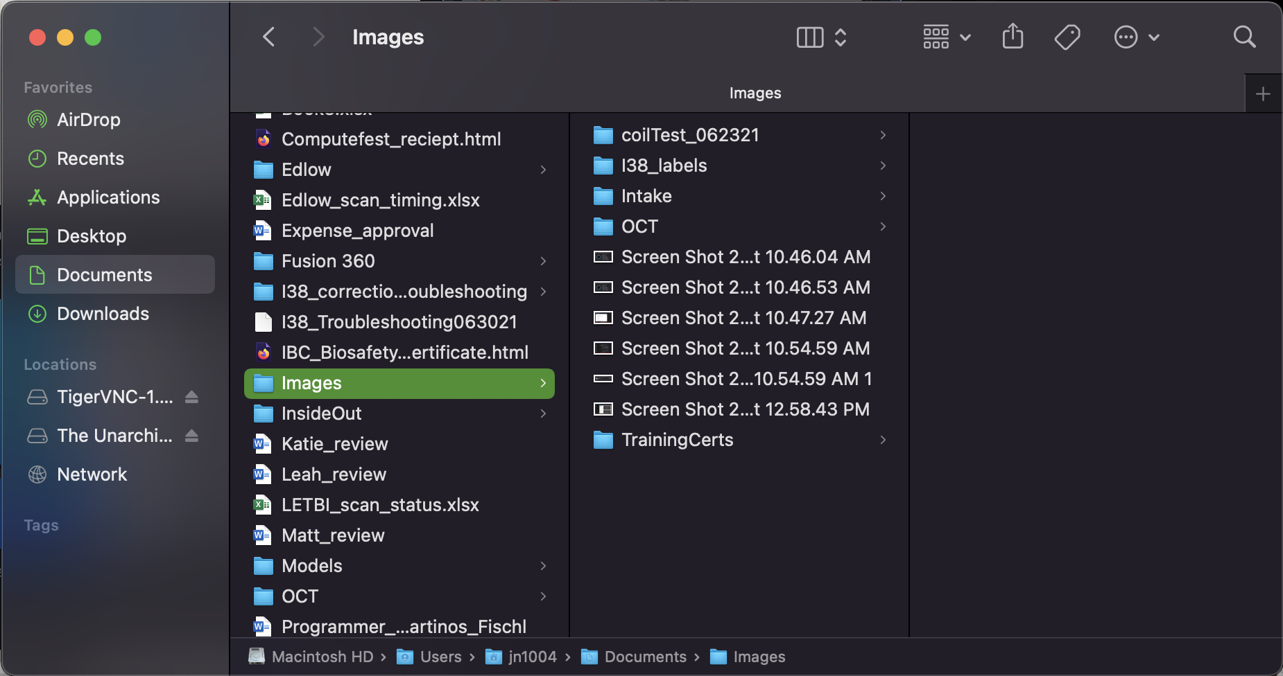
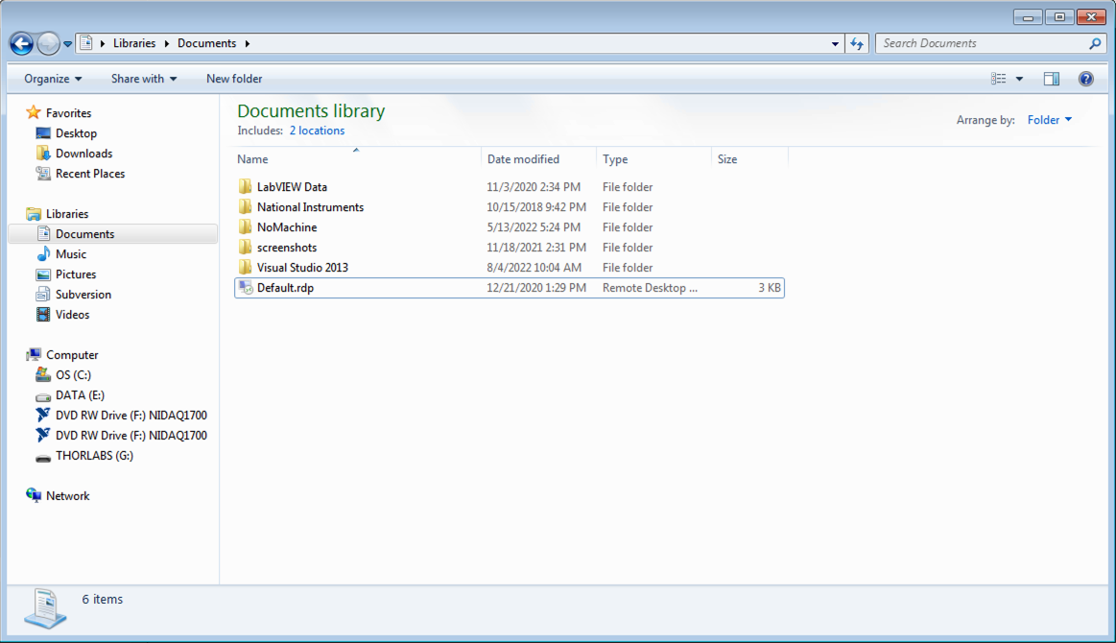
Navigating the File System
Useful commands:
pwd – print working directory
cd – change directory
  Use ‘cd ..’ to go back up a directory level
ls – list directory contents
  -a (list all files)
  -l (long list formatting)
Notes:
Use ubuntu file explorer while you’re showing how to navigate, so they don’t get scared it’s too different. Tell them why GUI’s suck and they should be using terminals!

Slide 4
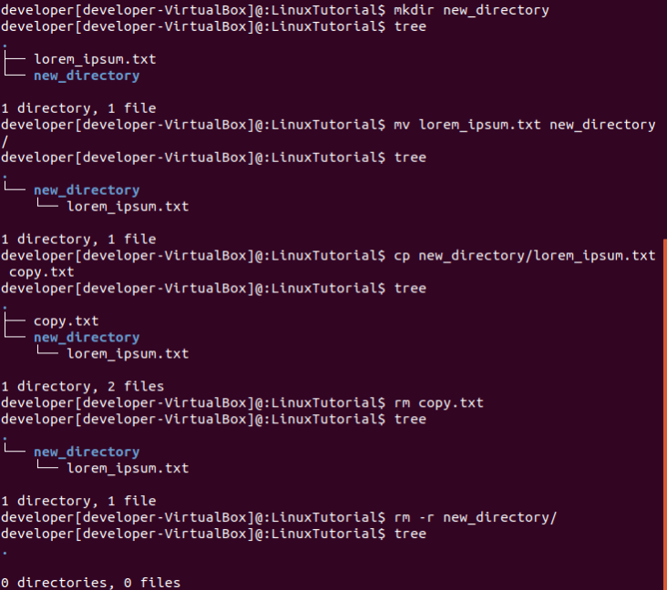
Make, Move, Copy & Delete
Useful commands:
mkdir – make directory
  -p (create parent directories)
mv – move files & directories
  This is how we rename things in Linux
cp/rsync – copy files
  rsync is recommended for larger files
rm – remove files
  BE SURE, THERE IS NO ‘UNDO’
  -r (recursive, for removing directories)
Notes:
Give context for why we need to do this. Tie it into freesurfer, they might not get ‘WHY’ they need to know this
MAKE THE TERMINAL BIG!!!!! CASE SENSITIVE

Slide 5
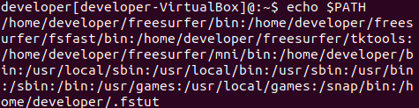
Executing Commands in Linux
Everything we have run in the terminal is a command
Executable files in your PATH
Previously run commands saved in your ‘history’
*Ctrl + C – kills the command running in your current terminal*

