Slide 1
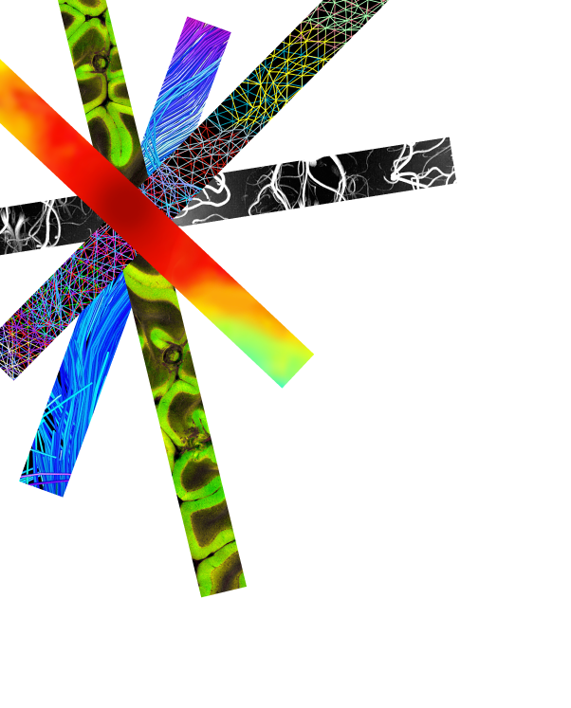
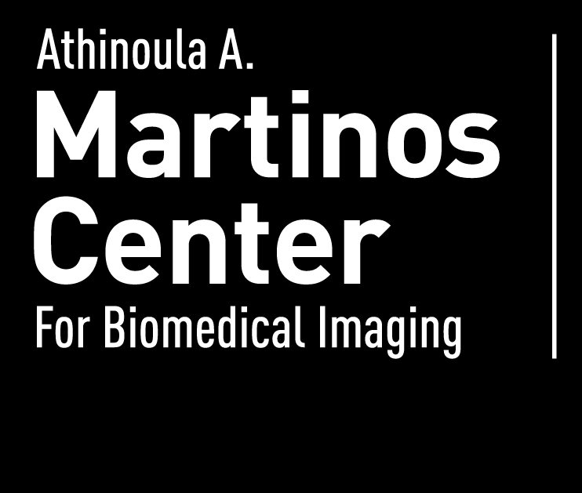
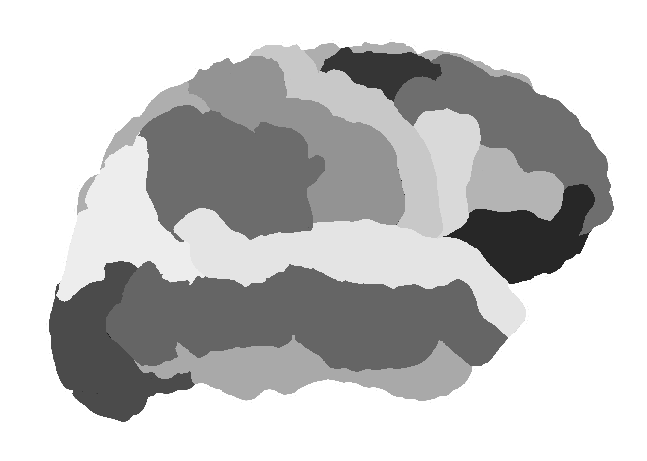
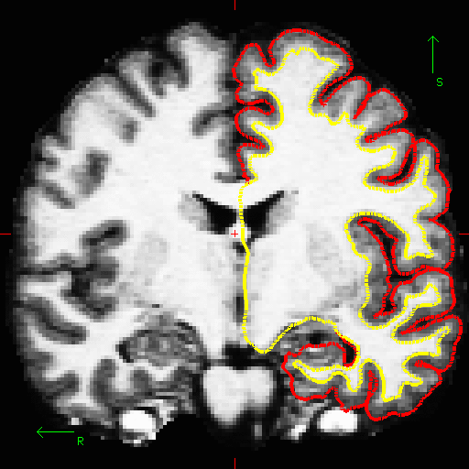
FreeSurfer
Analyzing the Individual Subject
March 31st, 2020
Bram Diamond
brdiamond@mgh.harvard.edu
FreeSurfer Help mailing list
freesurfer@nmr.mgh.harvard.edu
At-home FreeSurfer Course
https://surfer.nmr.mgh.harvard.edu/fswiki/TeachYourselfFreeSurfer

Slide 2
Talk Overview
Overview of the recon-all streamline
Specifics about the input image
Recon-all command breakdown
Introduction to subject directories and output files
(select) Streamline details
Brief overview of statistics
Where to find help

Slide 3
Talk Overview
Overview of the recon-all streamline
Specifics about the input image
Recon-all command breakdown
Introduction to subject directories and output files
(select) Streamline details
Brief overview of statistics
Where to find help

Slide 4
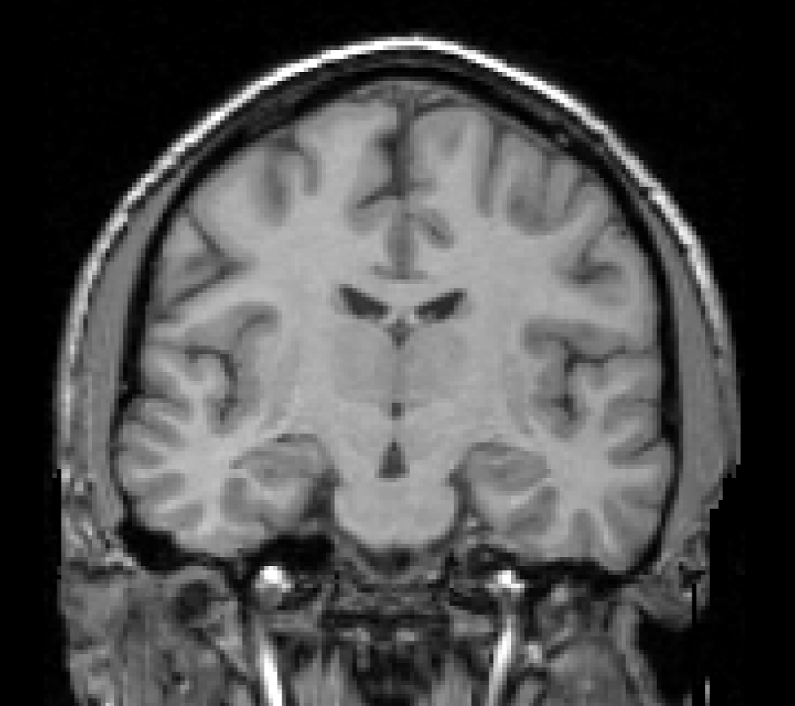
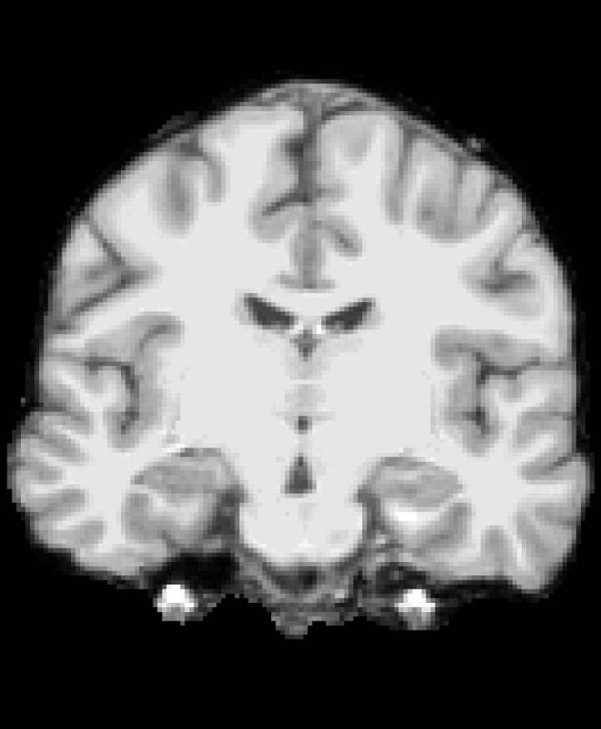
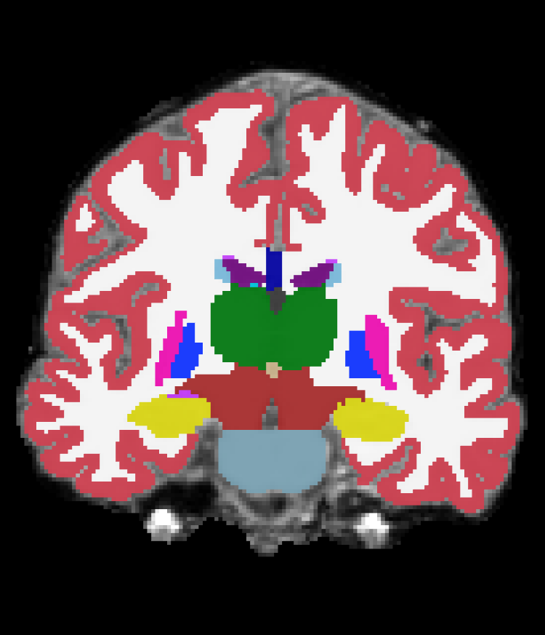
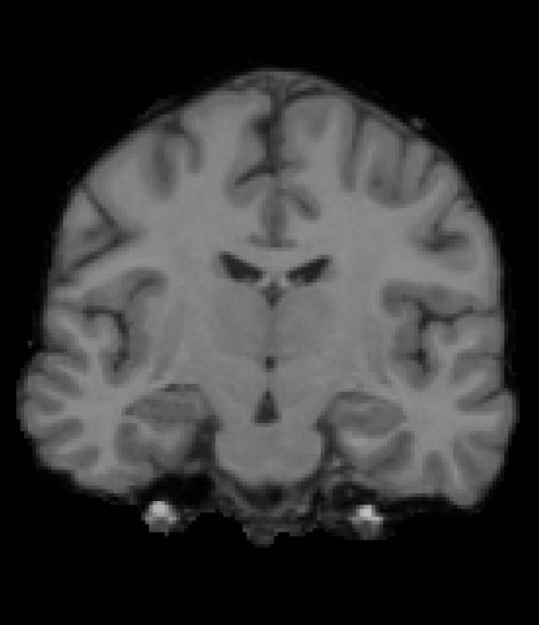
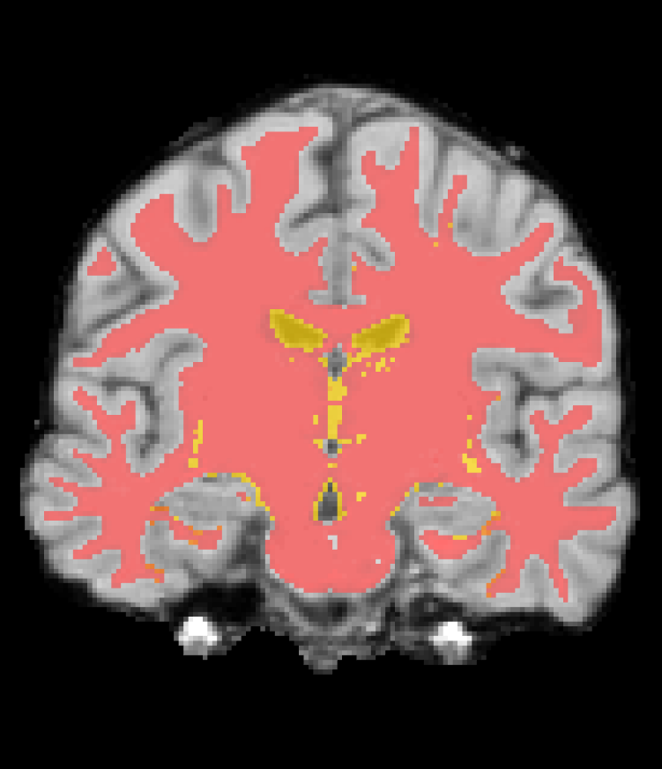
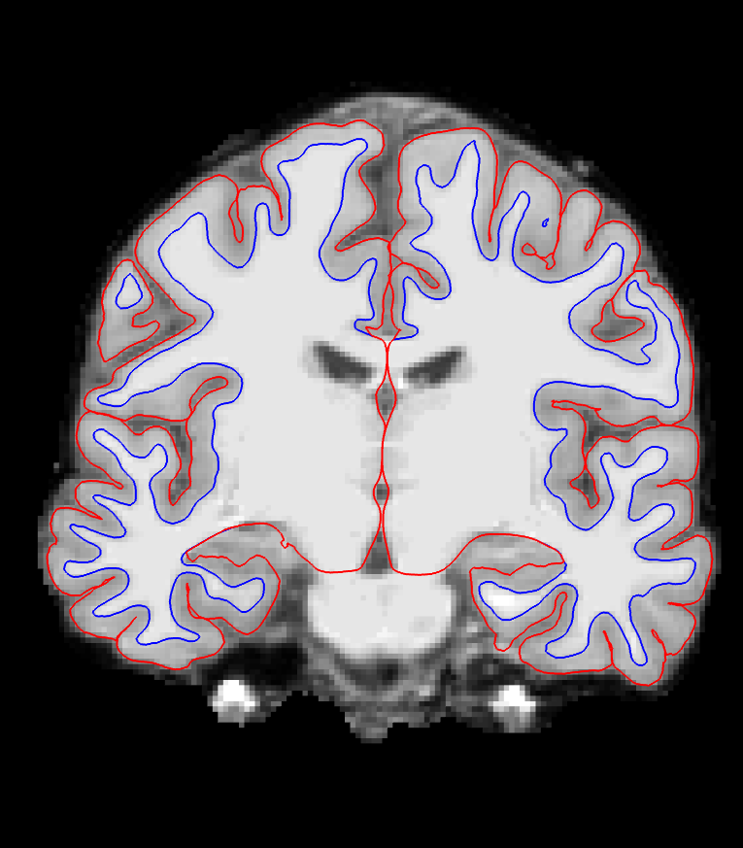
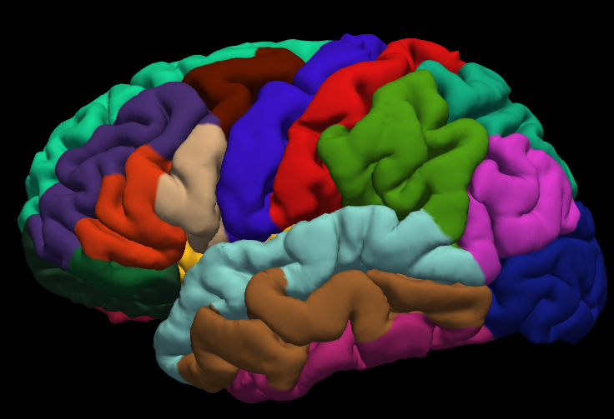
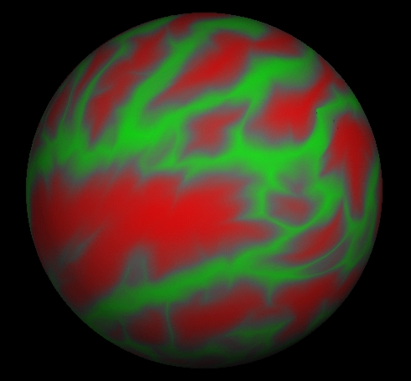
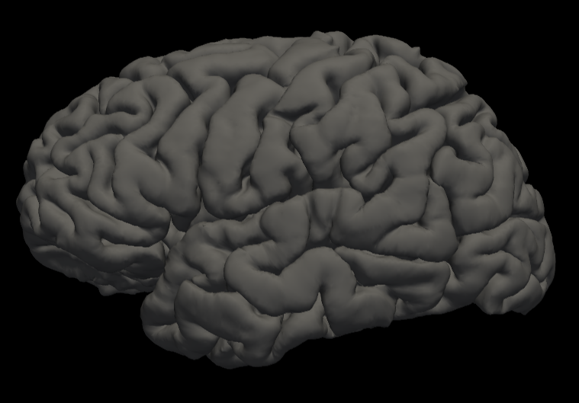
Overview of the Recon-all Streamline
T1 Weighted Input
Skull Stripping
Volumetric Labeling
Intensity Normalization
White Matter Segmentation
Gyral Labeling
Surface Atlas Registration
Surface Extraction

Slide 5
Talk Overview
Overview of the recon-all streamline
Specifics about the input image
Recon-all command breakdown
Introduction to subject directories and output files
(select) Streamline details
Brief overview of statistics
Where to find help

Slide 6
Input: T1 Weighted Image
T1 Contrast: white matter brighter than gray matter
~1mm³ (no more than 1.5mm)
Higher resolution may be worse!
Full Brain
Usually one acquisition is ok
MPRAGE (ME-MP-RAGE) or SPGR
1.5T or 3T
7T might have problems (hires flag)
Subject age > 5 years old
Brain has no major problems (i.e., tumors, parts missing)
Non-human primates possible
More MRI Pulse Sequence Parameter Details:
http://www.nmr.mgh.harvard.edu/~andre
http://adni.loni.usc.edu/methods/documents/mri-protocols

Slide 7
Talk Overview
Overview of the recon-all streamline
Specifics about the input image
Recon-all command breakdown
Introduction to subject directories and output files
(select) Streamline details
Brief overview of statistics
Where to find help

Slide 8
Fully Automated Reconstruction*
*“reconstruction” here refers to cortical reconstruction (surfaces), not k-space reconstruction.

Slide 9
Fully Automated Reconstruction
file.dcm is a single DICOM file from the T1 MRI series
If you have more than one T1 image, then use two input (-i) flags:
  -i file1.dcm –i file2.dcm
You can use NIFTI as an input as well (mri_convert)
  -i file.nii

Slide 10
Fully Automated Reconstruction
Finding file.dcm is sometimes difficult…
To get a list of acquisitions:
dcmunpack –src /path/to/dicoms
MR.1.3.12.2.1107.5.2.43.67026.201711091646082874533087
…
MR.1.3.12.2.1107.5.2.43.67026.2017110917193866363913436
MR.1.3.12.2.1107.5.2.43.67026.2017110916460831999633315 MR.1.3.12.2.1107.5.2.43.67026.2017110917194188432513634
MR.1.3.12.2.1107.5.2.43.67026.2017110916460832005833316 MR.1.3.12.2.1107.5.2.43.67026.2017110917194189797813639
MR.1.3.12.2.1107.5.2.43.67026.2017110916020777318078761
1 Localizer 3 40 15 1.171875 MR.1.3.12.2…
…
13 T1w_MPR_vNav_4eRMS … MR.1.3.12…
MP-RAGE T1 Protocol
This will be different for everyone
You will have to know what this name is

Slide 11
Fully Automated Reconstruction
-i MR.1.3.12.2.1107.5.2.43.67026.2017110916020777318078761
A single DICOM file that belongs to the MPRAGE series (there might be several hundred; you only need one).
https://surfer.nmr.mgh.harvard.edu/fswiki/FsTutorial/Practice

Slide 12

Fully Automated Reconstruction
“bert” is the “name” of the subject
recon-all creates a folder in $SUBJECTS_DIR named bert
All output goes in this folder (~400MB)
$SUBJECTS_DIR
bert
ernie
fsaverage
Notes:
Always remember to set your $SUBJECTS_DIR variable:
csh → setenv SUBJECTS_DIR /path/to/subjects
sh → export SUBJECTS_DIR=/path/to/subjects

Slide 13
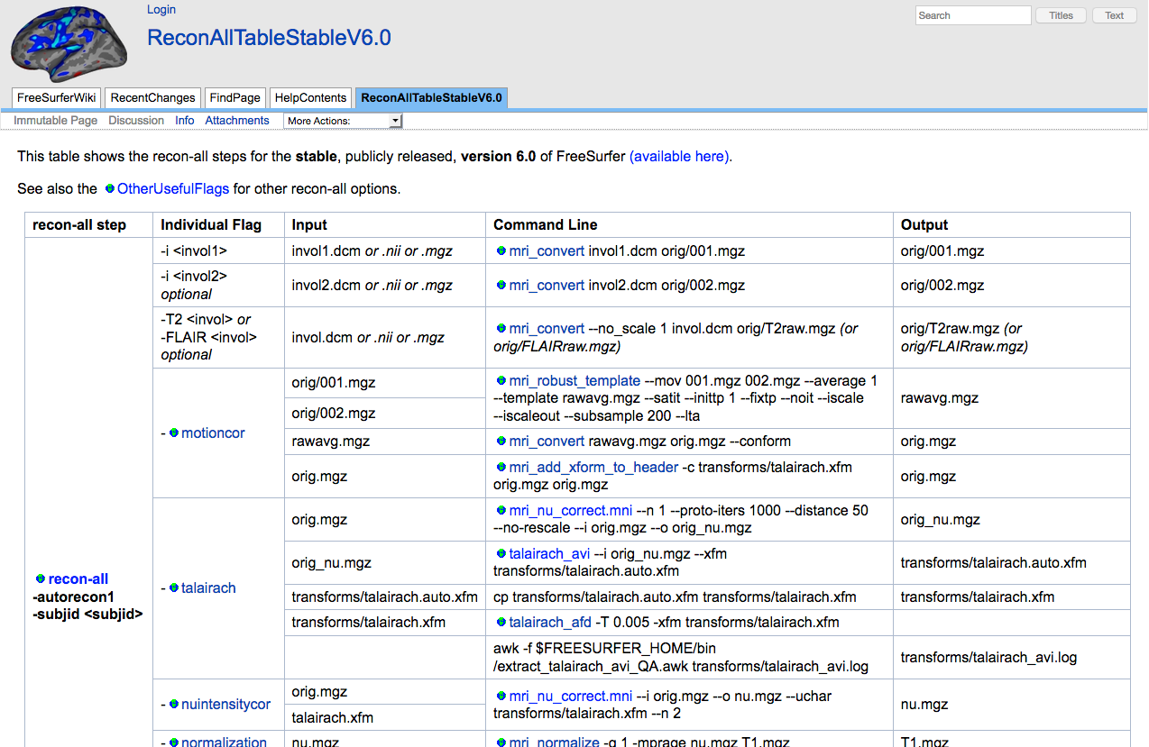
Fully Automated Reconstruction
”all” means to do (almost) everything!
Can take 10-13 hours
You can run subsets of the processing stream to make it faster when correcting errors.
recon-all –subject bert -autorecon-pial -autorecon3
recon-all –subject bert -autorecon2-wm -autorecon3
recon-all –subject bert -autorecon2-cp -autorecon3
Many additional options
Notes:
Always remember to set your $SUBJECTS_DIR variable:
csh → setenv SUBJECTS_DIR /path/to/subjects
sh → export SUBJECTS_DIR=/path/to/subjects

Slide 14
Talk Overview
Overview of the recon-all streamline
Specifics about the input image
Recon-all command breakdown
Introduction to subject directories and output files
(select) Streamline details
Brief overview of statistics
Where to find help

Slide 15
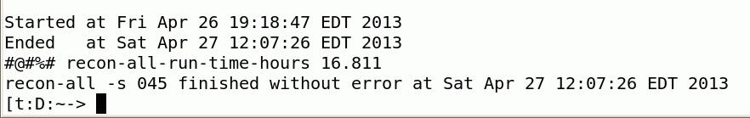
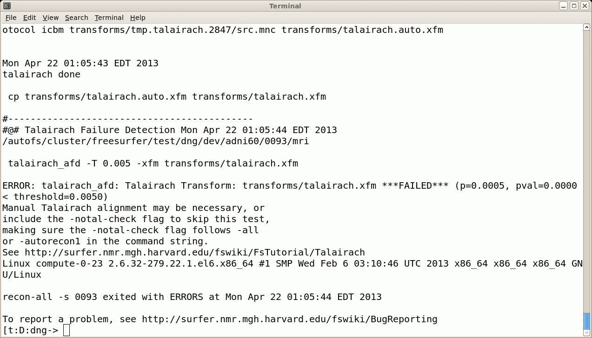
Fully Automated Reconstruction
Upon completion…
~400MB
recon-all.log
recon-all.done
recon-all.error
Just because it finishes “without error” does not mean that everything is ok!
Send us recon-all.log when you have problems! freesurfer@nmr.mgh.harvard.edu

Slide 16
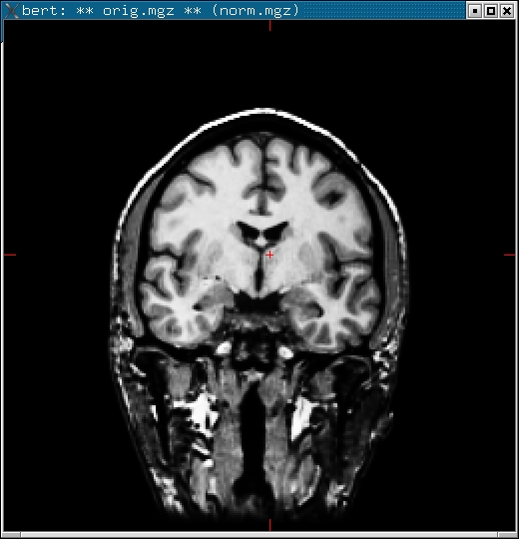
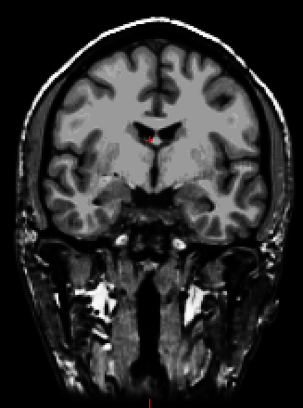
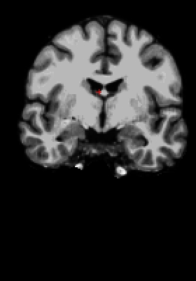
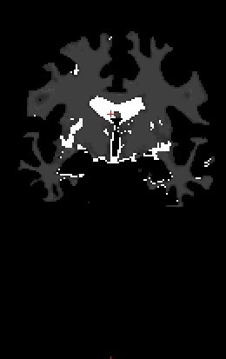
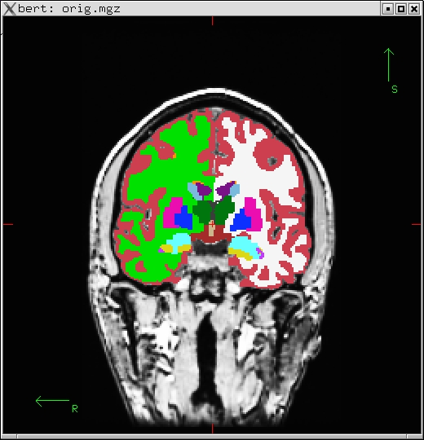
Fully Automated Reconstruction
Upon completion…
~400MB
Native Anatomical Space
eg, 1x1x1.2mm³
256x256x128
mgz = “compressed mgh” format (like nifti) unique to FreeSurfer
“Conformed” Anatomical Space
1x1x1mm³ , 256x256x256
rawavg.mgz
orig.mgz
T1.mgz
brainmask.mgz
wm.mgz
aseg.mgz

Slide 17
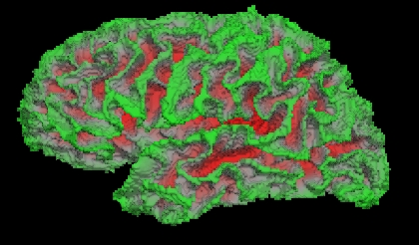
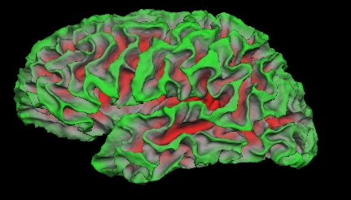
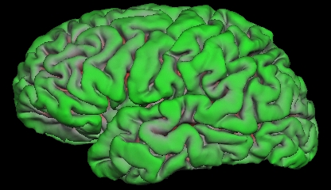
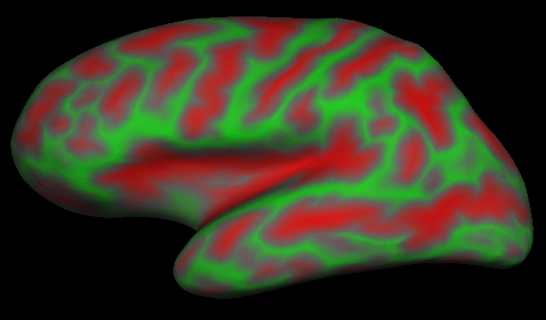
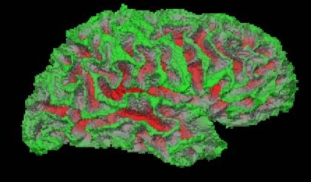
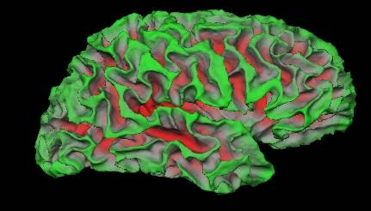
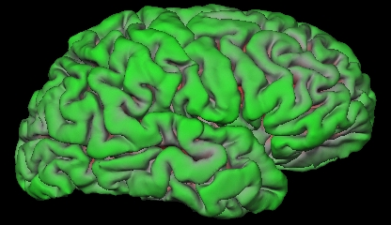
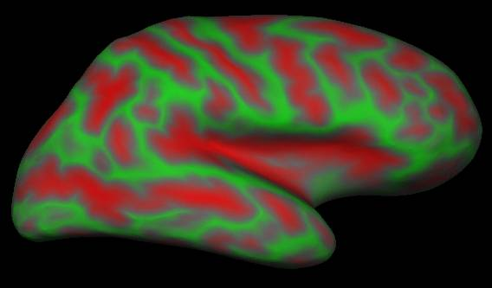
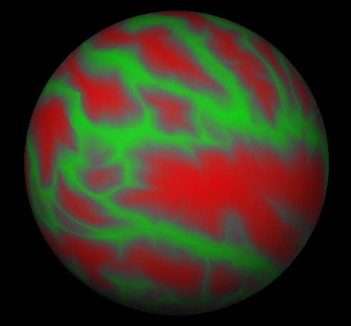
Fully Automated Reconstruction
Upon completion…
Also…
lh.thickness and rh.thickness, ?h.curv, ?h.sulc
lh.orig
lh.white
lh.pial
lh.inflated
lh.sphere.reg
rh.inflated
rh.orig
rh.white
rh.pial
rh.sphere.reg

Slide 18
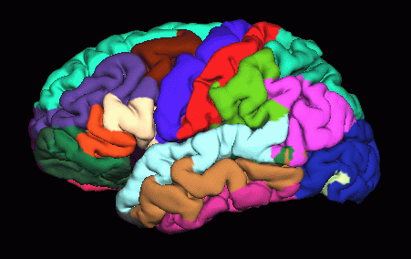
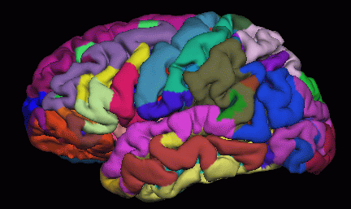
Fully Automated Reconstruction
Upon completion…
lh.aparc.annot
lh.aparc.a2009s.annot
Desikan/Killiany Atlas
Destrieux Atlas

Slide 19
Fully Automated Reconstruction
Upon completion…
aseg.stats – subcortical volumetric stats
wmparc.stats – white matter segmentation volumetric stats
lh.aparc.stats – left hemi Desikan/Killiany surface stats
rh.aparc.stats – right hemi Desikan/Killiany surface stats
lh.aparc.a2009.stats – left hemi Destrieux
rh.aparc.a2009.stats – right hemi Destrieux
lh.aparc.annot
lh.aparc.a2009s.annot
Desikan/Killiany Atlas
Destrieux Atlas

Slide 20
Talk Overview
Overview of the recon-all streamline
Specifics about the input image
Recon-all command breakdown
Introduction to subject directories and output files
(select) Streamline details
Brief overview of statistics
Where to find help

Slide 21
(select) Streamline details
T1 Weighted Input
Skull Stripping
Volumetric Labeling
Intensity Normalization
White Matter Segmentation
Gyral Labeling
Surface Atlas Registration
Surface Extraction

Slide 22
Conform Step
Native Anatomical Space 1x1x1.1mm, 256x256x128, Sag
Conformed Anatomical Space 1x1x1mm, 256x256x256, Cor
rawavg.mgz
orig.mgz
“Anatomical Space”
orig.mgz
Surfaces
Parcellations
Segmentations
rawavg.mgz

Slide 23
Talairach Transform
Computes 12 DOF transform matrix
Does NOT resample to Talaiarch space!
MNI305 template
Mostly used to report coordinates
transforms
talairach.xfm → text file with matrix

Slide 24
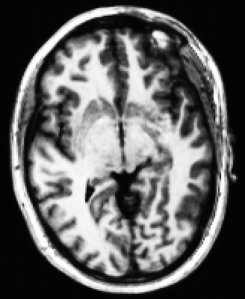
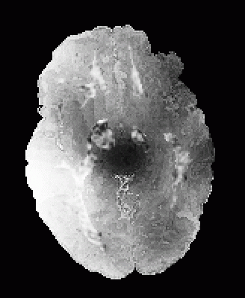
Intensity Bias Correction
T1.mgz
Outside of image is much brighter than inside (coils)
Worse with many coils
Makes gray/white segmentation difficult
Intensity Normalization (aka “Bias Correction”)
Raw Data
Corrected (T1.mgz)

Slide 25
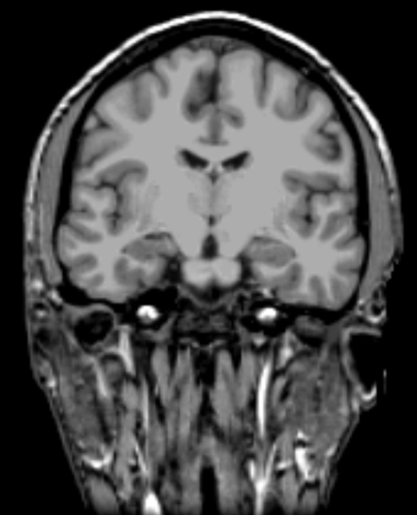
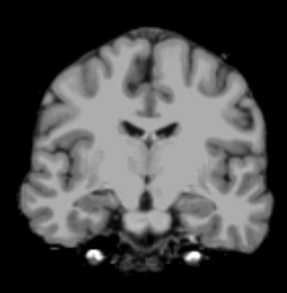
Skull Strip
T1.mgz
brainmask.mgz (brain.mgz)
brainmask.mgz
Removes all non-brain: Skull, eyes, neck and dura

Slide 26
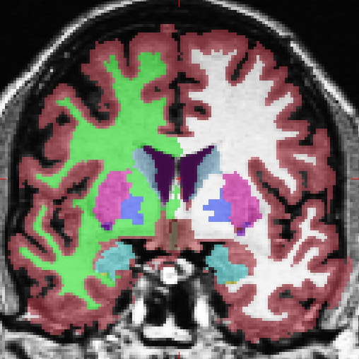
Automatic Volume Labeling
Used to fill in subcortical structures for creating subcortical mass and ROI volume analysis
Named the “aseg.mgz”
aseg.mgz
Atlas: $FREESURFER_HOME/average/RB_all_2016-05-10.vc700.gca

Slide 27
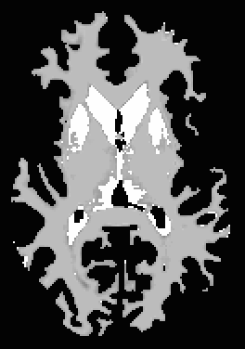
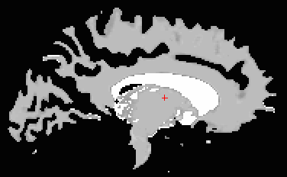
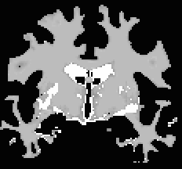
White Matter Segmentation
Separates white matter from everything else
Uses aseg volume to “fill in” subcortical structures
wm.mgz is not a very good name
  Cerebellum removed, brainstem still there
  Ventricles filled in
wm.mgz

Slide 28
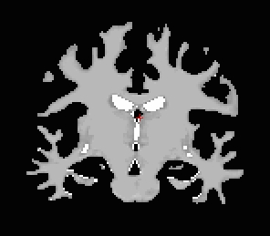
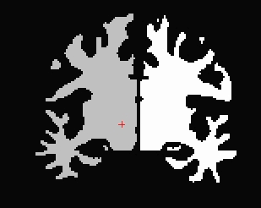
Fill and Cut (Subcortical Mass)
Fills in any holes
Removes any islands
Removes brain stem
Separates hemispheres (each hemi has different value)
filled.mgz = “subcortical mass”
wm volume (wm.mgz) filled volume (filled.mgz)

Slide 29
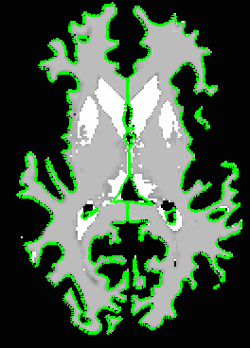
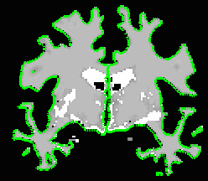
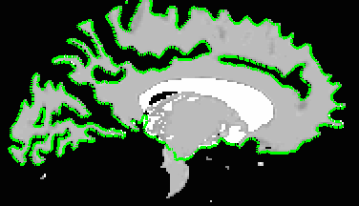
Surface Extraction
Hemispheres separated
Fit to wm.mgz
1mm resolution
Rough, jagged surface
lh.orig
rh.orig
lh.orig
rh.orig

Slide 30
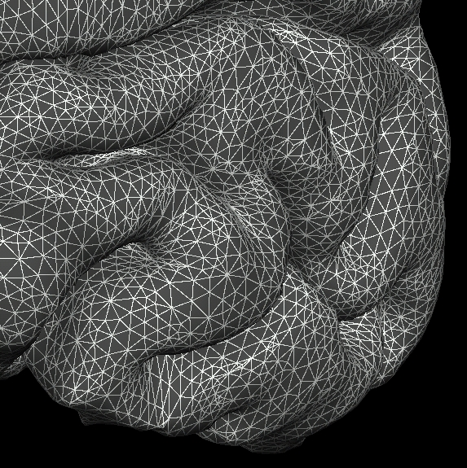
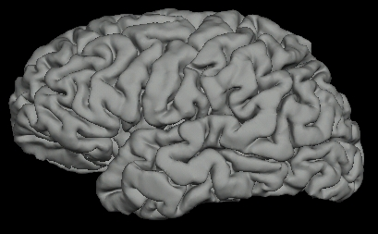
Surface Model
Mesh (“finite element”)
Vertex = intersection at point of triangles
Vertex neighborhood
Each vertex has XYZ coordinates
Triangles/Faces ~ 300,000
Vertices ~ 140,000
Measures
  Area
  Distance
  Curvature
  Thickness

Slide 31
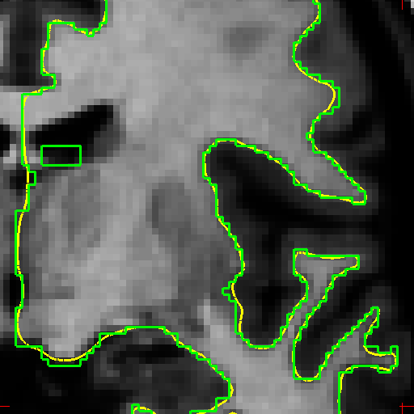
White Matter Surface
Nudge orig surface
Follow T1 intensity gradients
Smoothness constraint
Vertex identity preserved
orig surface
white surface
?h.white

Slide 32
Pial Surface
Nudge white surface
Follow T1 intensity gradients
Vertex identity preserved
?h.pial
Notes:
Errors in pial surface placement are typically caused by underlying errors in the white matter placement
Errors can be corrected by interventions such as white matter control points.

Slide 33
Volume vs. Surface Models
Volume
Surface
Uniform grid
Voxel is an intersection of grid lines
Columns, rows, slices
Voxel size/distance
Voxel assigned a value
XYZ
NON-uniform grid
Vertex is an intersection of triangles
Each vertex has an index
Distance between vertices ~1mm
Vertex assigned a value
XYZ

Slide 34
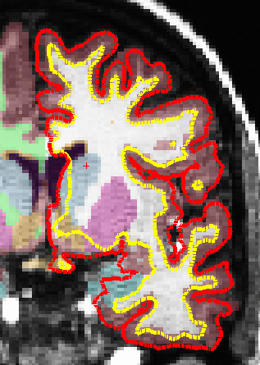
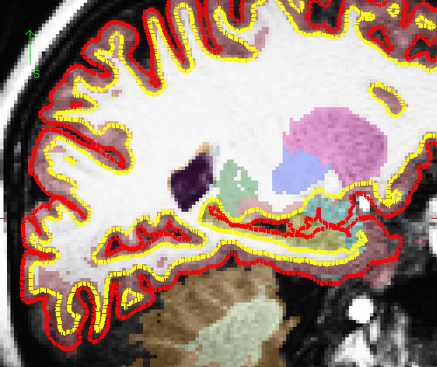



Non-Cortical Areas of the Surface
non-cortical regions are not errors!
To check:
?h.cortex.label

Slide 35



Inflation
2D surface in 3D space
Nudge vertices
No intensity gradient
See inside sulci
Used for sphere
Pial Surface
White Surface
Inflated Surface

Slide 36


Cortical Thickness
Distance between white and pial surfaces
One value per vertex
Surface-based more accurate than volume-based
lh.thickness

Slide 37
Curvature (Radial)
Circle tangent to surface at each vertex
Curvature measure is 1/radius of circle
One value per vertex
Signed (sulcus/gyrus)
lh.curv

Slide 38

Spherical Registration
High-Dimensional
Non-linear
Registration
Sulcal Map
Spherical Inflation
Spherical Template
“fsaverage”

Slide 39



Automatic Cortical Parcellation
Map to individual
through spherical registration
Fine-tune based on
individual anatomy
Spherical Atlas based on manual labeling
Note: Similar methodology to volume labeling

Slide 40





Surface Overlays
Value for each vertex
Color indicates value (grayscale, red/green, heat, color table)
Rendered on any surface
fMRI/stats maps too
lh.sulc on inflated
lh.curv on inflated
lh.thickness on inflated
lh.sulc on pial
lh.aparc.annot on inflated
fMRI on inflated

Slide 41
Talk Overview
Overview of the recon-all streamline
Specifics about the input image
Recon-all command breakdown
Introduction to subject directories and output files
(select) Streamline details
Brief overview of statistics
Where to find help

Slide 42
ROI Summaries
aseg.stats – subcortical volumetric stats
wmparc.stats – white matter segmentation volumetric stats
lh.aparc.stats – left hemi Desikan/Killiany surface stats
rh.aparc.stats – right hemi Desikan/Killiany surface stats
lh.aparc.a2009.stats – left hemi Destrieux
rh.aparc.a2009.stats – right hemi Destrieux
Index SegId NVoxels Volume_mm3 StructName normMean normStdDev normMin normMax normRange
1 1 0 0.0 Left-Cerebral-Exterior 0.0000 0.0000 0.0000 0.0000 0.0000
2 2 265295 265295.0 Left-Cerebral-White-Matter 106.6763 8.3842 35.0000 169.0000 134.0000
3 3 251540 251540.0 Left-Cerebral-Cortex 81.8395 10.2448 29.0000 170.0000 141.0000
4 4 7347 7347.0 Left-Lateral-Ventricle 42.5800 12.7435 21.0000 90.0000 69.0000
5 5 431 431.0 Left-Inf-Lat-Vent 66.2805 11.4191 30.0000 95.0000 65.0000
6 6 0 0.0 Left-Cerebellum-Exterior 0.0000 0.0000 0.0000 0.0000 0.0000
….
Generating spreadsheets of group data
  asegstats2table --help
  aparcstats2table --help

Slide 43

ROI Summaries
  During this course you will learn how to
    Using alternate atlases
    Hippocampal subfields, thalamic nuclei, brainstem
    Manipulating ROIs
    Making new *.stats files

Slide 44
Quick Overview
aseg.stats
?h.aparc.stats
…
recon-all.log
recon-all.done
recon-all.error

Slide 45
Talk Overview
Overview of the recon-all streamline
Specifics about the input image
Recon-all command breakdown
Introduction to subject directories and output files
(select) Streamline details
Brief overview of statistics
Where to find help

Slide 46


Getting Your Questions Answered
WIKI
Mail Archive
COMMAND HELP
SEND US YOUR QUESTIONS
recon-all –help
mri_convert -help
freesurfer@nmr.mgh.harvard.edu
(Attach recon-all.log)
Notes:
Continue with the Tutorials: Analyzing the Individual Subject Part and Part 2
The next live lecture is on Wednesday at 3:00PM ET on Intro to FreeView and working with data followed by ROI Analysis at 4:00PM ET.

Slide 47
Thank You!
Bram Diamond
brdiamond@mgh.harvard.edu
FreeSurfer Help mailing list
freesurfer@nmr.mgh.harvard.edu
At-home FreeSurfer Course
https://surfer.nmr.mgh.harvard.edu/fswiki/TeachYourselfFreeSurfer

Slide 48
Additional Slides

Slide 49
Motion correction and averaging
001.mgz
rawavg.mgz
+
002.mgz
bert
mri
Does not change native resolution.
Usually only need one.
orig
rawavg.mgz
001.mgz 002.mgz

Slide 50
The stages of recon-all
-autorecon1
-autorecon2
-autorecon3

Slide 51
autorecon1
Volumetric Processing Stages (subjid/mri):
1. Motion Cor, Avg, Conform (orig.mgz)
2. Non-uniform inorm (nu.mgz)
3. Talairach transform computation (talairach/talairach.xfm)
4. Intensity Normalization 1 (T1.mgz)
5. Skull Strip (brainmask.mgz)
6. EM Register (linear volumetric registration)
7. CA Intensity Normalization (norm.mgz)
8. CA Non-linear Volumetric Registration
9. CA Label (Volumetric Labeling) (aseg.mgz)
10. Intensity Normalization 2 (T1.mgz)
11. White matter segmentation (wm.mgz)
12. Edit WM With ASeg
13. Fill and cut (filled.mgz)
Surface Processing Stages (subjid/surf):
14. Tessellate (?h.orig.nofix)
15. Smooth1
16. Inflate1
17. Sphere (?h.qsqhere)
18. Automatic Topology Fixer (?h.orig)
19. Final Surfs (?h.white ?h.pial ?.thickness)
20. Smooth2 (?h.smoothwm)
21. Inflate2 (?h.inflated)
22. Aseg Statistics (stats/aseg.stats)
23. Cortical Ribbon Mask (?h.ribbon.mgz)
24. Spherical Morph
25. Spherical Registration (?h.sphere.reg)
26. Map average curvature to subject
27. Cortical Parcellation (Labeling)
28. Cortical Parcellation Statistics
29. Cortical Parcellation mapped to Aseg
30. White Matter Parcellation (wmparc.mgz)
recon-all -help
Note: ?h.orig means lh.orig or rh.orig

Slide 52
autorecon2
Volumetric Processing Stages (subjid/mri):
1. Motion Cor, Avg, Conform (orig.mgz)
2. Non-uniform inorm (nu.mgz)
3. Talairach transform computation (talairach/talairach.xfm)
4. Intensity Normalization 1 (T1.mgz)
5. Skull Strip (brainmask.mgz)
6. EM Register (linear volumetric registration)
7. CA Intensity Normalization (norm.mgz)
8. CA Non-linear Volumetric Registration
9. CA Label (Volumetric Labeling) (aseg.mgz)
10. Intensity Normalization 2 (T1.mgz)
11. White matter segmentation (wm.mgz)
12. Edit WM With ASeg
13. Fill and cut (filled.mgz)
Surface Processing Stages (subjid/surf):
14. Tessellate (?h.orig.nofix)
15. Smooth1
16. Inflate1
17. Sphere (?h.qsqhere)
18. Automatic Topology Fixer (?h.orig)
19. Final Surfs (?h.white ?h.pial ?.thickness)
20. Smooth2 (?h.smoothwm)
21. Inflate2 (?h.inflated)
22. Aseg Statistics (stats/aseg.stats)
23. Cortical Ribbon Mask (?h.ribbon.mgz)
24. Spherical Morph
25. Spherical Registration (?h.sphere.reg)
26. Map average curvature to subject
27. Cortical Parcellation (Labeling)
28. Cortical Parcellation Statistics
29. Cortical Parcellation mapped to Aseg
30. White Matter Parcellation (wmparc.mgz)
recon-all -help
Note: ?h.orig means lh.orig or rh.orig

Slide 53
autorecon3
Volumetric Processing Stages (subjid/mri):
1. Motion Cor, Avg, Conform (orig.mgz)
2. Non-uniform inorm (nu.mgz)
3. Talairach transform computation (talairach/talairach.xfm)
4. Intensity Normalization 1 (T1.mgz)
5. Skull Strip (brainmask.mgz)
6. EM Register (linear volumetric registration)
7. CA Intensity Normalization (norm.mgz)
8. CA Non-linear Volumetric Registration
9. CA Label (Volumetric Labeling) (aseg.mgz)
10. Intensity Normalization 2 (T1.mgz)
11. White matter segmentation (wm.mgz)
12. Edit WM With ASeg
13. Fill and cut (filled.mgz)
Surface Processing Stages (subjid/surf):
14. Tessellate (?h.orig.nofix)
15. Smooth1
16. Inflate1
17. Sphere (?h.qsqhere)
18. Automatic Topology Fixer (?h.orig)
19. Final Surfs (?h.white ?h.pial ?.thickness)
20. Smooth2 (?h.smoothwm)
21. Inflate2 (?h.inflated)
22. Aseg Statistics (stats/aseg.stats)
23. Cortical Ribbon Mask (?h.ribbon.mgz)
24. Spherical Morph
25. Spherical Registration (?h.sphere.reg)
26. Map average curvature to subject
27. Cortical Parcellation (Labeling)
28. Cortical Parcellation Statistics
29. Cortical Parcellation mapped to Aseg
30. White Matter Parcellation (wmparc.mgz)
recon-all -help
Note: ?h.orig means lh.orig or rh.orig

