Slide 1


Intro to
Image Registration
FreeSurfer Course
Iman Aganj
Athinoula A. Martinos Center for Biomedical Imaging, MGH / HMS
Computer Science and Artificial Intelligence Laboratory, MIT
October 4, 2018

Slide 2


Image Registration
Spatial Correspondence
Photo by:
Manu H., pentaxforums.com
Photo by:
David L. Ryan, Boston Globe

Slide 3
Intrasubject Image Registration
Multiple Contrasts
T1
T2
PD
PET
CT
Brain images from the RIRE dataset (Fitzpatrick et al, IEEE Trans Med Imag, 1998)

Slide 4
Intrasubject Image Registration
Longitudinal Images
Baseline
3 months
6 months
1 year
2 years
Brain images from the ADNI dataset (adni.loni.usc.edu)

Slide 5
Inter-subject Image Registration
Group Analysis & Comparison
Group 1
Subject 1
Subject 2
Subject 3
Subject 4
Group 2
Subject 1
Subject 2
Subject 3
Subject 4
Brain images from the OASIS database (Marcus et al, J Cogn Neurosci, 2007)

Slide 6
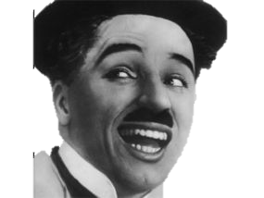
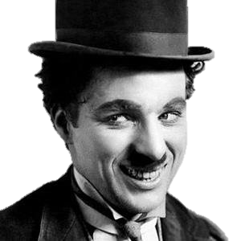
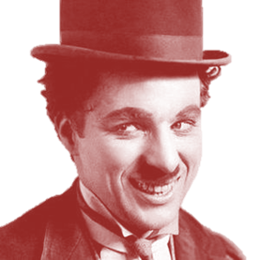
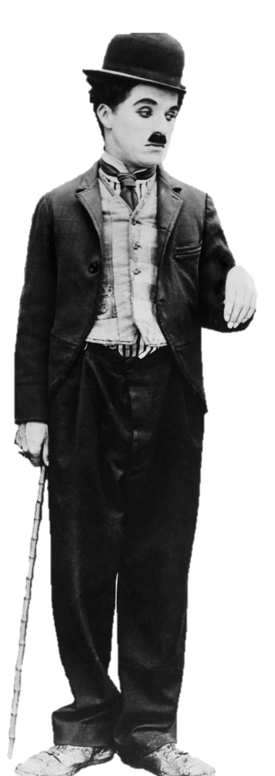
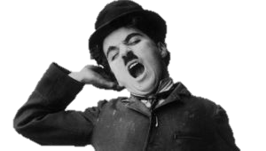
Image Registration
Linear Alignment

Slide 7
Image Registration
Deformable Alignment
before
after
after registered to before
Notes:
Image registration is useful in population and longitudinal studies. Non-rigid pairwise image registration provides a dense point-wise correspondence between the two input images.

Slide 8
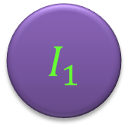
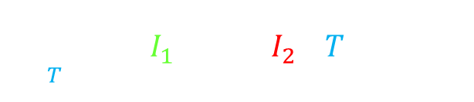

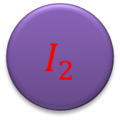
Image Registration Objective Function
Same-Contrast Images
$$I_{1}$$
$$I_{2}$$
$$T$$
Sum-of-squared-differences data term:
$$\underset{T}{argmin}{\int{{\left(I_{1}\left(x\right)−\left(I_{2}∘T\right)\left(x\right)\right)}^{2}dx}}$$
$I_{1},I_{2}$: Images
$T$: Transformation
Notes:
A change of variables and further calculation reveal that the data term is, remarkably, only a function of $T$, the transformation that takes one image to the other. So, we can minimize this data term directly with respect to $T$, as opposed to the previous methods that optimize their cost functions with respect to both $T_{1}$ and $T_{2}$, conditioned to constraints that prevent the mid-space drift. With this data term being independent of $T_{1}$ and $T_{2}$, the mid-space disappears, also eliminating the problem of the mid-space drift. We don’t need to enforce any anti-drift constraints anymore, and we won’t bias the space of possible transformations by the particular choice of such constraints. This is all while keeping the degrees of freedom of the optimization half of that of the unconstrained problem of solving for both $T_{1}$ and $T_{2}$. In addition, one can verify the symmetry of this data term, which, however, holds only in the continuous domain. In the discrete case, where one image is resampled and the other is not, discretization artifacts may produce a bias.

Slide 9
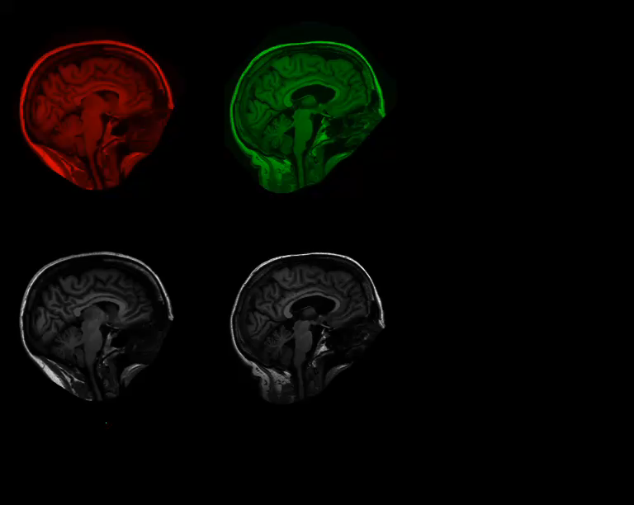


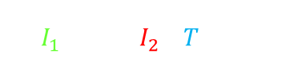
Image Registration Objective Function
Same-Contrast Images
$I_{1} ,$ $I_{2}∘T$
$${\left(I_{1}−I_{2}∘T\right)}^{2}$$
$$\int{{\left(I_{1}\left(x\right)−\left(I_{2}∘T\right)\left(x\right)\right)}^{2}dx}$$
Notes:
A change of variables and further calculation reveal that the data term is, remarkably, only a function of $T$, the transformation that takes one image to the other. So, we can minimize this data term directly with respect to $T$, as opposed to the previous methods that optimize their cost functions with respect to both $T_{1}$ and $T_{2}$, conditioned to constraints that prevent the mid-space drift. With this data term being independent of $T_{1}$ and $T_{2}$, the mid-space disappears, also eliminating the problem of the mid-space drift. We don’t need to enforce any anti-drift constraints anymore, and we won’t bias the space of possible transformations by the particular choice of such constraints. This is all while keeping the degrees of freedom of the optimization half of that of the unconstrained problem of solving for both $T_{1}$ and $T_{2}$. In addition, one can verify the symmetry of this data term, which, however, holds only in the continuous domain. In the discrete case, where one image is resampled and the other is not, discretization artifacts may produce a bias.

Slide 10
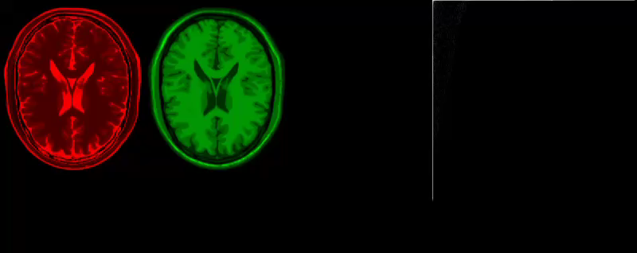
Image Registration Objective Function
Multi-Contrast Images
$I_{1} ,$ $I_{2}∘T$
Joint Entropy
(Mutual Information, Normalized Mutual Information, etc.)
Joint Histogram
(Wells et al, MedIA’96; Maes et al, TMI’97; Studholme et al, SPIE’98)
Brain images from the BrainWeb database (Collins et al, IEEE Trans Med Imag, 1998)
Notes:
A change of variables and further calculation reveal that the data term is, remarkably, only a function of $T$, the transformation that takes one image to the other. So, we can minimize this data term directly with respect to $T$, as opposed to the previous methods that optimize their cost functions with respect to both $T_{1}$ and $T_{2}$, conditioned to constraints that prevent the mid-space drift. With this data term being independent of $T_{1}$ and $T_{2}$, the mid-space disappears, also eliminating the problem of the mid-space drift. We don’t need to enforce any anti-drift constraints anymore, and we won’t bias the space of possible transformations by the particular choice of such constraints. This is all while keeping the degrees of freedom of the optimization half of that of the unconstrained problem of solving for both $T_{1}$ and $T_{2}$. In addition, one can verify the symmetry of this data term, which, however, holds only in the continuous domain. In the discrete case, where one image is resampled and the other is not, discretization artifacts may produce a bias.

Slide 11
Interpolation & Resampling
Notes:
A change of variables and further calculation reveal that the data term is, remarkably, only a function of $T$, the transformation that takes one image to the other. So, we can minimize this data term directly with respect to $T$, as opposed to the previous methods that optimize their cost functions with respect to both $T_{1}$ and $T_{2}$, conditioned to constraints that prevent the mid-space drift. With this data term being independent of $T_{1}$ and $T_{2}$, the mid-space disappears, also eliminating the problem of the mid-space drift. We don’t need to enforce any anti-drift constraints anymore, and we won’t bias the space of possible transformations by the particular choice of such constraints. This is all while keeping the degrees of freedom of the optimization half of that of the unconstrained problem of solving for both $T_{1}$ and $T_{2}$. In addition, one can verify the symmetry of this data term, which, however, holds only in the continuous domain. In the discrete case, where one image is resampled and the other is not, discretization artifacts may produce a bias.

Slide 12
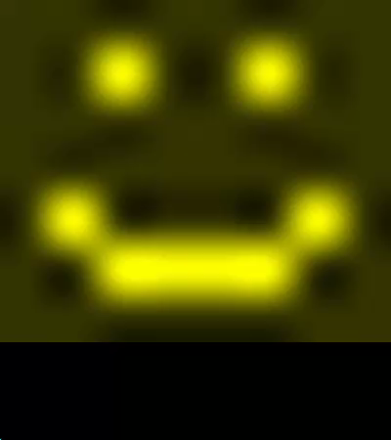
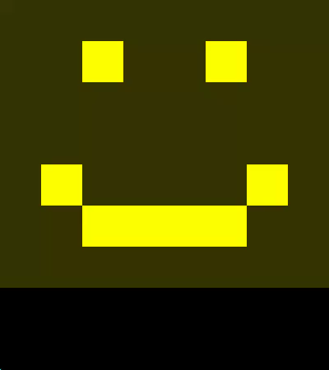
Asymmetry due to Resampling
Interpolation Artifacts
Resampling Artifacts
Notes:
A change of variables and further calculation reveal that the data term is, remarkably, only a function of $T$, the transformation that takes one image to the other. So, we can minimize this data term directly with respect to $T$, as opposed to the previous methods that optimize their cost functions with respect to both $T_{1}$ and $T_{2}$, conditioned to constraints that prevent the mid-space drift. With this data term being independent of $T_{1}$ and $T_{2}$, the mid-space disappears, also eliminating the problem of the mid-space drift. We don’t need to enforce any anti-drift constraints anymore, and we won’t bias the space of possible transformations by the particular choice of such constraints. This is all while keeping the degrees of freedom of the optimization half of that of the unconstrained problem of solving for both $T_{1}$ and $T_{2}$. In addition, one can verify the symmetry of this data term, which, however, holds only in the continuous domain. In the discrete case, where one image is resampled and the other is not, discretization artifacts may produce a bias.

Slide 13
Asymmetry in Non-Rigid Registration
$$I_{1}$$
$$I_{2}$$
$$I_{2}∘T$$
Notes:
In pairwise deformable image registration, we often minimize a cost function while deforming one image or both of them. The choice of the reference image affects the registration, thereby breaking the registration symmetry.

Slide 14
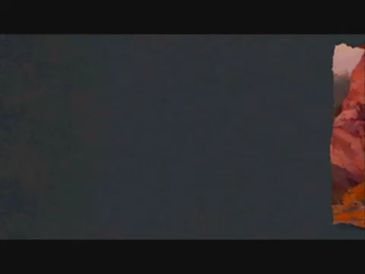
Notes:
In pairwise deformable image registration, we often minimize a cost function while deforming one image or both of them. The choice of the reference image affects the registration, thereby breaking the registration symmetry.

Slide 15
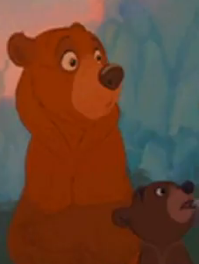
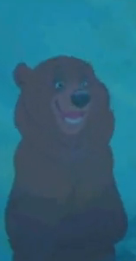
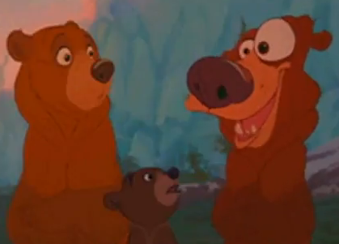
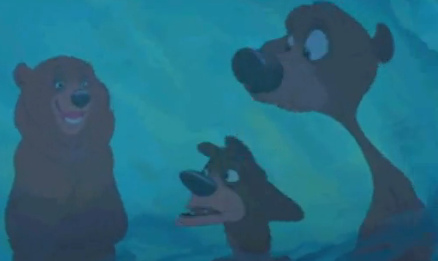




Asymmetry in Deformable Registration
$$I_{1}$$
$$I_{2}$$
$$I_{1}$$
$$I_{2}∘T$$
$$I_{1}∘T^{−1}$$
$$I_{2}$$
$$\int{{\left(I_{1}\left(x\right)−\left(I_{2}∘T\right)\left(x\right)\right)}^{2}dx} ≠ \int{{\left(\left(I_{1}∘T^{−1}\right)\left(x\right)−I_{2}\left(x\right)\right)}^{2}dx}$$
$$\underset{T}{argmin}{\int{{\left(I_{1}\left(x\right)−\left(I_{2}∘T\right)\left(x\right)\right)}^{2}dx}} ≠ \underset{T}{argmin}{\int{{\left(\left(I_{1}∘T^{−1}\right)\left(x\right)−I_{2}\left(x\right)\right)}^{2}dx} }$$
Brother Bear, © Disney
Notes:
In pairwise deformable image registration, we often minimize a cost function while deforming one image or both of them. The choice of the reference image affects the registration, thereby breaking the registration symmetry.

Slide 16
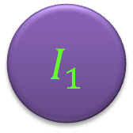



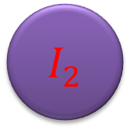
Mid-Space Approach to Symmetry
Mid-Space
$$T_{1}$$
$$T_{2}$$
$$I_{1}$$
$$I_{2}$$
$$T=T_{2}∘T_{1}^{−1}$$
$I_{1},I_{2}$: Images
$T_{1},T_{2}$: Transformations
(Lorenzen et al, MedIA’06; Avants et al, NI’04; Yang et al, PMB’08)
Notes:
In a common approach to achieve symmetry, both images are deformed and compared in a mid-space, which makes the registration invariant with respect to the ordering of the images. Such methods essentially minimize their cost functions with respect to two transformations $T_{1}$ and $T_{2}$ that take the two input images to the mid-space. Without additional constraints, however, this increases the degrees of freedom of the problem twofold, since the end result of pairwise registration is really one transformation, $T$, that takes the second input image to the first. In addition, the mid-space can drift arbitrarily far away from the native spaces of the images. To alleviate these issues, some additional anti-drift constraints are used to keep the mid-space “in between” the native spaces of the two images. For example, they may restrict $T_{1}$ and $T_{2}$ to have opposite displacement fields, or to be the inverse of each other. The choice of the anti-drift constraints may bias the registration algorithm towards favoring a particular set of transformations, and therefore affect the results.

Slide 17
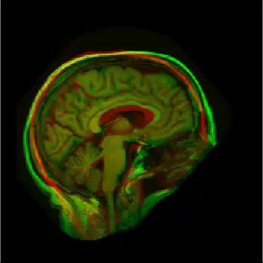

Regularization
$$I_{1}$$
$$I_{2}$$
$$I_{2}∘T$$
$$\underset{T}{argmin}{\int{{\left(I_{1}\left(x\right)−\left(I_{2}∘T\right)\left(x\right)\right)}^{2}dx}}$$
$T$: Transformation by sorting and matching pixel intensities
Example proposed by Rohlﬁng et al (IEEE Trans Med Imag, 2012)
Notes:
In a common approach to achieve symmetry, both images are deformed and compared in a mid-space, which makes the registration invariant with respect to the ordering of the images. Such methods essentially minimize their cost functions with respect to two transformations $T_{1}$ and $T_{2}$ that take the two input images to the mid-space. Without additional constraints, however, this increases the degrees of freedom of the problem twofold, since the end result of pairwise registration is really one transformation, $T$, that takes the second input image to the first. In addition, the mid-space can drift arbitrarily far away from the native spaces of the images. To alleviate these issues, some additional anti-drift constraints are used to keep the mid-space “in between” the native spaces of the two images. For example, they may restrict $T_{1}$ and $T_{2}$ to have opposite displacement fields, or to be the inverse of each other. The choice of the anti-drift constraints may bias the registration algorithm towards favoring a particular set of transformations, and therefore affect the results.

Slide 18
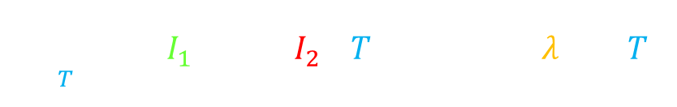

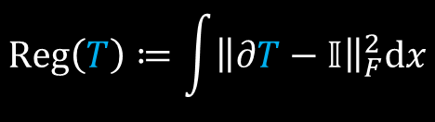
Regularization
$$\underset{T}{argmin}{\int{{\left(I_{1}\left(x\right)−\left(I_{2}∘T\right)\left(x\right)\right)}^{2}dx}+λReg\left(T\right)}$$
$$Reg\left(T\right)≔\int{{\left\|∂T−𝕀\right\|}_{F}^{2}dx}$$
$$\det{∂T}>0$$
(Diffeomorphism)
(Vercauteren et al, NeuroImage, 2009)
Notes:
In a common approach to achieve symmetry, both images are deformed and compared in a mid-space, which makes the registration invariant with respect to the ordering of the images. Such methods essentially minimize their cost functions with respect to two transformations $T_{1}$ and $T_{2}$ that take the two input images to the mid-space. Without additional constraints, however, this increases the degrees of freedom of the problem twofold, since the end result of pairwise registration is really one transformation, $T$, that takes the second input image to the first. In addition, the mid-space can drift arbitrarily far away from the native spaces of the images. To alleviate these issues, some additional anti-drift constraints are used to keep the mid-space “in between” the native spaces of the two images. For example, they may restrict $T_{1}$ and $T_{2}$ to have opposite displacement fields, or to be the inverse of each other. The choice of the anti-drift constraints may bias the registration algorithm towards favoring a particular set of transformations, and therefore affect the results.

Slide 19
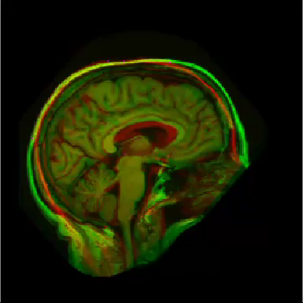
Regularization
Notes:
In a common approach to achieve symmetry, both images are deformed and compared in a mid-space, which makes the registration invariant with respect to the ordering of the images. Such methods essentially minimize their cost functions with respect to two transformations $T_{1}$ and $T_{2}$ that take the two input images to the mid-space. Without additional constraints, however, this increases the degrees of freedom of the problem twofold, since the end result of pairwise registration is really one transformation, $T$, that takes the second input image to the first. In addition, the mid-space can drift arbitrarily far away from the native spaces of the images. To alleviate these issues, some additional anti-drift constraints are used to keep the mid-space “in between” the native spaces of the two images. For example, they may restrict $T_{1}$ and $T_{2}$ to have opposite displacement fields, or to be the inverse of each other. The choice of the anti-drift constraints may bias the registration algorithm towards favoring a particular set of transformations, and therefore affect the results.

Slide 20
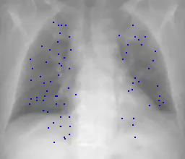
Validation of Registration
Manual Landmarks
CT images from DIR-LAB (Castillo et al, Phys Med Biol, 2009)
Notes:
In a common approach to achieve symmetry, both images are deformed and compared in a mid-space, which makes the registration invariant with respect to the ordering of the images. Such methods essentially minimize their cost functions with respect to two transformations $T_{1}$ and $T_{2}$ that take the two input images to the mid-space. Without additional constraints, however, this increases the degrees of freedom of the problem twofold, since the end result of pairwise registration is really one transformation, $T$, that takes the second input image to the first. In addition, the mid-space can drift arbitrarily far away from the native spaces of the images. To alleviate these issues, some additional anti-drift constraints are used to keep the mid-space “in between” the native spaces of the two images. For example, they may restrict $T_{1}$ and $T_{2}$ to have opposite displacement fields, or to be the inverse of each other. The choice of the anti-drift constraints may bias the registration algorithm towards favoring a particular set of transformations, and therefore affect the results.

Slide 21
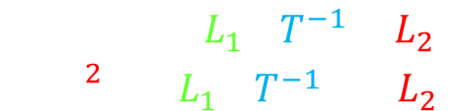
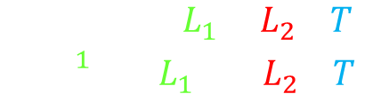


Validation of Registration
Manual Labels
$${Dice}_{1}≔\frac{2\left|L_{1}∩L_{2}∘T\right|}{\left|L_{1}\right|+\left|L_{2}∘T\right|}$$
$$L_{1}$$
$$L_{2}∘T$$
$${Dice}_{2}≔\frac{2\left|L_{1}∘T^{−1}∩L_{2}\right|}{\left|L_{1}∘T^{−1}\right|+\left|L_{2}\right|}$$
Label images of the “Buckner 40” dataset (Fischl et al, Neuron, 2002)
Notes:
In a common approach to achieve symmetry, both images are deformed and compared in a mid-space, which makes the registration invariant with respect to the ordering of the images. Such methods essentially minimize their cost functions with respect to two transformations $T_{1}$ and $T_{2}$ that take the two input images to the mid-space. Without additional constraints, however, this increases the degrees of freedom of the problem twofold, since the end result of pairwise registration is really one transformation, $T$, that takes the second input image to the first. In addition, the mid-space can drift arbitrarily far away from the native spaces of the images. To alleviate these issues, some additional anti-drift constraints are used to keep the mid-space “in between” the native spaces of the two images. For example, they may restrict $T_{1}$ and $T_{2}$ to have opposite displacement fields, or to be the inverse of each other. The choice of the anti-drift constraints may bias the registration algorithm towards favoring a particular set of transformations, and therefore affect the results.

Slide 22
Thank You!

