Slide 1
Intro to FreeSurfer Jargon
Notes:
This talk is an introduction to some common terms in FreeSurfer to give you a solid foundation for the rest of the course

Slide 2
Intro to FreeSurfer Jargon
voxel
surface
volume
vertex
surface-based
recon
cortical, subcortical
parcellation/segmentation
registration, morph, deform, transforms (computing vs. resampling)
Notes:
They might look like gibberish now, but hopefully by the end these terms will hold some meaning for you

Slide 3
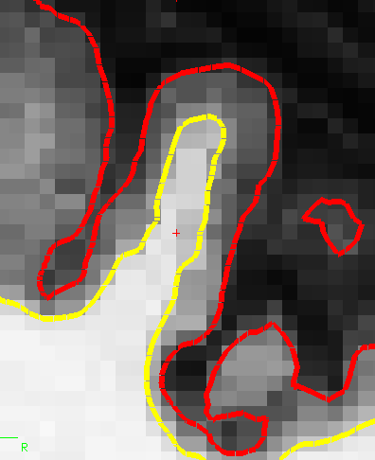
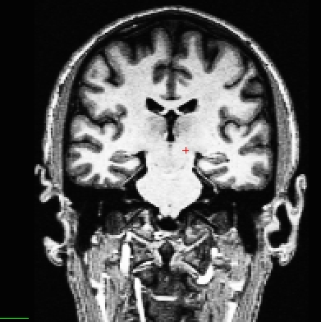
Intro to FreeSurfer Jargon
voxel
Notes:
If you zoom in on the MRI image on the left, you would see many little grey boxes (right)
tons of 2-D pixels make up this image, but with scan data we call them voxels (because they have a volume)
They have an area (as you see here in this slice), but each MRI slice also has a thickness (which you can’t see here), so it has volume too
Pixel is 2D, voxel is 3D
Typically our voxels are 1mm^3 in FreeSurfer

Slide 4
Intro to FreeSurfer Jargon
surface
Notes:
got all this data, want to divide it up to have some meaningful info about this subject
So another function of FS is to generate surfaces
Surface is a cortical boundary
White surface- between wm and gm (here the yellow line)
Pial surface- bewteen gm and pia/cerebral spinal fluid (here the red line)
colors not necessarily always red and yellow- can pick what colors you want them to be in Freeview

Slide 5
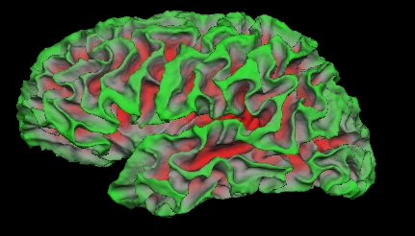
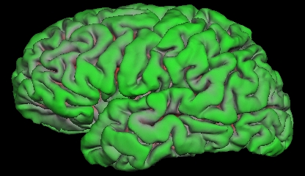
Intro to FreeSurfer Jargon
surface
Notes:
think of surfaces not only in terms of this 2D slice (picture on right) but also in terms of how they would look over the entire 3D structure of a brain
If you stack up every slice’s surfaces, you get these 3D versions on the left
Top left image: what boundary over all the wm in brain looks like – the white surface
can see into sulci
Bottom left image: what boundary over all the gm in brain looks like – the pial surface
probably more used to seeing this

Slide 6
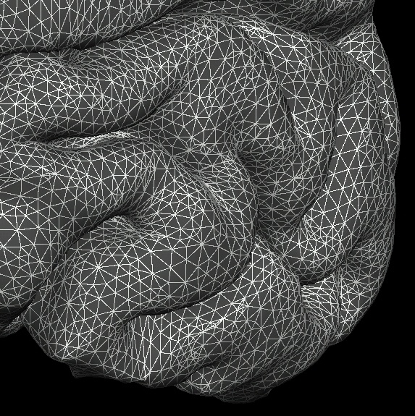
Intro to FreeSurfer Jargon
vertex
Notes:
Surface might look like just a solid line, but actually it is made up of many tiny points called vertices. (singular- vertex)
It is important to know that this is what makes up surfaces
b/c this is where we store all the information about the surface (and where we take measurements like thickness, curvature and others)

Slide 7
Recon
“recon your data”
…short for reconstruction
…cortical surface reconstruction
…shows up in command recon-all
Notes:
One of the most common terms you will hear is the word “recon”
Short for reconstruction, but that term refers to different things and we use it in several different ways
There are different types of reconstruction in MRI
In FreeSurfer we are referring to a cortical surface reconstruction, a surface model, not a k-space reconstruction (that will already be done, normally by the MRI scanner, to create the T1-weighted image you use as input to FreeSurfer)
Recon-all is how you process data in FreeSurfer. means recon everything- do all of the steps of the processing pipeline
Recon data=run through the processing stream and create a reconstruction
Finally, “check your recons” refers to the output of recon-all

Slide 8
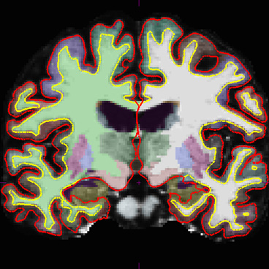
Recon
Notes:
Typical recon output

Slide 9
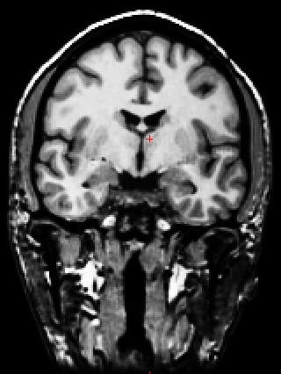
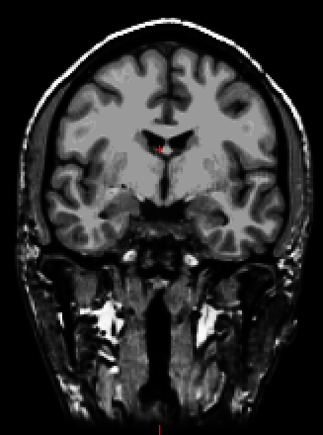
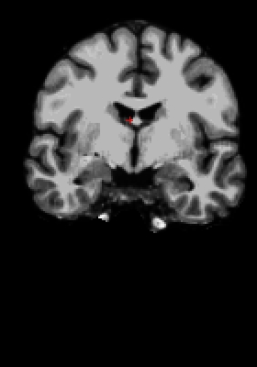
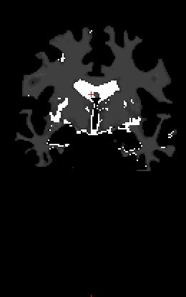
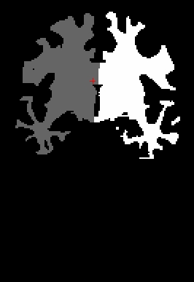
Volumes
orig.mgz
T1.mgz
brainmask.mgz
wm.mgz
filled.mgz
(Subcortical Mass)
Notes:
At many different points in the recon process, FS will generate files that look similar to MRI data -> called volumes
When we say “volumes”, we are usually referring to MRI data or mgz files created by FreeSurfer instead of actual volume measurements
Each one can tell you something a little different, which we will explain in a later talk

Slide 10
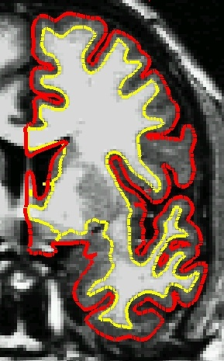
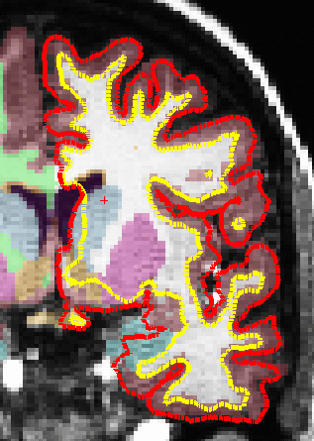
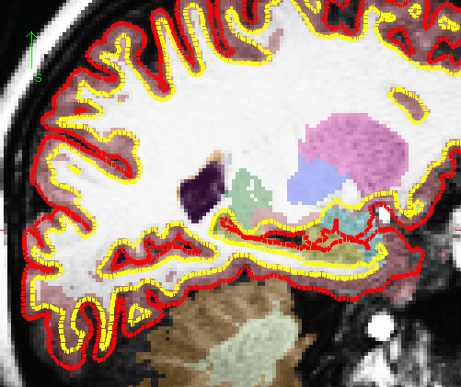
Cortical vs. Subcortical GM
cortical gm
subcortical gm
sagittal
coronal
Notes:
This is how we represent the two classes of gm- cortical and subcortical
Surfaces are used to get measurements on cortical gm
Surfaces NOT used to get measurements on subcortical gm (putamen, hippo etc.) – for those we use segmentation color maps in the volume
So it’s ok that the surfaces get a little funky around the subcort structures (shown in the green ovals)
you don’t have to worry or try to fix anything because they’re not being used for the subcortical measurements

Slide 11
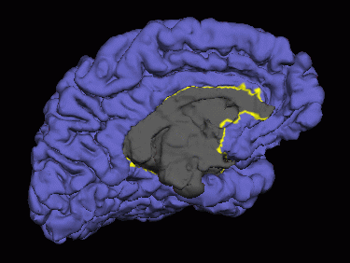
Cortical vs. Subcortical GM
subcortical gm
sagittal
coronal
Notes:
Image on left shows how the subcortical gm is masked out of the surfaces…
Blue/purple is cortical ribbon, gray is subcortical areas
The gray area isn’t included in surface measurements, so they don’t affect your surface statistics
Subcortical measures come from the color maps only
So again, an important point we want to stress is to not worry about the accuracy of the surfaces in subcortical regions

Slide 12
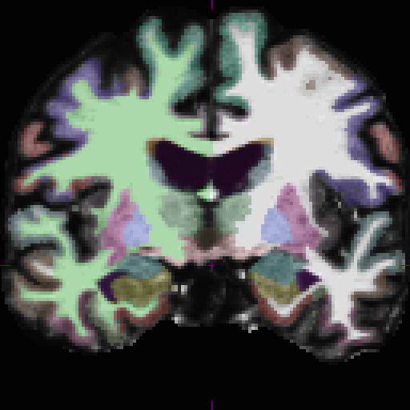
Parcellation vs. Segmentation
(cortical) parcellation
(subcortical) segmentation
Notes:
This is an example of two of the color maps FS produces
one for cortical ribbon
other for subcortical structures
parcellation refers to division of cortical areas
segmentation refers to division of subcortical areas, sometimes also segmentation of wm and gm

Slide 13
Intro to FreeSurfer Jargon
voxel
surface
volume
vertex
surface-based
recon
cortical, subcortical
parcellation/segmentation
registration, morph, deform, transforms (computing vs. resampling)
Notes:
We have covered all of the most common terms
The last section of terms that we didn’t go over (registration, transforms, etc.) will be covered by Doug tomorrow.

Slide 14
FreeSurfer Questions
Search for terms and answers
to all your questions in the Glossary, FAQ, or
FreeSurfer Mailing List Archives
Notes:
Links on FS wiki main page to glossary and FAQ
firefox opens to the schedule page. from there links to lecture slides and tutorials. follow along
----- Meeting Notes (2/26/15 12:32) -----
demo

Slide 15
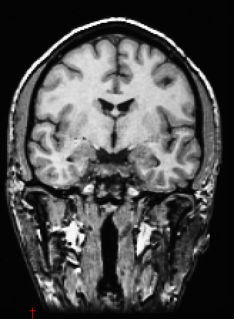
What FreeSurfer Does…
FreeSurfer creates computerized models of the brain from MRI data.
Input:
T1-weighted (MPRAGE)
1mm³ resolution
(.dcm)
Output:
Segmented & parcellated conformed volume
(.mgz)

Slide 16
Registration
Goal:
to find a common coordinate system for the input data sets
Examples:
comparing different MRI images of the same individual (longitudinal scans, diffusion vs functional scans)
comparing MRI images of different individuals

Slide 17
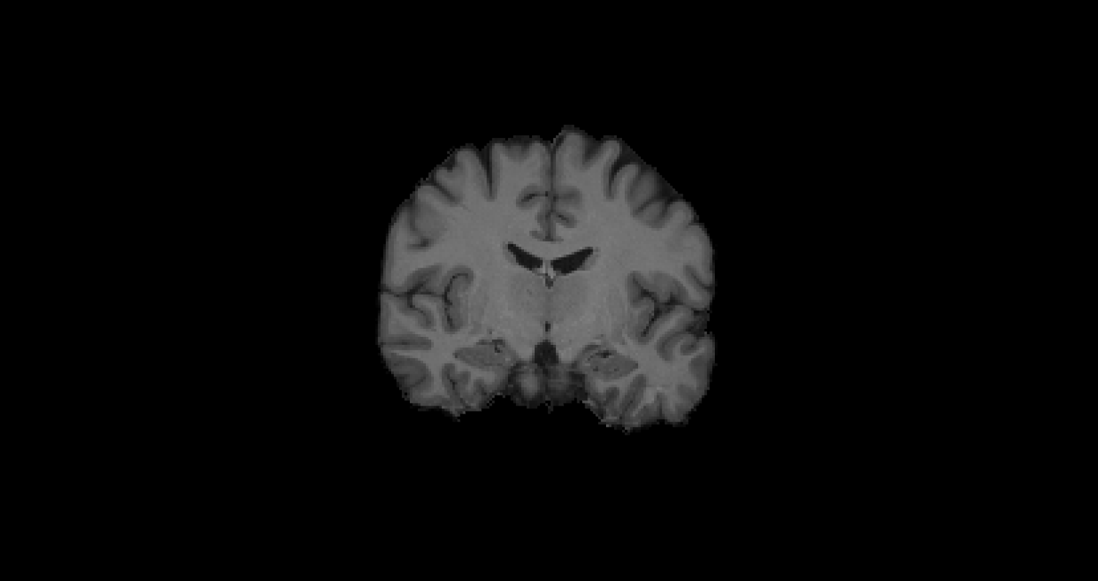
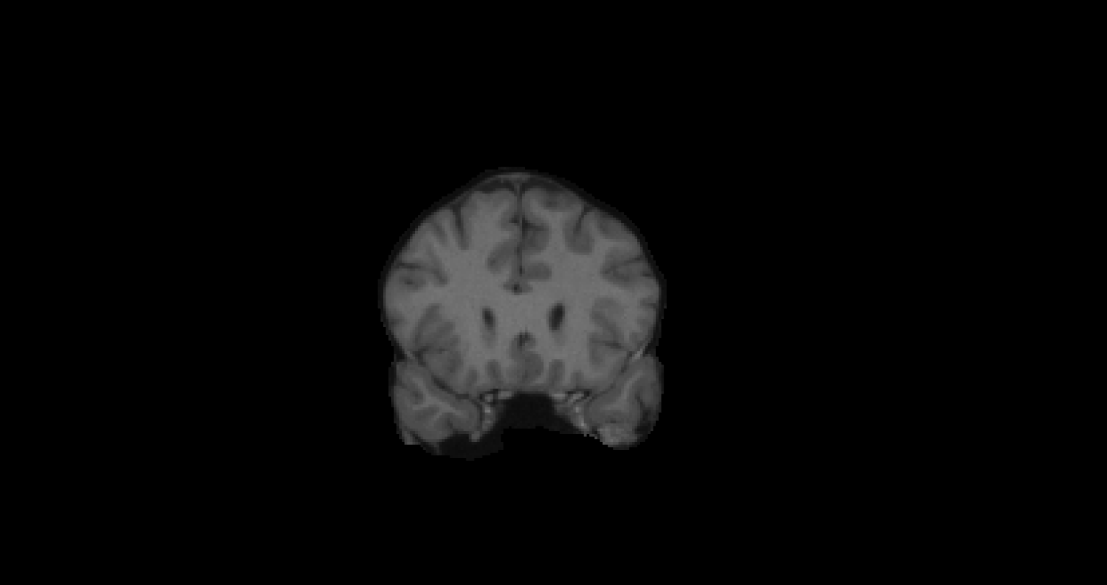
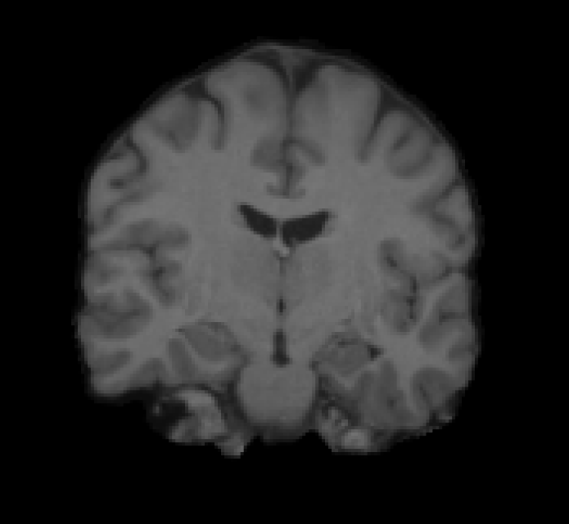

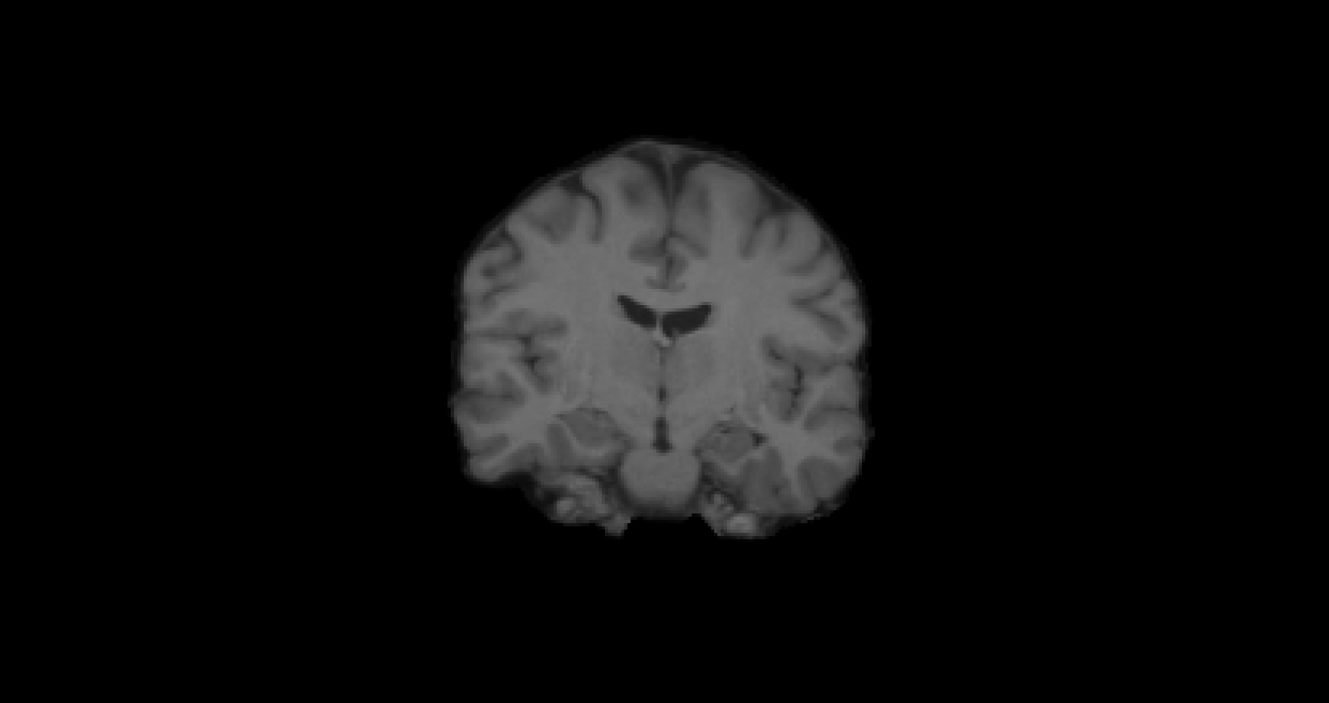
Inter-subject, uni-modal example
target
subject
Flirt 6 DOF
Flirt 9 DOF
Flirt 12 DOF
12/13/2011
Notes:
17

Slide 18
Linear registration: 6, 9, 12 DOF
target
subject
Flirt 12 DOF
Flirt 9 DOF
Flirt 6 DOF
Notes:
18

Slide 19
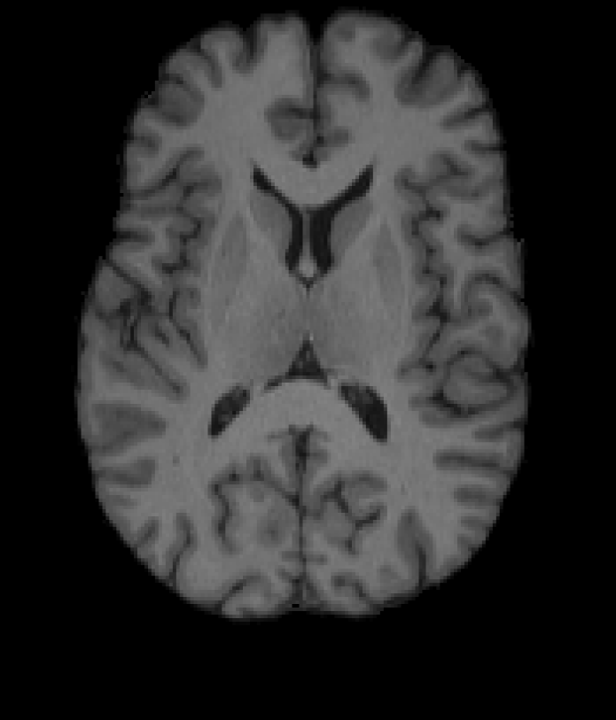
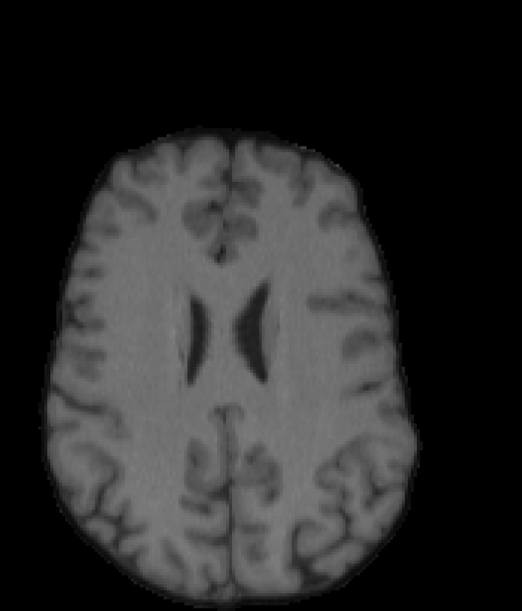
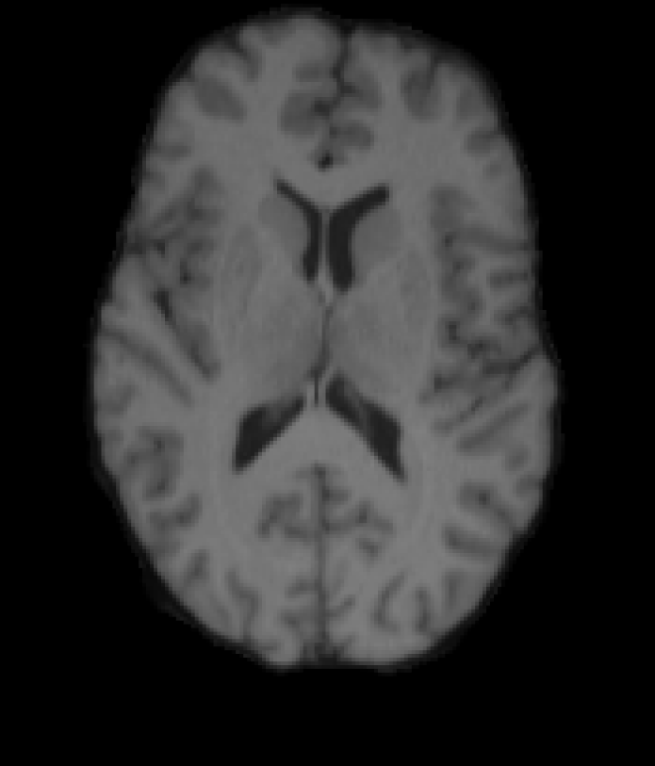
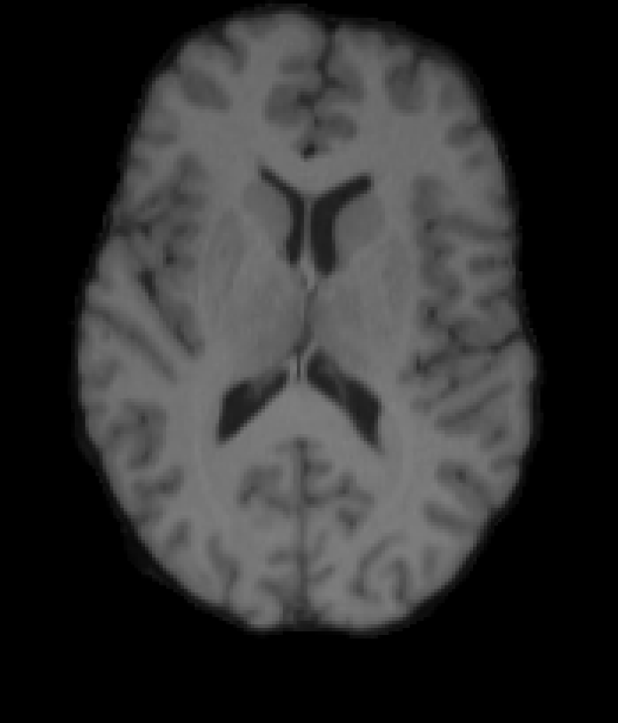
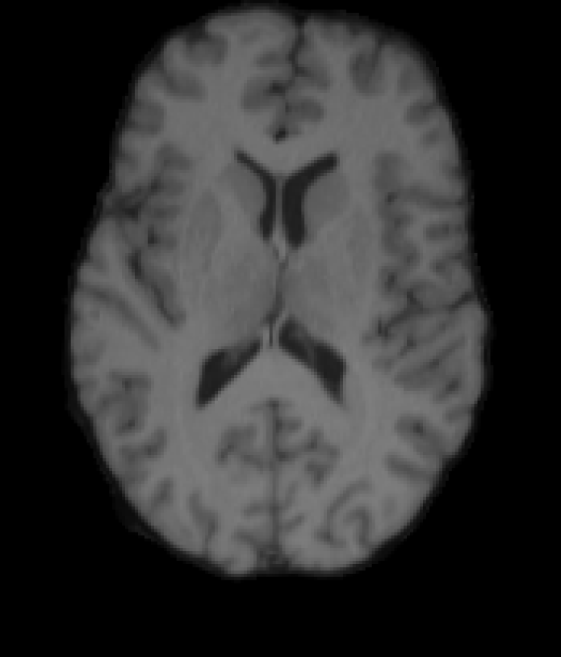
Linear registration: 6, 9, 12 DOF
Flirt 6dof
Flirt 9dof
target
subject
Flirt 12 DOF

Slide 20
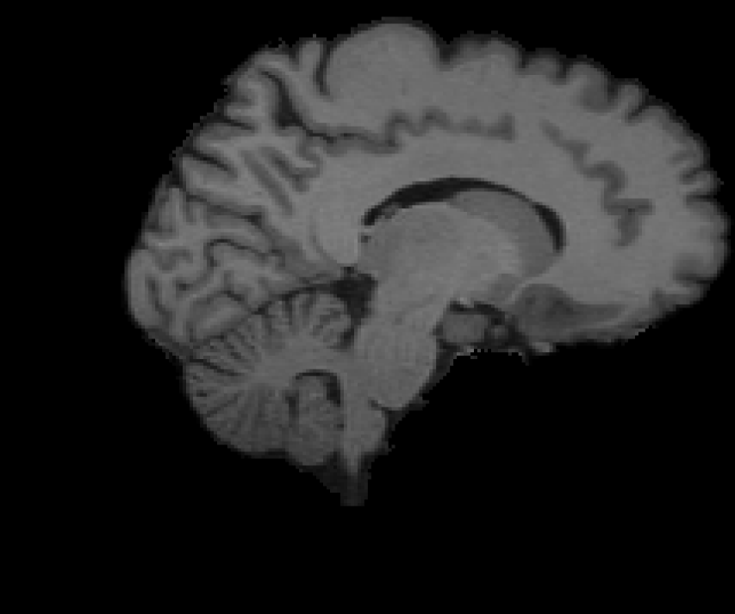
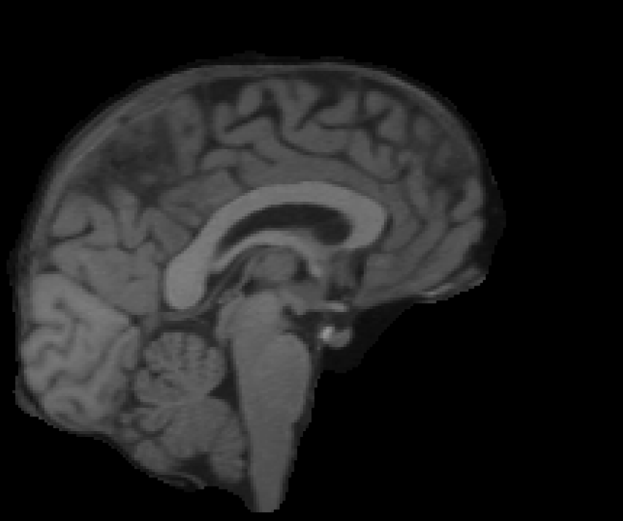
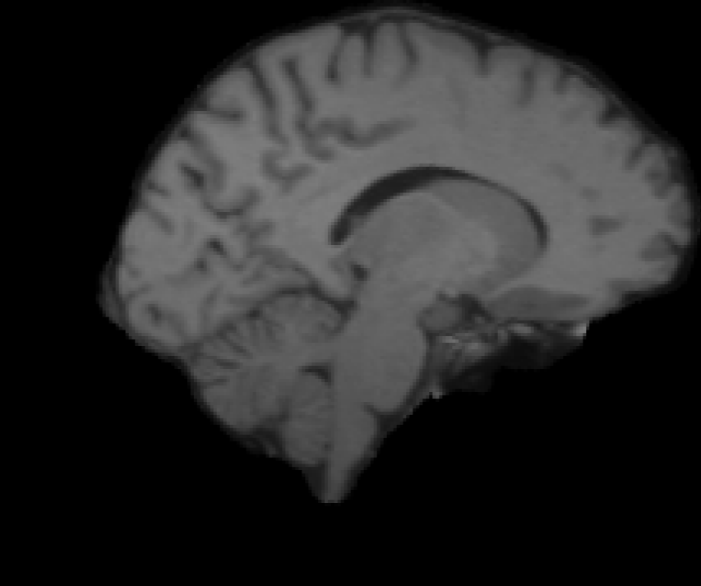

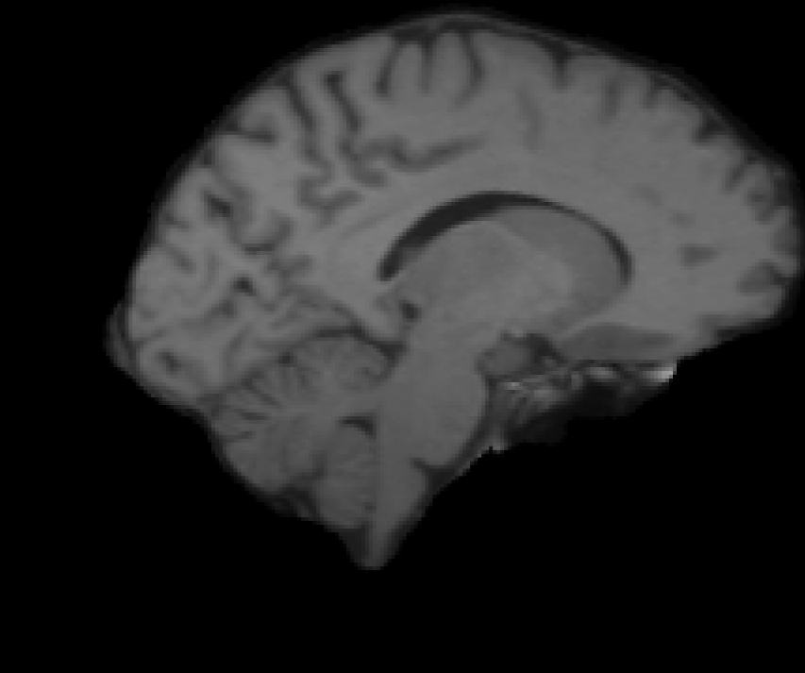
Linear registration: 6, 9, 12 DOF
Flirt 6 DOF
Flirt 9 DOF
target
subject
Flirt 12 DOF

Slide 21
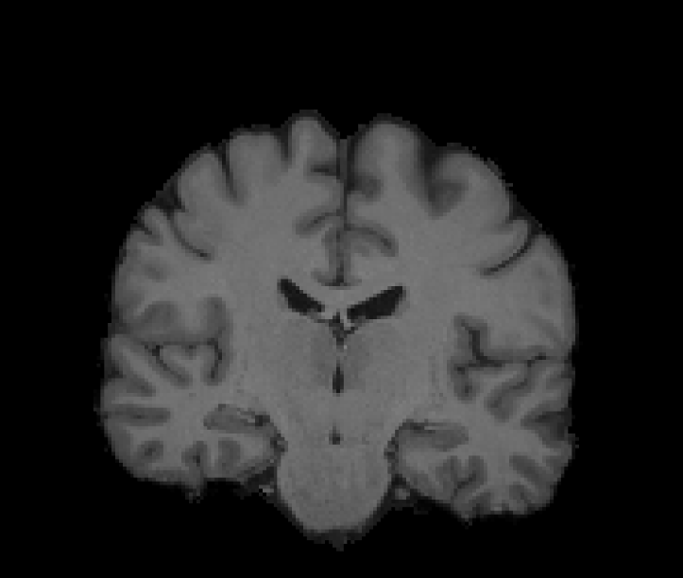
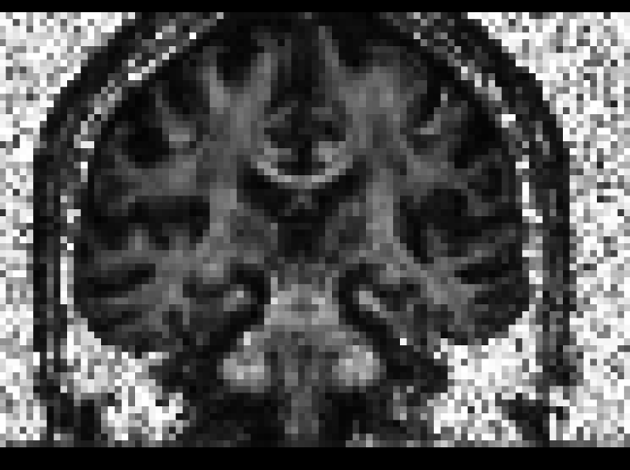
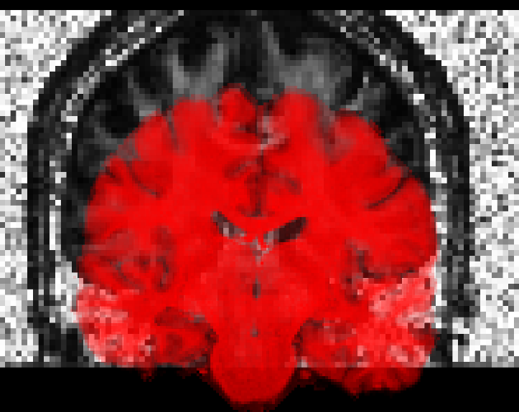
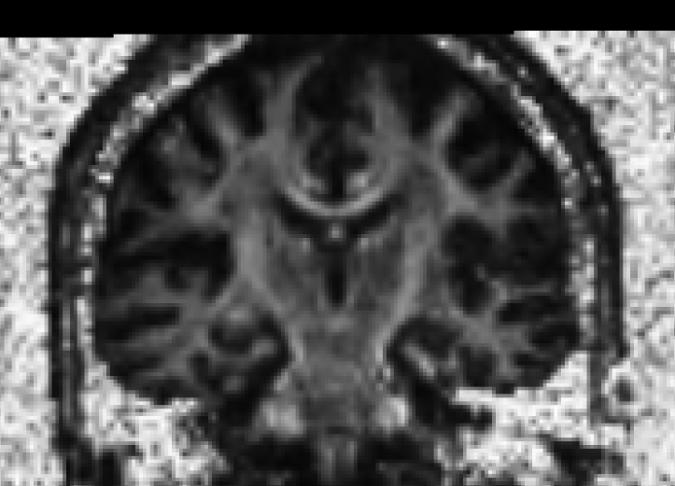
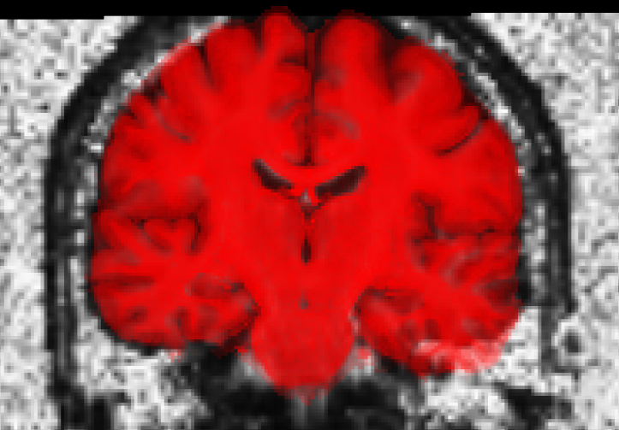
Intra-subject, multi-modal example
before spatial alignment
after spatial alignment

Slide 22
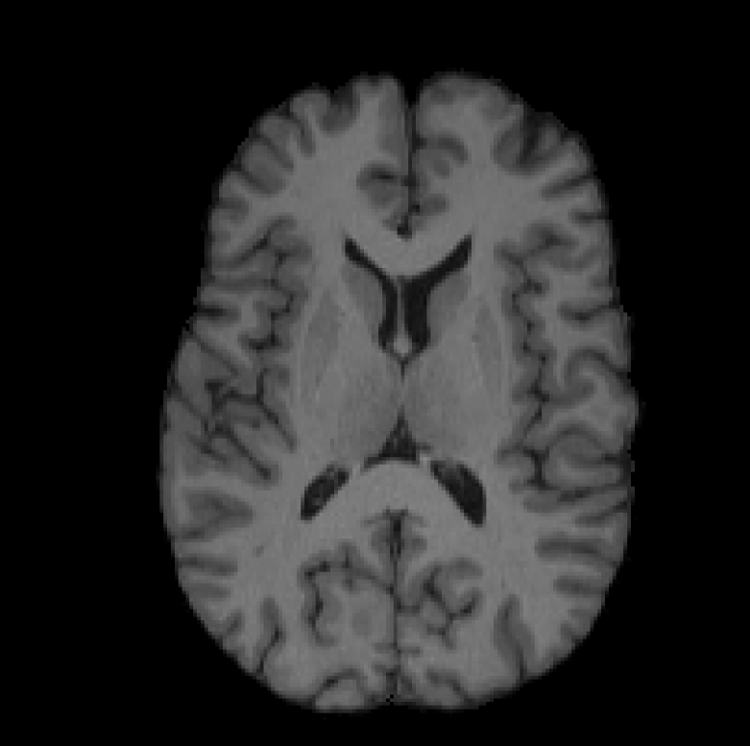
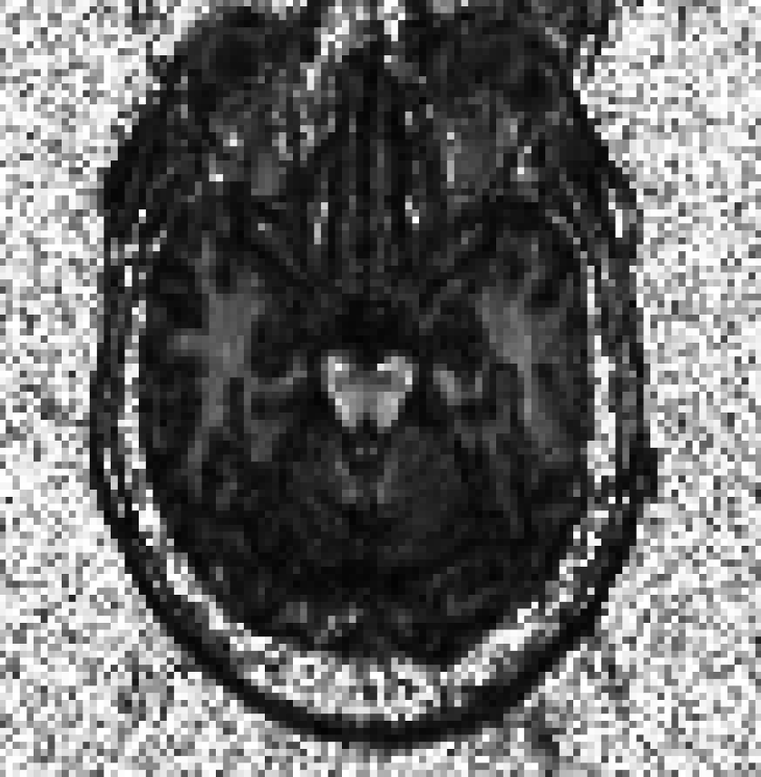
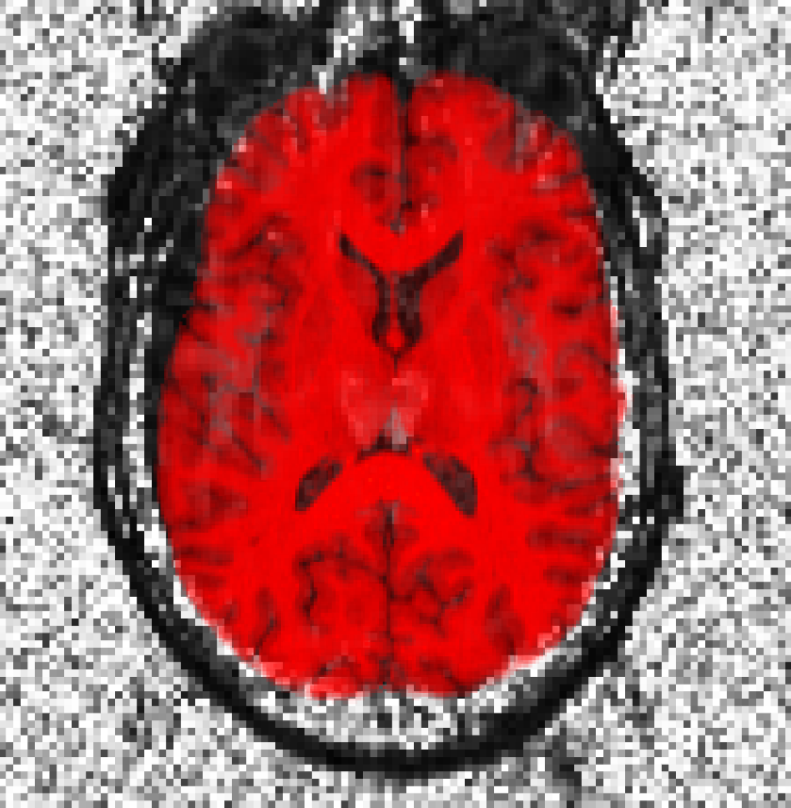
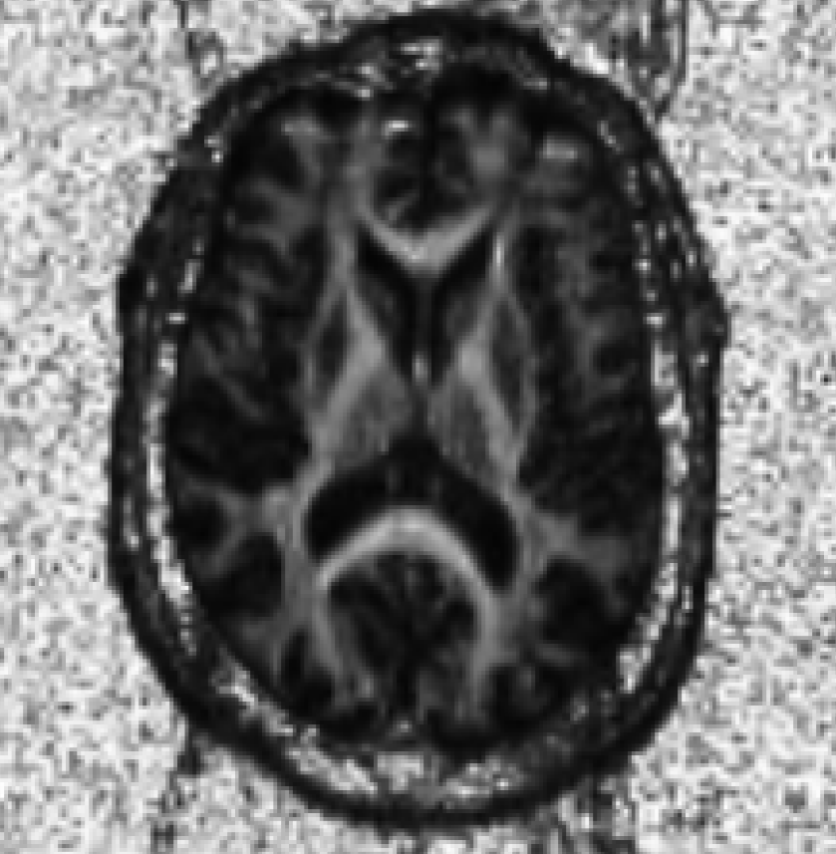
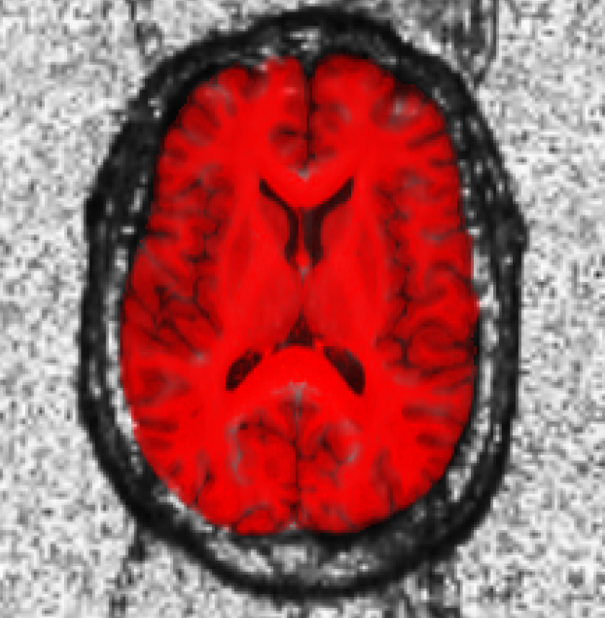
before spatial alignment
after spatial alignment

Slide 23
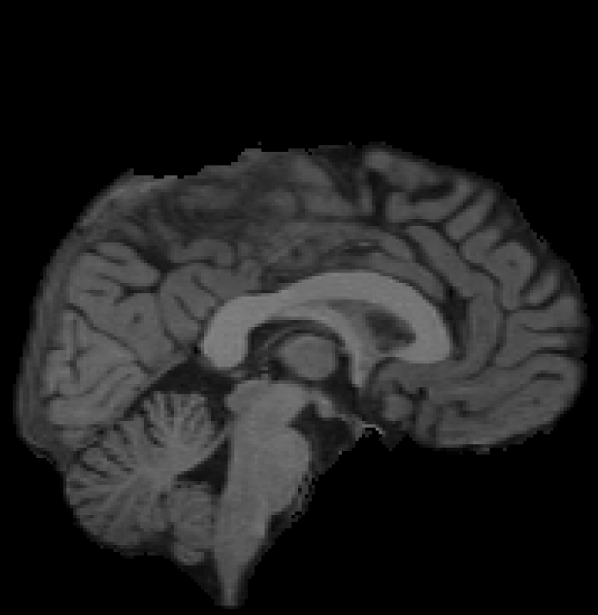
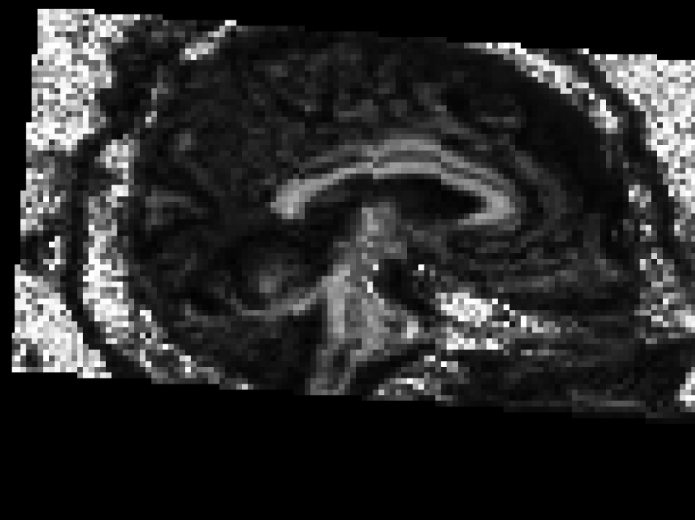
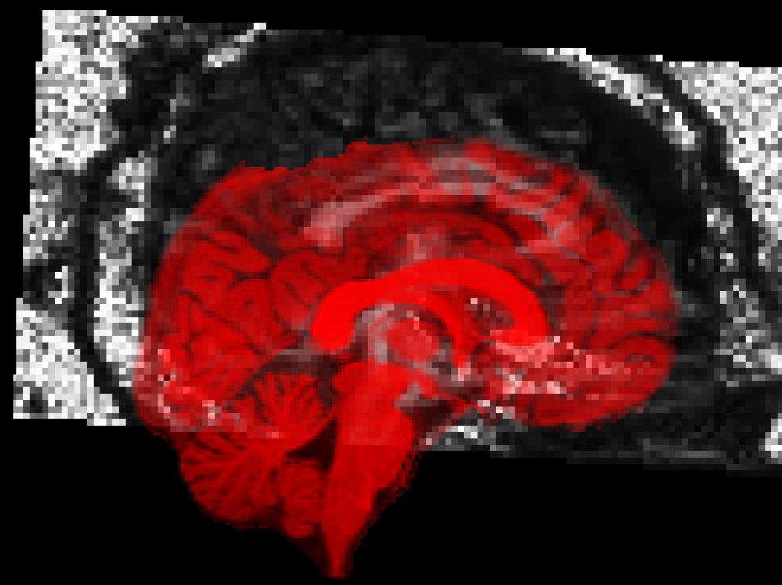
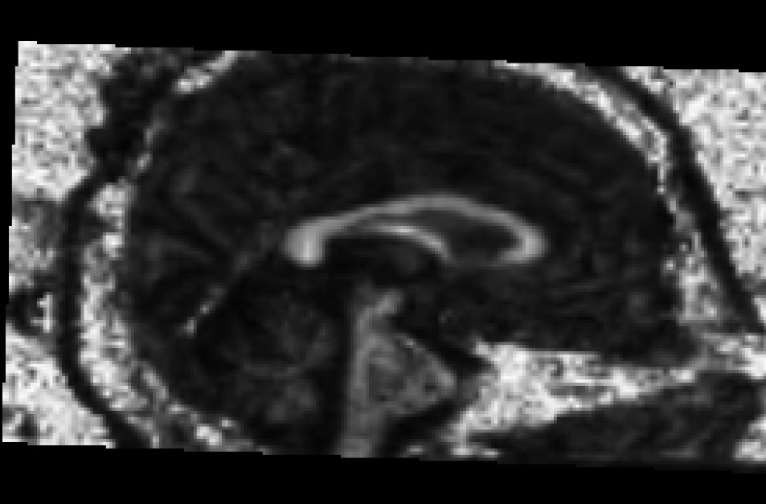
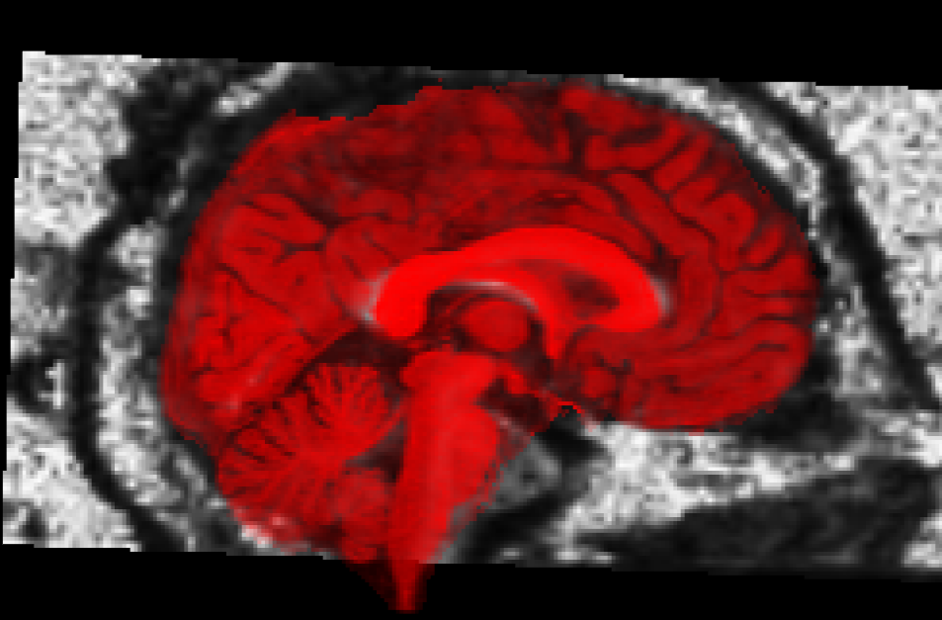
before spatial alignment
after spatial alignment

Slide 24
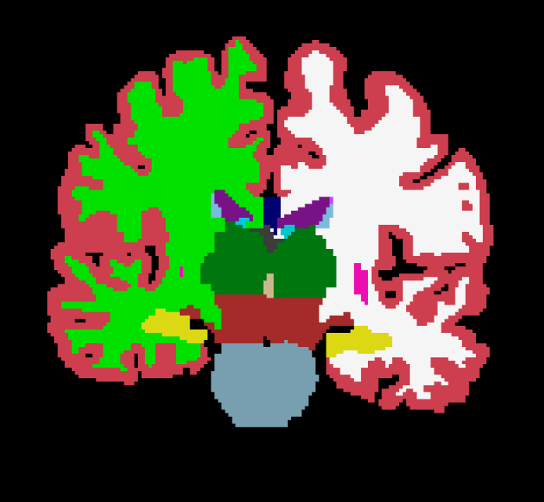
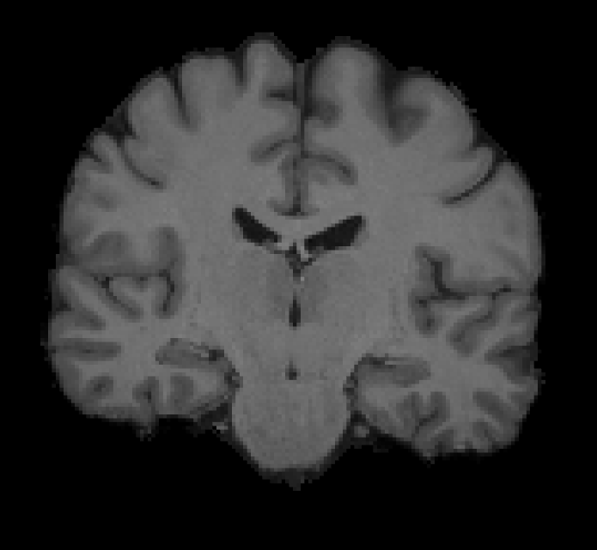
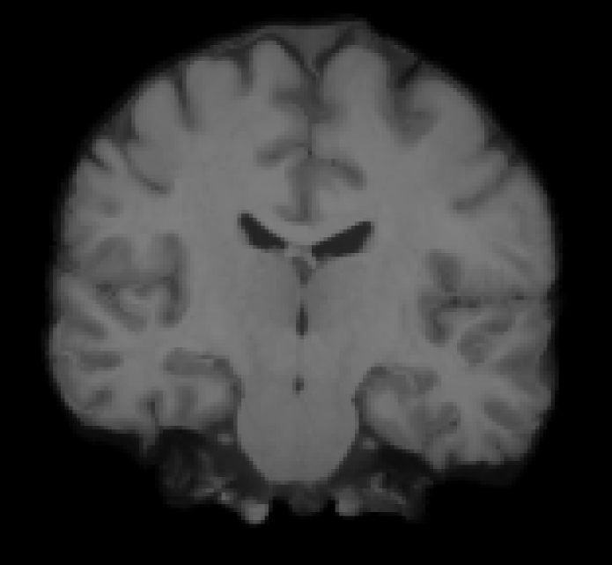
Inter-subject non-linear example
target
CVS reg

Slide 25
Some registration vocabulary
Input datasets:
  Fixed / template / target
  Moving / subject
Transformation models
  rigid
  affine
  nonlinear
Objective / similarity functions
Applying the results
  deform, morph, resample, transform
Interpolation types
  (tri)linear
  nearest neighbor

