Slide 1
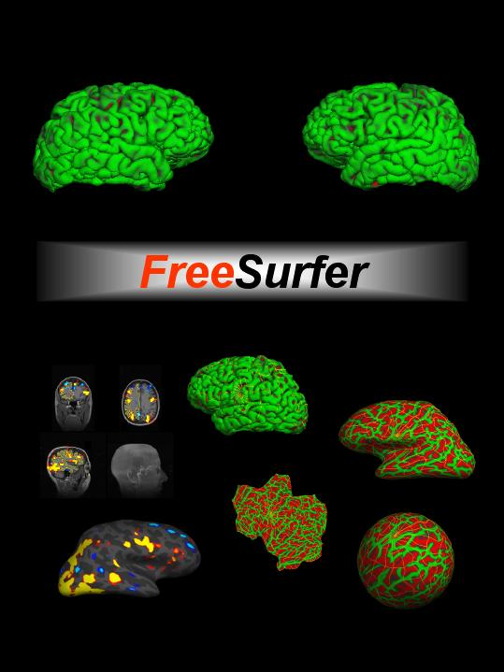


More Registration Techniques

Slide 2
registration tool summary
mris_register
fslregister: bet + flirt
bbregister
mri_robust_register
mri_cvs_register
mris_register
mri_nl_align
Notes:
Some require recons!
-with the registration tool summary slide, will you cover the strengths and weaknesses of each or when it is most appropriate to use them? Like
bbregister and cvs can only be used if you have surfaces, fsl takes into account X while robust_register takes into account Y so you would choose one over the other in such Z situations.

Slide 3
registration morph summary
.dat, .lta, .xfm, .fslmat: encode rigid and affine transformations
mri_vol2vol
sphere.reg: encodes spherical morph
mris_resample
.m3z: encode nonlinear volumetric morphs
mri_vol2vol
Notes:
Some require recons!

Slide 4
A new registration solution?
Surface-based (2D) registration does an excellent job of aligning cortical folds, but does not apply to non-cortical structures (e.g. basal ganglia).
Volumetric (3D) registration applies to the entire brain but does not, in general, align folding patterns.
Goal: combined their strength

Slide 5
Why aligning folds in the volume is hard…
Affine transform of surfaces from one subject mapped to another.
Notes:
Bruce’s brain affine transformed and mapped on Doug’s
Affine – does not provide the a good initialization; does not bring folds close enough for the basin of attraction

Slide 6
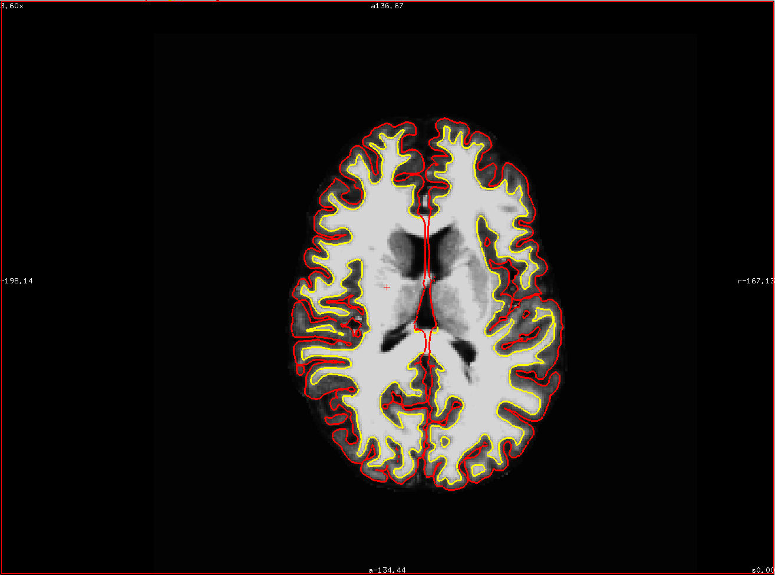
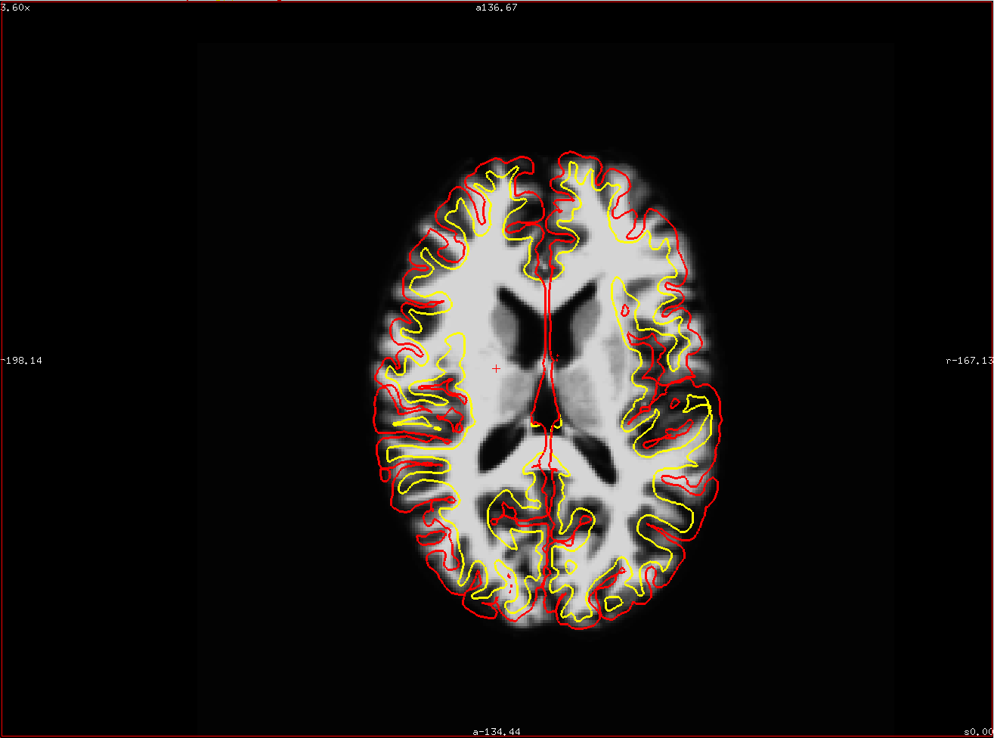
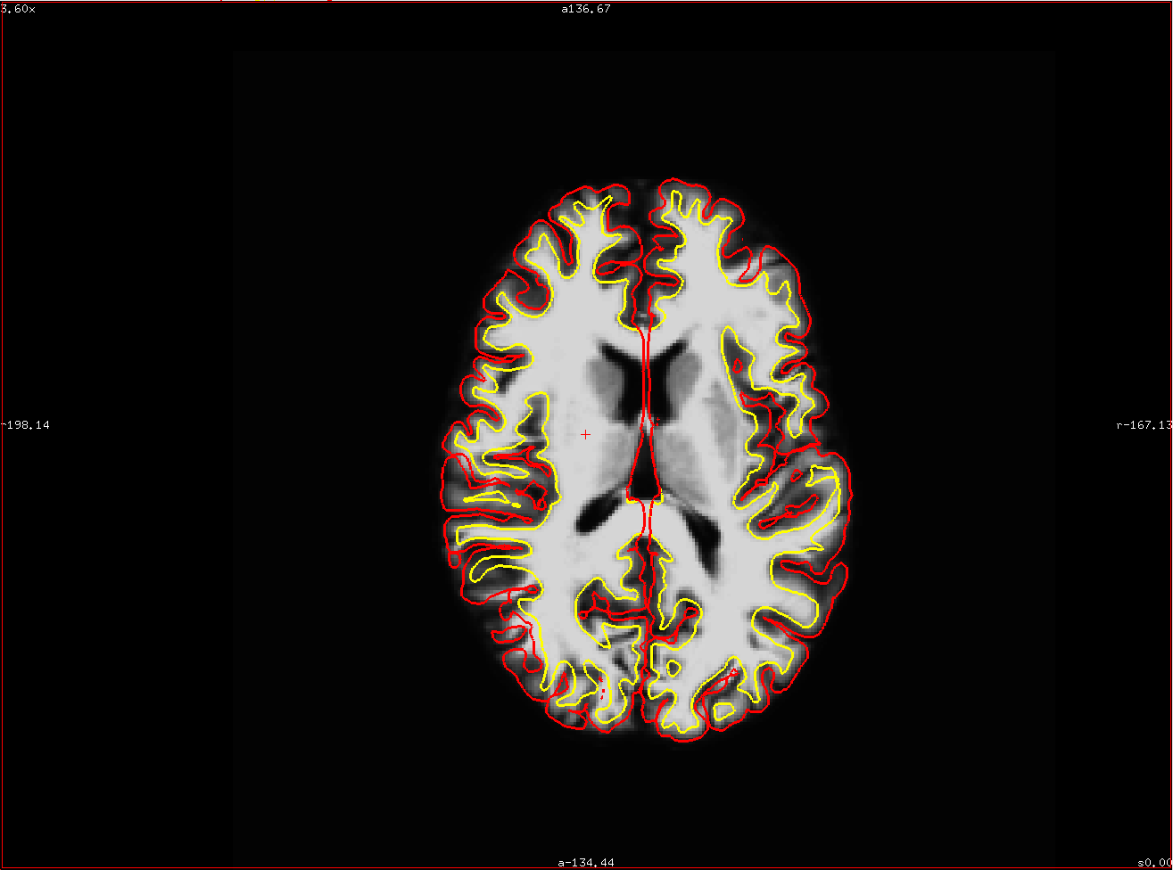
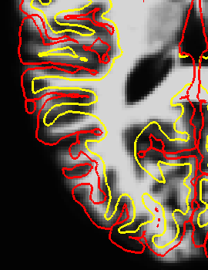
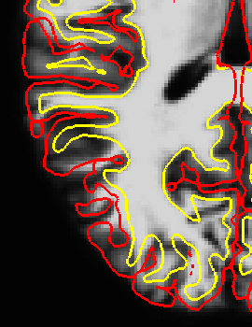
Template
Affine
Nonlinear
pial surface
WM surface
Notes:
Mention (red , yellow)

Slide 7
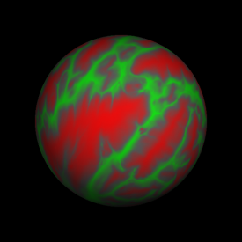
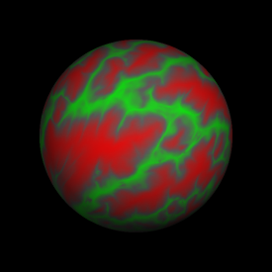
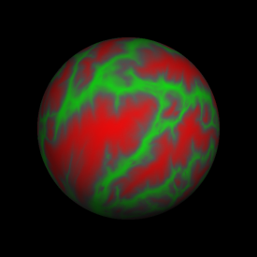
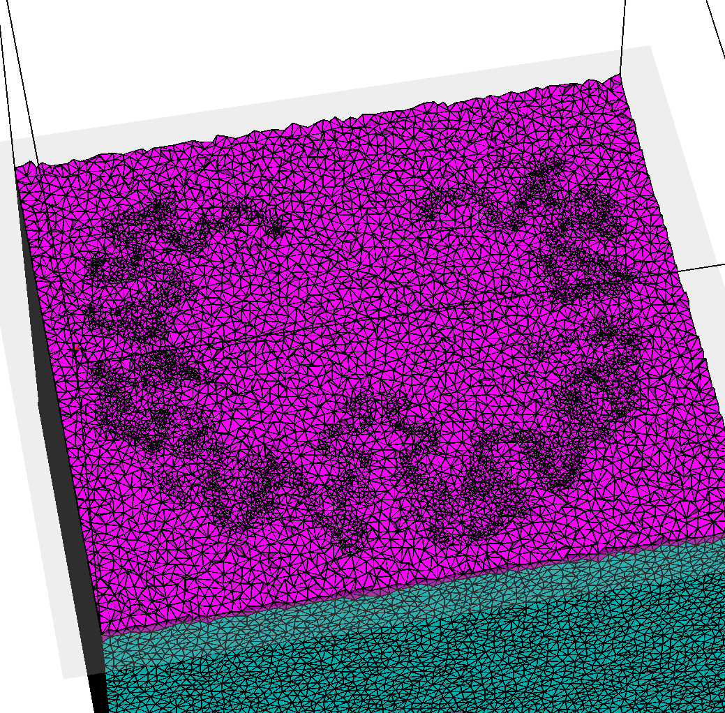
Combined volumetric and surface-based registration (CVS)
Spherical alignment
Elastic propagation of
cortical registration results
in the 3D volume
Volumetric alignment of sub-cortical regions
Notes:
sub-cortical alignment using cortical correspondence as initialization

Slide 8
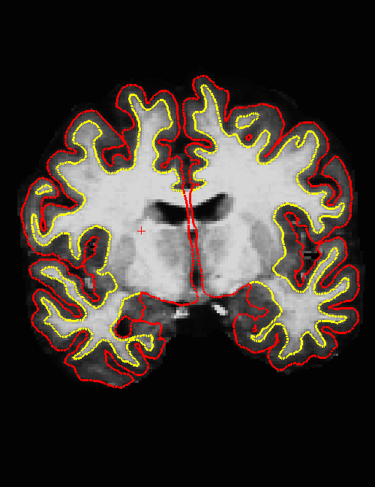
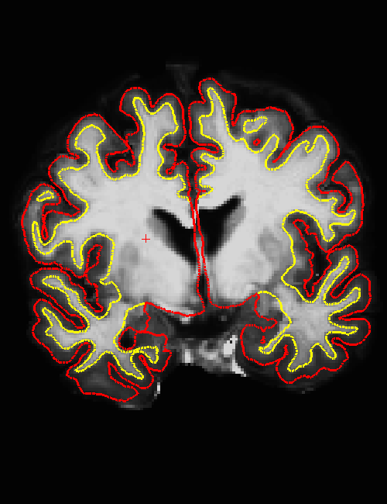

Resulting morph
Template
Elastic
CVS
Template

Slide 9
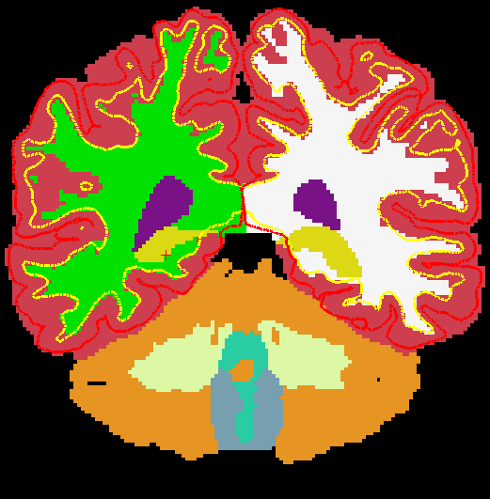
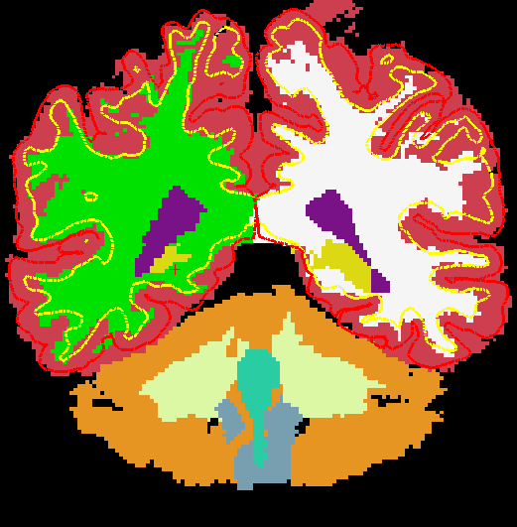
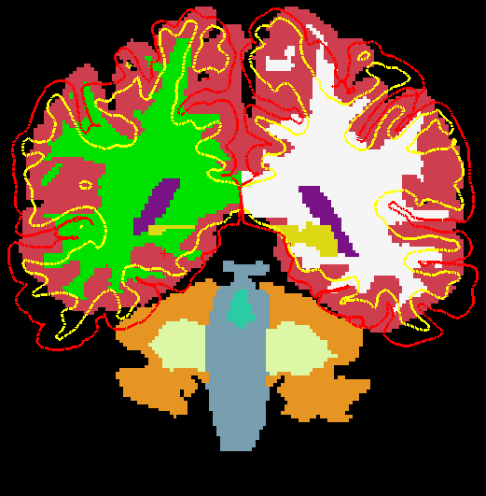
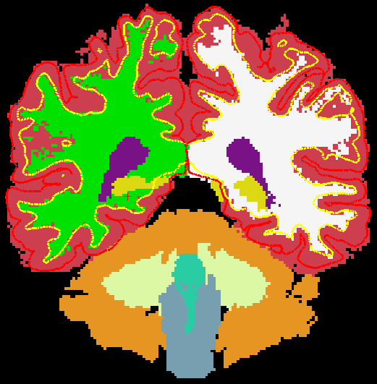
Template
HAMMER
FLIRT
CVS
Notes:
Examples of results obtained in Inter-Subject Experiment 2. The first column displays the template segmentation and the second, third and
fourth columns represent the deformed segmentation volumes resulting from FLIRT (affine), HAMMER and our new combined surface- and intensity-based registration. In all the images, the surfaces shown are those of the template (pial surfaces in red and gray/white surfaces in yellow).

Slide 10
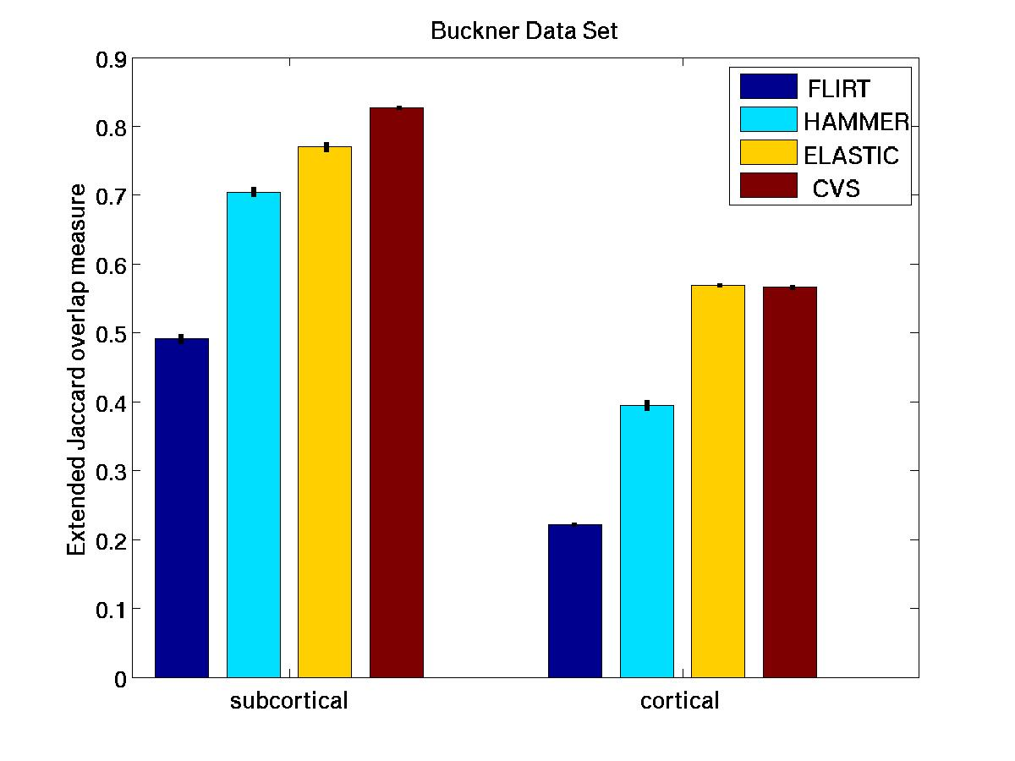
Extended Jaccard Coefficient measures: 20 cortical and 21 sub-cortical labels. (The vertical lines represent the standard error of the mean of the measurement.)
G.M. Postelnicu*, L . Zöllei*, B. Fischl: "Combined Volumetric and Surface Registration", IEEE Transactions on Medical Imaging (TMI), Vol 28 (4), April 2009, p. 508-522
Notes:
Extended Jaccard Coefficient (23) measures computed for Experiment 1. The last column of the cortical measures represents the overlap measure
computed in the surface space. The vertical lines represent the standard error of the mean of the measurement.

Slide 11
mri_cvs_register --mov subjid
registering the subject to, by default, the CVS atlas space
make sure that the SUBJECTS_DIR for subjid is correctly set
Optional Arguments
-- template subjid : subjid for template subject
-- templatedir dir : recon directory for template
(default is SUBJECTS_DIR)
--outdir dir : output directory for all the results
(default is SUBJECTS_DIR/subjid/cvs)
… and many more: use --help

Slide 12
mri_cvs_register
Optional Arguments (cont)
--step1
Only do step 1 (spherical registration).
--step2
Only do step 2 (elastic registration).
--step3
Only do step 3 (volumetric registration).
--noaseg
Do not use aseg volumes in the volumetric registration
pipeline (default is 0). Setting this option could shorten
significantly the time of registration, however, might also
take away from the accuracy of the final results.

Slide 13
mri_cvs_register
Optional Arguments (cont)
--nocleanup
Do not delete temporary files (default is 0).
--keepelreg
Do not delete elastic registration (default is 0) outcome.
--cleanall
Recompute all CVS-related morphs that might have been computed prior to the current CVS run (def = 0).
--cleansurfreg
Recompute CVS-related surface registration morphs that might have been computed prior to the current CVS run (def = 0).
--cleanelreg
Overwrite /recompute the CVS-related elastic registration morph that might have been computed prior to the current CVS run (default is 0).
--cleanvolreg
Overwrite / recompute CVS-related volumetric morphs that might have been computed prior to the current CVS run (default is 0).

Slide 14
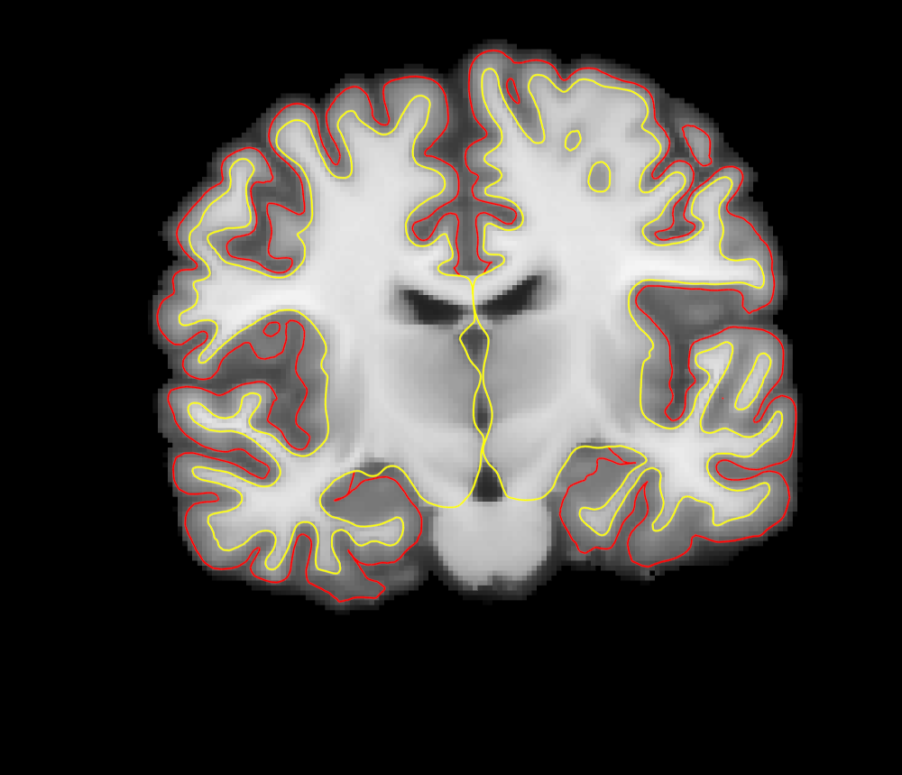
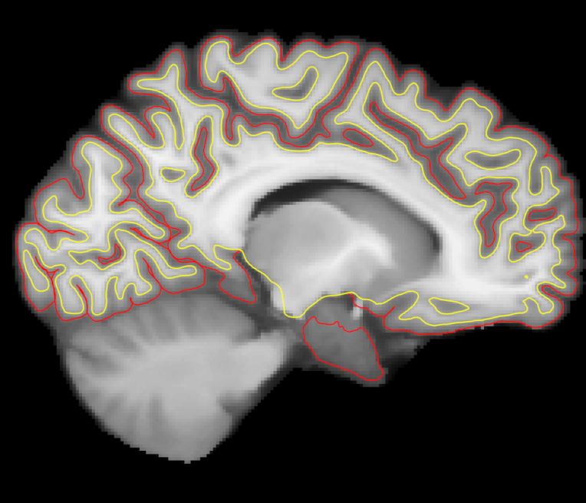
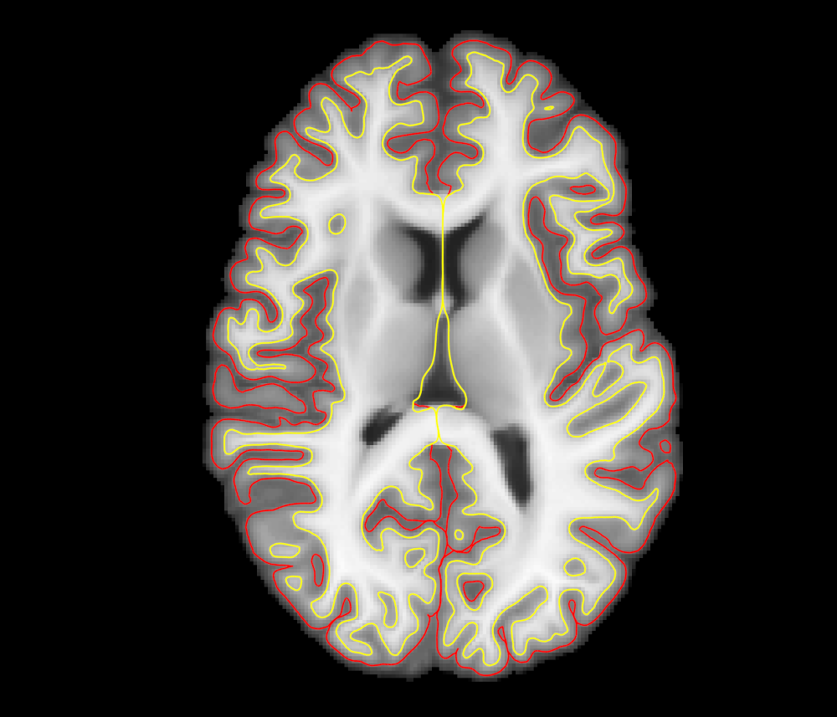
CVS atlas
path: $FREESURFER_HOME/subjects/cvs_avg35

Slide 15
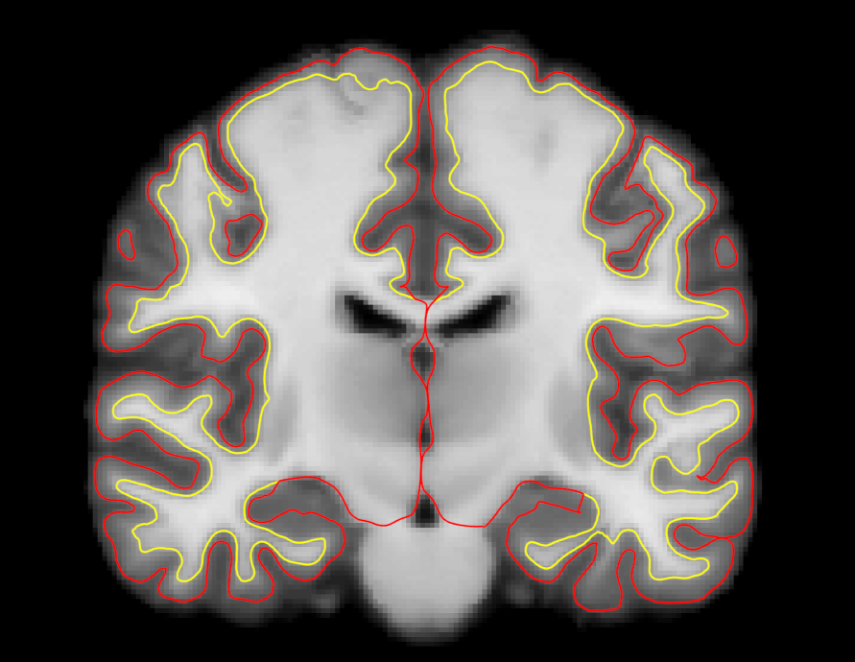
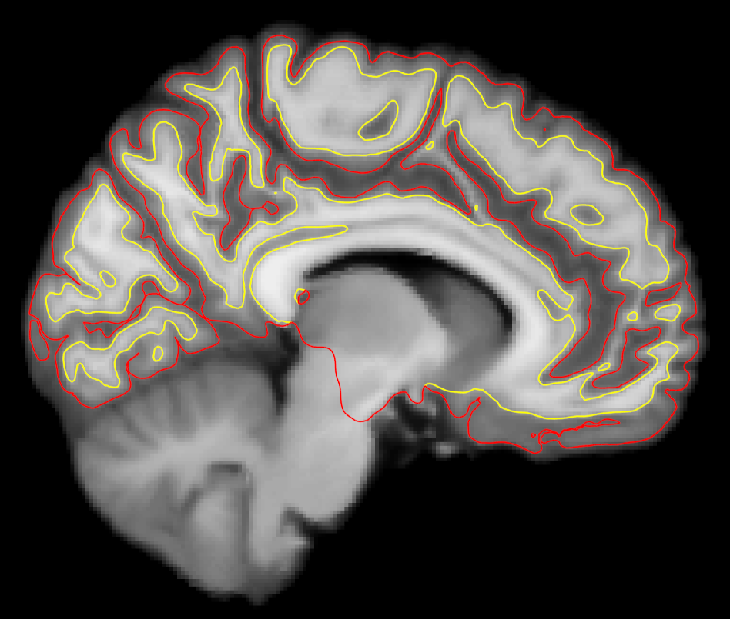
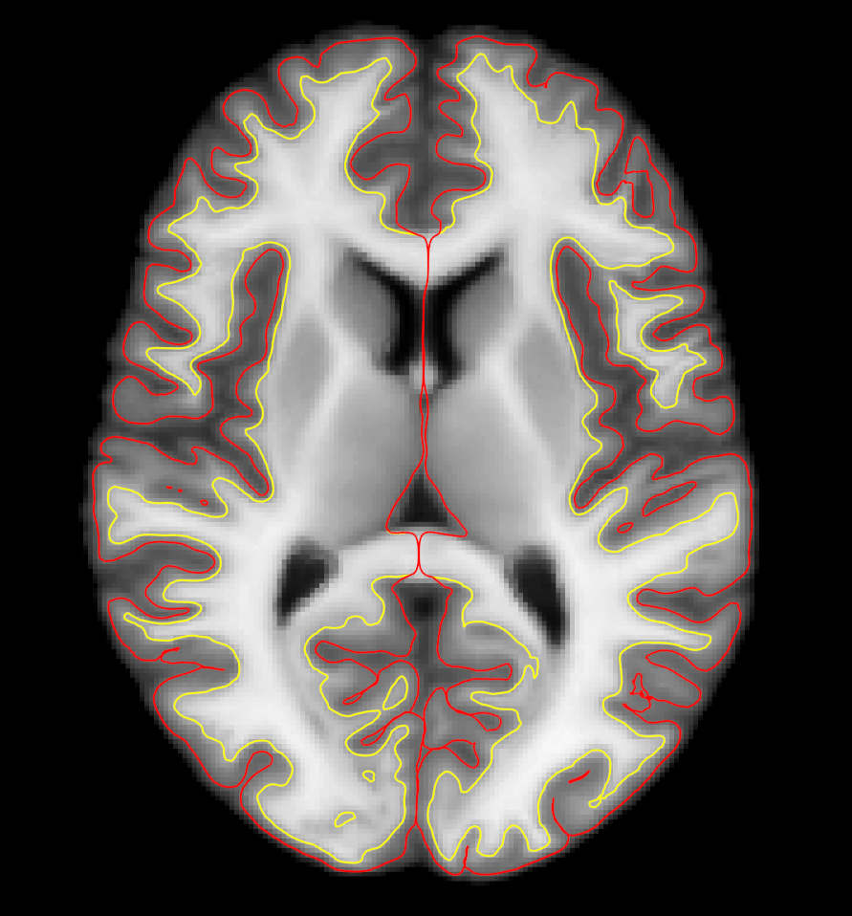
CVS atlas in MNI152 space
path: $FREESURFER_HOME/subjects/ cvs_avg35_inMNI152/

Slide 16
related commands
mri_cvs_check
checking whether all files needed for a successful CVS registration are present
mri_cvs_data_copy
copying the CVS-relevant recon directories over to a new location
mri_vol2vol
applying the CVS registration morph to files corresponding to the moving subject

Slide 17
Applying CVS morphs
mri_vol2vol
applying CVS morph to aseg file
mri_vol2vol --targ templateid --m3z morph.m3z \
--noDefM3zPath --mov asegvol \
--o asegvol2CVS --interp nearest \
--no-save-reg
applying morph to corresponding diffusion file
mri_vol2vol --targ templateid --m3z morph.m3z
--noDefM3zPath --reg 2anat.register.dat
--mov diffvol --o diffvol2CVS
--no-save-reg

Slide 18
Application of CVS to tractography
Goal: fiber bundle alignment
Study: compare CVS to methods directly aligning DWI-derived scalar volumes
Conclusion: high accuracy cross-subject registration based on structural MRI images can provide improved alignment
Zöllei, Stevens, Huber, Kakunoori, Fischl: “Improved Tractography Alignment Using Combined Volumetric and Surface Registration”, NeuroImage 51 (2010), 206-213

Slide 19
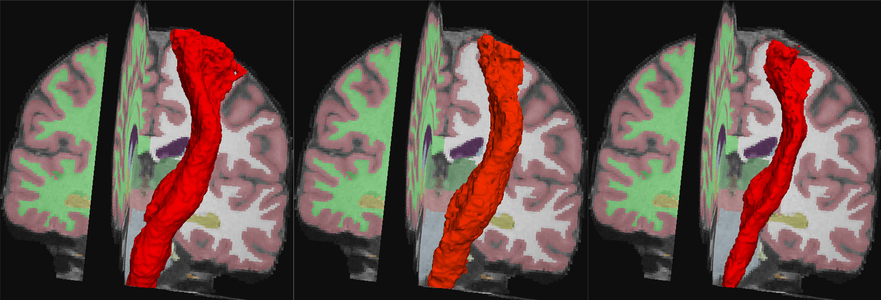
Average tracts after registration mapped to the template displayed with iso-surfaces
FLIRT
FA-FNIRT
CVS
Notes:
The probability maps were thresholded at 0.1

Slide 20
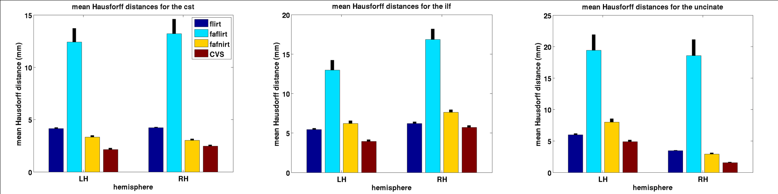
Mean Hausdorff distance measures for three fiber bundles
CST
ILF
UNCINATE

Slide 21
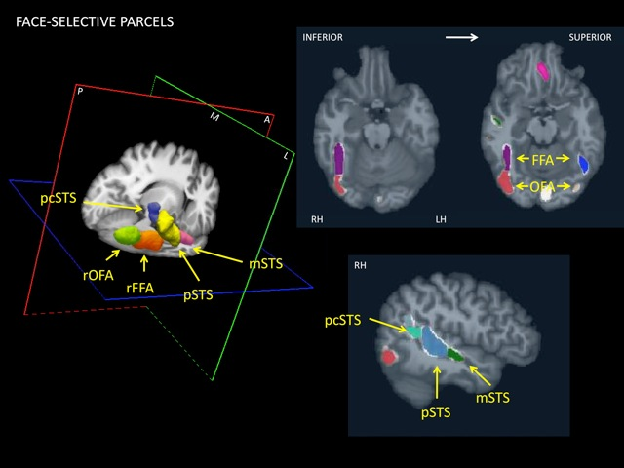
Functional MRI analysis in CVS space
Collaboration with Kami Koldewyn, Joshua Julien and Nancy Kanwisher at MIT

Slide 22
Ongoing development
Improve CVS capability to register ex-vivo to in-vivo acquisitions
Implemented MI-based volumetric registration (for CVS step 3) to accommodate intensity profile differences
Qualitative preliminary results on 4 subjects
L. Zöllei, Allison Stevens, Bruce Fischl: Non-linear Registration of Intra-subject Ex-vivo and In-vivo Brain Acquisitions, Human Brain Mapping, June 2010
L. Zöllei, B. Fischl, Automatic segmentation of ex-vivo MRI images using CVS in FreeSurfer, HBM 2011

Slide 23
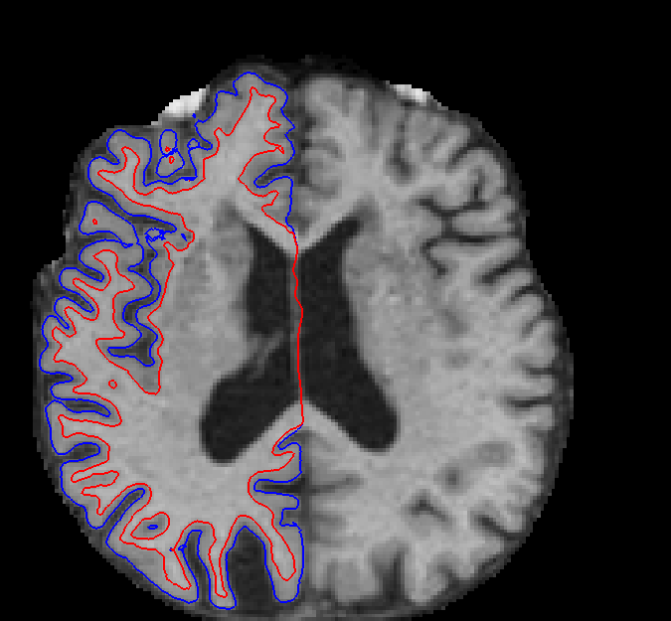
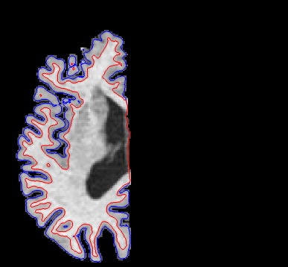
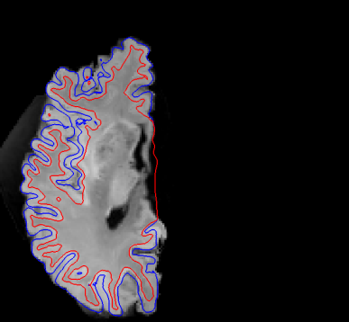
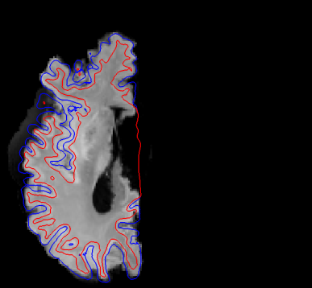
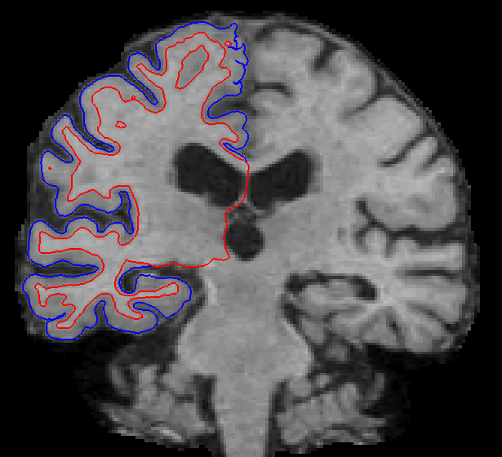
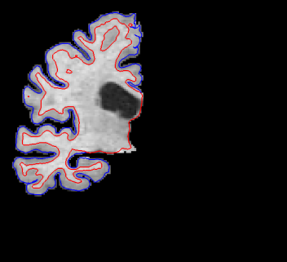
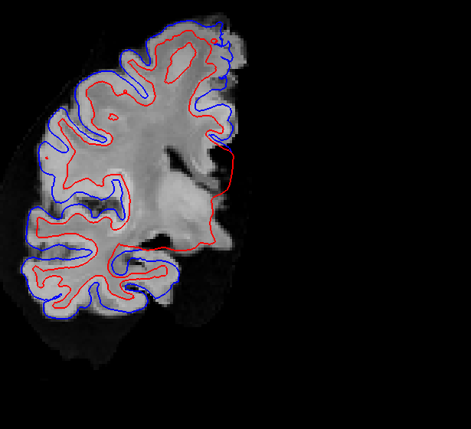
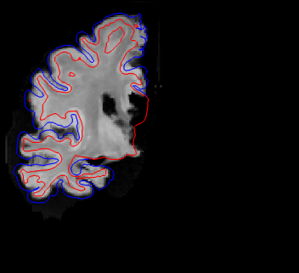
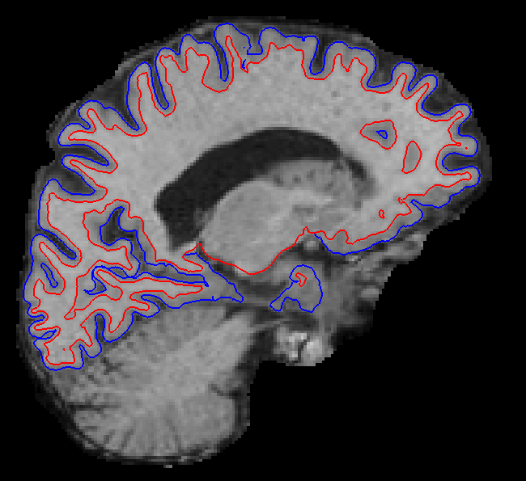
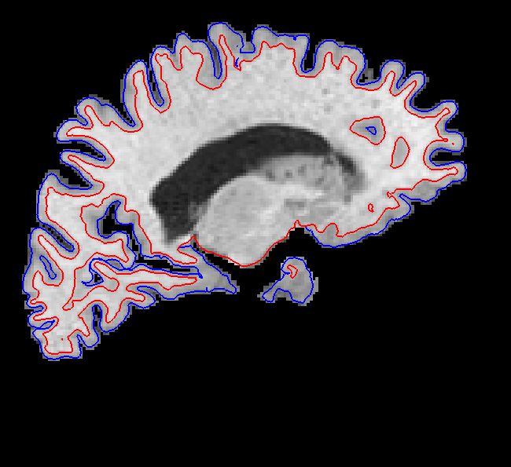
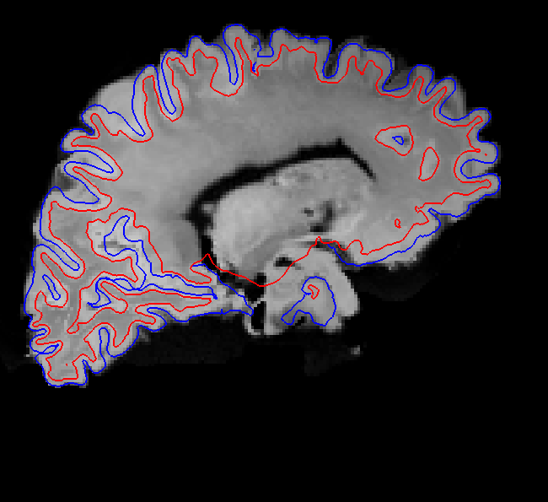
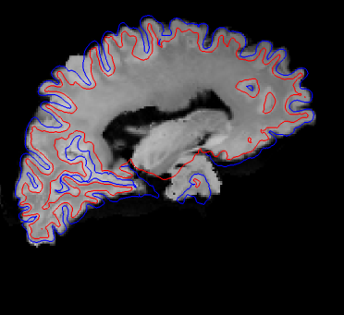
Subject 1
Target (in-vivo) Masked target 2-step CVS CVS with MI

