Slide 1
Welcome to the FreeSurfer Course!

Slide 2
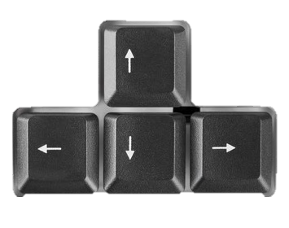
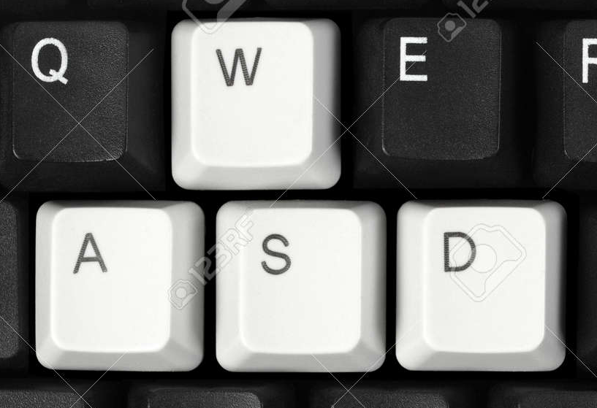
Navigating in Gather.Town
Use Keyboard Arrow Keys to navigate around the room
OR
Or double-click where you want to go!

Slide 3
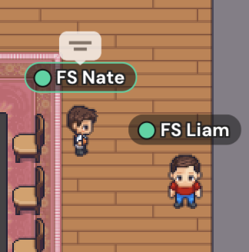
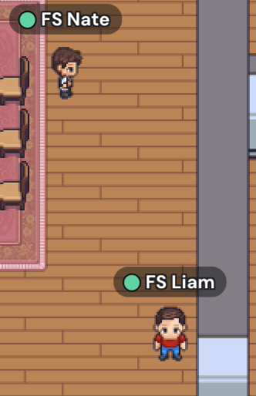
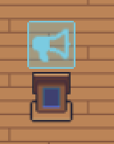
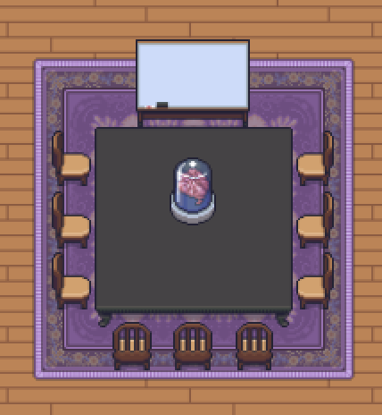
If you stand near someone
…it starts a private conversation
If you walk away from someone
…you will no longer be able to hear/see them
If someone is on the podium/megaphone,
…everyone will be able to hear them
If you “enter a private space” such as a classroom
…only those in the same room can hear each other

Slide 4
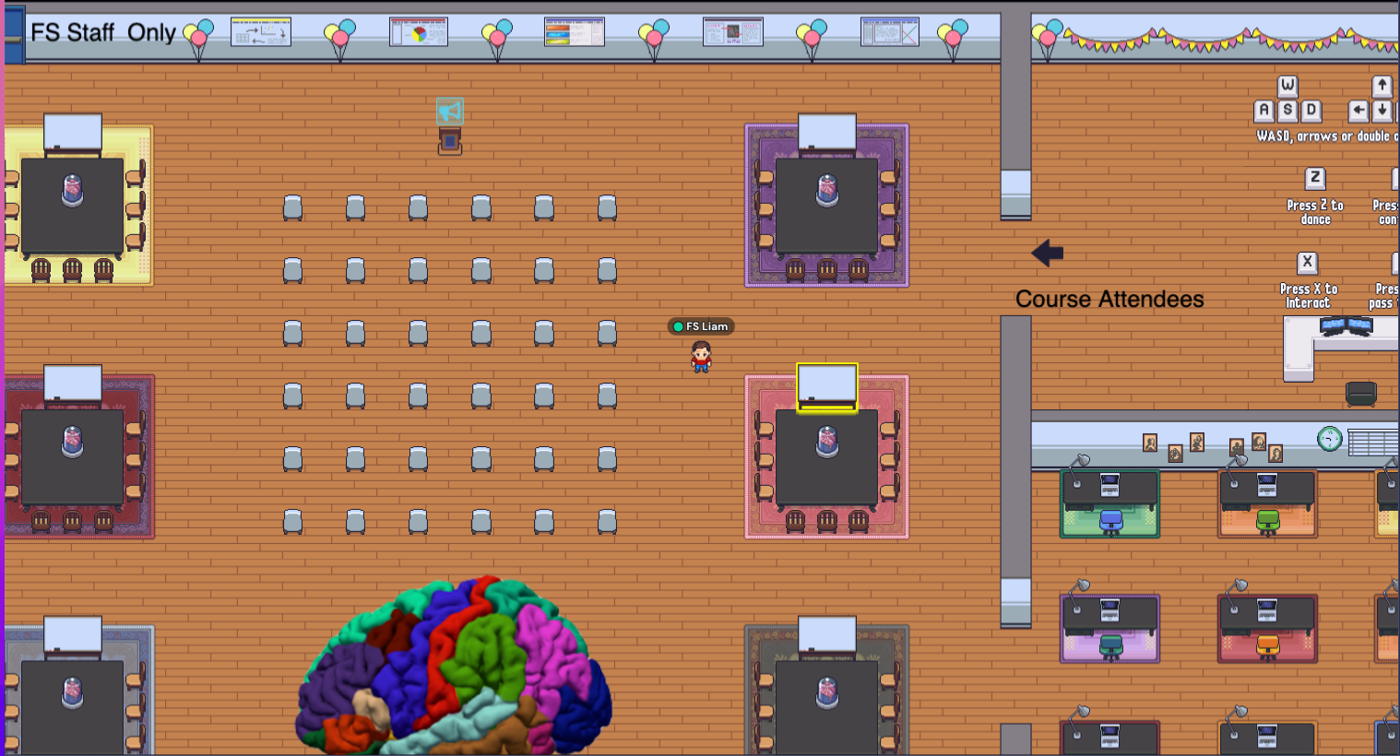
Speakers will stand on podium to talk to everyone

Slide 5
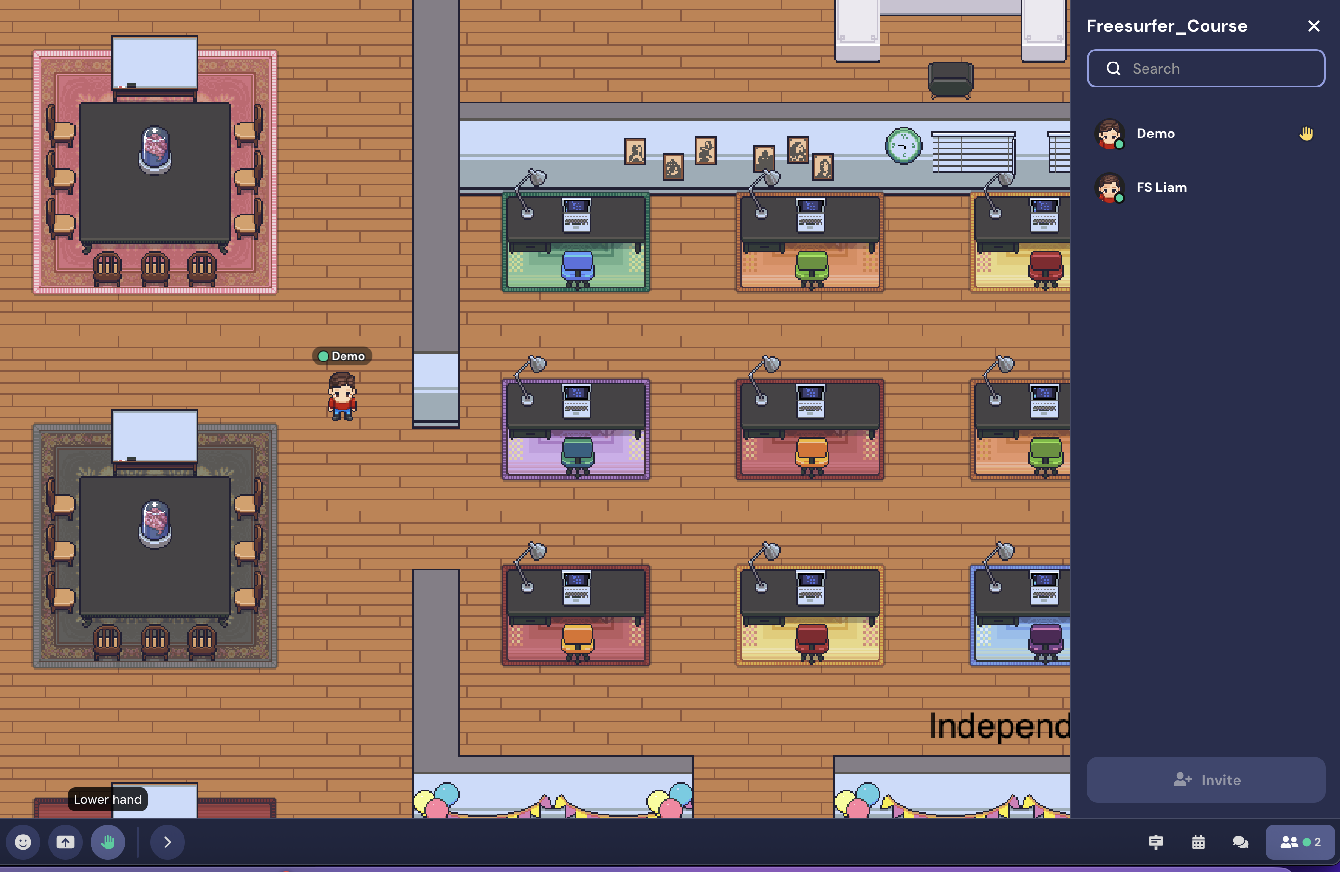
Raise your hand to ask questions!
Notes:
‘Demo’ clicks the hand raised button in the toolbar, and then a hand icon shows up in the participants toolbar. Use this to let the course staff know you have a question

Slide 6
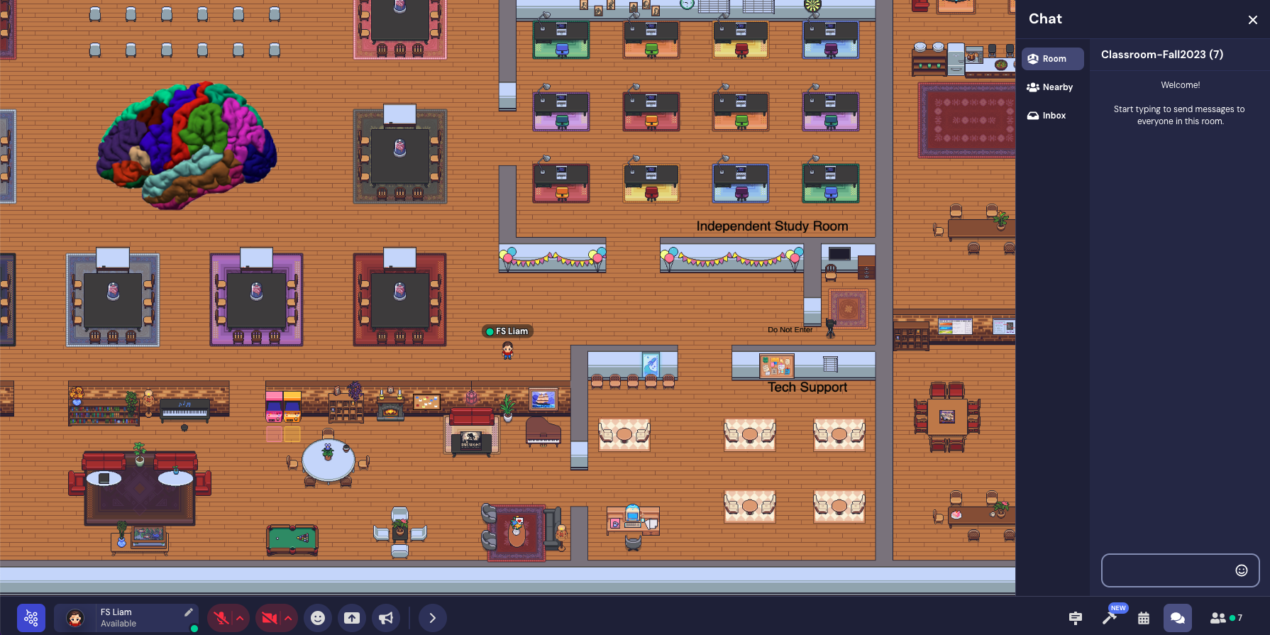

Chat function!
Notes:
Make sure to test how slides look in gathertown (may need to switch to individual window view for them to look right)

Slide 7
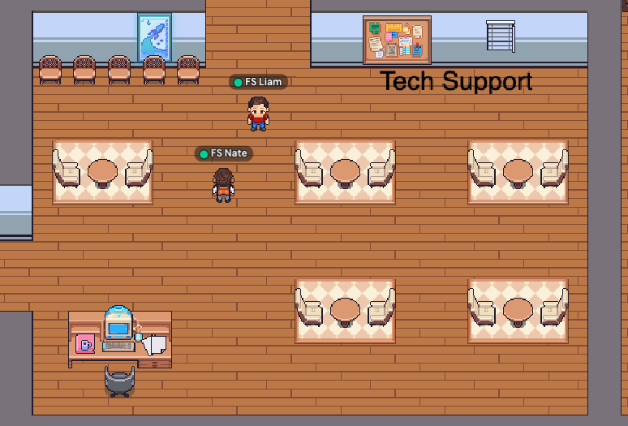
Tech Support room

Slide 8
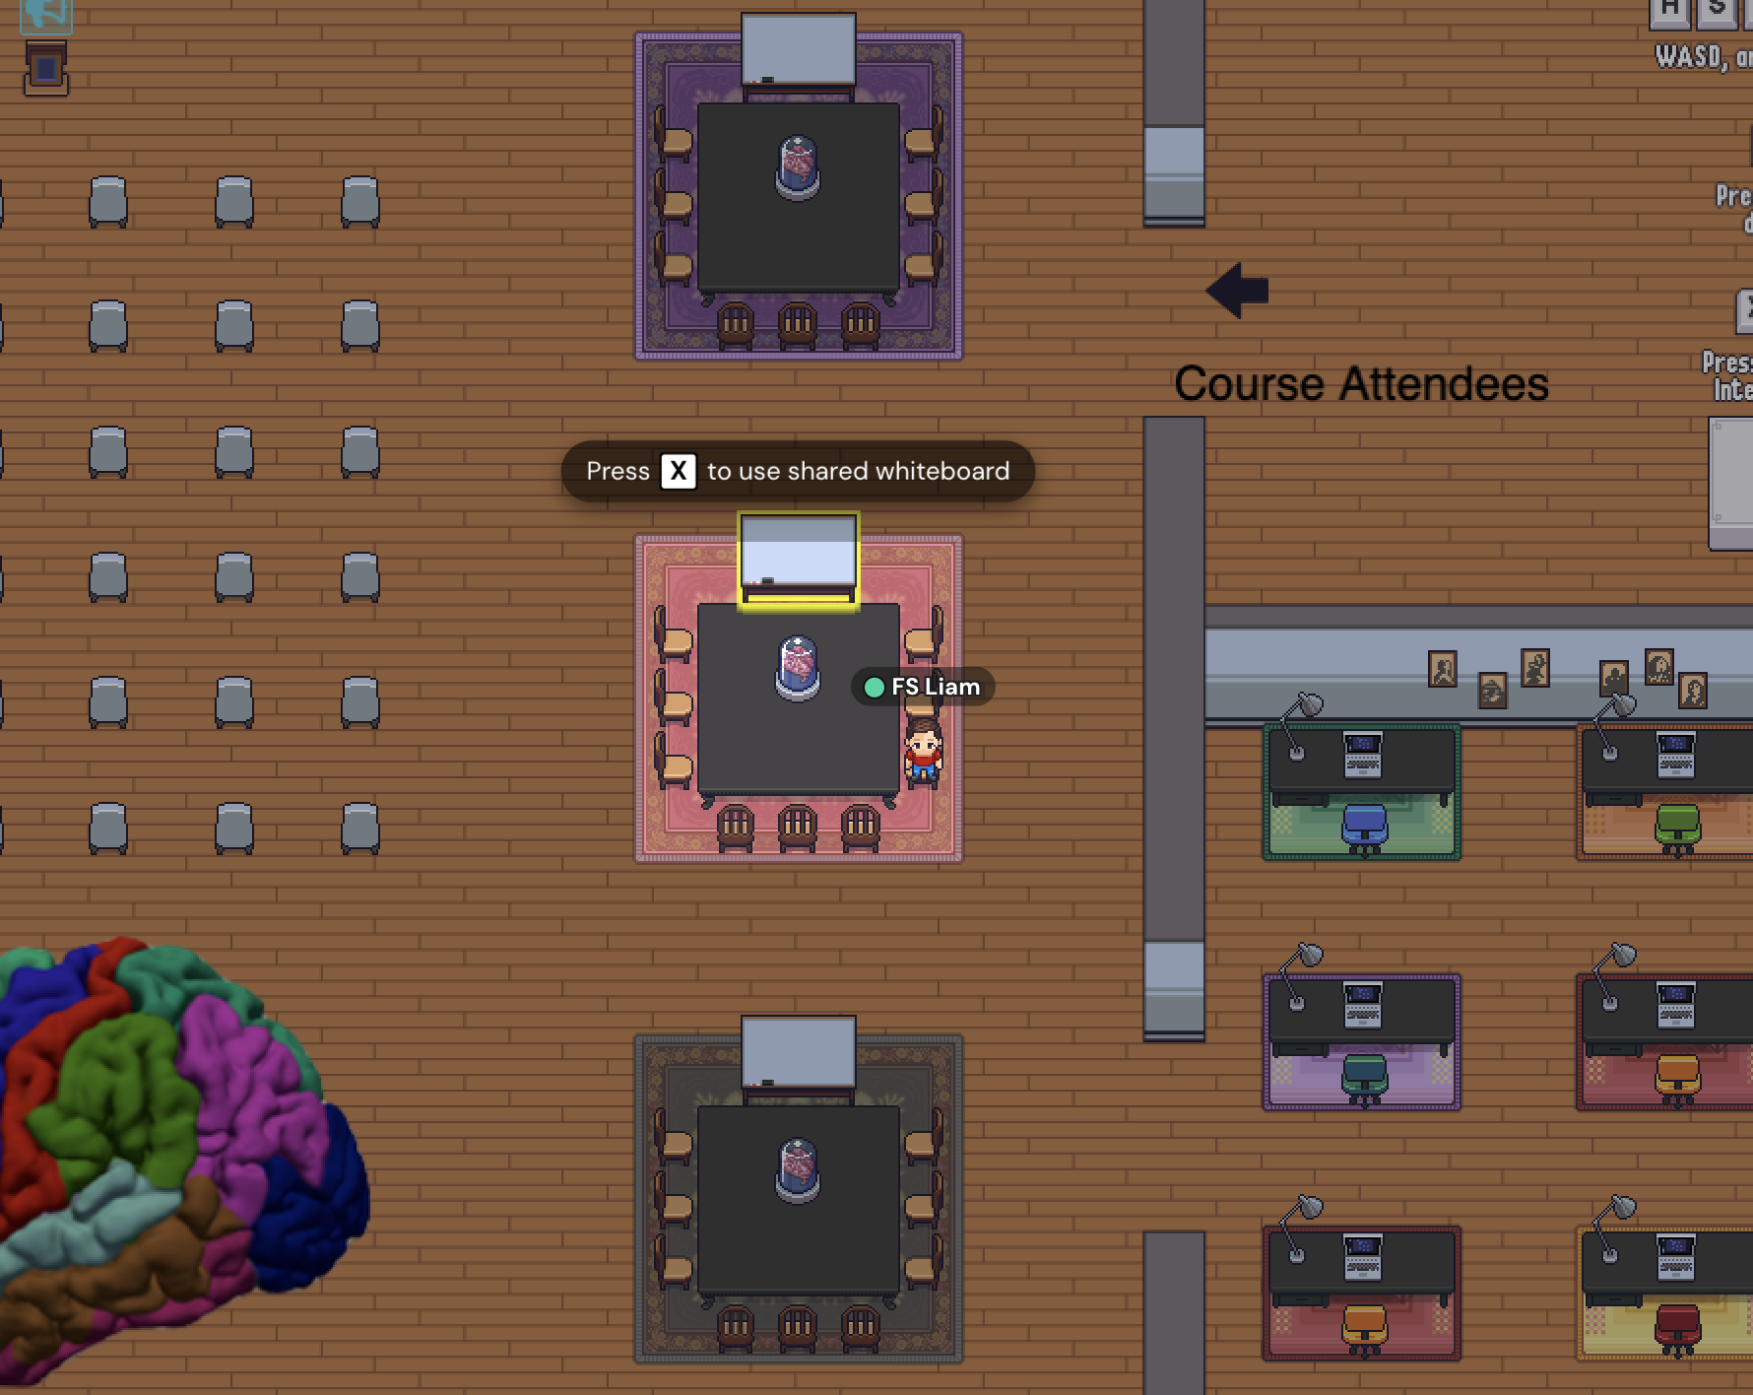
TO USE THE WHITEBOARD
Walk near a whiteboard
Press the ‘X’ key
You’ll be able to draw/explain things during tutorials if needed

Slide 9
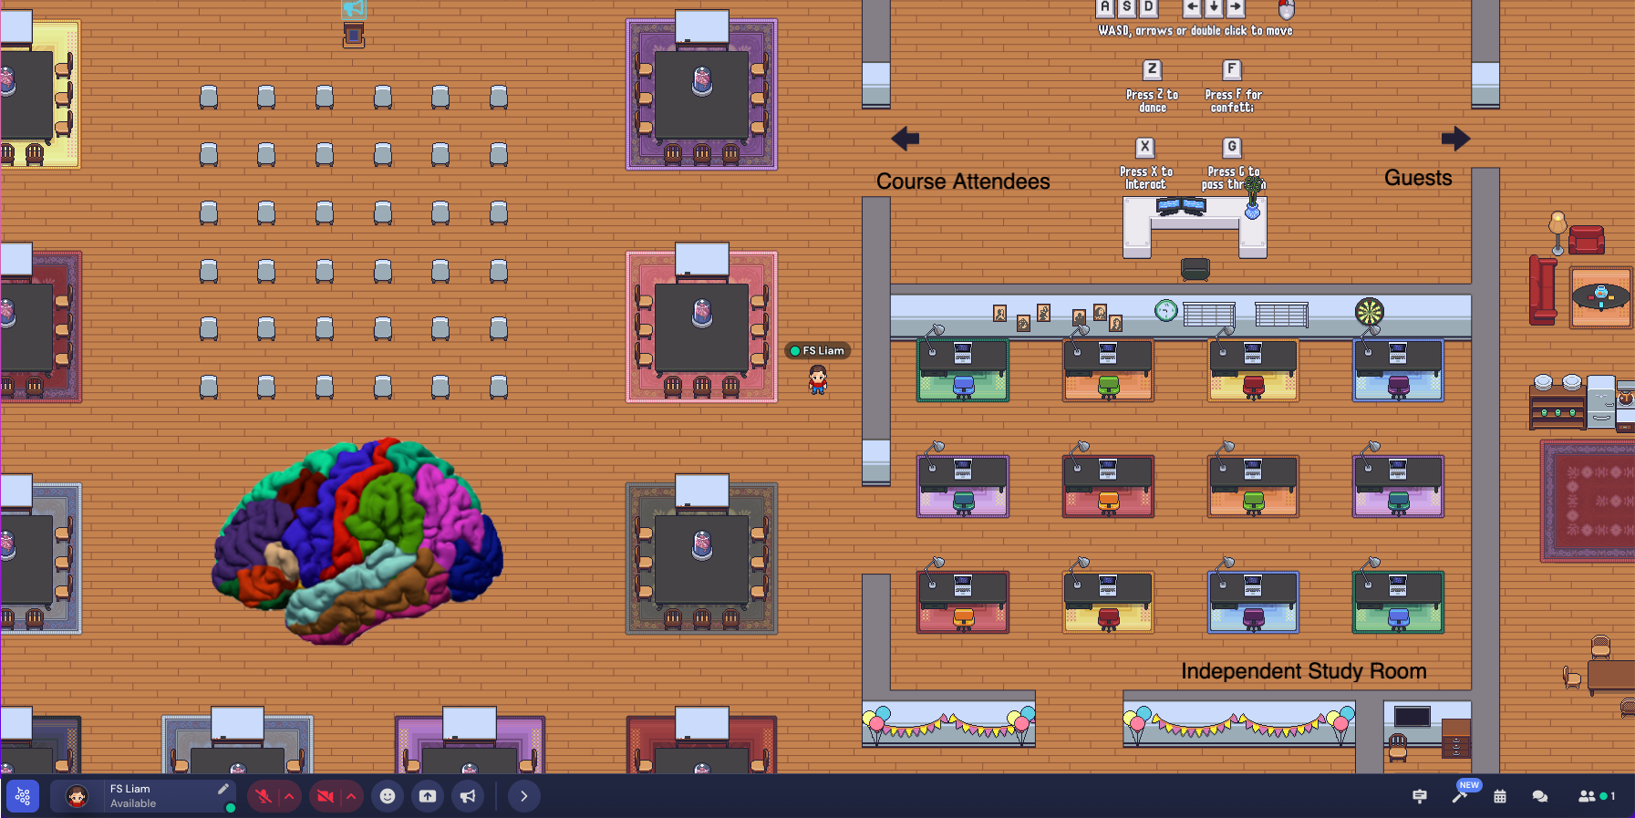
Please change your avatar's name to only your first name!
Change your avatar name & appearance
All course staff will be named 'FS [First Name]'
Notes:
You can change your appearance and name by clicking the arrow in the left side of the bottom toolbar

Slide 10
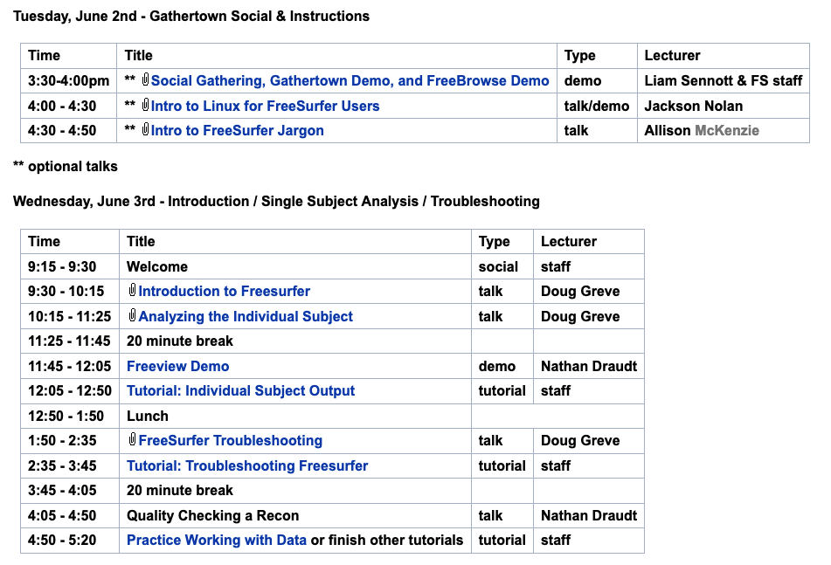
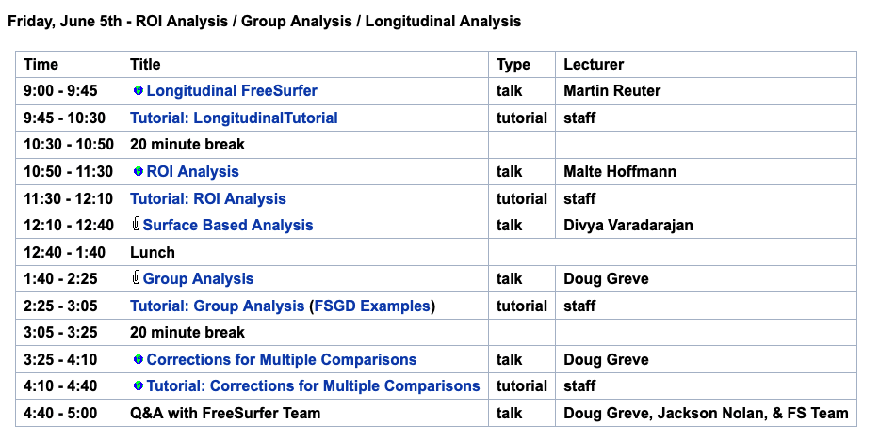
Course Schedule
https://surfer.nmr.mgh.harvard.edu/fswiki/VirtualCourse
Notes:
Come to the social
Upload slides here
Access tutorials here

